Slide 1
Transition pack for politics
With Mr. Court and Mr. Stowe

Slide 2
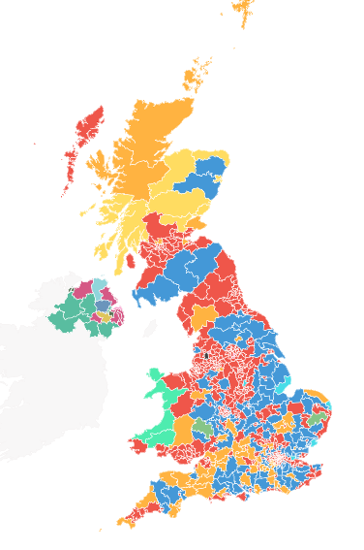
What you need to do for September:
Research the results of the 2024 General Election: seats won, votes for parties; the Labour majority; what policies did each party stand on (3 minimum); possible trends. A good place to start: UK election results 2024 | Constituency map - BBC News
Create an example bank for what’s going on in the news. You must have a minimum of 15 examples already in the bank (you can go back to the start of the year if you choose).
    For example:
    11 July – Sir Kier Starmer attended a NATO summit in the USA.
    June – the betting scandal (politicians betting on the predicted day of the election).
    June – the Presidential debate between Biden and Trump – Biden appeared lacklustre and old
Watch the series ‘State of Chaos’ on the BBC. This can be found using the links below or YouTube. This gives you vital insight into what has occurred in UK politics the past decade or so.
BBC iPlayer - Laura Kuenssberg: State of Chaos - Series 1: 1. May/Johnson
BBC iPlayer - Laura Kuenssberg: State of Chaos - Series 1: 2. Johnson
BBC iPlayer - Laura Kuenssberg: State of Chaos - Series 1: 3. Johnson/Truss

Slide 3
Additional work to do:
Research the difference between direct and representative democracies. What are the pros and cons of each?
Research the UK’s constitution – this video will help: The UK's Constitution Explained - TLDR Explains – YouTube
What do the major political parties in the UK believe? Give examples.
What does Parliament work? An introduction to Parliament - YouTube
What are the strengths and weaknesses of the previous Prime Ministers from 1997-present?

Slide 4
What you need to bring in September:
Two folders with dividers for sub-topics
A set of highlighters (we will use these regularly)
Your required work over the holidays
You desire to study Politics at A-Level

