Slide 1
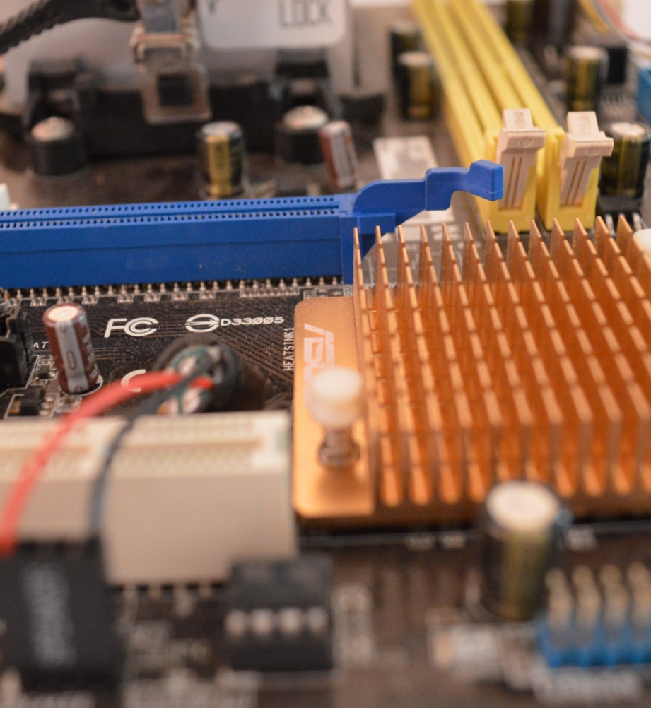
Computer Science
Transition workbook
The course is assessed by
2 exams (50% each exam)
The topic of Computer Science is at the heart of the modern world
Studying it can make you extremely sought after in todays job market
The transition from GCSE to A level is significant, this includes:
  An increased emphasis on technical content
  An increased emphasis independent research
This workbook is designed to allow you to practice some of these skills and build on your existing knowledge.
Please complete by your first lesson back in September.

Slide 2
1
“Tell me about yourself”
Why did you choose Computer Science?
Expected time to complete: ½ hour
In this simple task you get the opportunity to tell me your choices and reasons behind choosing to study Computer Science. Please answer all questions as best you can.
1. Why did you choose to study A level Computer Science?
2. What other courses have you chosen to study at Key Stage 5, and what made you choose this combination?
3. What are you hoping to achieve from studying Computer Science?
4. How would you describe yourself as a learner at GCSE? What skills where you good at, what areas would you like to improve on?
5. What are your other hobbies and interests outside of school? Anything related to Computing?

Slide 3

6
An introduction to the basics of programming tasks
Programming basics
Expected time to complete: 6 hours
Learning to “code” is a fun and essential part of A Level Computer Science. This task is ideal if you haven't done the GCSE in Computer Science or you simply want a nice refresher ahead of starting your A Level course.
Head over to the web site: https://www.learnpython.org/
Complete the following python tutorials under the heading:
  • Hello, World!
  • Variables and Types
  • Lists
  • Basic Operators
  • String Formatting
  • Basic String Operations
  • Conditions
  • Loops
  • Functions
Each section presents you with theory, code to run and exercises to try out.
If you want to practice writing your own python programs you can download and install a simple python development tool here: https://www.python.org/downloads/
Additional note:
This task is most suited to students who intend to do the A Level and have not previously gained much / or any programming experience from the GCSE Computer Science course.
Although the language chosen here is Python, and that may not be what you will be using at A Level, it is the underlying programming concepts which are important.
The list of topics above cover the standard set of programming concepts you would be expected to know having completed a GCSE and Computer Science and so will prepare you well for the A level.

Slide 4
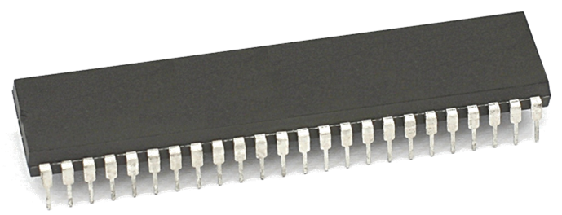
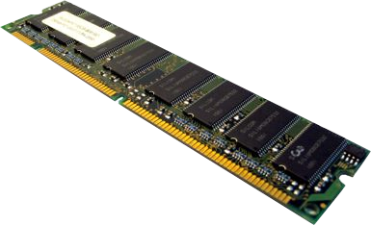
10
Memory task
Different types of memory
Expected time to complete: 1 hour
Computer memory comes in many different forms, some of the main ones are:
Random Access Memory (RAM)
Read Only Memory (ROM)
Virtual Memory
Carry out some research into these forms of memory and then complete the tasks on the following slide.
Additional help:
For additional help and support in completing this task you might like to watch some of the following videos from Craig ‘n’ Dave:
RAM and ROM:
https://student.craigndave.org/videos/ocr-gcse-slr1-2-ram-and-rom
The need for Virtual Memory:
https://student.craigndave.org/videos/ocr-gcse-slr1-2-the-need-for-virtual-memory

Slide 5
10
Memory task
Different types of memory
Expected time to complete: 1 hour
Random Access Memory (RAM)
<Enter a definition for RAM>
Read Only Memory (ROM)
<Enter a definition for ROM>
Virtual Memory
<Enter a definition for Virtual Memory>
<State if RAM is volatile or non volatile>
<State if RAM is read only or read & writeable>
<Describe what sort of information RAM typically holds>
<State if ROM is volatile or non volatile>
<State if ROM is read only or read & writeable>
<Describe what sort of information ROM typically holds>
<Explain why virtual memory is needed>

Slide 6
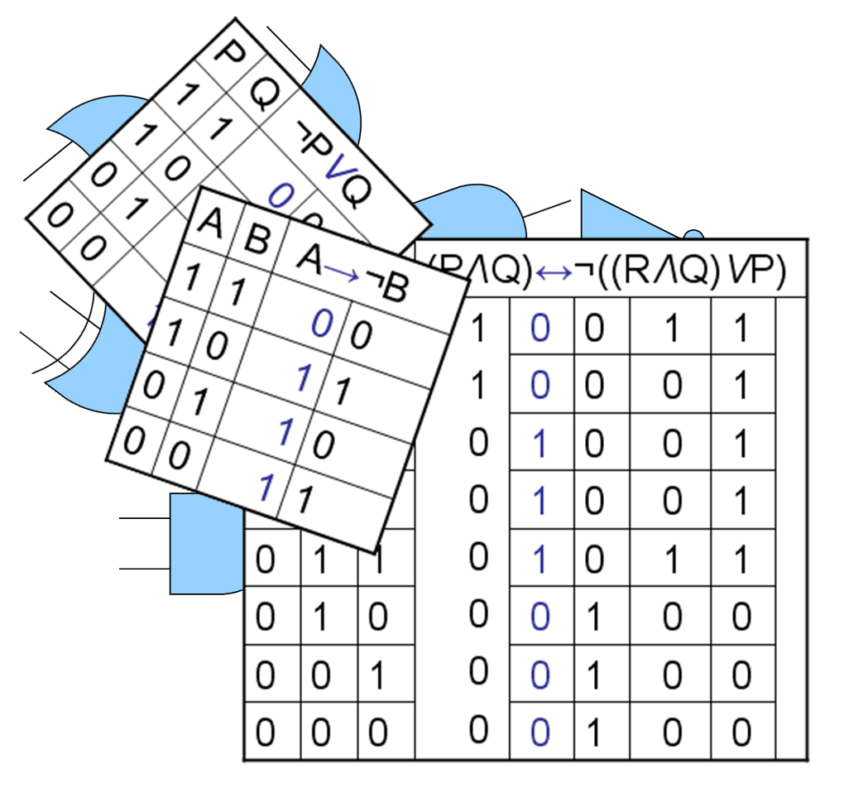
14
Computational logic task
Truth tables to circuit diagrams
Expected time to complete: 2 hours
An important area of computer science is understanding the logic gates and diagrams which are used to represent the physical circuitry of computer systems.
Carry out some research into the following areas:
Logic gates:
  AND
  NAND
  NOR
  NOT
  OR
  XOR
Truth tables
Boolean expressions
Circuit diagrams
Complete the tasks on the following slides.
Additional help:
For additional help and support in structuring your answer you might like to watch some of the videos from the following Craig ‘n’ Dave playlists:
OCR: SLR 15 – Boolean algebra
https://student.craigndave.org/videos/slr-15-boolean-algebra
AQA: SLR16 – Logic gates & Boolean algebra
https://student.craigndave.org/videos/slr16-logic-gates-boolean-algebra

Slide 7
14
Computational logic task
Truth tables to circuit diagrams
Expected time to complete: 2 hours
Drag the labels into their correct place on the following diagram:
OR
AND
XOR
NOT
NAND
NOR

Slide 8
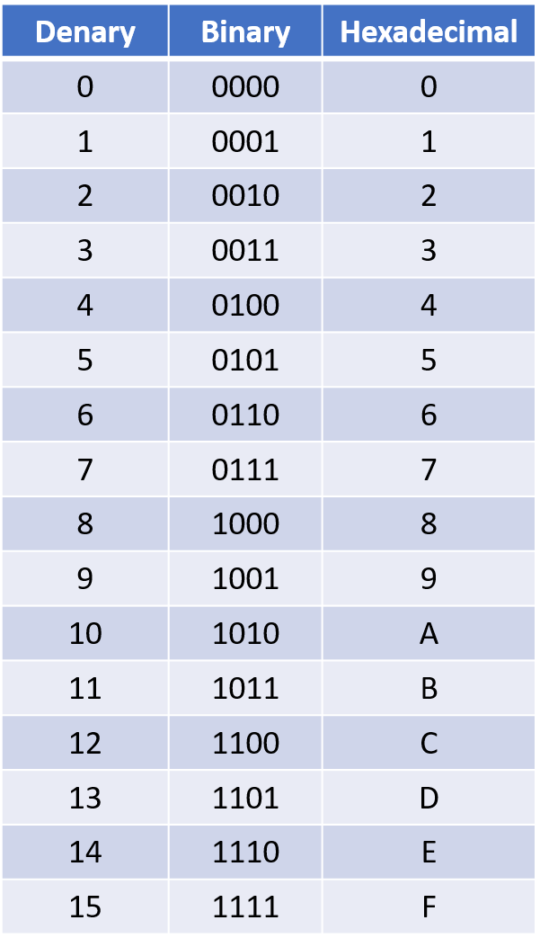
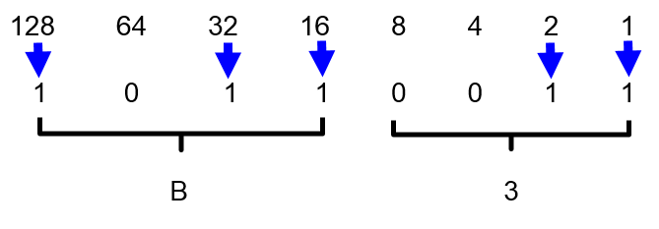
16
Binary task
Converting between base-2, base-10 and base-16
Expected time to complete: 1½ hours
As humans we have use the decimal or denary number system (base-10), made up of the unique digits 0-9.
Computer systems at the most basic level use only binary 1’s and 0’s (base-2).
As a computer scientist you will also need to become familiar with the hexadecimal number system (base-16).
You will also need to be comfortable with converting numbers between these three base systems.
Research the following areas:
Base-2 binary number system
Base-10 decimal/denary number system
Base-16 hexadecimal number system
How to convert between base-2, base-10 and base-16
Complete the tasks on the following slides.
Additional help:
For additional help and support in structuring your answer you might like to watch some of the following videos from Craig ‘n’ Dave:
Base 2, 10 and 16 number systems:
https://student.craigndave.org/videos/aqa-alevel-slr10-base-2-10-and-16-number-systems
Converting between binary, hex and decimal:
https://student.craigndave.org/videos/aqa-alevel-slr11-aqa-converting-between-binary-hex-and-decimal

Slide 9
16
Binary task
Converting between base-2, base-10 and base-16
Expected time to complete: 1½ hours
Convert the base-2 binary number 11000101 into base-10 and base-16.
(Show all your working)
Convert the base-16 hexadecimal number 9F into base-2 and base-10.
(Show all your working)
You may wish to cut and paste this standard binary weighting line to help lay out parts of your answer
128 | 64 | 32 | 16 | 8 | 4 | 2 | 1
Binary weighting
Binary value

Slide 10

17
Linear search programming task
Algorithms: from theory to practice
Expected time to complete: 4 hours
A core concept of computer science is that of data structures and algorithms.
It is also an area which many students struggle with during examinations.
Probably the most basic algorithm is that of the “linear search”.
If you have done the GCSE course you will have learnt about this searching algorithm already.
Start by learning or refreshing your knowledge of the linear search algorithm by using the videos on this page:
https://www.craigndave.org/algorithms-linear-search
Once you are happy with the theory complete the exercises on the following slides.

Slide 11
17
Linear search programming task
Algorithms: from theory to practice
Expected time to complete: 2 hours
Describe what the linear search algorithm does.
What are the applications of the linear search algorithm?
Write out the steps of the linear search algorithm in simple-structured English.
Draw a simple diagram which illustrates the linear search algorithm.

Slide 12
17
Linear search programming task
Algorithms: from theory to practice
Expected time to complete: 2 hours
Write out pseudocode for the linear search algorithm.
The algorithm should use an array called items which is pre-populated with the following values: "Florida","Georgia","Delaware","Alabama","California“
The algorithm should ask the user to “Enter the state to find:”
If the algorithm locates the state entered by the user in the array it should report back to the screen “Item found at position n”
If the algorithms can not locate the state entered by the user in the array it should report back to the screen “Item not found”

Slide 13
17
Linear search programming task
Algorithms: from theory to practice
Expected time to complete: 2 hours
Have a go at coding the linear searching algorithm in a programming language of your choice.
The program should work use an array called items which is pre-populated with the following values: "Florida","Georgia","Delaware","Alabama","California“
The program should ask the user to “Enter the state to find:”
If the program locates the state entered by the user in the array it should report back to the screen “Item found at position n”
If the program can not locate the state entered by the user in the array it should report back to the screen “Item not found”
Cut and paste the code you have written into the box below:

