Slide 1
Drama and Theatre Studies
A Level
Edexcel
St Peter’s

Slide 2
How you’ll be examined
Component 1 – Devising
Component 2 – Text in Performance
Component 3 – Set text A – Machinal
Practitioner and extract from a text
Could/should be linked in style, but doesn’t have to be the same person
We go through a series of workshops and decide on our practitioner and extract to best suit you
Two performances:
Group piece
Monologue or duologue
One of these must be linked to a practitioner (that is different to C1).
This isn’t quite a free choice – but it’s pretty close. We’ll match this to your strengths to give you the best chance
Component 3 – Set text B –Lysistrata/Punchdrunk
Component 3 – Live Theatre
Modern Text. Expressionist.
Old Text. Ancient Greek play. You need to stage it having been influenced by a key practitioner - Punchdrunk
You will respond to a statement in relation to a performance you’ve seen

Slide 3
Current 12s Drama Curriculum
Autumn 1
Autumn 2
Spring 1
Spring 2
Summer 1
Summer 2
1
Machinal
Machinal
Practitioner Workshops
Devising
Devising
Write up
12
2
Lysistrata
Lysistrata
Lysistrata
13
Machinal
Text 1
Text 1
C2 Exam
Machinal
1
2
Lyistrata
Text 2
Text 2
C2 Exam
Lysistrata
Component 1
Devising
Component 2
Performance from Text
Component 3
Theatre Makers in Practice

Slide 4
Key differences
GCSE
  C1 – Devising – 40%
    Free choice of stimulus (not a script)
    Written portfolio
  C2 – Text in Performance – 20%
    One text
    Either a monologue or duologue or a group piece
  C3 – Written – 40%
    One text
    LTE
A Level
  C1 – Devising – 40%
    Almost free choice of key extract and key text (can’t clash with other elements of the course)
    Free choice of practitioner
  C2 – Text in Performance – 20%
    Two texts
    One monologue/duologue
    One group piece
  C3 – Written – 40%
    Text 1 – 2 questions
    Text 2 – 1 question – linked to practitioner
    LTE – respond to a statement based on a performance you’ve seen

Slide 5
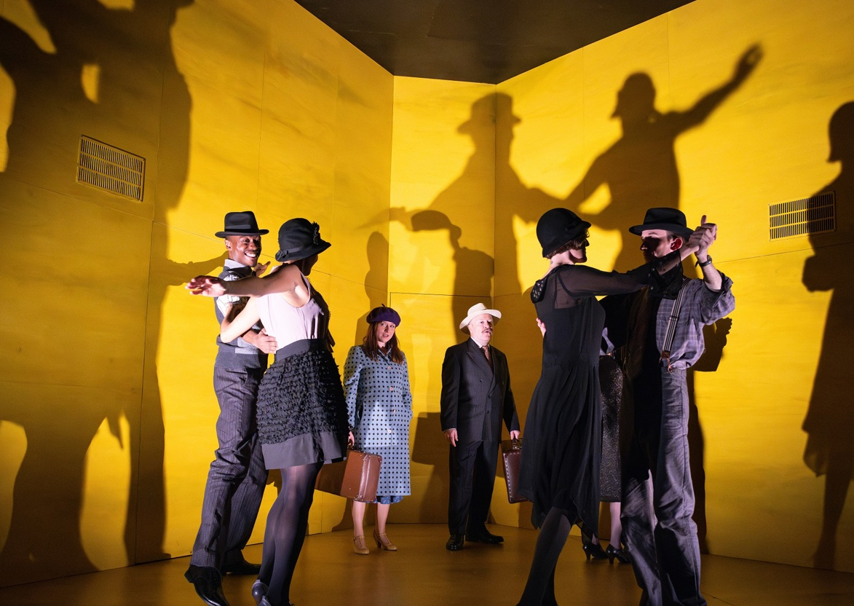
Machinal
Sophie Treadwell
First performance in 1928
Expressionist Feminist
An every(wo)man tragedy about the mechanics of modern society and what happens when someone doesn’t conform
Production in London has just ended – possible national tour upcoming

Slide 6
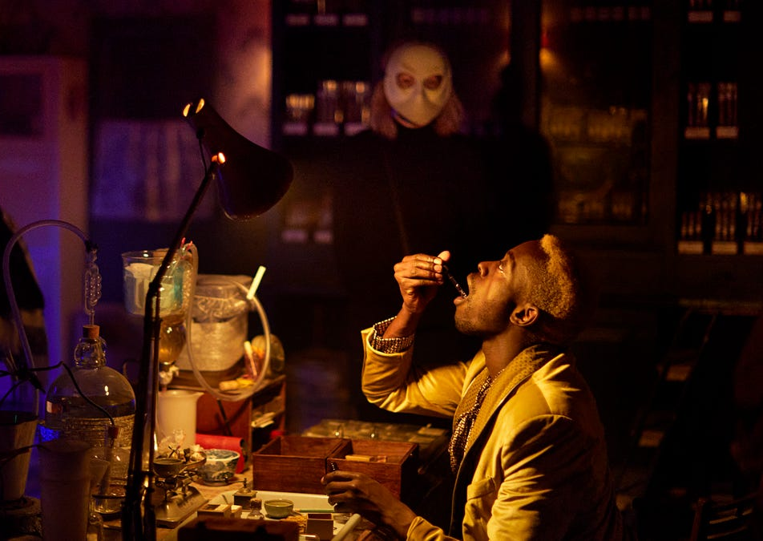
Lysistrata/
Punchdrunk
Aristophanes
Ancient Greek comedy set during the Peloponnesian War
Punchdrunk are a contemporary company who work in a site-specific and immersive style

Slide 7
Summer Work
Use Drama Online to choose to watch three of the following productions:
Frankenstein – Benedict Cumberbatch
Frankenstein – Jonny Lee Miller
A Streetcar Named Desire
The Threepenny Opera
A View From the Bridge
Answer two essay questions from the following page
The questions are all the same, you just need to respond to the different statements
Username: 9Up*9Mu-
Password: 8At#5Sq#

Slide 8
Choose two
1. Analyse and evaluate the live performance you have seen in light of the following statement:
‘Theatre in the 21st century is out of touch with its audience’.
Your answer should:
  include analysis and evaluation of key moments from the performance you have seen and the contribution made by different theatre makers
  offer balanced consideration between your analysis and evaluation of the performance and your response to the statement.
2. ‘Actors are nothing without Designers’.
3. ‘Live theatre today has no connection to the lives of young people.
4. ‘Technology is more important in live theatre today than the play itself.

Slide 9
What we need from you
Lever-arch ring binder (the ones that are a bit bigger that use an arm inside to open the metal loops)
We will give you three books. Always have them all with you. We have hole punched them so they can go in your folders.
  Machinal
  Lysistrata
  Practitioners & Devising
Organisation and preparation will get you top grades. Develop ways to be the most organised person

