Slide 1






WELCOME !
We are SO proud of the fantastic results achieved at St Peter’s this summer in GCSE’s, A levels and B Tecs! Congratulations. Aim always to use you God given talents to be the BEST you can be!

Slide 2

OUR SCHOOL PRAYER
We thank you for our gifts and talents. Help us to strive to use them wisely for the benefit of our special community. Guide us to fulfil your plan for each of us. Give us the grace to be humble, respectful and tolerant this day and all the days of our lives. Amen.

Slide 3


  CATHOLIC LIFE
Our Catholic Mission
Our faith is based on the teachings of Jesus Christ, the Son of God, who came to prove God’s love for all eternity.
To demonstrate God’s love for each us, bringing an inner peace because of the joy that this love brings enabling us to have hope in the future.

Slide 4


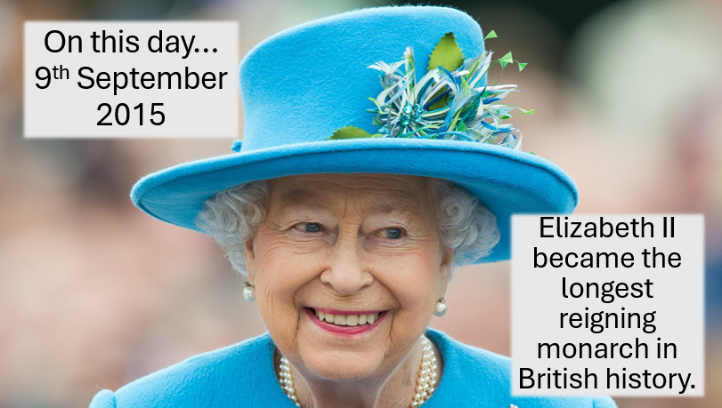
  ON THIS DAY

Slide 5

  WHAT’S GOING ON?
Fair Trade Fortnight
This year we are joining our churches, Solihull Council and many more, iin urging everyone to Be the Change, by picking up Fairtrade products and speaking up for fairer trade.

Slide 6


  WHAT’S GOING ON?

Slide 7


  WE ARE SO PROUD OF YOU!

Slide 8



  LOOK WHAT WE’VE ACHIEVED!

Slide 9
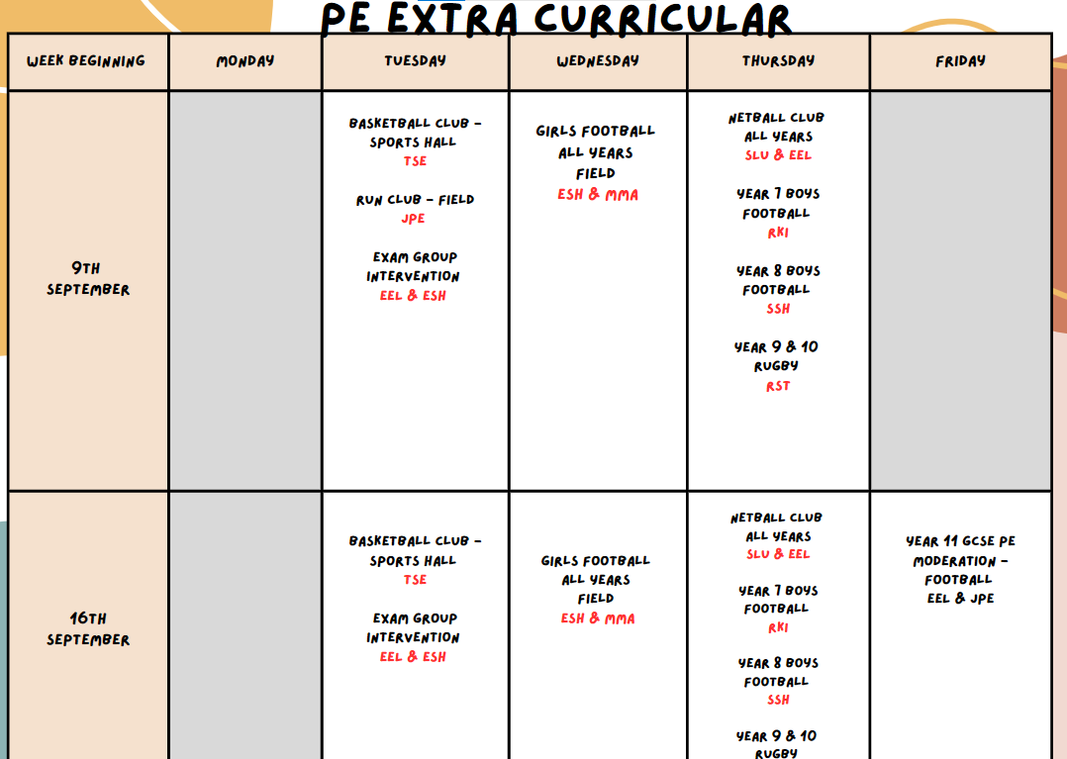
  PE 9TH AND 16TH SEPT

Slide 10
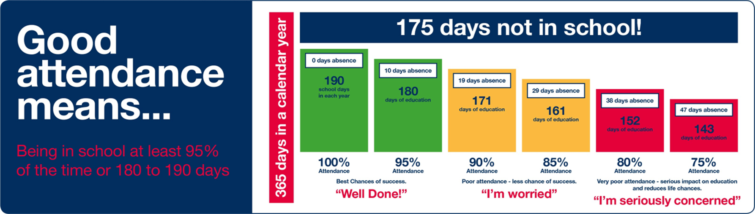
  WHOLE SCHOOL NOTICES

Slide 11
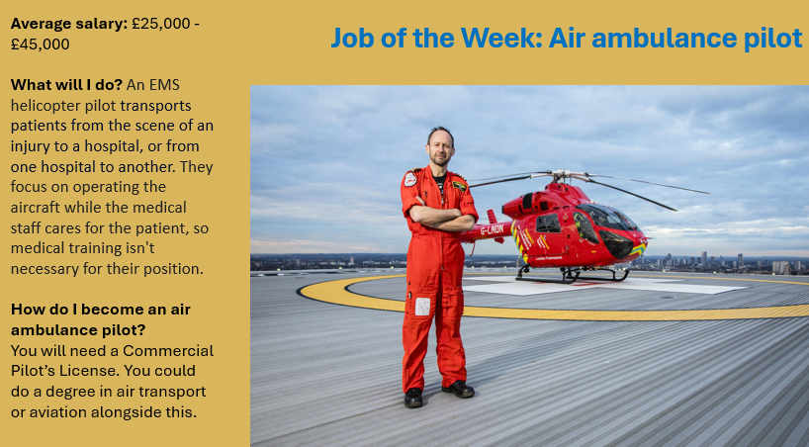
  JOB OF THE WEEK

Slide 12
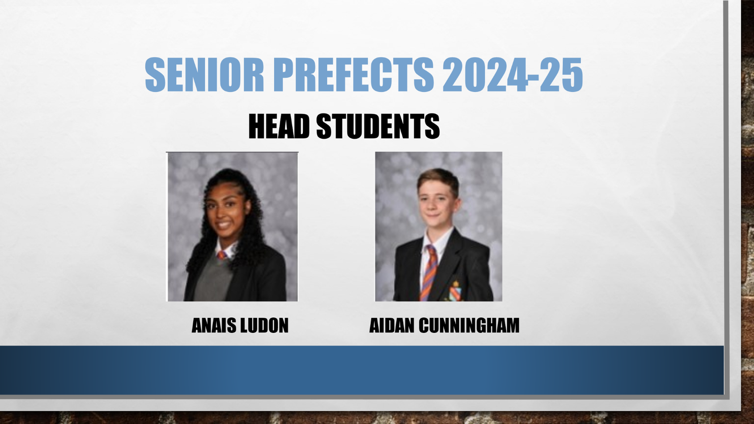
  PUPIL LEADERSHIP

Slide 13
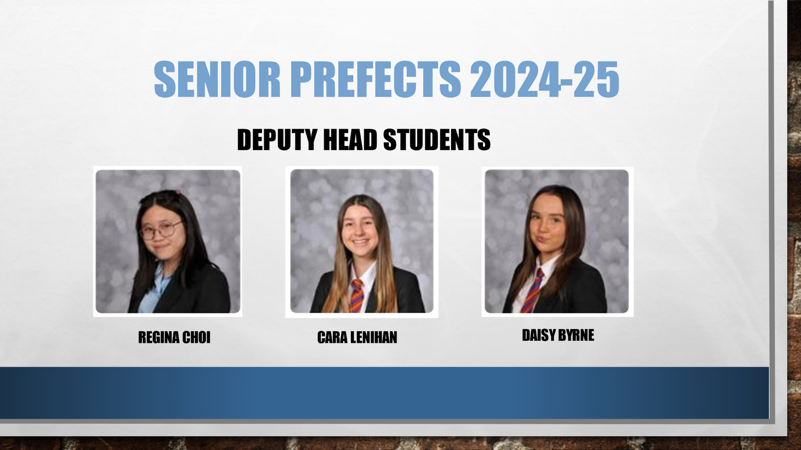
  PUPIL LEADERSHIP

Slide 14
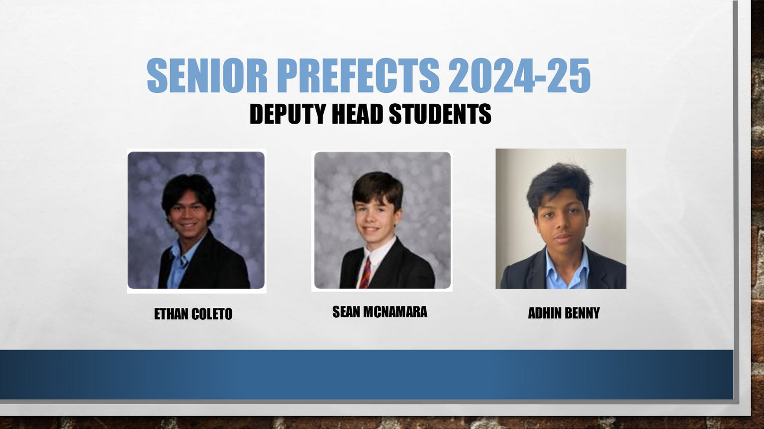
  PUPIL LEADERSHIP

Slide 15



  PUPIL VOICE ON OUR FAITH

Slide 16



  PUPIL VOICE ON OUR FAITH

