Slide 1


An introduction to your ucas personal statement

Slide 2

What’s the purpose?
It’s your
chance to:
Question prompts
are there to help you
but remember to:
Don’t panic about
the sections:
show your curiosity, knowledge and passion.
evidence relevant skills and your potential.
communicate your genuine interest and a desire to learn more.
link your academic, extra-curricular and other experiences to your chosen area(s)
of study.
use relevant examples throughout your personal statement.
the important thing is to explain why you’re including the example.
reflect on what you’ve learned from it.
the statement will
still be reviewed
as one piece.
Remember there's no right or wrong!

Slide 3






Format and structure
Three
sections with question prompts
4,000-total character count split across sections
Minimum character count 350 characters per section
Don’t waste characters listing grades and subjects
Don’t repeat information across
sections

Slide 4




What are the questions?
“
“
“
Why do you
want to study this course or subject?
How have your qualifications and studies helped you to prepare for this course or subject?
What else have you done to prepare outside of education, and why are these experiences useful?
“
“
“

Slide 5

Universities & colleges will consider
  Have you chosen the course for the right reasons?
  Do you have a depth of interest in the subject?
  Do you appear motivated and committed?
  Can you study independently?
  Are you genuinely engaged and
  knowledgeable about the area
  you're applying to?
Notes:
For example, if you take law; the admissions team won't be impressed with 'I want to make a load of money' but 'I want to advocate for social change' is a much better answer. If you're talking about career prospects, emphasise how you're passionate about it and what you can GIVE as well as what you can GAIN.

Slide 6

Research is the foundation
Research and preparation is key when you’re starting to think about your personal statement.
Don’t worry about making your notes perfect; this is about checking
you fully understand the course and have specifics to refer to in your personal statement.
Whether you know what you’re applying to or still considering your options, the more research you do the easier it will be to write.
Before you start writing anything, take some time to:
mind map what you might want to include
build up a bank of examples you can refer to
list evidence of your skills and experiences
rank your evidence and examples that are MOST relevant
to the course(s) you're thinking of applying to

Slide 7

Where can I start?
There are lots of places you can start to research the details of the course(s) / subject you're looking to apply to.
Remember requirements may differ for each university or college, as well
as depending heavily on the course. So, this research on your chosen area of study is vital before you start writing your personal statement.
Start by looking at the course description; this’ll help you with what
to include and give you a good idea of what they are looking for.
If you visit a UCAS Discovery event, ask the university or college representatives.
Attend an open day and ask faculty staff what they like to see in
the personal statement.
Use Unibuddy to speak to a student ambassador on a course
you’re interested in.

Slide 8

Q1: why do you want to study this course or subject?
You’ll want to show evidence of passion, curiosity and interest, this might include:
Motivations for studying this course(s):
Knowledge of this subject area and interests:
Future plans; demonstrate why this course/subject
is a good fit:
Have you been inspired
by a key role model or moment in your life?
Is it a subject you love and want to pursue further?
What is your drive?
How has your path led
you to this course or subject area?
Is there a particular subject area you’ve researched?
Something you can’t wait to learn more about?
What about a book or subject expert doing great things that’s sparked your interest?
Do you already have a particular profession in mind?
How might you use your studies to launch your career?
What’s important to you and your future, and how might
the knowledge gained from
this course(s) help you
achieve this?
Remember these are just some examples, you don’t need to include it all.
The key is to research the course(s) to find out what might be most relevant.
Notes:
Remind students that examples don't need to be something 'grand' or academic as the very first starting point if that's not the truth! If the starting point was something 'pop culture', social media or a holiday and they then expanded on this in depth through a variety of methods, then that's great as it shows progression!

Slide 9

Q2: How have your qualifications and studies helped
you to prepare for this course or subject?
Focus on what’s most recent and relevant to your subject or course(s), examples could include:
How your studies or training relate to chosen course(s) or subject area:
What relevant or transferable skills have you got that make you a great candidate:
Any relevant educational achievements
Are there a couple of subjects that helped you develop a core set of relevant skills required for your chosen course(s).
Maybe a particular module or project helped you understand where your interests and strengths lie.
Universities and colleges will
see your grades on your application - don’t waste space talking about these.
Focus on your other accomplishments like a competition, holding a position
of responsibility or
representing the
school/college.
This could be your current or previous studies.
This could be from any form of formal education – think school, college, training, or short online courses.
Remember these are just some examples, you don’t need to include it all.
The key is to research the course(s) to find out what might be most relevant.

Slide 10

Q3: what else have you done to prepare outside of
education, and why are these experiences useful?
Examples should be reflective and demonstrate further suitability for your subject or course(s), this could include:
Work experience, employment, or volunteering
Personal life
experiences or responsibilities
Hobbies and any extracurricular or outreach activities:
Achievements
outside of school
or college
In-person or virtual
work experience.
Paid for work or volunteering.
The key thing is reflection on the experiences and
the skills gained relevant to your chosen course(s).
Is there a situation
you’ve personally overcome that has influenced your decision?
Are there personal experiences that have helped you develop essential qualities for
the course?
Think sports, reading, community work,
summer schools.
Any activities outside
of core studies that
help further showcase
why you’d make a
great student.
This could be a position
of responsibility for
local clubs or groups, competitions, or qualifications you’ve attained outside of
the classroom.
Remember these are just some examples, you don’t need to include it all.
The key is to research the course(s) to find out what might be most relevant.
Notes:
This is students' chance to talk about any other activities they have undertaken outside of their formal education or personal experiences which further demonstrate their suitability for the course. This section is likely to be highly personal to them and anything they do include should reflect on why they're including it.
Here are some more examples for this section:
Extra and super-curriculars
Volunteering
Personal life experiences e.g. caring for a family member, overcoming a challenge
Young enterprise
Work experience
Job/employment – part-time or full-time
Work-based learning/CPD
Shadowing
Online learning activities e.g. Springpod, MOOCs etc.
Tutoring
Trips and visits (online or in person) e.g. Museums, exhibitions, galleries, sites of historic interest, relevant sites connected to your course e.g. magistrate courts for law etc.
Podcasts, TED talks, documentaries etc.
Duke of Edinburgh/Duke of York awards

Slide 11
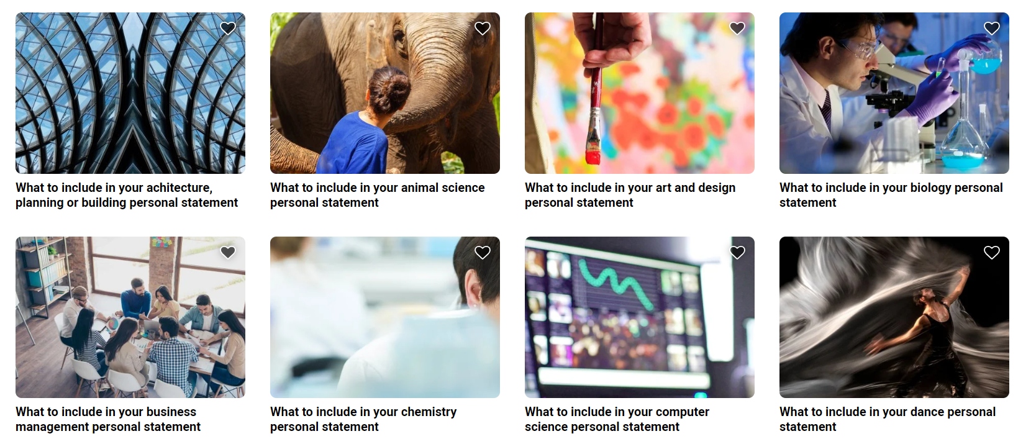
Personal statement guides
All illustrations designed by Storyset on Freepik.com

