Slide 1


Year 12 Information Evening
Thursday 5th June 6 pm

Slide 2
Welcome
Aims of the session
1. To understand the UCAS process at St Peter’s
2. To understand and be able to support students writing their personal statements
3. To understand student finance options

Slide 3
The Sixth Form Team
Mr Williams / Ms A Keane – Deputy Headteachers
Mr Grice – Director of Learning - Progress
Mrs McHale – Director of Learning – Pastoral
Miss Jordan – Assistant Lead Tutor KS5
Mrs Przyrodzki – Careers, Aspirations and Achievement
Mrs Beale – Career advisor

Slide 4
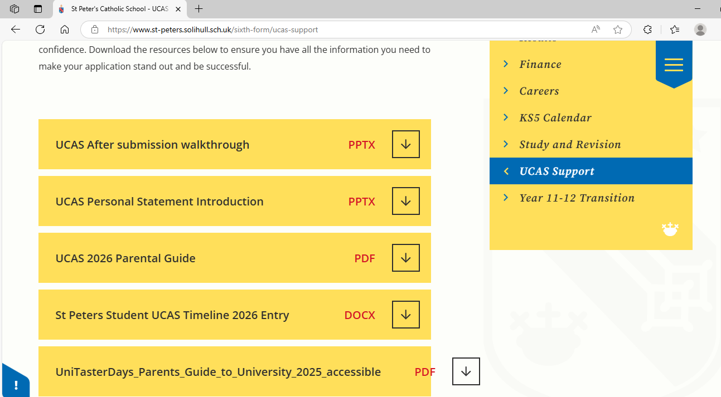

Slide 5
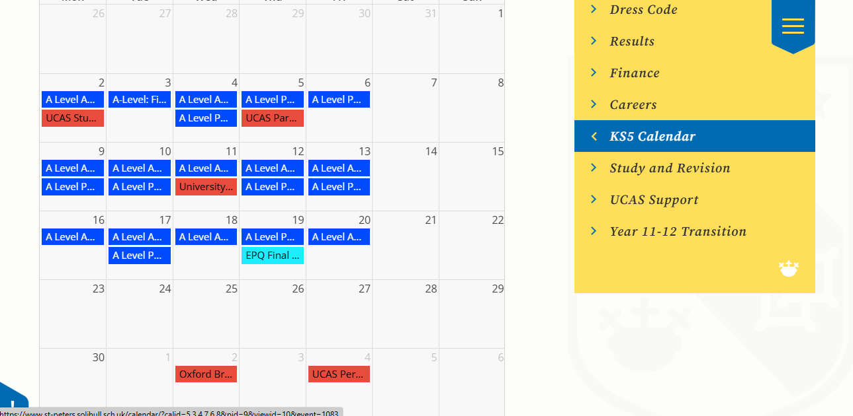

Slide 6
The UCAS Timeline
2nd September 2025 | Completed applications can start to be submitted to UCAS.
2nd October 2025 | 2025 entry deadline for conservatoire (music) applications.
15th October 2025 6pm | Deadline for Oxford/Cambridge applications and most medicine/dentistry/veterinary science courses
14th January 2025 6pm | Final deadline for most undergraduate courses.
External key Dates

Slide 7
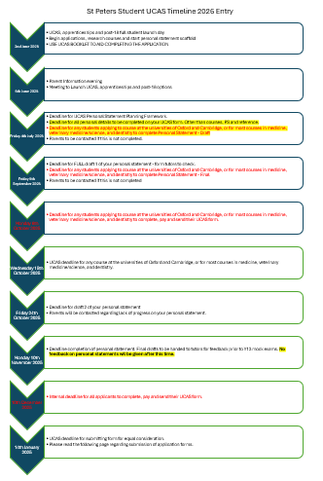

Slide 8
Key Dates
  Deadline for UCAS Personal Statement Planning Framework.
  Deadline for all personal details to be completed on your UCAS form. Other than courses, PS and reference.
  Deadline for any students applying to course at the universities of Oxford and Cambridge, or for most courses in medicine, veterinary medicine/science, and dentistry to complete Personal Statement - Draft
  Parents to be contacted via email if this is not completed.
Friday 4th July 2025

Slide 9
  Deadline for FULL draft 1 of your personal statement - form tutors to check.
  Deadline for any students applying to course at the universities of Oxford and Cambridge, or for most courses in medicine, veterinary medicine/science, and dentistry to complete Personal Statement - Final
  Parents to be contacted via email if this is not completed
Friday 5th September 2025

Slide 10
  Deadline for any students applying to course at the universities of Oxford and Cambridge, or for most courses in medicine, veterinary medicine/science, and dentistry to complete, pay and send their UCAS form.
Monday 6th October 2025
  UCAS deadline for any course at the universities of Oxford and Cambridge, or for most courses in medicine, veterinary medicine/science, and dentistry.
Wednesday 15th October 2025

Slide 11
  Deadline completion of personal statement. Final drafts to be handed to tutors for feedback prior to Y13 mock exams. No feedback on personal statements wil be given after this time.
Monday 10th November 2025

Slide 12
  Internal deadline for all applicants to complete, pay and send their UCAS form.
10th December 2025
  UCAS deadline for submitting form for equal consideration.
  Please read the following page regarding submission of application forms.
14th January 2025

Slide 13
University numbers – based on 2021 numbers
University | Number of Applications | Number of places available
Oxford | 23,000 | 3,250
Cambridge | 23,140 | 3,625
LSE (London school of Economics) | 26,000 | 1,700
Southampton | 43,255 | 5,075
York | 30,180 | 4,955
Warwick | 42,260 | 6,000
Birmingham | 56,850 | 7,865
Liverpool | 43,435 | 5,910

Slide 14
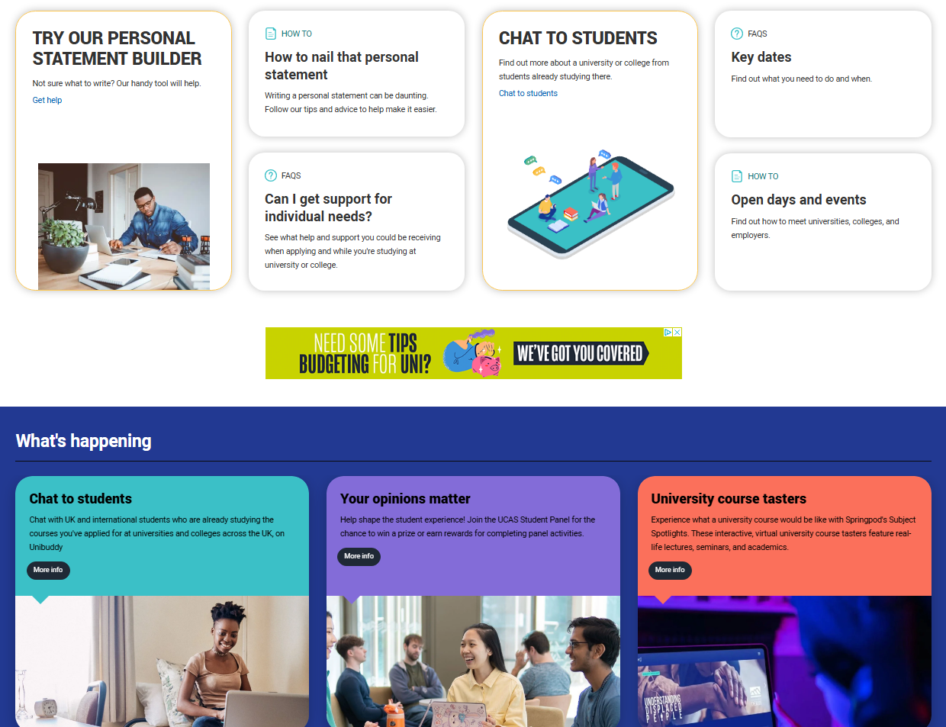

Slide 15
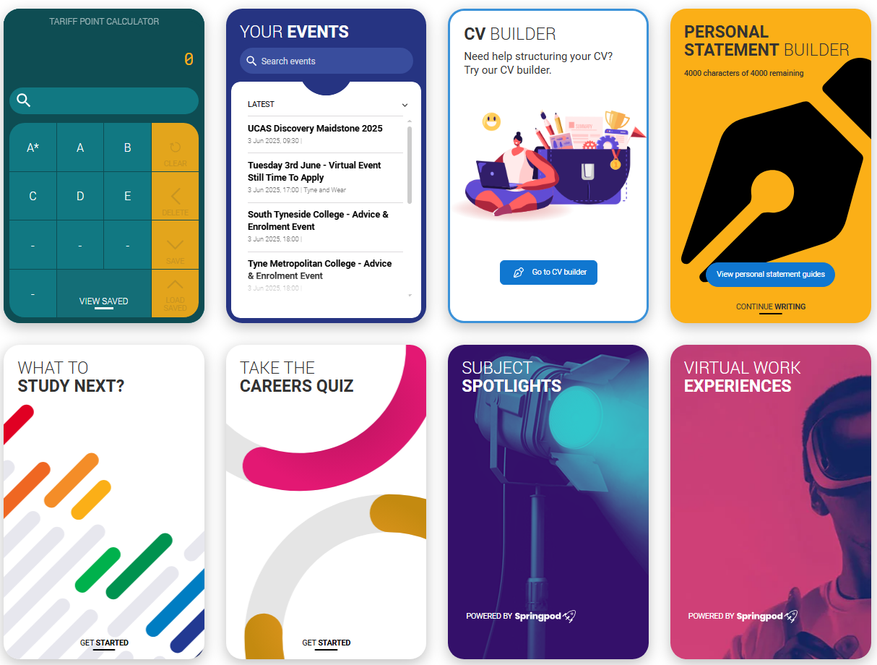

Slide 16


Slide 17


Slide 18
UCAS Application
Linked to the sixth form through a buzzword
Gives form tutors and sixth form team overview to check and feedback after the set deadlines
Parents can help student with application at home and is advised

Slide 19
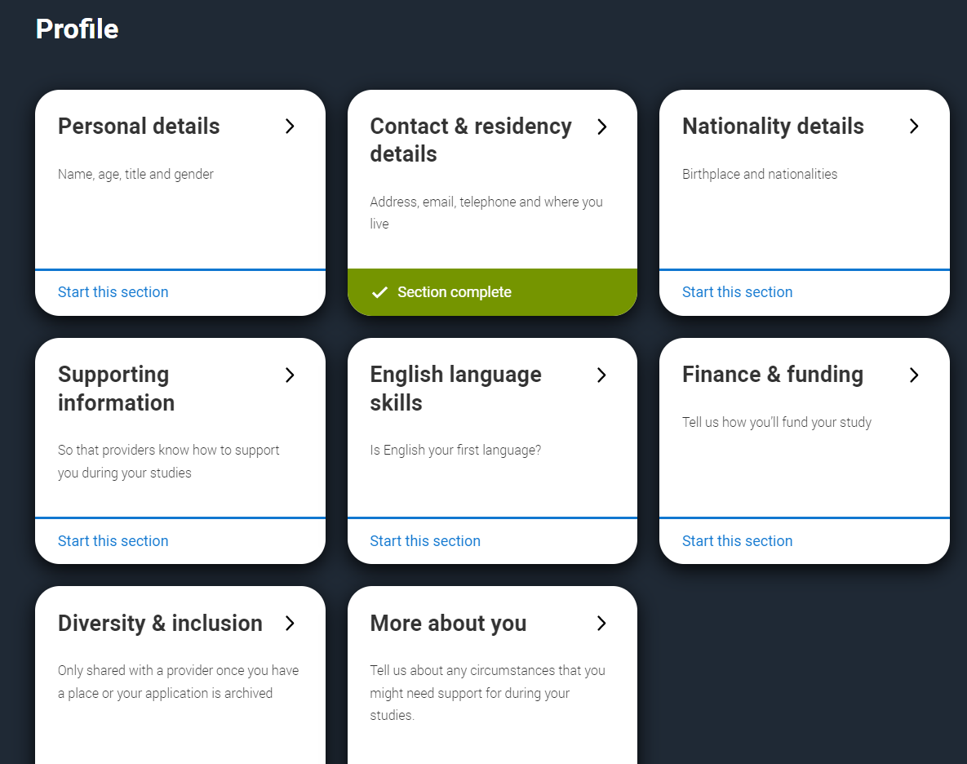
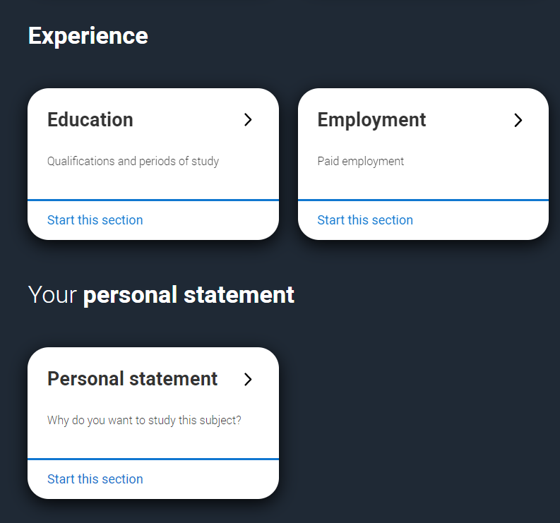
UCAS Application Form
This is the main body of your application form, and you need to fill out each section. The sections are split into:
Profile
Experience
Personal Statement

Slide 20
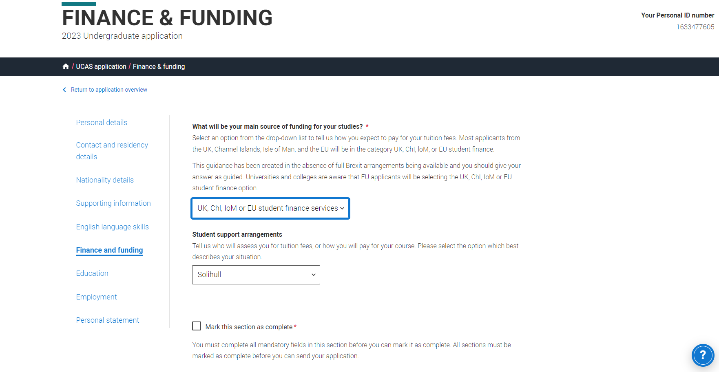
Select UK, ChI, loM, or EU student finance
This does not mean you have to take out a student loan but it gives you the option and ensures you are sent this information.
Finance and funding
You must select the council your parents pay their council tax to NOT your address.
So for students living in Balsall Common this is Solihull.
For students living in Tile Hill this is Coventry. For some of you it may be Warwickshire.
Check at home which council your family pay council tax to.

Slide 21
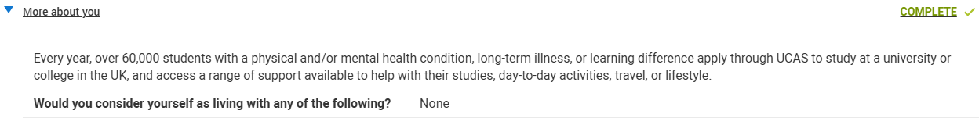
Mental Health Support
On the section below – you can input any mental health concerns or issues you want to make the universities aware of
You DO NOT need to have a diagnosis
This will not be shared with the university to make decisions
Will be sent to universities once offers have been given to allow them to offer support
It does not hinder your ability to choose any courses (Eg Medicine)
You can choose to tell the uni’s privately – but recommended before starting the course so support can be put in place prior

Slide 22
Personal Statement
Students will complete a scaffold at first
This is to help students get down all of their experience and points by answers smaller, simpler questions
They can then transfer this into their personal statement
This will be completed on Unifrog (Paid platform)
2026 Cycle is in the form of 3 questions
  Why you want to study that course
  What skill from your courses have you got
  Any extra-curricular
Form tutors will check and advise throughout the deadlines
Can send to teachers through Unifrog to check also if possible
Final check by Sixth form team before send off

Slide 23
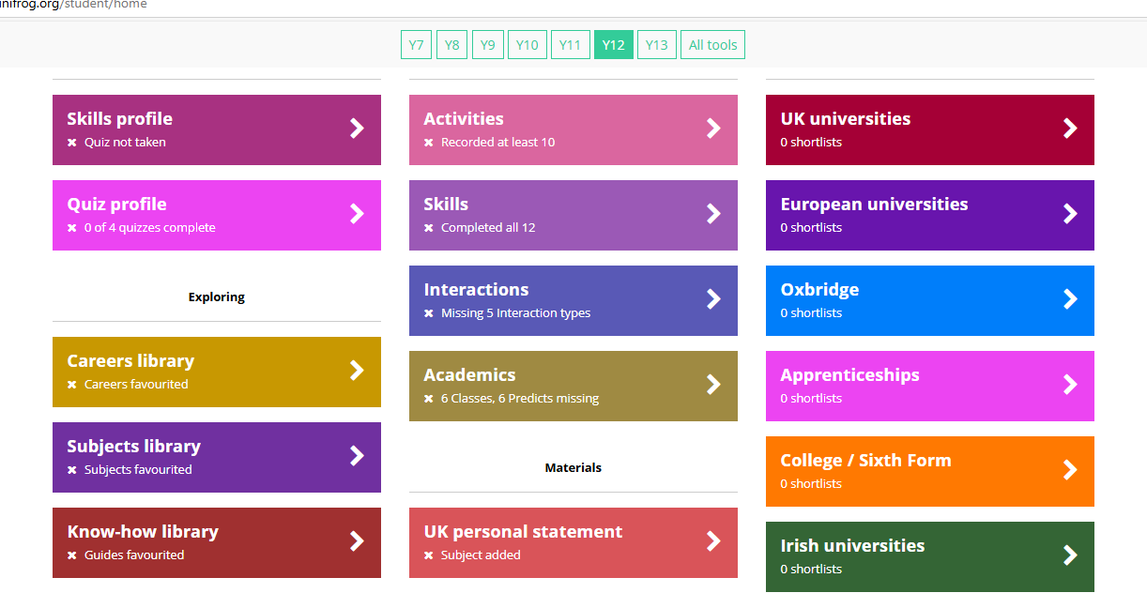
Unifrog

Slide 24
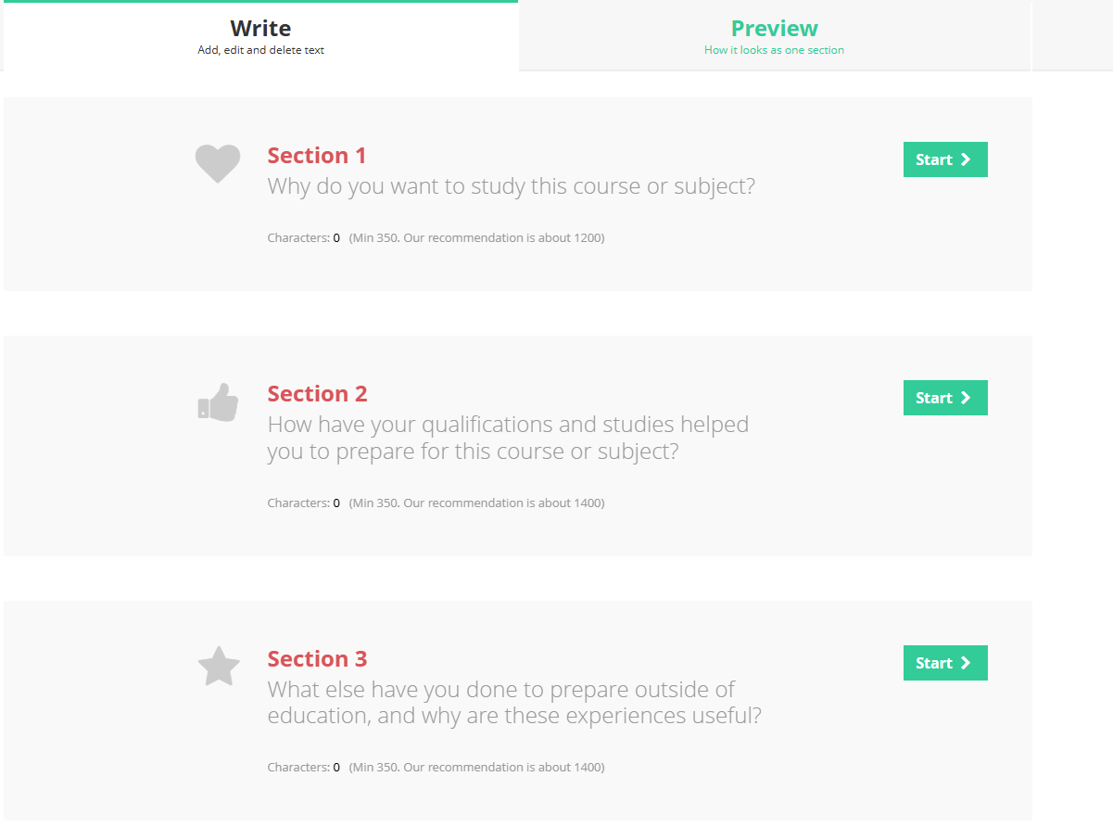

Slide 25
Predicted grades
Calculated from the work completed in year 12 + classroom assessment
Y12 Mock exams
Post Summer Internal Exams
Professional judgement of each student's independent work ethic throughout the year to date. (Requests for additional work, support, emails etc)

Slide 26
Predicted grades….
In the student booklet it says:
DO NOT PUT PRESSURE ON TEACHERS TO CHANGE YOUR PREDICTED GRADES. A CAREFUL AMOUNT OF CONSIDERATION WILL HAVE GONE INTO THESE PREDICTIONS FROM THE OUTSET. TRUST THAT THE GRADES WE PREDICT ARE THE GRADE YOU ARE MOST LIKELY TO GET.
Universities can (and will) ask for assessment data to support our predictions in cases where the GCSE grades and the predicted grades do not match.
The grades reflect the course difficulty. We do not want to set your child up to fail and be disappointed in the summer or struggle on a course.

Slide 27
Predicted grades
Students who would like to try and provide evidence to improve this grade will be advised to do the following things…
Evidence the extra work they are doing alongside their set studies to show effort and motivation to improve.
A post summer assessment will be conducted in class to provide evidence of improvement in assessment style conditions.

Slide 28
The reference
Tutors will write the reference using subject teacher information
These will always be created to reflect positively on the student, but will be based on evidence
Specific structure : information about school, Extenuating Circumstances and additional information about the student

Slide 29
Opportunity to improve predicted grades - Scenario 1
Grades you’ve been getting all year - E D C C C C C
Current prediction - C
Prediction you want - A*

Slide 30
Opportunity to improve predicted grades - Scenario 2
Grades you’ve been getting all year - E D C C C C C
Current prediction - C
Prediction you want - B

Slide 31
Post Summer Internal Assessments (2-5th September)
An opportunity to improve predicted grades
A check on whether Sixth Form is the right option for you going forward
Basis for conversations with yourself and your parents

Slide 32
Finally
Once all deadlines have been met and the application is complete – PAY FOR APPLICATION
One on One meeting with a member of the sixth form team will be arranged
Final checks and sent off before Christmas

Slide 33
UCAS & All That
CLAIRE OWEN
RECRUITMENT & ADMISSIONS
Notes:
All titles 40 size

Slide 34
Student Finance

Slide 35
Thank you for listening. Any questions?
We will be available after to discuss anything

