Slide 1



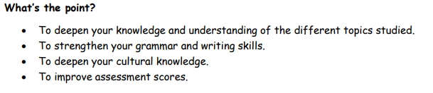
MFL
Department
Y11 to Y12
Transition pack
SPANISH

Slide 2
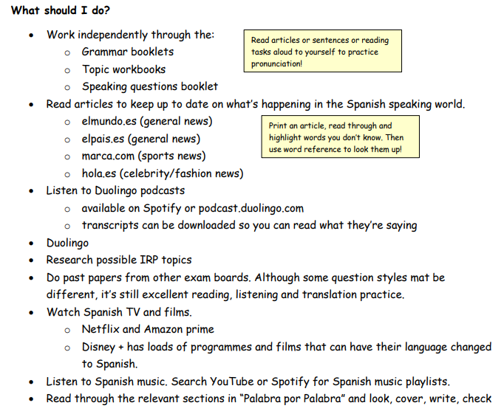

Slide 3
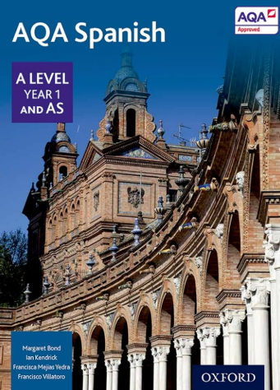


Resources for Y12 you must buy

Slide 4
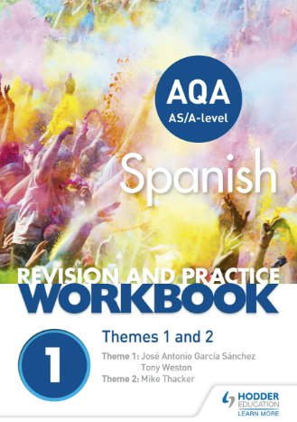

Useful extra resources to buy

Slide 5
Year 1
Artistic culture in the Hispanic world La influencia de los ídolos La identidad regional en España El patrimonio cultural Study of a film: Volver (Pedro Almódovar) | Aspects of Hispanic society: current trends Los valores tradicionales y modernos El ciberespacio La igualdad de los sexos

Slide 6
How is the course assessed?
Paper 1: Listening, Reading and Writing
2 hour 30 minutes
50% of A-level grade
Listening Comprehension (including summary in Target Language)
Reading Comprehension (including summary in Target Language)
Translation into English
Translation into Target language

Slide 7
How is the course assessed? Just a reminder!
Paper 2: Writing
2 hours
20% of A-level grade
2 Essay questions on the book and film studied in class (300 words)
Students have a choice of two questions for each task.
Students given guidance on points to make

Slide 8
How is the course assessed? Just a reminder!
Paper 3: Speaking
21-23 minutes (including preparation time)
30% of AS grade
5 minutes to prepare one unseen card. (5-6 minutes)
Presentation on individual research project. (2 minutes)
Discussion of individual research project. (9-10 minutes)

Slide 9
A-Level Exams
Paper 1: Listening, Reading and Writing
2 hour 30 minutes
50% of A-level grade
Listening Comprehension (including summary in Target Language)
Reading Comprehension (including summary in Target Language)
Translation into English
Translation into Target language
Paper 2: Writing
2 hours
20% of A-level grade
2 Essay questions on the book and film studied in class (300 words)
Students have a choice of two questions for each task.
  Students given guidance on points to make
Paper 3: Speaking
21-23 minutes (including preparation time)
30% of AS grade
5 minutes to prepare one unseen card. (5-6 minutes)
Presentation on individual research project. (2 minutes)
Discussion of individual research project. (9-10 minutes)

Slide 10
For more info check:
AQA | Spanish | A-level | A-level Spanish

Slide 11


