Slide 1

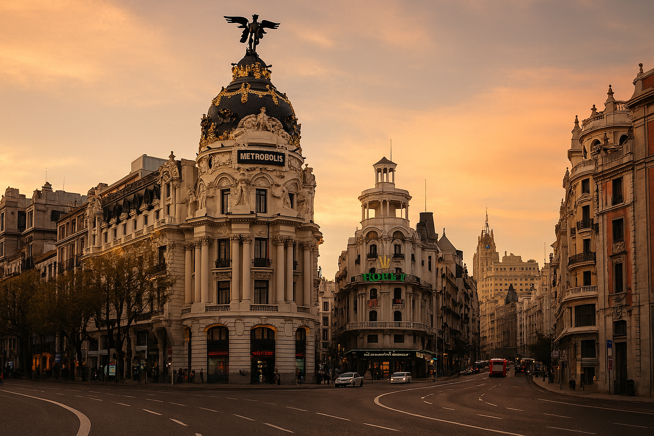
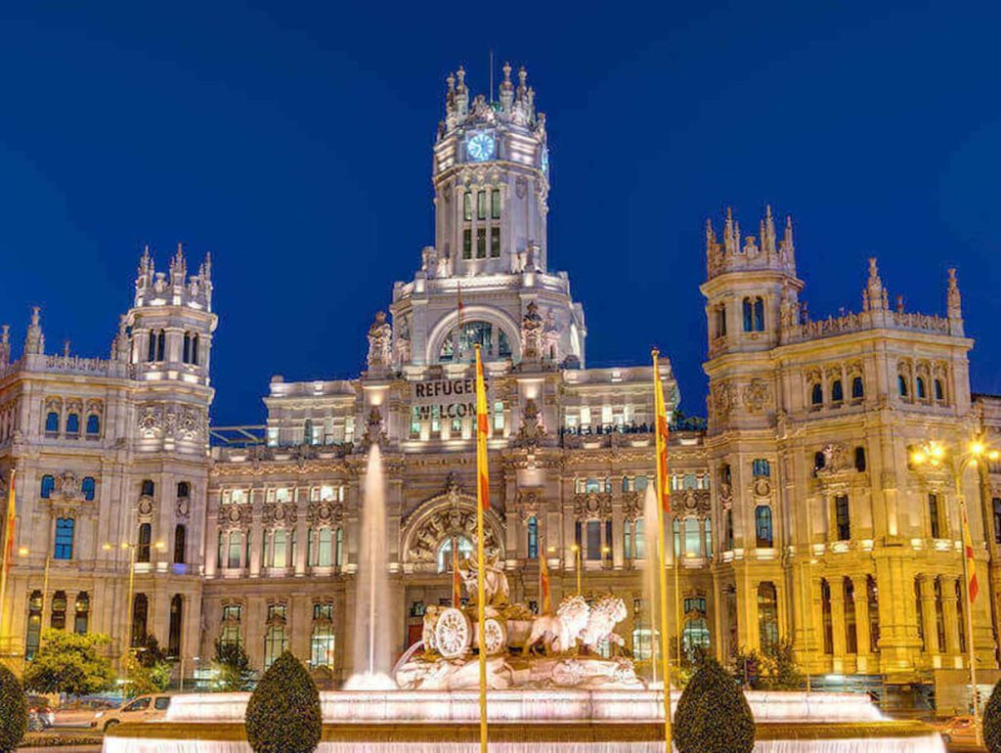
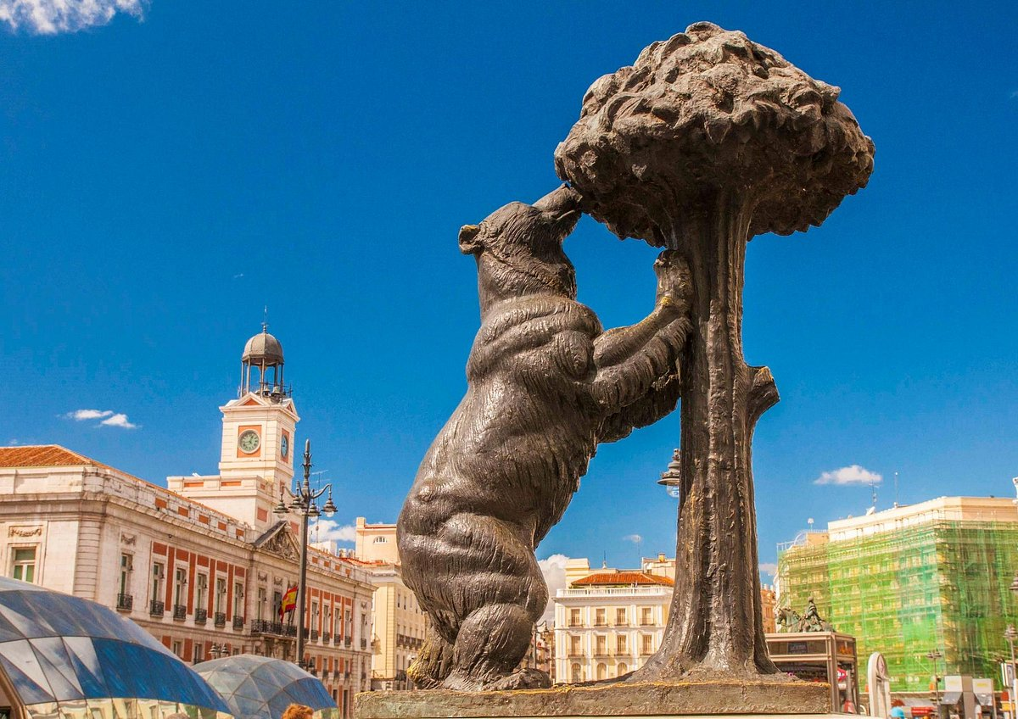


Bienvenidos
St Peter’s - TRIP TO MADRID
Travel Dates:
Thursday 21st May – Sunday 24th May
MFL
Department

Slide 2
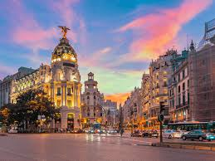
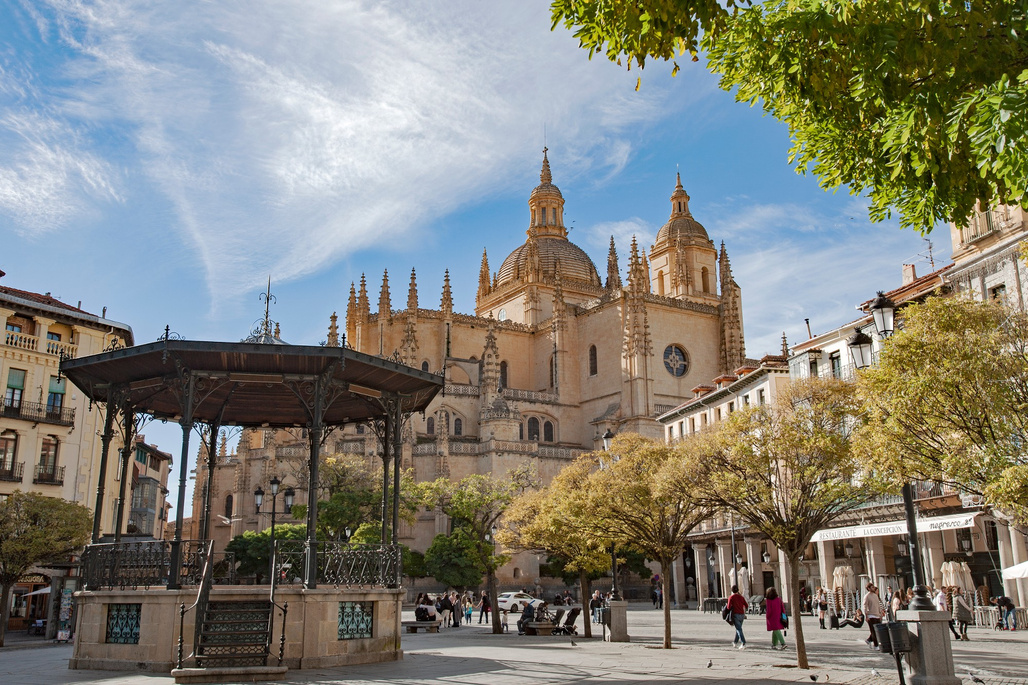
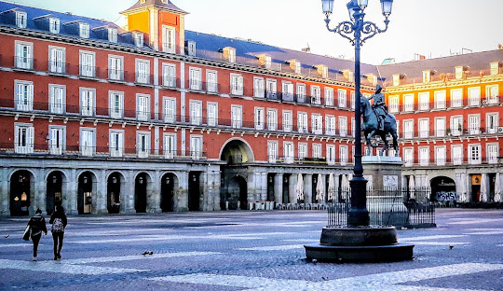



Madrid

Slide 3
Mrs Pacheco
pachecoj@st-peters.solihull.sch.uk
Mrs Przyrodzki
Mrs Fealy
Mr Murphy
Mr Steinmann
Contact number for trip
TBC closer to the departure date.

Slide 4
Fully ABTA bonded with own ATOL licence
Members of the School Travel Forum

Slide 5

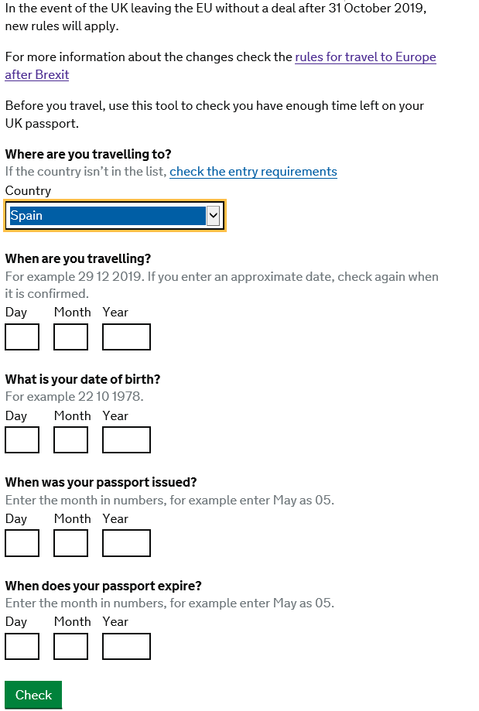
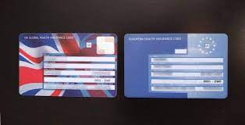
Administration
Passport – check the expiry date (must be handed to JPC at the latest on Monday 4th May 2026 if not handed in today)
For non-UK passport holders, please check any visa requirements.
GHIC Card (4th May)
https://www.gov.uk/european-health-insurance-card
Comprehensive insurance is included
Mobile Phones
Spending money – no more than
100 euros
Medical & Dietary Information
(update with the school if necessary)
www.passport.service.co.uk

Slide 6
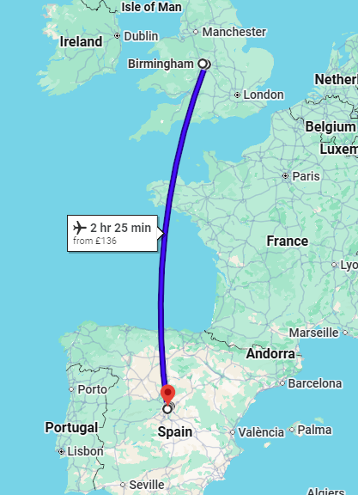
Flights
London Stansted – Madrid Barajas – Birmingham
Outbound Thursday 21st May 2026
London Stansted – Madrid Barajas
Ryanair FR347
Depart 10.00
Arrive 13.30 (local time)
Madrid Barajas – Birmingham
Return Sunday 24th May 2026
Ryanair FR2082
Depart 21.20 (local time)
Arrive 22.50

Slide 7
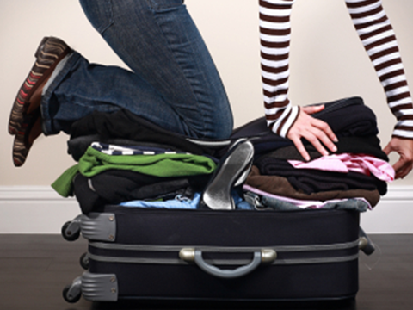
Luggage allowance
Outbound
Ryanair Airline
Hand Luggage: One handbag or backpack no bigger than 40 cm x 30 cm x 20 cm including the handle and pockets (must fit under the seat)
Checked Luggage: One piece not exceeding 10 kg
Return
Ryanair Airline
Hand Luggage: one handbag or backpack no bigger than 40 cm x 30 cm x 20 cm including the handle and pockets (must fit under the seat)
Checked Luggage: One piece not exceeding 10 kg

Slide 8
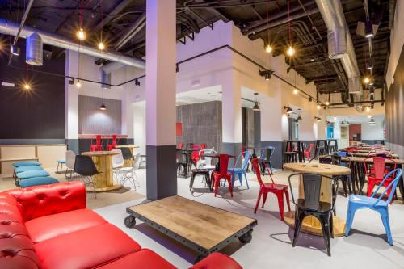
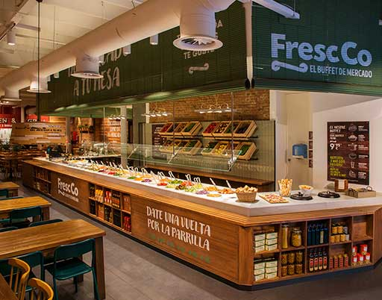
Meals
Half board included
First meal provided is dinner on day of arrival
Thereafter
Breakfast
Dinner
Plus meal voucher for Warner Park
Last meal provided is breakfasts on day of departure
Special diets:
Please advise Mrs Pacheco
Breakfast at
Mola! Hostel
Dinner at
local restaurant

Slide 9
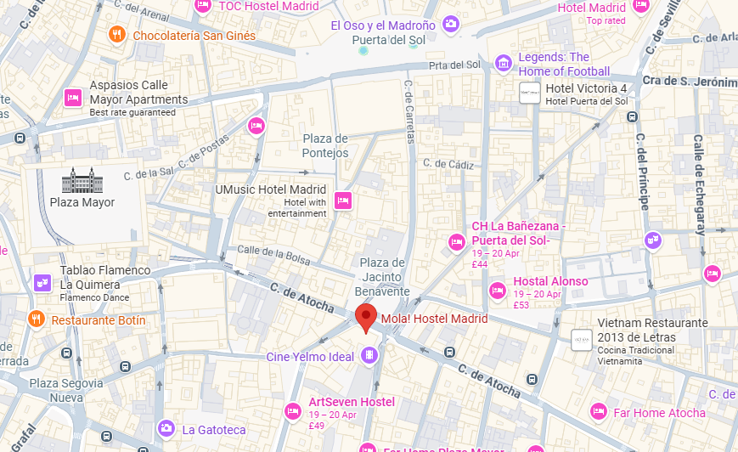
Accommodation
Location: Mola! Hostel
Calle Atocha 16, Madrid, 28012, Spain
Hostel en Madrid Centro | Cerca Puerta del Sol | Mola! Hostel

Slide 10
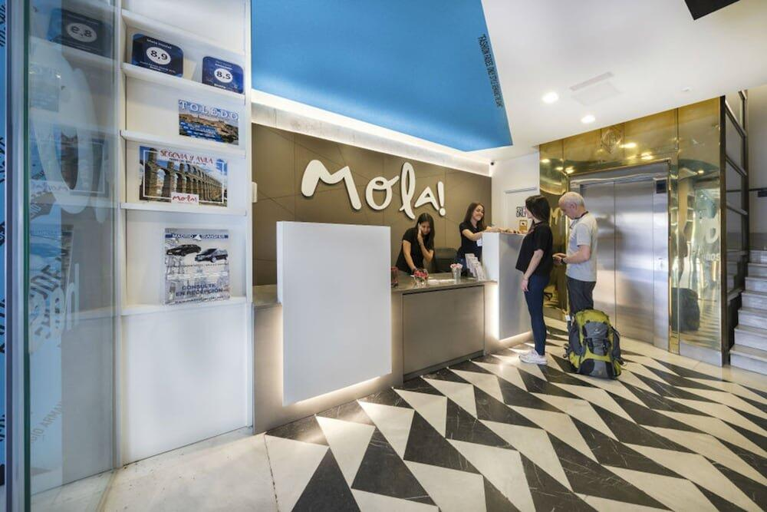
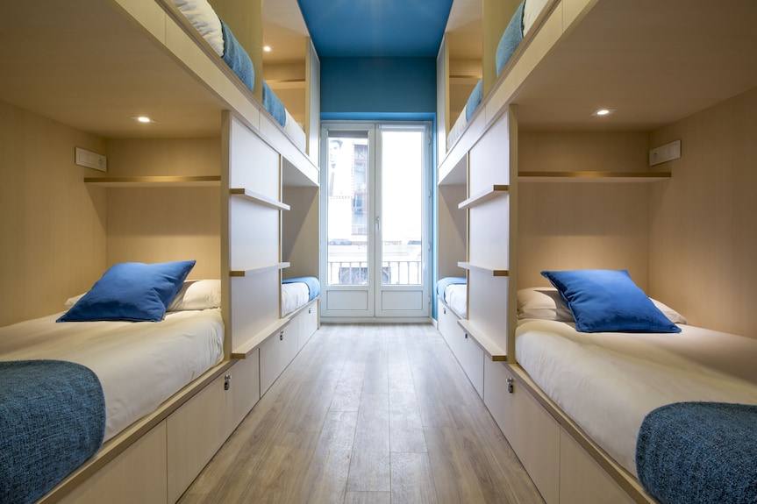
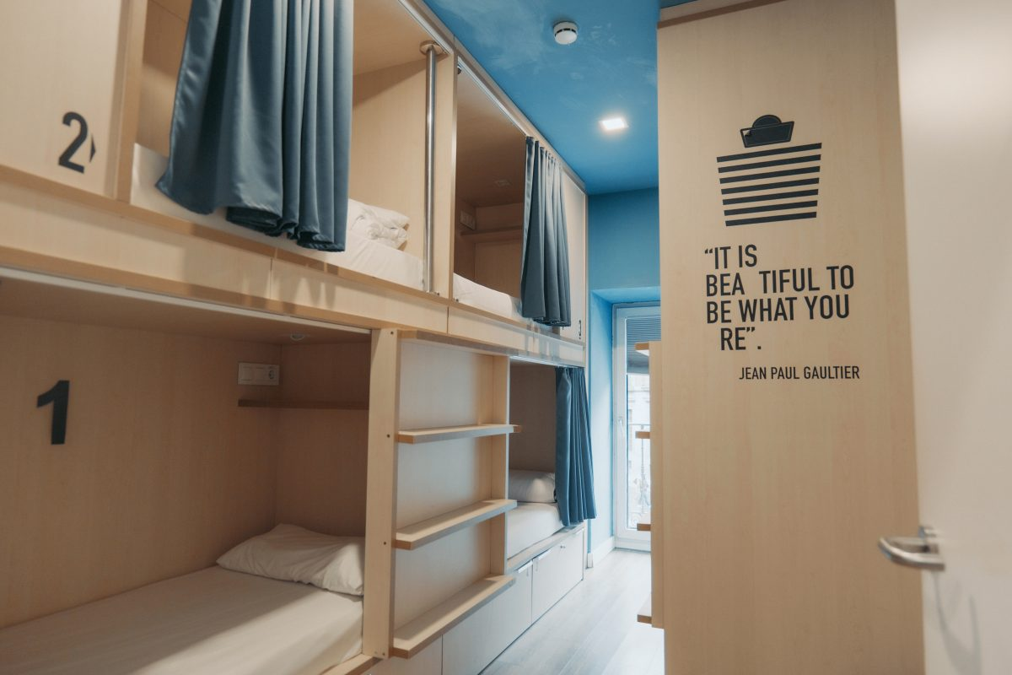
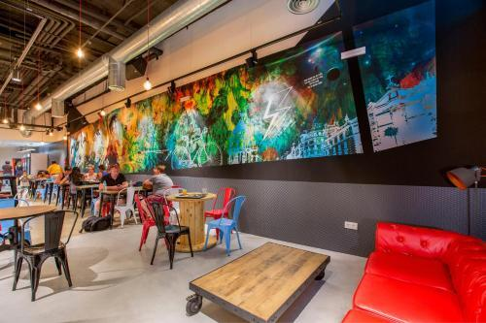
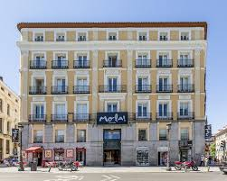
Accommodation
Great location
Free WIFI
Towels provided.
Bed & breakfast accommodation included
Rooms will vary from groups of 6-8

Slide 11
Thursday 21st May 2026
Departure Day
04.30am Meet at St Peter’s Catholic School –
07.15 Arrive Stansted Airport + check in
10.00 Depart Stansted Airport
13.30 Arrive Madrid Airport
14.30 Transfer to accommodation
15.00 Check-in at Mola! Hostel
16.00 Head to explore the city centre and Madrid’s Landmarks
18.00 Visit to La Almudena Cathedral & The Royal Palace
21.00 Tapas meal at Restaurante 100 Montaditos, La Sureña pre-booked.
Car park will not be opened.
Leave room for Coach. 4.45am depart.
Behaviour Deposit: €10 per person payable upon arrival
Please have this in cash.

Slide 12
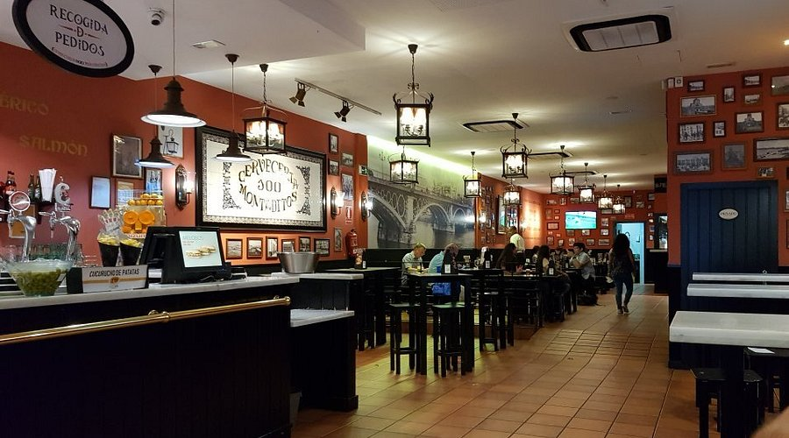
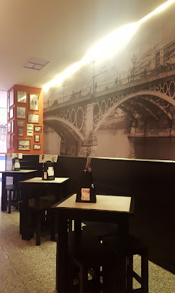
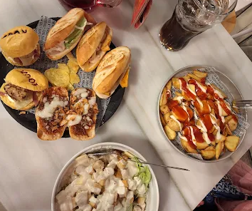
Dinner at Restaurante 100 Montaditos
La Sureña
Sample menu
TAPAS:
Montaditos variados
Ensalada vegana
Tortilla española
Patatas bravas
Croquetas de pollo
Calamares a la romana
Una bebida y un helado

Slide 13
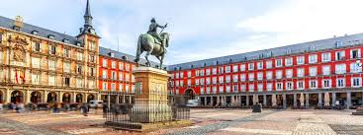
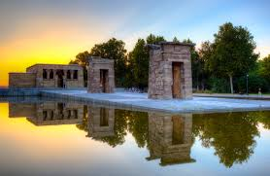
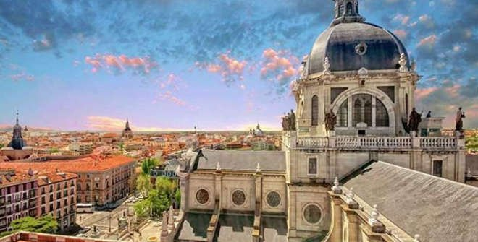
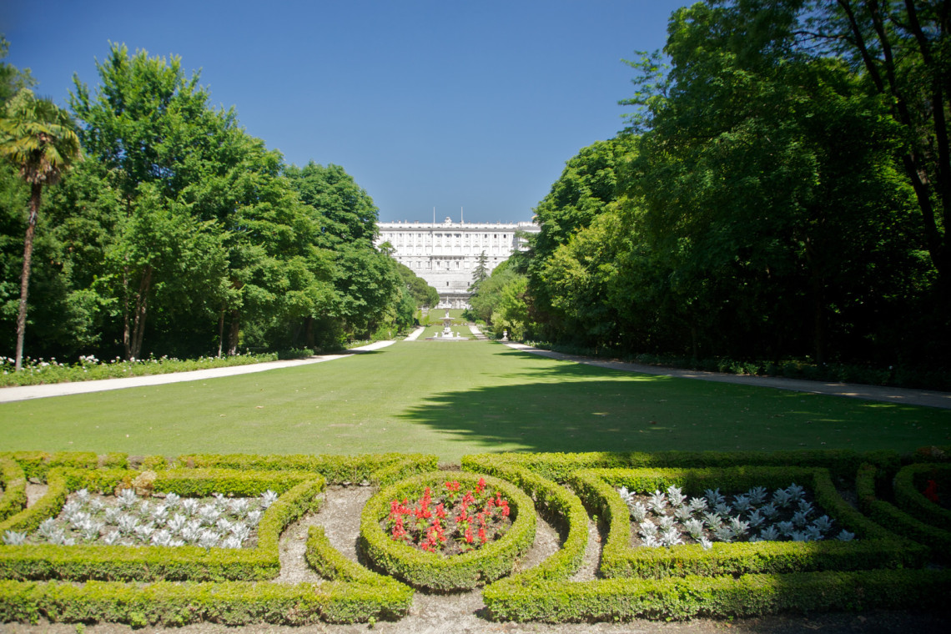
Plaza Mayor
Templo de Debod
La Catedral de la Almudena
Jardín del Palacio Real

Slide 14

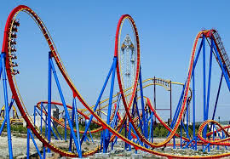

Friday 22nd May 2026
Warner Bros Theme Park
Day 2
8.00 Breakfast
9.00 Visit to Templo del Debot (Egyptian temple)
10.00 Visit to San Miguel Market
11.15 Coach to Parque Warner
11.45 Arrive at Parque Warner
13.30 Lunch (voucher)
20.15 Depart Parque warner
21.00 Dinner at FrescCo Buffet Restaurant

Slide 15
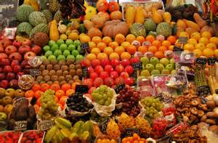
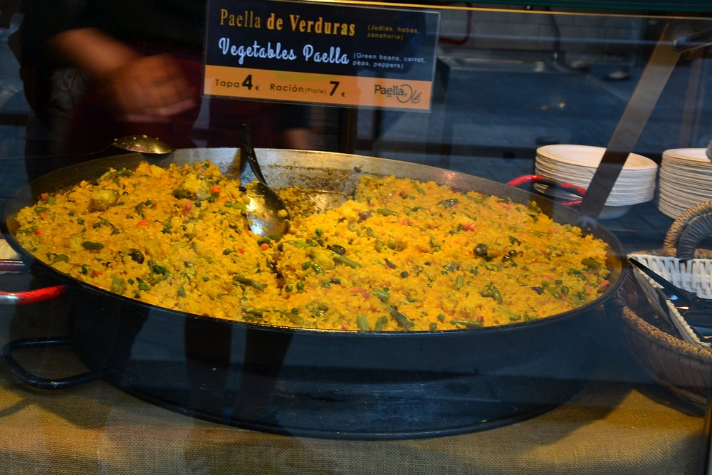
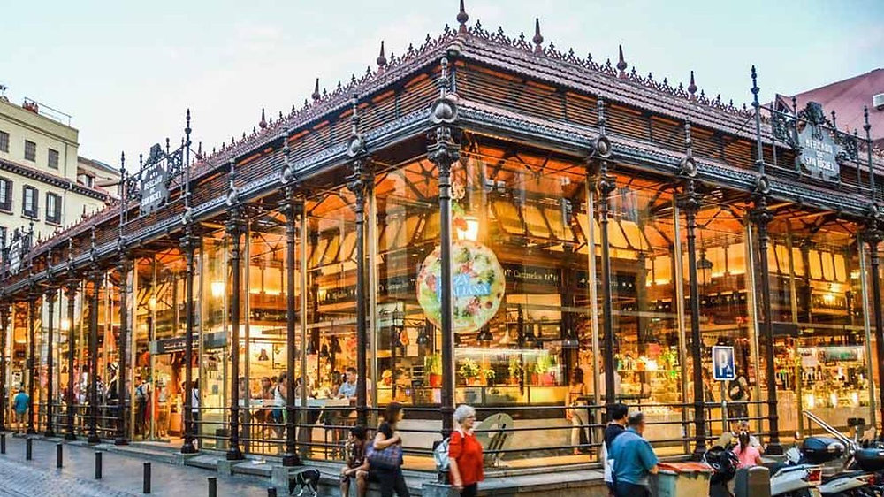
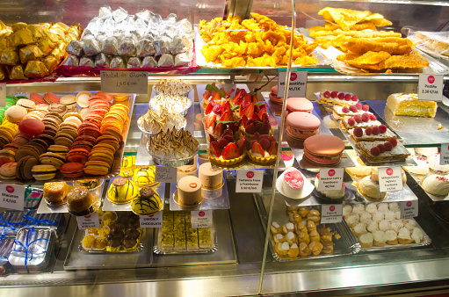
San Miguel Market
Opened in May 1916, San Miguel is a historic
20th century cast-iron and glass architecture structure originally designed as a fresh wholesale food market.

Slide 16
Saturday 23rd May 2026
Trip to Toledo
The City of the Three Cultures UNESCO World Heritage city,
known for its historical coexistence of Christians, Muslims, and Jews.
Day 3
08.00 Breakfast (hostel)
08.45 Coach to Toledo
10.30 Guided walking tour of Ancient Toledo
13.30 Lunch
14.30 Free time to explore and buy souvenirs
17.00 Depart Toledo
18.30 Visit to Chocolatería San Ginés famous for their churros since 1894
21.00 Dinner at Dinner at FrescCo Buffet Restaurant (pre-booked)

Slide 17
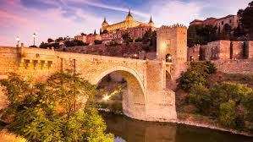
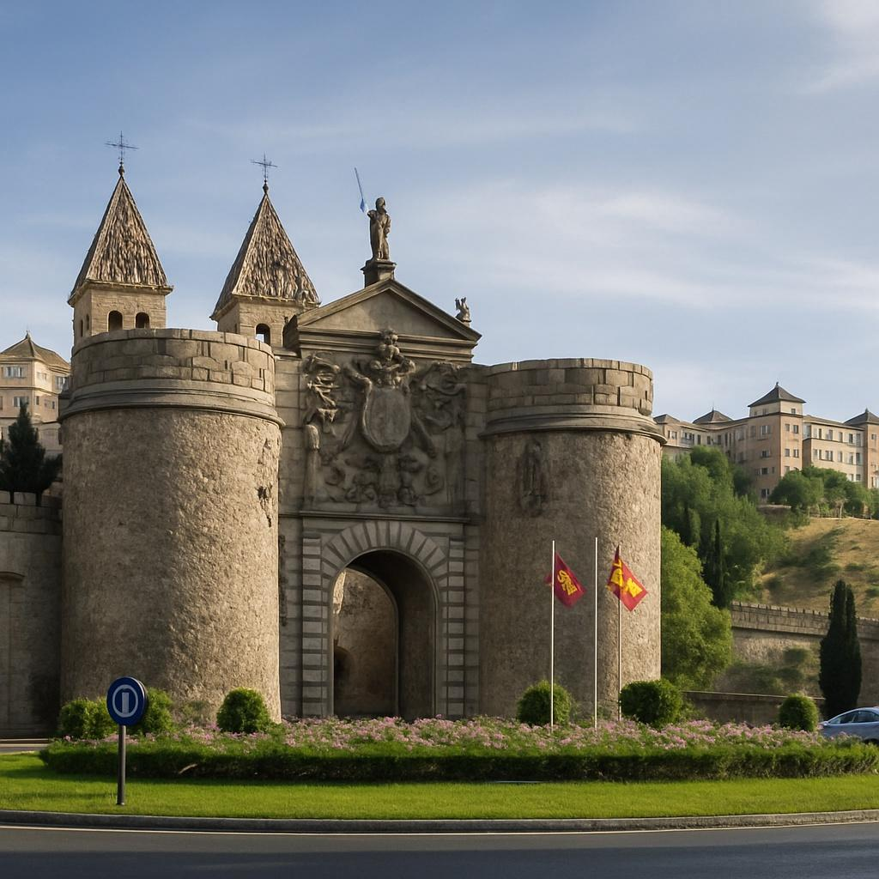
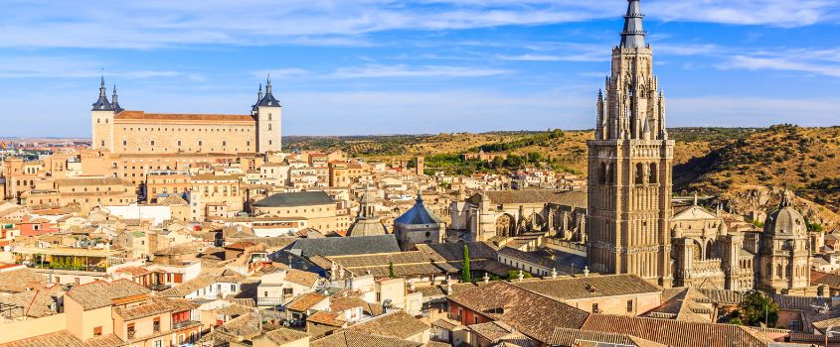

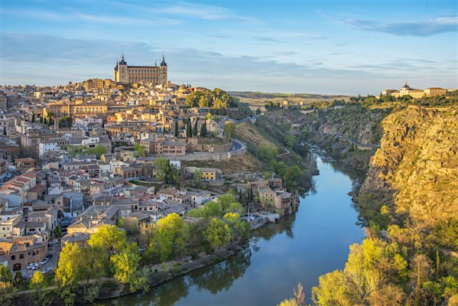
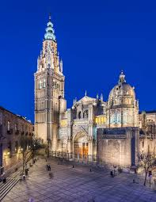
The view over Toledo
Notes:
.

Slide 18
Sunday 24th May 2026
08.00 Breakfast
08.30 Room inspections, check-out + store luggage
10.00 Visit to Santiago Bernabéu (Real Madrid Stadium)
13.00 Lunch
14.00 Visit to Parque de El Retiro
18.00 Return to Mola! Hostel to collect luggage and depart for Madrid Airport
19.00 Arrive Madrid Airport + check in
21.20 Depart Madrid Airport
23.30 Arrive at Birmingham International Airport
Parents to collect from Birmingham Airport

Slide 19
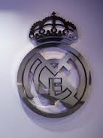
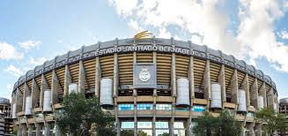

El Santiago Bernabéu
Real Madrid Stadium

Slide 20
Essentials 1: Suggested Kit List
1 small/medium suitcase – hold luggage
1 rucksack for the plane and to carry lunch each day, water bottle, sunscreen, etc.
Enough changes of clothes for the duration of the trip (temp around 20˚C - 25 ˚C)
3 Pairs Shorts/4 T-Shirts etc.
Warm clothes for the journey and flight e.g. hoodie, cardigan, etc.
Sensible walking shoes or trainers (not sandals)
Flip flops for use in showers
Underwear & Socks
Pyjamas
Toiletries: Shampoo, shower gel/soap, toothpaste etc (not bigger than 100ml)
A high factor suncream
Sun hat/cap
Brush/Comb
Plastic Bag for Dirty Clothes
Small Spanish/English dictionary
Phone charger and adapter plug
Travel sickness tablets / any medication you need e.g. inhaler, etc.

Slide 21
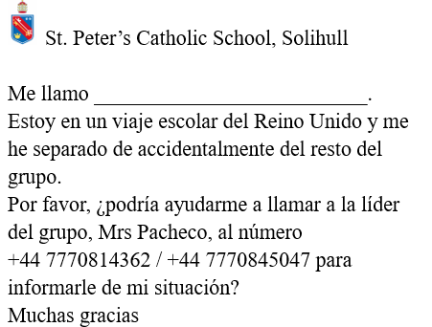


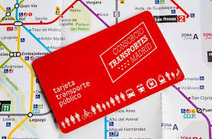
Essentials 2:
A bag for valuables - pouch / pocket / belt in which their mobile phone, information card, metro ticket and money can be kept and can be kept close to their body.
The week before the trip pupils involved will have a briefing about:
Behaviour expectations i.e. staying in their designated groups, etc.
Safety; what to do in case of an emergency, etc.
When in Madrid to get around, we will sometimes use the metro.
On arrival, we will buy a pass, which cost 12.50 euros and will last the whole time that we are there.
Cash needed for this but the machines can be temperamental so a card might be useful.
Pupils will buy this and be responsible for it, any lost passes will need to be replaced by the pupil.

Slide 22
Mobile phones
Permitted – but pupils will be solely responsible for these
Not allowed during meal times
These will be collected in each evening before bed and returned the next morning

Slide 23
Dietary requirements
Dietary Requirements: We must be advised of any serious allergies at least 6 weeks before travel.
Most have but if anything was missed/has changed please inform ASAP.

Slide 24
Valuables
Pupils are permitted to bring phones, but they are their responsibility. These will be collected every night before bedtime.
Please do not upload photos of other pupils onto social media.
If pupils are using phones incorrectly, we will confiscate them.
Avoid bringing other valuables - Pick pocketing is common in Madrid please ensure all money is kept in zipped wallets and bags.
Money – Suggested £20 sterling in case of delays at the Airport.
Lunch for Saturday and for Sunday 15€ per meal.
To be put in an envelope with pupil name on and given in before departure.
No more than 100 Euros for spending on gifts, snacks, drinks, etc.
Pupils can bring bank cards if they wish but they are their responsibility.

Slide 25
Food
Please bring packed breakfast & lunch to eat at the airport if not buying it for the first day.
Breakfast and dinner is provided everyday however pupils may wish to pack snacks for the duration.
It will be hot so please avoid chocolate as this will melt. Some cereal bars, biscuits and crisps.
PLEASE NO NUTS – WE ARE A NUT FREE SCHOOL
A refillable water bottle – very important!!
Return on Friday:
Pupils may bring some extra money to purchase dinner at the airport as
we have an evening return flight.

Slide 26
Medical
Please ensure all medical requirements are completed on ParentPay.
Medication – Needs to be in a labelled, resealable plastic bag, with the student’s name clearly labelled and with instructions on. This will be given to a teacher who will administer.
Travel sickness tablets – please take if needed.
Paracetamol – Pupils may wish to bring a small amount with them.
Please pack plasters, hand sanitiser, suncream etc.
GHIC/EHIC CARDS ARE COMPULSORY

Slide 27
Behaviour
If a pupil is not following teacher instructions, then we may require parents to come and collect their son/daughter.
Pupils need to follow all timings, and they will need to show resilience and punctuality.
Poor behaviour will impact the experience for other pupils.
Pupils will be placed into smaller groups with a teacher for registers and room checks.
Pupils are not allowed to refuse to attend any activities – our ratio is 1 teacher per 10 pupils therefore we will need to stay together.
At Warner Bros Theme Park, pupils need to stay in groups of 3/4. We will have a designated spot where teachers will be.
There will be a seating plan on the plane, pupils will stay in this seat for the flight – no changes.
Conduct in rooms – behaviour deposit. The accommodation rules state that pupils are not allowed to enter each other's rooms, no congregating in corridors and charges will be applied (100 Euros) for any damaged caused
to a room.
Please use phones in a safe and responsible manner.

Slide 28
Summary
To be handed to staff in a sealed envelope:
• Passport and EHIC (if not already handed in)
• Labelled medication (if needed)
• Room security deposit – 10€
• Metro ticket - 12.50€
• Lunch money – Saturday 15€ + Sunday 15€
• Checked luggage max. 10kg
Check Ryanair’s baggage allowance for hand luggage
• Spending Money – Max €100 (cash/card at your discretion)

Slide 29
Select School Travel Insurance Details
Insurance Company: Aviva Insurance | Insurance Policy Number: 100744155GPA
SAIF - OLAAS - St Peter's Catholic School
Insurance Company: Zurich Municipal | Insurance Policy Number: KSC-242102-2853
The following is a summary of the main features of cover:
Personal Accident
Overseas Medical Expenses Medical, travel & emergency repatriation expenses
Search & Rescue Expenses
Personal Property
Personal Money
Electronic Business Equipment
Cancellation, Curtailment, Rearrangement & Replacement Expenses
Kidnap Consultants’ Costs
Political & Natural Disaster Evacuation
Legal Expenses
Personal Liability

