Slide 1


Welcome
Aims of the session
1. For you to understand the UCAS process
2. To understand and be able to support students writing their personal statements
3. Understand student finance options

Slide 2
The Sixth Form Team
Mr Williams– Deputy Headteacher
Mr Grice – Director of Learning - Academic
Mrs McHale – Director of Learning – Pastoral
Miss Jordan – Assistant Lead Tutor KS5
Mrs Przyrodzki – Careers, Aspirations and Achievement
Mrs Beale – Career advisor

Slide 3
The Sixth Form Tutor Team
Mr Branson
Mrs McNeil
Mr Slater
Miss Hansrod
Miss Griffin
Mr McLiddy

Slide 4
The UCAS Timeline
1st September 2026 | Completed applications can start to be submitted to UCAS.
15th October 2026 6pm | Deadline for Oxford/Cambridge applications and most medicine/dentistry/veterinary science courses
13th January 2027 6pm | Final deadline for most undergraduate courses.
Dates and deadlines for uni applications | UCAS
External key Dates

Slide 5
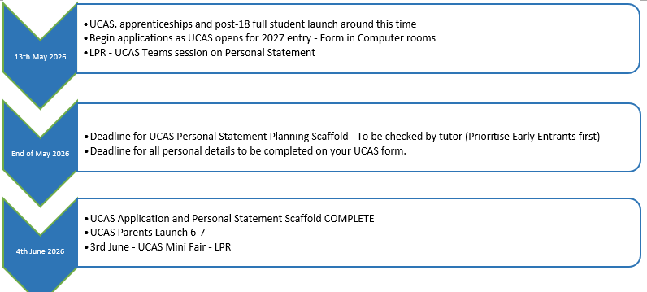
So Far…

Slide 6
Provision
UCAS Fair – Edgbaston Uni (Oct 25)
Dedicated Form Time for UCAS progress and research
Personal Statement Scaffold (Relevant to All)
Guest Speakers
LPR – Personal Statement Teams Seminar
Paid Subscription to Unifrog to research and support process
UCAS Mini Fair 3rd June
26th June – Half Day PS Writing
9th July – Aston Uni Trip
10th July –Mock Interviews
Autumn – Career Fair

Slide 7

UCAS PERSONAL STATEMENT PRELIMINARY SCAFFOLD
University or Apprenticeship?
Regardless of knowing which course you will apply for, answering the following prompts in detail will make writing your Personal Statement easier and quicker when you finally finalise your choice later on.
Did you study at another school for your GCSE’s? If so, please write the name of the school here: _________________________________________________
Current Studies
Sarah
What are you currently studying at St Peter’s.
Next to each, list the skills you have shown within the course with examples of evidence
Which subject(s) have you enjoyed most this year and why?
E.g., “I enjoy Psychology because I’m fascinated by human behaviour, especially memory and obedience.”
Have any specific topics or themes really caught your interest?

Slide 8
Which Course?
What course are you hoping to study at university or what area of employment/ apprenticeships are you most interested in?
Why this?
Why have you chosen this pathway?
Activities outside school
What activities do you take part in outside of school? (gym, football, dance etc.)
Do any of these involve leadership roles.
Again, list the skills with examples you have shown within these with evidence.

Slide 9
School Roles
What things have you been involved in at St Peter’s (or your previous school) that shows skills and responsibilities you have had, eagerness to be part of the school/ college community etc.?
Include things from your time in main school – e.g. helping at open evenings, being a prefect, English/ Math peer support, reading with year 6 at St Augustine’s, involvement in charity work ….
Employment
Since starting the Sixth Form have you/do you hold a part time job?
What type of job is it?
What skills are you learning/ responsibilities do you have?

Slide 10
Work Experience
Where did you do your work experience?
What kinds of tasks or responsibilities did you have?
What skills did you develop? (e.g., communication, time management, working under pressure)
Give clear examples of showing these skills
Super Curricular
Have you completed any further study online? If so, which subjects have you focused on.
Any MOOCs?
Anything else? Subject related visits? Course? Subject related books you have read independently?
Try to say how this has helped you?

Slide 11
Personal Circumstances
Are there any personal circumstances you need to be included in your reference?
Missed school (physical or mental health condition; caring for a family member)
Financial hardship, e.g. receiving a bursary to cover the cost of your studies.
Further information
Is there anything else that could be included?
Being limited in the qualifications you could choose, e.g. a new school not offering the same options as your previous one.
Have different qualifications, skills and experience to other applicants, e.g. serving in the Armed Forces
Any other information that may be useful to present the best possible version of you!

Slide 12

COURSE RESEARCH TASK
What course and which provider?
Write down your 5 researched choices (plus course code) of Course/Apprenticeship and University/Provider
Course Title | Course Code | University or Provider | Skills Required (found in course description) Highlight those that are common across most

Slide 13
Course Title | Course Code | University or Provider | Skills Required (found in course description) Highlight those that are common across most

Slide 14
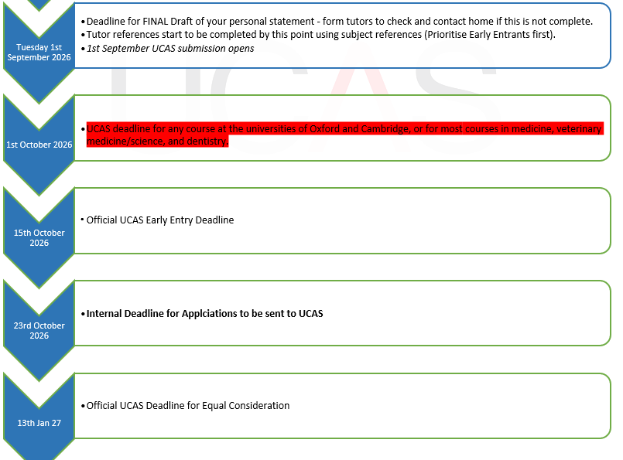

Slide 15
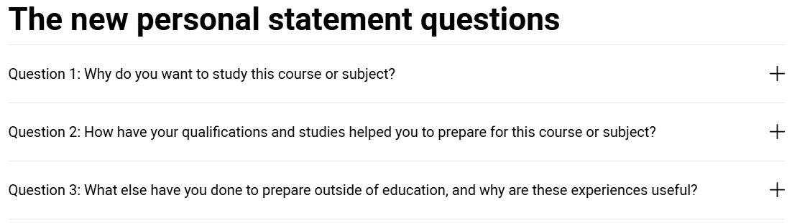
Personal Statement
How to write your personal statement: 2026 entry onwards | UCAS
Personal statement guides | UCAS

Slide 16
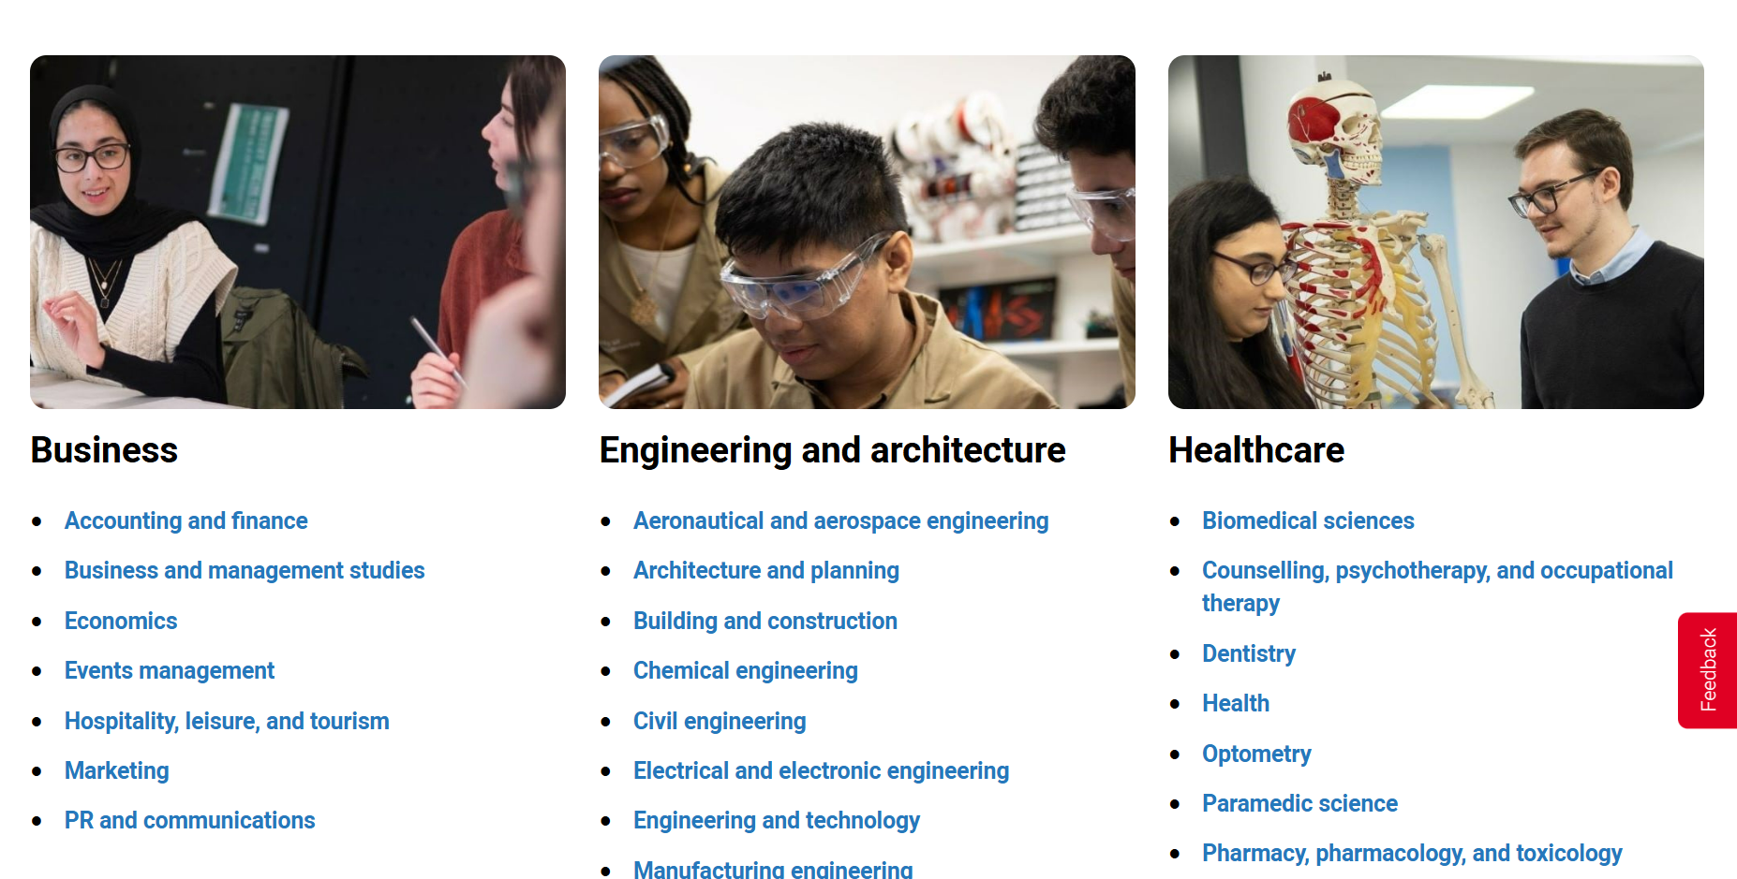

Slide 17
University numbers – based on 2024 numbers
University | Applications | Places | Apps per Place
Oxford | 23,061 | 3,245 | 7.1
Cambridge | 22,153 | 3,632 | 6.1
UCL | 79,082 | 7,001 | 11.3
Imperial | 32,887 | 3,483 | 9.4
Warwick | 48,026 | 6,045 | 8.0
LSE | ~26,000 | ~1,800 | ~14–15
Edinburgh | ~60,000 | ~8,000 | ~7–8
King’s College London | ~70,000 | ~6,500 | ~10–11
Manchester | ~90,000 | ~10,000 | ~9
Bristol | ~50,000 | ~6,500 | ~7–8
Leeds | ~65,000 | ~9,000 | ~7
Nottingham | ~55,000 | ~8,000 | ~7
Birmingham | ~50,000 | ~7,500 | ~6–7
Durham | ~30,000 | ~4,500 | ~6–7
Glasgow | ~45,000 | ~8,000 | ~5–6
This is on average for ALL courses
Competitive courses (Law, STEM etc) will be even more competitive
So Uni and Course Choice will impact competitiveness of application

Slide 18
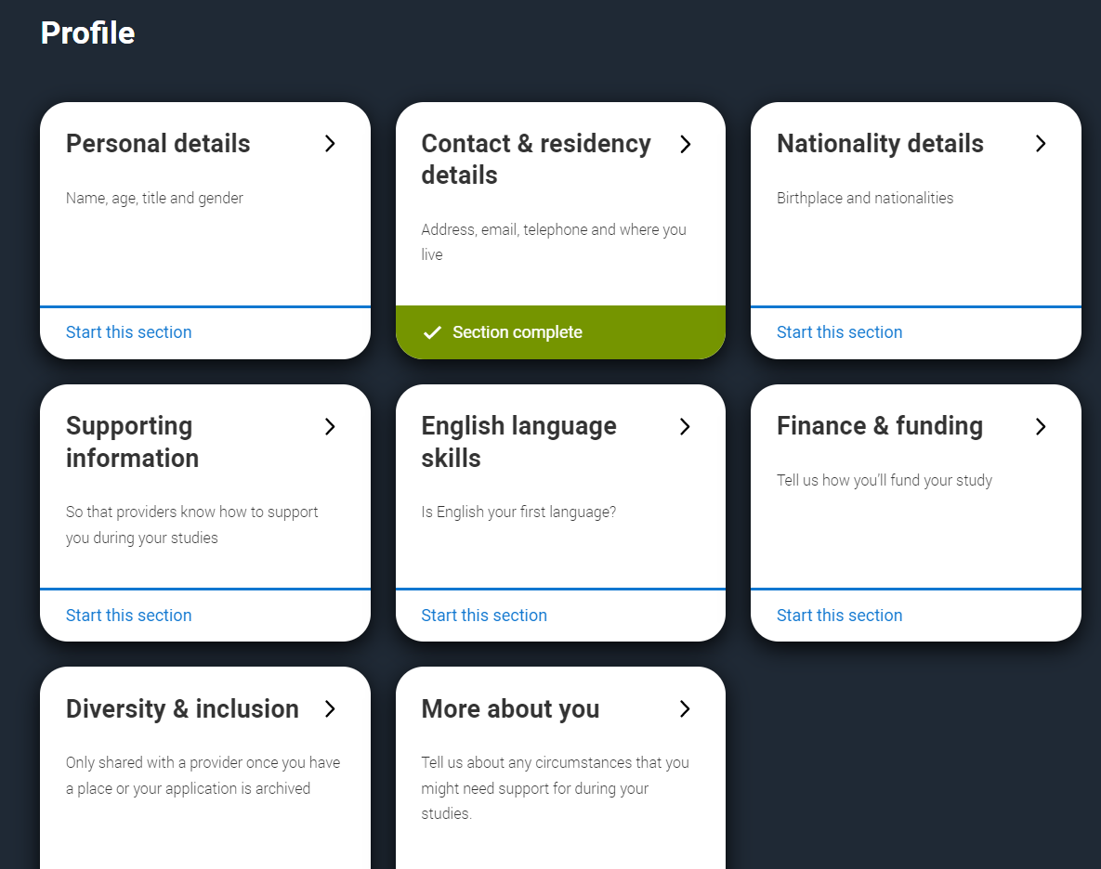
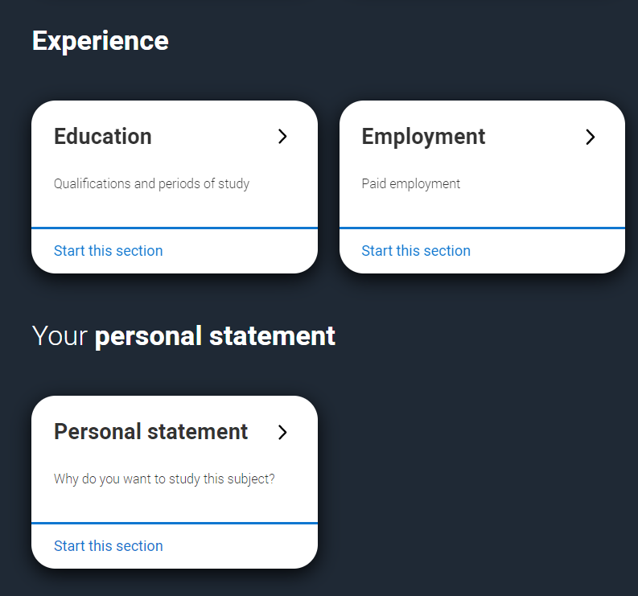
UCAS Application Form
This is the main body of your application form, and you need to fill out each section. The sections are split into:
Profile
Experience
Personal Statement

Slide 19
Learn all about filling in your UCAS application for uni
St Peter's Catholic School - UCAS Support

Slide 20
How to support the students at home…
1. Encourage early preparation
Help students start researching courses and universities early
Attend open days and look at entry requirements together
2. Support with organisation and deadlines
Keep track of key UCAS deadlines (especially Oxbridge/Medicine in October)
Help students manage time alongside schoolwork
3. Help review the personal statement
Check spelling, clarity, and structure
Encourage students to reflect on experiences (work experience, reading, hobbies)
Avoid writing it for them — universities want the student’s voice
4. Offer encouragement and realistic choices
Help students choose a balanced list (1 aspirational, 2 realistic, and 2 safe options)
Be supportive — the process can feel stressful
5. Encourage wider reading and super-curriculars
Support students in reading around their subject
Podcasts, lectures, documentaries, books all help

Slide 21
The reference
Tutors will write the reference using subject teacher information
These will always be created to reflect positively on the student, but will be based on evidence
Specific structure : information about school, Extenuating Circumstances and additional information about the student

Slide 22
Predicted grades
Calculated from the assessment data throughout year 12
Mock exams Pre and Post Summer
Professional judgement of each student's independent work ethic throughout the year to date. (Requests for additional work, support, emails etc)
Post Summer Mocks = Wed 2nd Sept – Tuesday 8th Sept)

Slide 23
Predicted grades….
In the student booklet it says:
DO NOT PUT PRESSURE ON TEACHERS TO CHANGE YOUR PREDICTED GRADES. A CAREFUL AMOUNT OF CONSIDERATION WILL HAVE GONE INTO THESE PREDICTIONS FROM THE OUTSET. TRUST THAT THE GRADES WE PREDICT ARE THE GRADE YOU ARE MOST LIKELY TO GET.
Universities can (and will) ask for assessment data to support our predictions in cases where the GCSE grades and the predicted grades do not match.
The grades reflect the course difficulty. We do not want to set your child up to fail and be disappointed in the summer!

Slide 24
Predicted grades
Students who would like to try and provide evidence to improve this grade will be advised to do the following things…
Evidence the extra work they are doing alongside their set studies to show effort and motivation to improve.
A post summer assessment will be conducted to provide evidence of improvement in assessment style conditions.

Slide 25
Opportunity to improve predicted grades - Scenario 1
Grades you’ve been getting all year - E D C C C C C
Current prediction - C
Prediction you want - A*

Slide 26
Opportunity to improve predicted grades - Scenario 2
Grades you’ve been getting all year - E D C C C C C
Current prediction - C
Prediction you want - B

Slide 27
Post Summer Assessments
An opportunity to improve predicted grades
A check on whether Sixth Form is the right option for you
Can reflect on progress and what is required in year 13
Basis for conversations with yourself and your parents

Slide 28
Q and A
Other Pathways Apprenticeship or Degree Apprenticeship
Search apprenticeships | UCAS
Find an apprenticeship - GOV.UK
Rate My Apprenticeships - National Apprenticeship & Education Events
Alternatives To University | NGTU
Careers Team - Emails

Slide 29
Degree Apprenticeships
Key Benefits
No tuition fees
Earn a salary
Gain real work experience
Strong career prospects
Often leads to a full-time job
Things to Consider
Very competitive
Less traditional university lifestyle
Need to balance work + study
Limited flexibility (employer + course)

Slide 30
Q and A
Scholarships, bursaries & grants
  Search | | UCAS
  Uni Websites
  Student Finance England
  Charities and Organisations

Slide 31
Q and A
SEND Disclosure
UCAS Application – has no bearing on offers
Universities will then be in contact to discuss necessary support if any if required

Slide 32
Student Finance

Slide 33
Thank you for listening. Any questions?

