Slide 1
Steps to successful revision:
Blurt the topic.​
Make a mind map, adding new information that you didn’t remember when blurting.
Challenge yourself by having a go at the practice paper.
What you need to revise for your upcoming assessment:
Language analysis (including topic sentences)
Structural analysis (including topic sentences)
Evaluation (including topic sentences and embedding evidence)

Slide 2
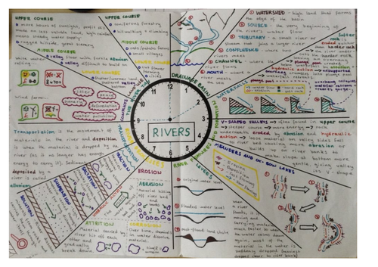
Blurting
What is the Blurting method and how can you use it to revise? - YouTube
Write a topic in the centre of a page.
Blurt from memory everything you know about the topic.
Check what you have written using your book or a revision guide. Correct it using a different colour.
Add extra facts/information using a different colour.
Revise the new information.
Repeat these steps until the topic is memorised.

Slide 3
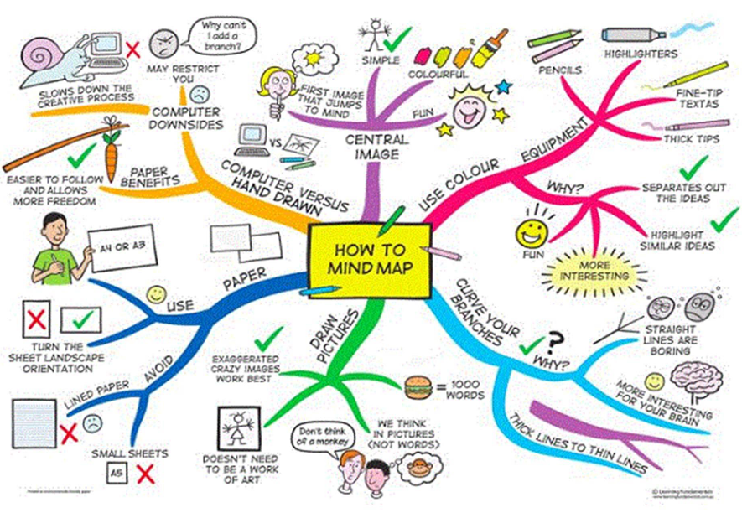
Mind maps
GCSE - How do you revise? (Mind map) - YouTube

Slide 4
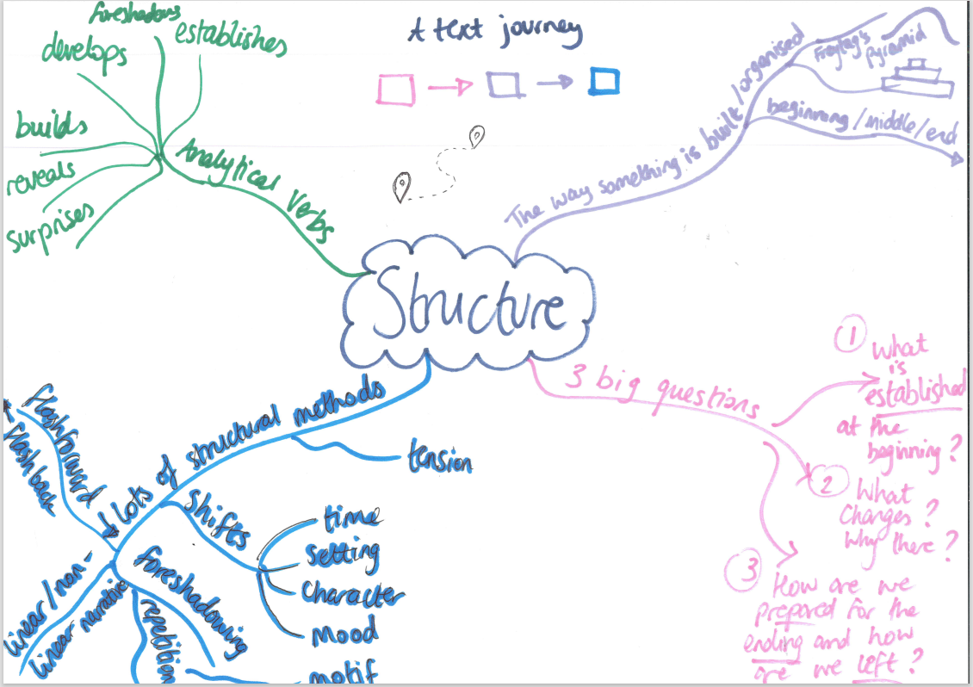
Here is an example mind-map based on structural analysis in English.

Slide 5

Recap- Analysing language
Analysing language is the process of examining how writers use specific language choices to convey meaning, create effects, and achieve a particular purpose.
You might examine things like:
Specific word choices- verbs, adverbs, adjectives, etc.
Figurative language- similes, metaphors, imagery, personification

Slide 6

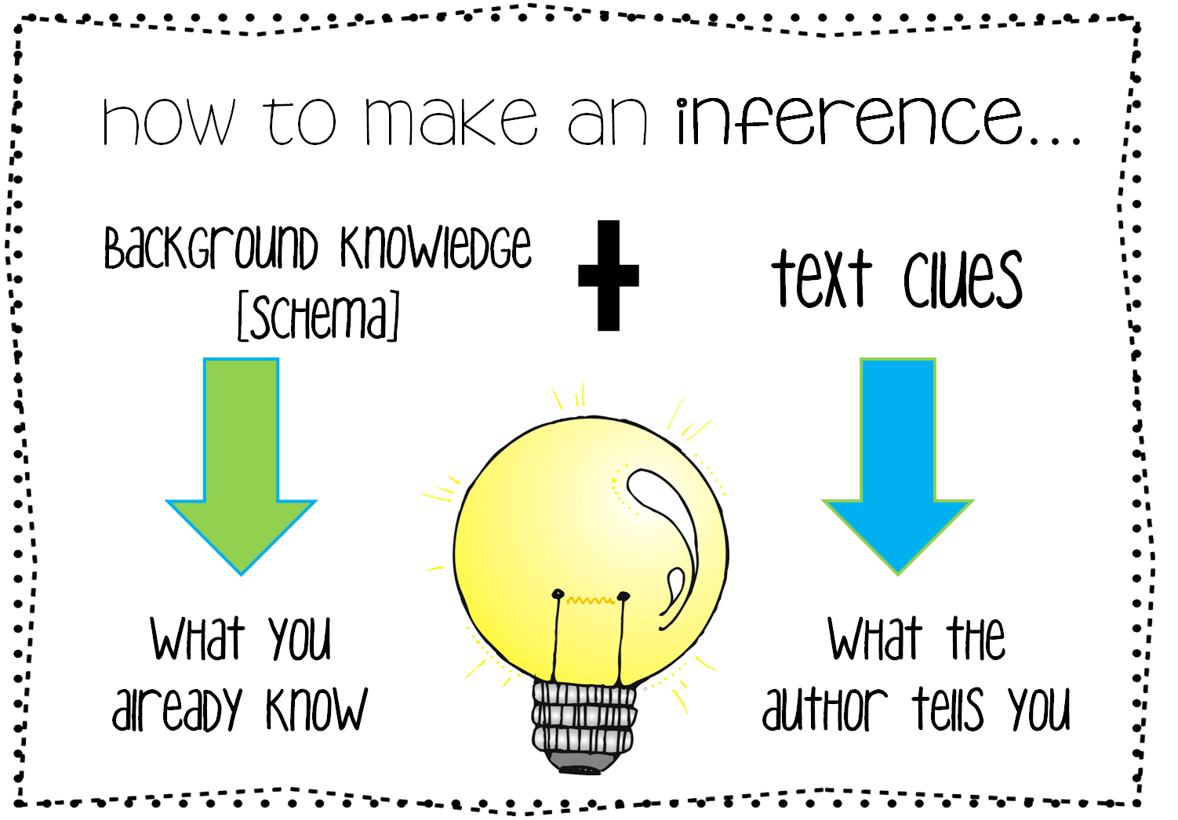
Deduction
Inference
To infer: to draw conclusions that go beyond the literal meaning of the text or situation. It's about understanding what is implied but not explicitly stated.
To deduce: arrive at (a fact or a conclusion) by reasoning; draw as a logical conclusion.

Slide 7
Key vocabulary
When exploring a vocabulary choice made by a writer, you can look at meanings and connotations.
Meaning = the definition of a word
Connotation = emotions and ideas suggested by a word in addition to its literal meaning.
Example: She shouted at the class for their poor behaviour.
Meaning = To speak in a loud voice
Connotation = anger, aggression, frustration
Notes:
Add definition to vocabulary sheet

Slide 8
Vocab choices in context
The same word can have different connotations depending on how it is used and therefore, it is essential that you understand the context in which the word is being used.
Shouted
Meaning = To speak loudly
TASK: How are the connotations of ‘shouted’ different in each example below?
When Taylor Swift came on stage, she shouted at the top of her voice.
He saw the puppy run out into the road and shouted at his dad to stop the car.
His sister had gone into Luke’s room without his permission and so he shouted at her.

Slide 9


What picture do these words create?
How do these word choices make us feel?
The morning burned so August-hot, the marsh's moist breath hung the oaks and pines with fog. The palmetto patches stood unusually quiet except for the low, slow flap of the heron's wings lifting from the lagoon. And then, Kya, only six at the time, heard the screen door slap. Standing on the stool, she stopped scrubbing grits from the pot and lowered it into the basin of worn-out suds. No sounds now but her own breathing. Who had left the shack? Not Ma. She never let the door slam.
What is the mood or tone the writer is intending to create?
Notes:
The tone of the fiction extract is tense and foreboding, with a subtle undercurrent of loneliness and uncertainty.
Key words/ideas that support this:
“burned so August-hot” – The oppressive heat sets a heavy, stifling atmosphere, often used to reflect emotional tension.
“the marsh’s moist breath” / “fog” – Personifying the marsh adds a slightly eerie, surreal feeling. Fog implies obscurity or confusion—mirroring the character’s uncertainty.
“unusually quiet” – Implies that something is off or unnatural, setting the reader on edge.
“low, slow flap” – The deliberate pacing of this auditory image adds to the suspense, contrasting normal vibrant life with a slowed-down, almost watchful moment.
“screen door slap” – A sudden, jarring sound that breaks the silence, signaling change or danger. It’s also a turning point in the scene.
“No sounds now but her own breathing” – Emphasizes isolation and anxiety, drawing the reader into Kya’s perspective.
“Not Ma. She never let the door slam.” – Introduces the idea of something being wrong, suggesting abandonment or something worse.

Slide 10
TASK: You need to change the selected sections to create a bright, positive tone instead.
What picture do these words create?
How do these word choices make us feel?
Example: The morning glowed with golden August warmth, and a light mist drifted gently among the oaks and pines like a soft veil. The palmetto patches basked peacefully in the hush, broken only by the graceful sweep of the heron’s wings rising from the sparkling lagoon. Then, Kya, only six at the time, heard the screen door click shut behind someone. Standing on the stool, she paused from scrubbing the last bits of grits and let the pot sink into a basin of sudsy water. All was still for a moment, save for her gentle breathing. Who had stepped outside the shack? Maybe Ma, out to pick flowers—she always closed the door with care.
What is the mood or tone the writer is intending to create?
Notes:
Key Tone Shifts:
“burned” → “glowed” and “August-hot” → “golden August warmth”: transforms oppressive heat into welcoming sunshine.
“moist breath hung” → “light mist drifted gently”: replaces heaviness with softness and lightness.
“unusually quiet” → “basked peacefully”: replaces unease with tranquility.
“low, slow flap” → “graceful sweep”: makes the heron’s movement elegant, not ominous.
“slap” → “click shut”: removes harshness and replaces it with gentler sound imagery.
“No sounds now but her own breathing” → “All was still for a moment, save for her gentle breathing”: shifts isolation into peaceful calm.
“Not Ma. She never let the door slam.” → “Maybe Ma, out to pick flowers—she always closed the door with care.”: replaces worry and suspicion with hope and warmth.

Slide 11
What method is this?
What are the connotations of this word?
Is there anything else interesting about this word choice?
Is this word worth analysing? What is there to say?
What are the connotations of this word?
What do the connotations suggest about the swamp?
What method is this? Link to the start.
“Swallowed the light in its muddy throat”
Light is often associated with life, hope, and clarity- -> By saying the swamp swallows light, the writer implies it swallows life and hope too.
“Muddy” conveys filth, heaviness, and lack of purity (not that interesting on its own). “Throat” personifies the swamp as something with a gaping, consuming mouth—an unsettling, almost monstrous image.
-> Together, “muddy throat” suggests suffocation, dirt, and an inability to breathe or escape.
Suggests aggression and finality: once something is swallowed, it’s gone and cannot escape.
-> Implies the swamp doesn’t just block light but devours it completely.
Creates a sense of darkness, mystery, and even danger.
Personification- makes the swamp seem alive and like it is deliberately (perhaps maliciously) taking the light-> predatory

Slide 12

Exploring effect
Tenor Vehicle Ground
Exploring the ground of a writer’s metaphor can help us unpick the intended effects on the reader.
The very name Barry Tamerlane was enough to make you feel an icy hand reaching into your stomach.
McEwan shows the impact that bullying can have on someone’s emotional and physical wellbeing.
McEwan presents a cold hand as a terrifying and deathly experience.
Barry’s bullying makes you feel physically sick.
Notes:
Discuss with the class the ground for this example before discussing the effects of the choices of McEwan’s words

Slide 13

Recap- Analysing structure.
Structure is the way that something is built or organised.
When we analyse structure, we need to look at the order of events.
When we analyse structure we consider:
What is established at the beginning?
What changes? Why there?
How are we prepared for the ending and how are we left?

Slide 14
Recap- Analysing structure.
When a writer is planning a piece of fiction, he or she must think about guiding the reader through it in a way that makes it clear and effective.
Ideas must be introduced in an order which effectively reveals information to the reader and helps them to the ‘see’ what the writer intends in the order they intend it.
This is similar to the way that a film director structures a film, by selecting camera shots.

Slide 15

The 3 questions to ask
What is established early on? What ideas become important later?
What changes? Why there?
How are we prepared for the ending and how are we left?

Slide 16
Structural Methods | Structural Effects
Focuses on Establishes Develops Concludes Contrasts Zooms in Zooms out Repetition Shift in tone/focus Withholding information Linear/non-linear structure Flashback Motif | Establishes Develops Builds Shifts Changes Contrasts Transforms Prepares Reveals Foreshadows Concludes Leaves us… Prepares us… Connects Suprises Repeats
Notes:
You may want to get the students to stick this slide in their books

Slide 17


The writer…
Builds…
Develops…
Contrasts…
Intensifies…
Reinforces…
Highlights…
Foregrounds..
Isolates…
Layers…
Begins…
Maintains…
Juxtaposes…
Sequences…
Shifts…
Introduces…
Emphasises…
Constructs…
Organises…
Guides…
Anchors…
Analytical Verbs
Use different analytical verbs to track the story over time. E.g.:
At the beginning the writer establishes…
Later, the writer builds towards…
At the end, the writer reveals…

Slide 18

Recap- Evaluation
Evaluation means making a judgment about something—like a book, a character, or a writer’s choices—by thinking carefully about how well it works and why.

Slide 19
What do we mean by ‘evaluation’ in English?
Example evaluation task:
‘Dracula is presented as a threatening character, and we can understand the terror he creates in others.’ To what extent do you agree?
What are we evaluating here?
What would we have to do to complete this task properly?

Slide 20
What does evaluation look like?
I strongly agree that Dracula is presented as a threatening character, especially in the early parts of the novel. The writer uses powerful and chilling descriptions to create fear—for example, when Jonathan Harker sees Dracula crawling down the castle wall like a lizard. This image is unnatural and disturbing, which makes the reader feel uneasy and shows how terrifying Dracula is. Also, Dracula’s ability to control others and appear suddenly without warning adds to his threatening nature. We can understand why other characters are terrified, because his behaviour is mysterious and dangerous. Overall, the way he is described makes him seem like a real threat, and this helps the reader share the fear felt by characters like Harker and Mina.

Slide 21
These aren’t evaluative sentences because they don’t think about the writer’s choices and how well they work.
Dracula lives in a castle and Jonathan Harker visits him. He sees Dracula climbing on the walls.
Dracula has sharp teeth and drinks blood from people. He is a vampire.
The characters are scared of Dracula because he appears suddenly and he’s different from them.
TASK: How could we re-write these to make them evaluative? Look at the example on the previous slide to help you.

Slide 22
Below are some evaluation questions you looked at last year:
‘Gothic fiction is more effective than Dystopian fiction in exploring human fears.’
To what extent do you agree?
‘In ‘The Crossover’ we feel more empathy for JB’s character than Josh’s.’
To what extent do you agree?
"The ending of The Crossover gives the story a powerful and satisfying conclusion.” To what extent do you agree?
Explain your response using evidence from the ending of the novel.

Slide 23
On a scale of 1-10, to what extent do you agree based on your exploration of the text today?
This part of the text where Mrs Mallard reacts to the news of her husband’s death makes us feel both pity and joy for her.
To what extent do you agree?
Completely agree
Completely disagree
1 | 2 | 3 | 4 | 5 | 6 | 7 | 8 | 9 | 10

Slide 24


Topic Sentences
LO. To develop our analytical writing skills.
The first part of an analytical paragraph is a clear, well-constructed topic sentence.
Recall task: What do you think a topic sentence is?
What should be included in a topic sentence?

Slide 25
Topic sentences
LO. To develop our analytical writing skills.
How is the character Josh Bell established in the exposition of the novel?
Success criteria:
Author’s name
Key words of the question
Writer’s methods
Links to Big Ideas
Targeted analytical verbs
Author
Method
Alexander uses metaphorical language to
demonstrate Josh’s
confidence in his basketball skills
in the exposition of the novel.
Analytical Verb
Big Idea
Key Words
Notes:
Students should not need to spend too long – recapping only

