Slide 1

Year 9
RE Assessment
Revision

Slide 2
Wednesday, 07 October 2026
Revision
Do it now
Fill in your name and teacher’s name on the revision booklet.
Complete the mind map on page 2. What do you remember about the conscience?
Conscience…

Slide 3
The RE Assessment
What to expect:
The assessment will take 45 minutes.
There will be 3 sections:
1) 10 multiple choice questions
10 knowledge questions
A section with an A/B/C type exam question. (There will be 2 of each.)

Slide 4
The following is list of questions you need to be able to answer to be successful in your RE assessment.
Conscience
What are the different ideas about conscience and how it is formed?
What are some different moral situations and dilemmas where conscience is used?
How does a conscience help make a moral decision?
What are the problems with relying on the conscience?
What is freewill and how does it link to the conscience?
What happened in the story of the Fall?
What is forgiveness, temptation and how does it link to the idea of conscience?
Why is the conscience important in Catholic teaching?
Sanctity of Life
What is the meaning of ‘sanctity of life’?
Why do Catholics believe that life is sacred?
What is the difference between pro-life and pro-choice?
What is abortion?
Why is the Catholic Church opposed to abortion?
What are some reasons people want the right to have abortions?
Revision List

Slide 5
What do you remember about conscience?
Conscience…

Slide 6
Conscience
Moral act
Amoral
Immoral
Non moral act
Psychology
Freewill
Forgiveness
Fill in the meaning of the key words.

Slide 7
FEEDBACK
Conscience | A person’s moral sense of right and wrong
Moral act | An act which is good or acceptable, something a student should do.
Amoral | Lacking a moral sense.
Immoral | It is a sin, something that is considered wrong to do.
Non moral act | An act that is neither right or wrong, just a choice.
Psychology | The study of the human mind and its functions.
Freewill | The ability to choose what you do in a given situation.
Forgiveness | To stop blaming someone for a wrongdoing.

Slide 8

Different ideas about the conscience

Slide 9
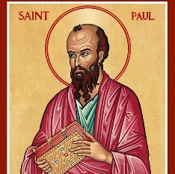
St Paul
According to St Paul our conscience is not the sole source of the moral judgement. It can be wrong; it therefore needs direction and illumination through the Bible and Church. It is a witness rather than a judge.

Slide 10
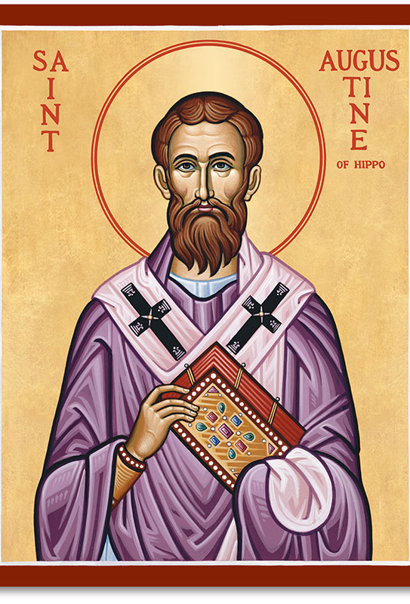
St Augustine of Hippo
St Augustine believed that conscience was literally the voice of God, informing us of what is right and wrong, and we receive this message intuitively. Augustine said that all goodness comes from God and God knows our actions and the choices behind those actions directly.

Slide 11
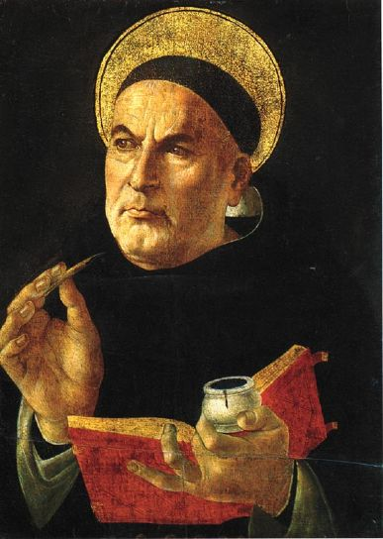
St Thomas Aquinas
Natural Law Theory.
‘Do good, avoid evil’
we have a law ‘written on our hearts’ naturally - we are all born with it and don’t have to learn it.
Our conscience must be properly formed.

Slide 12
St Thomas Aquinas
He developed Five Primary Precepts which he explained were known by all people.
A good action was one which followed the Primary Precepts.

Slide 13
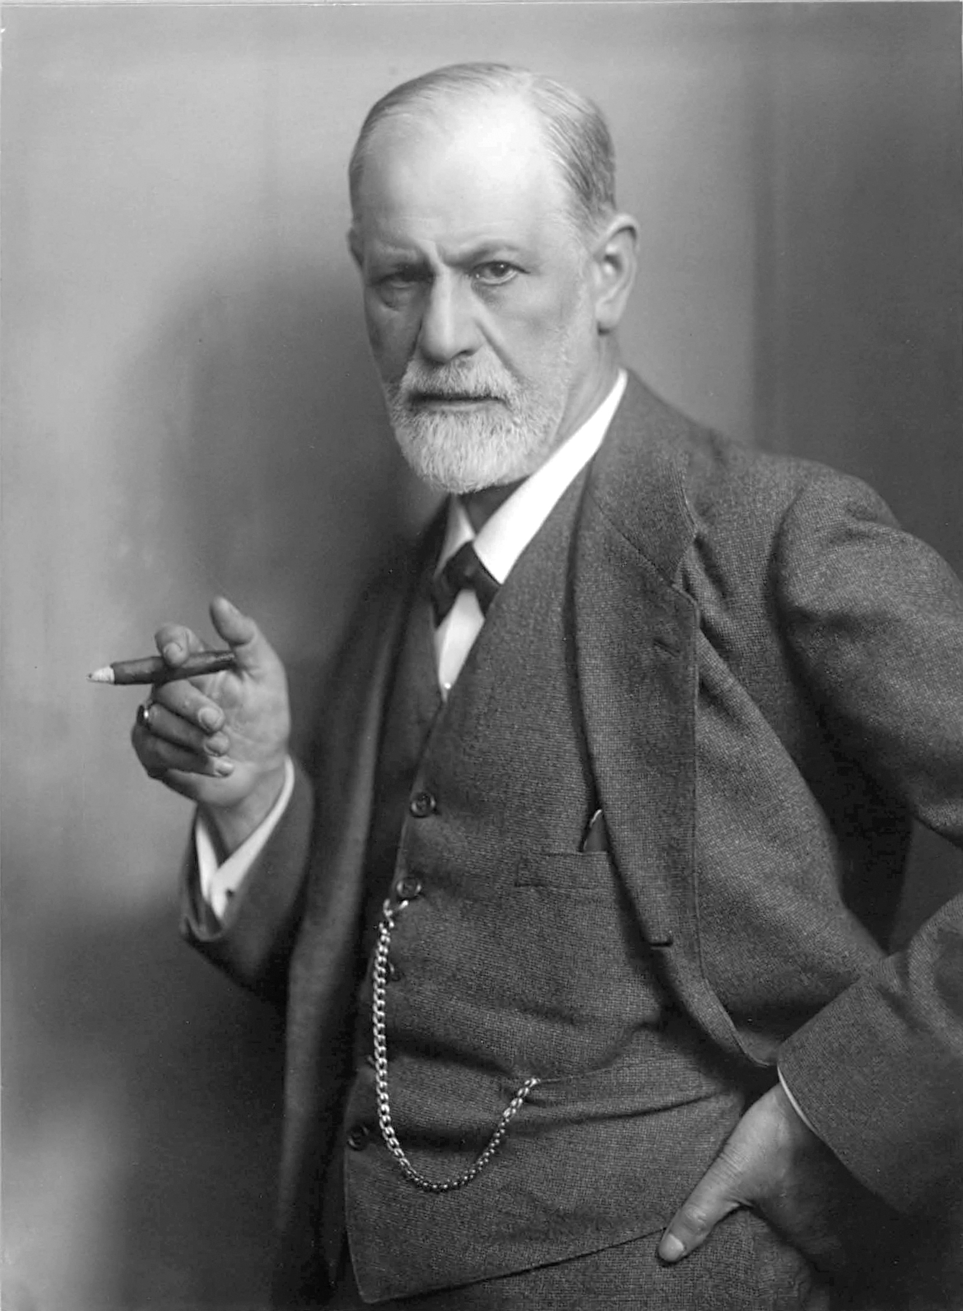
Freud
Freud (1856-1939) was a psychologist.
He believed that people did have a conscience but that it was not from God.
He believed that our conscience actually comes from parents, teachers and authority figures such as police.
When we are babies, we are rewarded for good behaviour and punished for bad behaviour.
Freud believed that we remembered these rules and felt good when we followed them but bad when we did not.
He believed we created for ourselves an inner voice that acted like a parent or lawgiver.
For Freud, this is what the conscience is. God is merely a figment of a delusional mind.
Notes:
L.O guide:
-To investigate how the …….was so significant to …….(Level 5c)
-To analyse the actions …….compared to that of …….(Level 5b)
-To evaluate how much ……..was influenced by…….(Level 5a/6c)

Slide 14
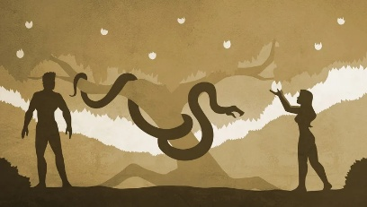
The Fall

Slide 15
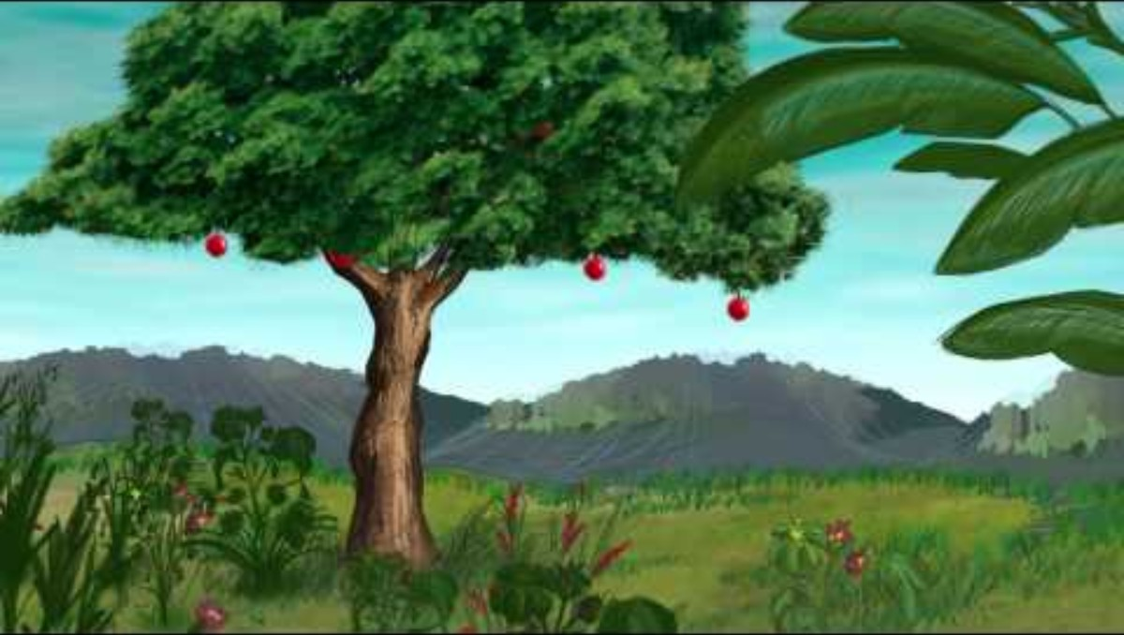

Slide 16
The Fall
Read the story of The Fall.
Summarise into 5 bullet points.

Slide 19
What were the punishments given to the characters in the story of the Fall?
Character | Punishment
The serpent | It had to crawl on its belly and would be stamped on by humans.
The woman | Painful childbirth.
The man | Hard work and labour to work the ground.

Slide 20
Responses to evil and suffering in the world

Slide 21
Theodicy
What is the meaning of theodicy?
An explanation as to how it possible to believe in a loving, omnipotent God if there is evil and suffering in the world.

Slide 22
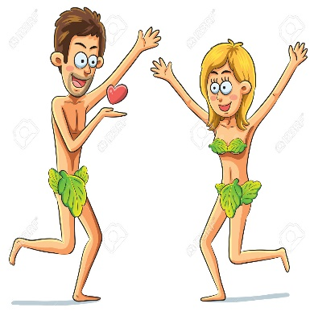
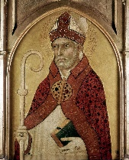
St Augustine’s Theodicy
God is perfect.
God created the world and everything in it.
God, therefore, made a perfect world and everything he created was “good”, including humans and angels.
Evil was not created by God. It is a lack (or privation) of goodness caused by the disobedience of humans.
God does not cause evil but allows it so that humans suffer the consequences of sin.
However, God allows humans to have the opportunity for redemption through Jesus.
Summarise into 3 bullet points.

Slide 23
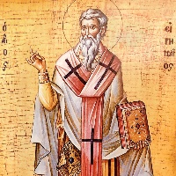
The Theodicy of St Irenaeus
God did not make a perfect world.
There are two stages to human creation.
First, humans are made in the image of God.
Second, humans must develop into the likeness of God.
He thought that God created humans imperfectly in order that they could develop into perfection over time.
Humans need free will.
If humans have free will, they must have the possibility to sin.
The world could not be made perfect as suffering is necessary and the ability to choose good meant that the possibility of evil has to exist.
Summarise into 3 bullet points.

Slide 24
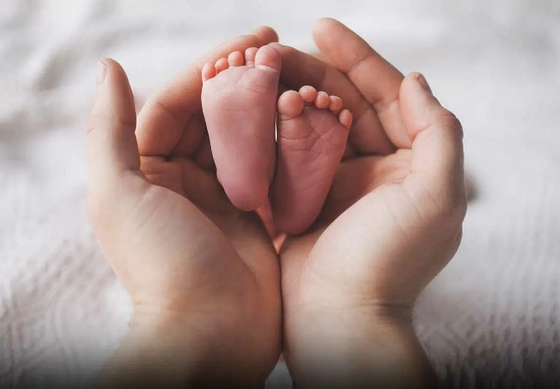
Sanctity of Life

Slide 25
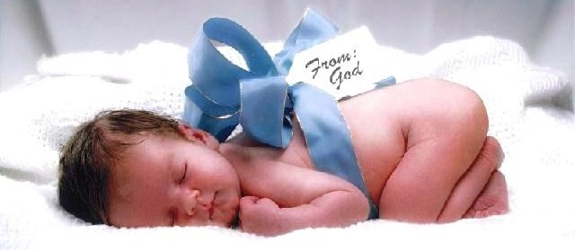

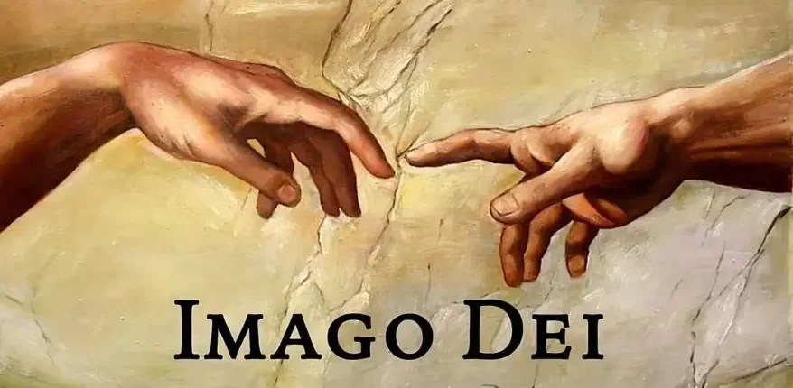
Fill in the meaning of the key words.
Key word | Meaning
Sanctity of life
Imago Dei
Pro-life
Pro-choice

Slide 26
FEEDBACK
Key word | Meaning
Sanctity of life | The belief that life is sacred and belongs to God.
Imago Dei | The belief that humans are made in the image of God.
Pro-life | An anti-abortion view that says that only God can decide when life starts and ends.
Pro-choice | A view supportive of women’s right to choose an abortion. The belief that it is a woman’s body so her choice.

Slide 27


Slide 28
Why do Catholics believe that life is sacred?
Sanctity of life

Slide 29
FEEDBACK
It is the belief that all life is sacred and important, and should be protected and respected at all times.
‘’So God made man to his own image, to the image of God he created him, male and female he created them.” (Genesis 1:27)
It is wrong to take a life.
We are told by St. Paul that our bodies are precious as they have the Holy Spirit within them. Although they belong to us they have come from God and as such should be seen as important.
God knew us before we were born – we are reminded that God has planned life for us.
God knows everything about us and never forgets us. We are special and Holy to God.

Slide 30
Bible teaching about the belief that life is sacred
Bible teaching | How does it show that life is sacred?
“In the image of God, he made them, male and female he made them.” Genesis 1:27
“Do not kill.” Exodus 20:13
“Before I formed you in the womb I knew you…” Jeremiah 1:5
“I came that they might have life, life in all its fullness.” John 10:10
“Your body is a temple of the holy spirit, who lives in you and was given to you by God. You do not belong to yourself.” 1 Corinthians 6:19

Slide 31
Bible teaching about the belief that life is sacred
Bible teaching | How does it show that life is sacred?
“In the image of God he made them, male and female he made them.” Genesis 1:27 | All people have been created by God and made in a way unlike anything else by being in the image of God.
“Do not kill.” Exodus 20:13 | This is one of the basic and most important commandments given by God.
“Before I formed you in the womb I knew you…” Jeremiah 1:5 | God knows us and designed us before we were even born.
“I came that they might have life, life in all its fullness.” John 10:10 | Jesus’ sacrifice was for people to live their life the best it could be.
“Your body is a temple of the holy spirit, who lives in you and was given to you by God. You do not belong to yourself.” 1 Corinthians 6:19 | The body is a gift from God so it is wrong to do anything that harms the body.

Slide 32
What is abortion?
Abortion = the removal of the foetus from the womb before it can survive.

Slide 33

ABORTION – THE LAW:
Legal in Britain up to 24 weeks in a pregnancy.
2 doctors must agree on the following…………..
The mother’s physical or mental health is at risk.
The baby is likely to be born severely disabled.
The birth would have a seriously bad effect on other children in the family.
The law states that only in very exceptional cases is a late abortion permitted if there is a substantial risk that the child would suffer severe physical or mental abnormalities.

Slide 34
https://www.google.com/url?sa=t&rct=j&q=&esrc=s&source=video&cd=&cad=rja&uact=8&ved=2ahUKEwifp5L3npr7AhUBacAKHVZ3Ab4QtwJ6BAgDEAI&url=https%3A%2F%2Fwww.truetube.co.uk%2Fresource%2Fthe-view-from-the-classroom-abortion%2F&usg=AOvVaw3NSR3xAumKYk9DgNrUx-pT

Slide 35
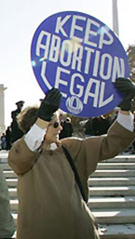
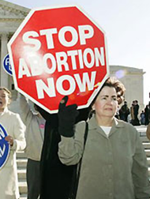
Pro-life vs Pro-choice
Pro-choice
Pro-life
The view which argues that the foetus is a human being, and therefore has a right to live.
The view that a woman should have complete control over her pregnancy.

Slide 36
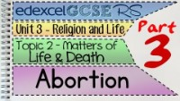
Watch from 5.35

Slide 37
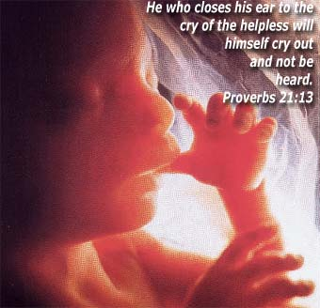
The Roman Catholic View………………..
The Roman Catholic view…
Abortion is always wrong.
Can you remember why????

Slide 38
The R.C. View….
Abortion is always wrong.
Life is Holy and belongs to God and only God has the right to end a pregnancy.
Life begins at conception – abortion is taking a life.
‘Do not murder’
Everyone has the ‘right to life’
Adoption is a better solution

Slide 39
The RC view on Rape and abortion
If a woman becomes pregnant as a result of rape the church teaches that counselling and adoption may be a better option.
This is so that some good can come out of an evil act in a new life.

Slide 40

Progress Check
True or False
Sanctity of Life means that life is only worth living if a person is healthy.
One doctor has to agree to a woman having an abortion.
The legal limit for an abortion is 24 weeks.
The Catholic Church teaches that life begins at the moment of conception.
The Catholic church agrees that an abortion can be allowed if the woman
has been raped.

Slide 41
Progress Check
True or False
Sanctity of Life means that life is only worth living if a person is healthy. (F)
One doctor has to agree to a woman having an abortion. (F)
The legal limit for an abortion is 24 weeks. (T)
The Catholic Church teaches that life begins at the moment of conception. (T)
The Catholic church agrees that an
abortion can be allowed if the woman
has been raped. (F)

Slide 42
Fill in the following table:
Reasons in favour of allowing abortion | Reasons against abortion

Slide 43
Exam questions

Slide 44
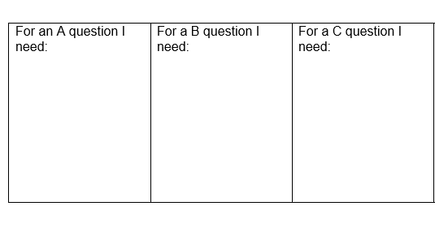
Exam Technique

Slide 45
Exam Technique
Outline three…………………. (3) = Give 3 examples/full sentences.
Explain two…………………..(4) = Write 2 separate paragraphs with a different example in each one.
Explain two…..(add a Source of Wisdom) = Write 2 separate paragraphs with different examples AND a SOWA eg: Bible story/quote/reference to Jesus.

Slide 46
Exam questions:
A) Outline three reasons Catholics are opposed to abortion. (3)
One reason Catholics oppose abortion is…………….
Another reason Catholics oppose abortion is ……
A final reason Catholics oppose abortion is ……..

Slide 47
Exam questions:
A) Outline three reasons Catholics believe that life is sacred. (3)
One reason Catholics believe that life is sacred is…
Another reason Catholics believe that life is sacred is…
A final reason Catholics believe that life is sacred is…

Slide 48
Exam questions:
B) Explain two reasons why some Catholics believe we should use the conscience to make a moral decision. (4)
One reason that some Catholics believe we should usethe conscience is…
This is important because…
Another reason that some Catholics believe we should use the conscience is…
This is important because…

Slide 49
Exam questions:
C) Explain two of the punishments given in the story of the Fall. You must include a source of wisdom in your answer. (5)
One punishment given in the story of the Fall is…
This is important because…
This is supported by… (SOWA)
Another punishment given in the story of the Fall is …
This is important because…

Slide 50
Exam questions:
C) Explain two reasons Catholics believe that life is sacred. You must include a source of wisdom in your answer. (5)
One reason Catholics believe that life is sacred is…
This is important because…
This is supported by… (SOWA)
Another reason Catholics believe life is sacred is…
This is important because…

Slide 51
Exam questions:
C) Explain two reasons Catholics believe we should trust the conscience to make a moral decision. You must include a source of wisdom in your answer. (5)
One reason that some Catholics believe we should trust the conscience is…
This is important because…
This is supported by… (SOWA)
Another reason that some Catholics believe we should trust the conscience is…
This is important because…

Slide 52


