Slide 1
Paper 1 Assessment: revision materials and resources

Slide 2
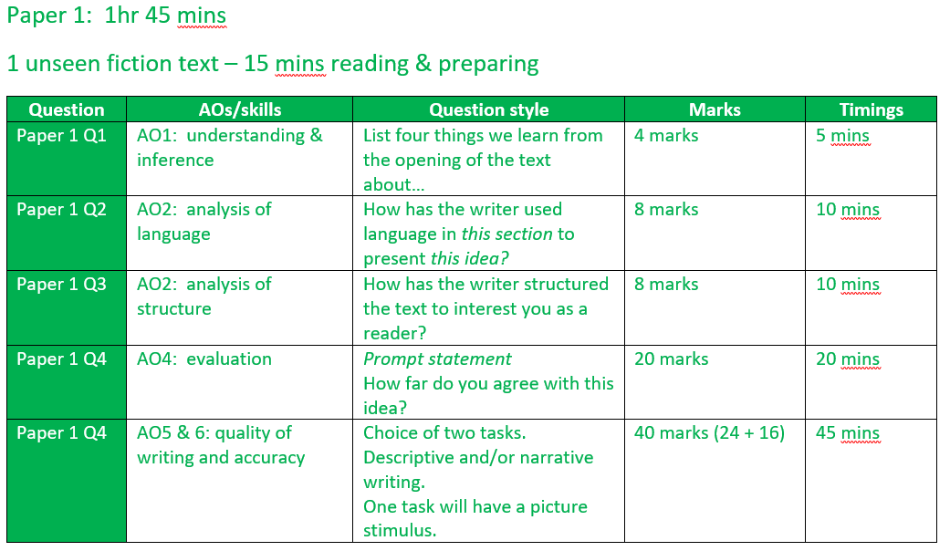
Reading section
Notes:
Annotate on page and talk through skills

Slide 3
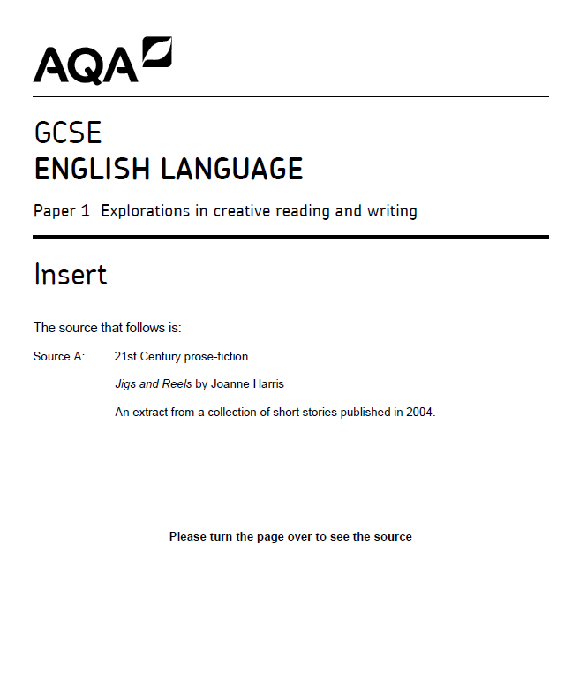

Focus/feel/ideas
 | Focus | Feel | Ideas
Beginning
Middle
End
Notes:
Read together 'Mr Fisher' extract. You could use some comprehension questions for understanding/discuss ideas as class.
Ask students to note their ideas about genre, content, setting and tone.

Slide 4

Section A - Reading

Slide 5



Exploring Language
Language Paper 1
Pre-requisite knowledge:
Where is this going?
Exploring language choices & devising strategies for analysis
Understanding of how word choice impacts the reader
Being able to express yourself clearly & with insight
Learning Journey

Slide 6
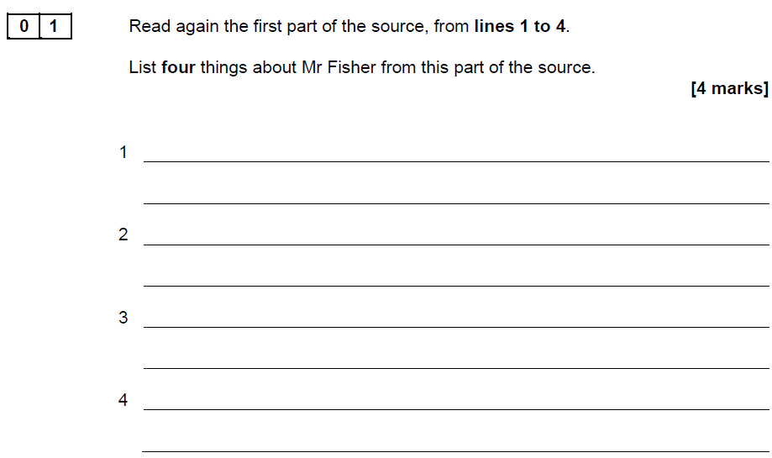
Do not overcomplicate this.
Begin every line with ‘he’ or ‘Mr Fisher’.
You do not need to analyse.

Slide 7
Q2: What do we mean by language analysis?
“And I still have other smothered memories, now unfolding themselves into limbless monsters of pain.”
What can you infer from this sentence?
Why has the writer used the word ‘smothered’?
Why has the writer used the metaphor ‘limbless monsters of pain’?
How has language been used for effect in this sentence? Use the prompts to help you.
What tone is being created by this sentence?

Slide 8

Q2: What are we looking for?
Level | Skills Descriptors
Level 4 Detailed, perceptive analysis 7-8 marks | Shows detailed and perceptive understanding of language: • Analyses the effects of the writer’s choices of language • Selects a judicious range of textual detail • Makes sophisticated and accurate use of subject terminology
Level 3 Clear, relevant explanation 5-6 marks | Shows clear understanding of language: • Explains clearly the effects of the writer’s choices of language • Selects a range of relevant textual detail • Makes clear and accurate use of subject terminology
Level 2 Some, understanding and comment 3-4 marks | Shows some understanding of language: • Attempts to comment on the effect of language • Selects some appropriate textual detail • Makes some use of subject terminology, mainly appropriately
Level 1 Simple, limited comment 1-2 marks | Shows simple awareness of language: • Offers simple comment on the effect of language • Selects simple references or textual details • Makes simple use of subject terminology, not always appropriately
You need to be able to identify interesting words and phrases.
You need to try to explain why they have been used in this text.
You need to comment on the effect on the reader.

Slide 9
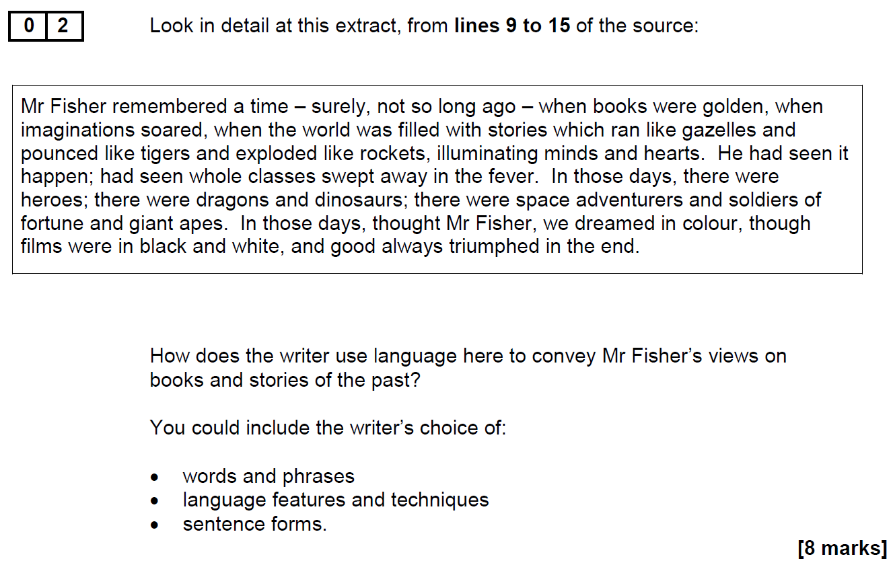

How does this work in an exam?
Focusing on just this section, identify the four most interesting uses of language.
Identify the method used.
Identify the effect of the choices on the reader.
How do these words support the overall message and tone of the extract? Why have they been chosen?

Slide 10
Why are words important?
‘…when the world was filled with stories which ran like gazelles and pounced like tigers and exploded like rockets.’
‘…when the world was filled with stories which ran like treacle and pounced like kittens and exploded like party poppers.’
What’s the difference?
Review your annotations on your word choices.

Slide 11
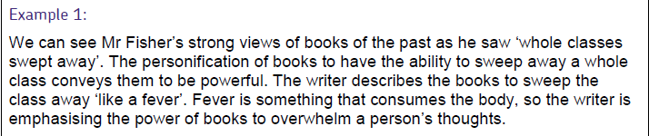
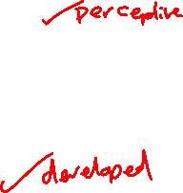
Moving from ‘clear’ to ‘perceptive’
We’d normally consider a ‘fever’ and being ‘swept away’ to be negative or dangerous, so their use here is quite provocative. It is clear that the writer intends for this literary ‘fever’ is intended as a positive in this text, that being ‘swept away’ on this particular wave would be an exciting adventure. Perhaps we would consider both of these ideas as transformative; being ‘swept away’ on these stories could take us to somewhere new, while the ‘fever’ might leave us changed for the better once it abates. Therefore the writer is using this language to suggest that reading, far from being a static action, is actually an adventure into the unknown that opens up new experiences and places to us.
The trick is depth, not breadth. You really need to dig down into the specifics of the word choices and the links you can make to the purpose and intent of the writer.

Slide 12

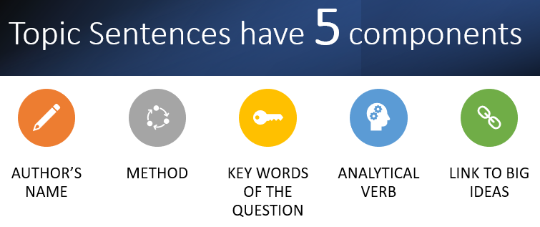
Harris presents Mr Fisher’s views on books as positive ones; he describes them as ‘golden’. The adjective, golden, has connotations of being valuable and precious because it is rare and expensive. This metaphor could suggest that Mr Fisher thinks we are lucky to have books that give us so much pleasure. Fisher thinks about books in the past tense, ‘were’, which implies that he feels nostalgic for how much books excited students in the past. The reader is made to feel sympathy for Mr Fisher because we see how sad he is that students don’t enjoy books anymore like he still does.

Slide 13
Exploring Structure
Language Paper 1
Pre-requisite knowledge:
Where is this going?
Developing systems for exploring structure
Understanding of how a writer organises their narratives
Being able to express yourself clearly & with insight
Learning Journey

Slide 14
What are we looking at?
Structure: the organisation of ideas or information.
You need to be able to demonstrate your understanding of how an author has structured their work.
This involves thinking about how something begins, how it develops, and how it ends.

Slide 15

The 3 key questions
DO NOT SIMPLY SUMMARISE WHAT HAPPENS
1. What is established early on?
What information about characters or plot are presented early in the text that form our opinions and expectations?
Is anything foreshadowed?
Are any false assumptions embedded?
2. What changes? Why there?
Identify a shift in the text – it might be the introduction of a new character, a change in setting, a change in activity, a shift in focus, a flashback etc. Comment on what the change is and why it happens at this point in the text.
3. How are we prepared for the ending & how are we left?
What ideas or themes are built up to make the ending work?
What sort of ending is it?
How does it leave the reader feeling? Is it satisfying or unsatisfying? In what way?

Slide 16
Recap
Read through the Mr Fisher extract, thinking about the structure of the text.
Remember, we are looking for three key questions:
1. What is established early on?
2. What changes? Why there?
3. How are we prepared for the ending & how are we left?

Slide 17
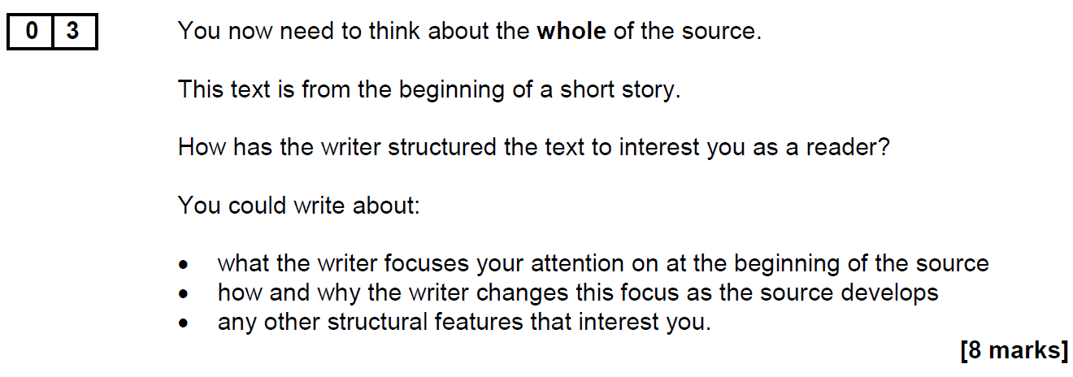
The key skill for Question 3 is the analysis of structure and, as noted previously, in its simplest terms, students are required to examine what happens where and why, usefully asking themselves the question, ‘How does reading about this at this point add to my understanding of the source as a whole?’
From the examiner’s report

Slide 18
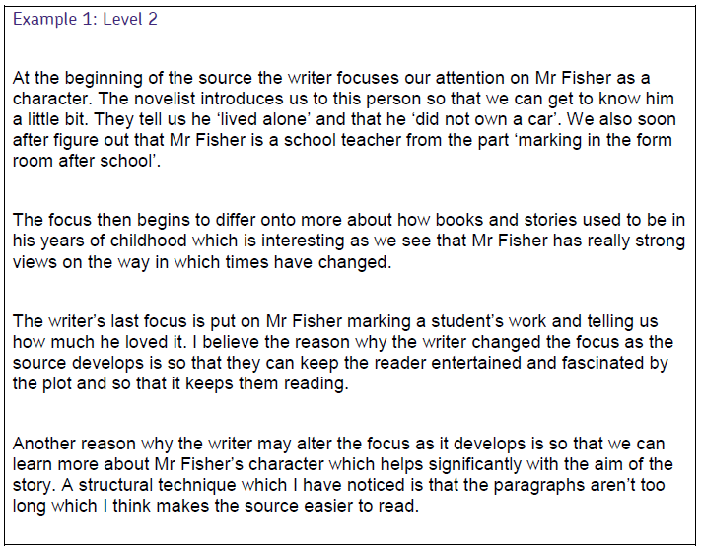
Example answer
This is level 2: ‘some attempts’. Why?

Slide 19
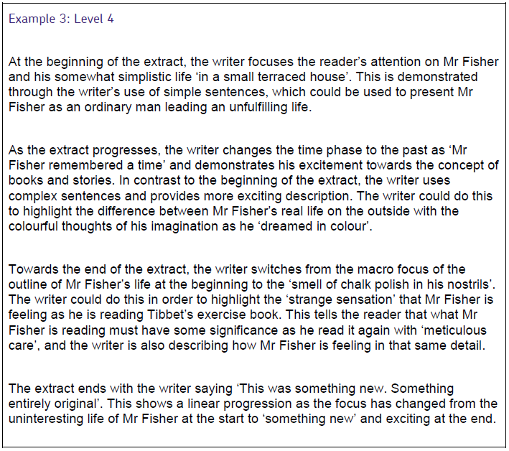



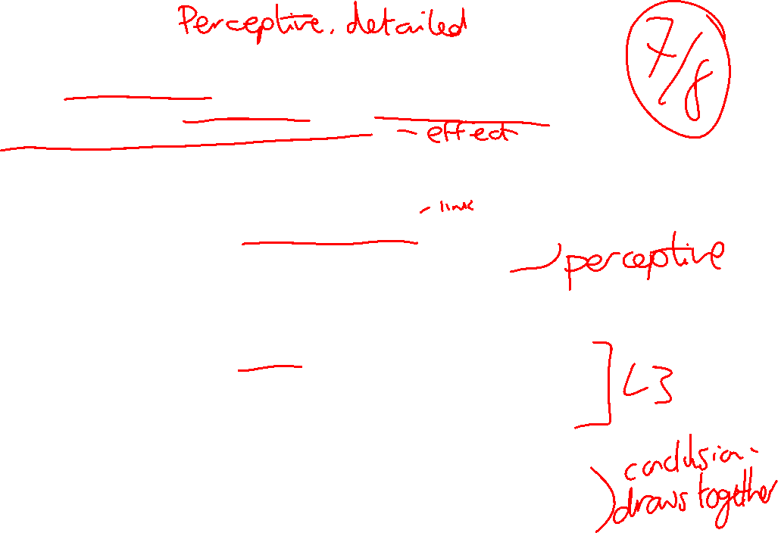
Notes:
Read this once they have written their response. Draw attention to the difference between the band 2 and band 4 response.

Slide 20
The writer begins the text by establishing the central focus of the text: Mr Fisher alone in his classroom marking. The writer creates an increasingly sombre and melancholic tone in the opening moments in order to effectively create contrast later in the text when he is ‘swept away’ by Tibbet’s writing. The gloomy tone is established through the focus on Mr Fisher’s solitary life in his ‘small house’ which encourages the reader to feel a strong sense of pity for him. The writer continues to zoom in on the growing sense of disillusionment felt by Mr Fisher by highlighting how this has been a particularly ‘disappointing term’. The reader is hooked by the growing sense of frustration in Mr Fisher which is later alleviated when he stumbles upon Tibbets’ work.
The focus of the text changes to a different tone when Mr Fisher starts to reminisce about his memories of stories and books in the past when he first started teaching. He describes books as ‘golden’, which creates a feeling to the reader of nostalgia; a time in Mr Fisher’s life that was very important to him. He remembers when books had the power ‘illuminating minds and hearts’, which shows the reader how inspired Mr Fisher used to be about teaching and story-telling. However, the tone suggests that these feelings are no longer there, ‘the magic had run out’, contrasts his feelings with his past experiences. We feel sympathy that he no longer feels the same passion he used to.

Slide 21
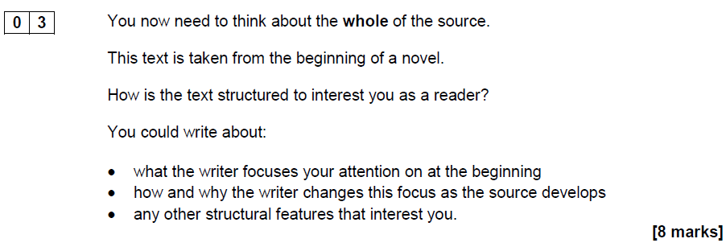
12 minutes

Slide 22
Building Evaluation Skills
Language Paper 1
Pre-requisite knowledge:
Where is this going?
Developing confidence in engaging with opinions
Understanding that writers have specific aims and purposes
Being able to express yourself clearly & with insight
Learning Journey

Slide 23
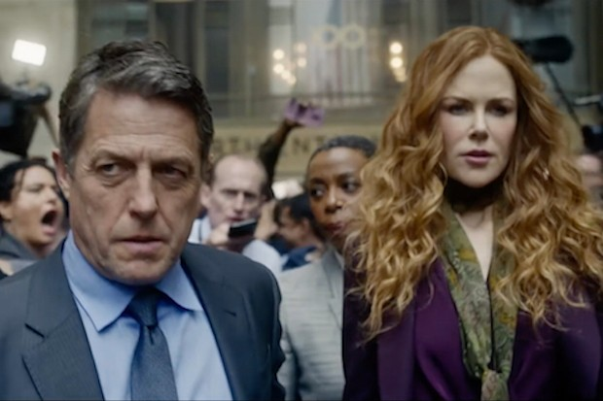
Evaluating an opinion
‘This person feels uncomfortable. It’s as if he doesn’t want to be there’.’
To what extent to you agree?
Key questions:
Do you agree with this statement?
What details in the image have formed your opinion?

Slide 24
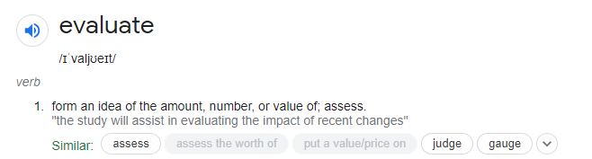
Key Vocabulary

Slide 25
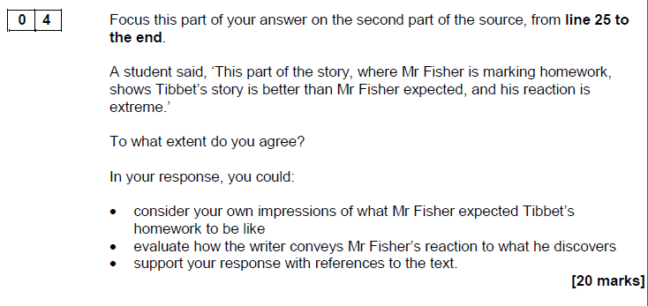
What is this question asking?
Will be on the second half of the source
You will get a prompt statement, giving an opinion about the impact/content of the text
The statement will often have two parts.
You will then be asked for your evaluation of the opinion – is it right or wrong? How do you know?
This is a big question – you’re going to be covering a few ideas, and it should take about 20-25 mins

Slide 26
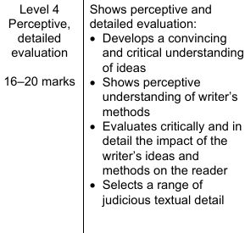




What’s expected?
What Grade 7+ Candidates Must Do:
Offer perceptive and convincing evaluations.
Use a range of precise evidence to justify your points.
Engage critically with the writer’s techniques and their effects.

Slide 27
Key Techniques for higher grades:
Use evaluative language such as "masterfully," "subtly," "expertly manipulates the reader's emotions by…"
Discuss multiple layers of meaning and effects (e.g., how a description affects both the atmosphere and character development).
Focus on complex methods: symbolism, narrative perspective, shifts in tone.

Slide 28
Do NOW: Apply the marker’s checklist to this paragraph. How does it measure up?
‘This extract reveals the horror and desperation of homelessness; it’s impossible not to pity the narrator.’
Marker’s Checklist:
Have you given your opinion on both parts of the statement?
Have you included evidence to back up your opinion?
Have you identified how the writer has helped you to form your opinion – the methods they have used? (Necessary to get to the top of the band)
Have you explained why this evidence has helped you to form this opinion? Can I follow your line of reasoning?
Swindells makes effective use of direct address to fully convey the horror of the narrator’s situation. By creating the impression of a conversation with the reader through rhetorical questions such as ‘settled for the night?’ and idiomatic language like ‘the psycho who’ll knife you’ makes the narrative feel so much more immediate and important; we feel more like there’s a real person behind the words on the page and are able to much more clearly envisage the horror of finding ourselves in the same situation. This direct address forces us to imagine ourselves on the street alongside the speaker: this is in fact the writer’s explicit intention as he tells us he’d ‘sort of talk you through a typical night.’ By sustaining the repeated address to the reader in declarations such as ‘you won’t find it comfy’ and ‘if you manage it’, it positions the reader as the less-knowledgeable member of this conversation and elevates the narrator, inverting the ‘expected’ power dynamic when conversing with someone homeless. The overall impression through the use of this strategy is one of overwhelming horror at the prospect of a single night spent the way the narrator is describing directly to us.

Slide 29
Process
Step 1: Reread the Question and Extract (2 mins): Ensure you know exactly what aspect of the text you're evaluating.
Step 2: Plan a High-Scoring Response (3 mins) Choose 2-3 key writer's methods that are most relevant to the question (e.g., use of imagery, shifts in narrative focus, contrast in tone).
Identify specific evidence (short quotes, clear moments) that illustrate these methods.
Step 3: Write a Detailed Paragraph (10 mins)
Structure your paragraph for maximum precision:
  Evaluation statement: Start with a clear opinion about the writer’s success (e.g., "The writer masterfully builds tension by...").
  Evidence: Integrate short, focused quotes to support your point.
  In-depth analysis: Discuss the technique’s effect on the reader and how it contributes to the overall purpose. Consider multiple layers of meaning.
  Link back to the question: Make sure every point answers the specific evaluation prompt.

Slide 30
What are we looking for?
Evidence to agree or disagree that Tibbet’s story is better than expected.
Evidence to agree or disagree that his reaction is extreme.
Notes:
Model notes/highlighting/annotation

Slide 31
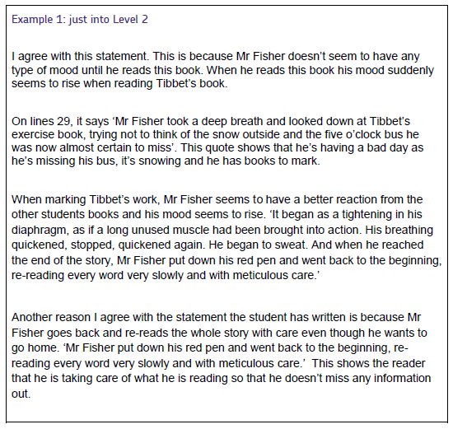
Use the marker’s checklist
Can you identify why this is a level 2 response? Where do you think it is gaining the marks?
Can you identify any missed opportunities? How could we make this better?
Marker’s Checklist:
Have you given your opinion on both parts of the statement?
Have you included evidence to back up your opinion?
Have you identified how the writer has helped you to form your opinion – the methods they have used? (Necessary to get to the top of the band)
Have you explained why this evidence has helped you to form this opinion? Can I follow your line of reasoning?

Slide 32
Notes: lines 25 – the end
Agree or disagree that Tibbet’s story is better than expected. | Agree or disagree that his reaction is extreme.
From your notes, you should now be able to identify the different points you will make for this response.
Notes:
Lots of modelling!
Help them to write the opening and first paragraph (Shared under visualiser?), then continue themselves as a WTM.

Slide 33

To what extent do you agree?
We can disagree with opinion that Tibbet’s work is better than Mr Fisher expected. Before he marks Tibbet’s work, Mr Fisher recognised that ‘there was a spark in him which deserved attention.’ The metaphor, spark, means something or someone we associate with being special. This shows the reader that Mr Fisher already thinks that Tibbet is better than the other students through marking previous work. The phrase, deserved attention, also shows that Mr Fisher recognises that Tibbet is an anomaly in his class and he is prepared to give his time up to help him improve. We can also disagree with the opinion that Mr Fisher’s reaction is extreme because he is doing his job, supporting students in their work.
However, we can agree with the statement when Mr Fisher is reading Tibbet’s work and ‘He began to sweat.’ The verb, sweat, shows an extreme reaction because we associate sweating with being tense and excited. The adverb, began, emphasises to us that it’s Tibbet’s work that has caused this excitement. We can see that he has an extreme reaction to the unexpected work because it seems an overreaction to Tibbet’s writing, which shows us how excited and enthusiastic he is that a student has written something that he’s enjoyed so much.

Slide 34
To what extent do you agree?
We can disagree with opinion that Tibbet’s work is better than Mr Fisher expected. Before he marks Tibbet’s work, Mr Fisher recognised that ‘there was a spark in him which deserved attention.’ The metaphor, spark, means something or someone we associate with being special. This shows the reader that Mr Fisher already thinks that Tibbet is better than the other students through marking previous work. The phrase, deserved attention, also shows that Mr Fisher recognises that Tibbet is an anomaly in his class and he is prepared to give his time up to help him improve. We can also disagree with the opinion that Mr Fisher’s reaction is extreme because he is doing his job, supporting students in their work.
However, we can agree with the statement when Mr Fisher is reading Tibbet’s work and ‘He began to sweat.’ The verb, sweat, shows an extreme reaction because we associate sweating with being tense and excited. The adverb, began, emphasises to us that it’s Tibbet’s work that has caused this excitement. We can see that he has an extreme reaction to the unexpected work because it seems an overreaction to Tibbet’s writing, which shows us how excited and enthusiastic he is that a student has written something that he’s enjoyed so much.
Marker’s Checklist:
Have you given your opinion on both parts of the statement?
Have you included evidence to back up your opinion?
Have you identified how the writer has helped you to form your opinion – the methods they have used? (Necessary to get to the top of the band)
Have you explained why this evidence has helped you to form this opinion? Can I follow your line of reasoning?

Slide 35
Deliberate Practice: 20 mins
Notes:
Model notes/highlighting/annotation

Slide 36
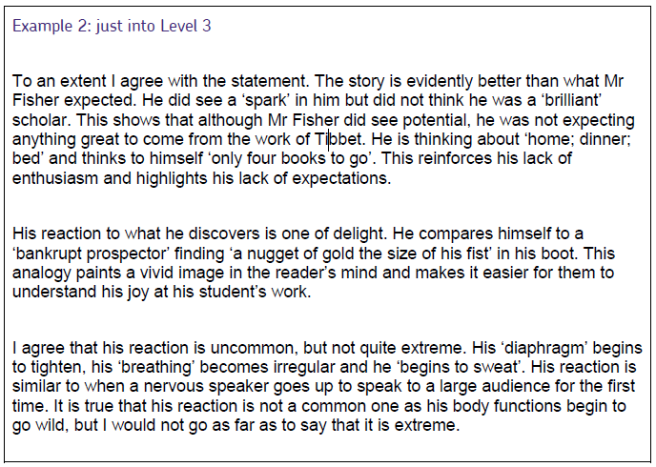
Use the marker’s checklist.
Can you identify why this is a level 3 response? Where do you think it is gaining the marks?
Can you identify any missed opportunities?
Now look at your own response. Are you confident it is a level 3 response? Do you need to add or change anything?

Slide 37
Creative Writing Intro
Language Paper 1
Pre-requisite knowledge:
Where is this going?
Mark scheme
Examples of tasks
Importance of planning to structure
Effective features of creative writing
Types of writing
building independent writing skills
Learning Journey

Slide 38

Section B – Creative Writing

Slide 39
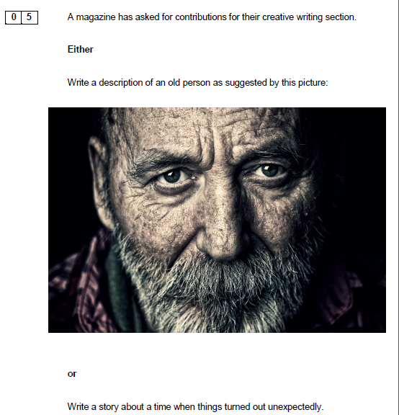
What you might be asked to do
Write a description
Write part of a story
THERE WILL BE A PICTURE PROMPT – this is not a requirement. You can use as much or as little of it as you would like.

Slide 40
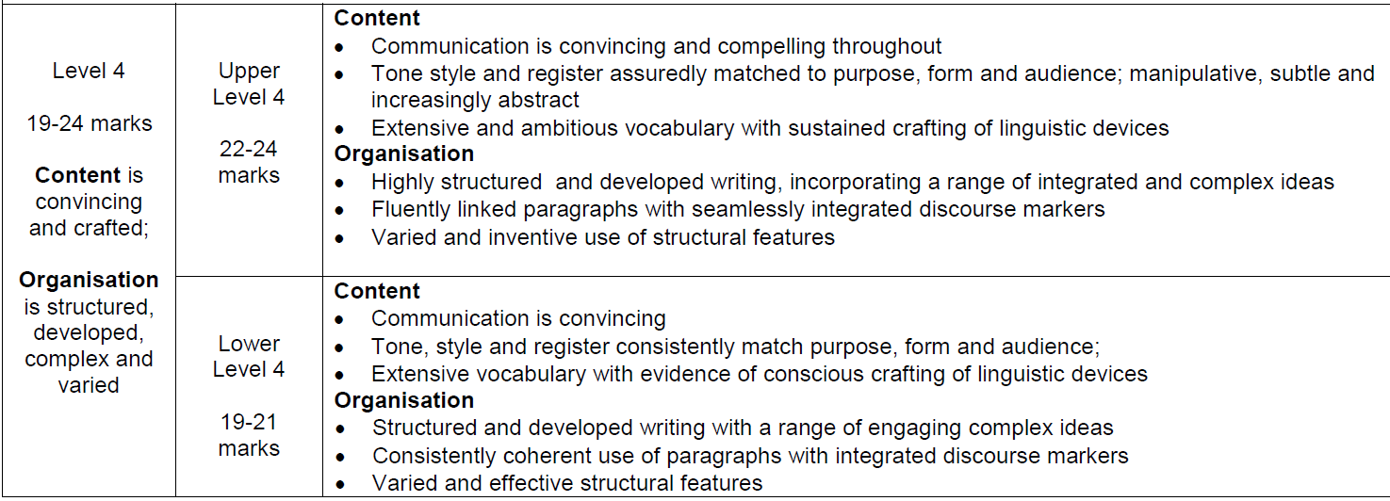
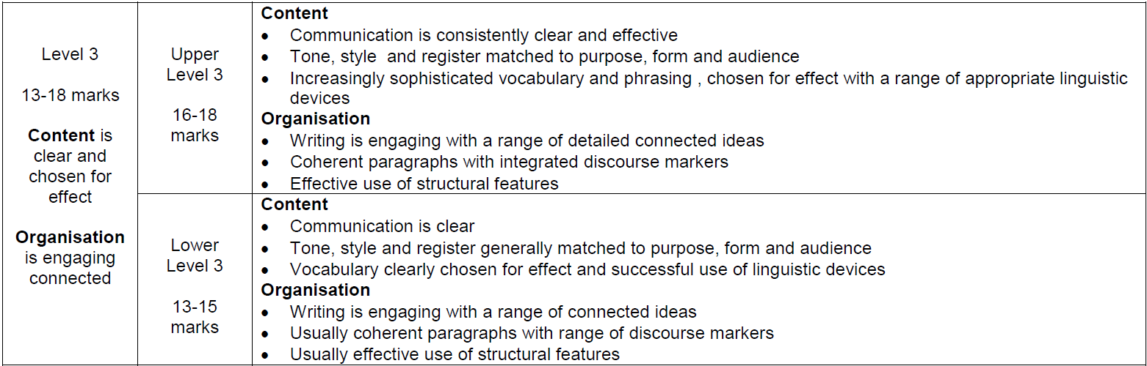
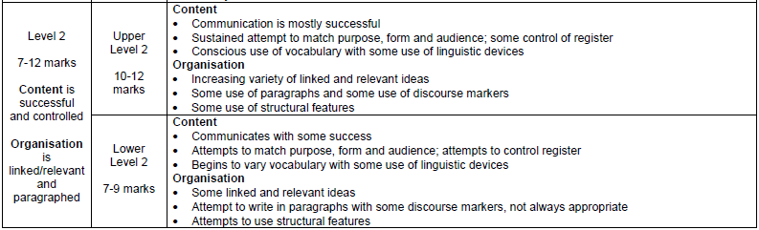
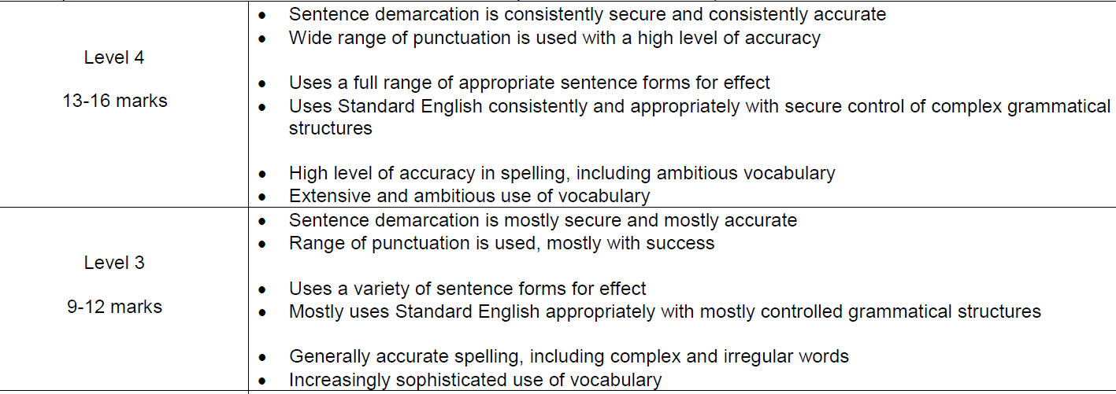
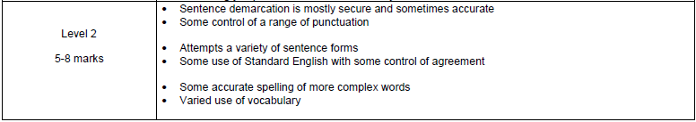
Writing Mark Scheme – Reference Sheet
Content & Organisation - /24
Technical Accuracy - /16

Slide 41
What has been asked before?
Write a story about an unlikely friendship
Write a story about a life-saving rescue
Write a story about a new beginning
Write a story about a magical world, as suggested by…
Write a story about an event that cannot be explained
Write a story with the title ‘abandoned’
Write a story about time travel, as suggested by…
Write a story about a time when things turned out unexpectedly
Write a story about two people from very different backgrounds
Write a story set in a mountainous region, as suggested by…
Write a story with the title ‘discovery’
Write a description of a fishing village, as suggested by…
Write a description of an unusual place to stay, as suggested by…
Describe a place at sunset, as suggested by…
Describe a place you think is beautiful
Write a description of a mysterious place, as suggested by…
Describe a market place, as suggested by…
Describe life as you imagine it in 200 years time
Write a description of an old person, as suggested by…
Describe a journey by bus, as suggested by…

Slide 42
What has been asked?
PLACE
Write a description of a fishing village, as suggested by…
Write a description of an unusual place to stay, as suggested by…
Describe a place at sunset, as suggested by…
Describe a place you think is beautiful
Write a description of a mysterious place, as suggested by…
Describe a market place, as suggested by…
Describe life as you imagine it in 200 years time
Write a description of an old person, as suggested by…
Describe a journey by bus, as suggested by…
Write a story about an unlikely friendship
Write a story about a life-saving rescue
Write a story about a new beginning
Write a story about a magical world, as suggested by…
Write a story about an event that cannot be explained
Write a story with the title ‘abandoned’
Write a story about time travel, as suggested by…
Write a story about a time when things turned out unexpectedly
Write a story about two people from very different backgrounds
Write a story set in a mountainous region, as suggested by…
Write a story with the title ‘discovery’

Slide 43
What has been asked?
PEOPLE
Write a story about an unlikely friendship
Write a story about a life-saving rescue
Write a story about a new beginning
Write a story about a magical world, as suggested by…
Write a story about an event that cannot be explained
Write a story with the title ‘abandoned’
Write a story about time travel, as suggested by…
Write a story about a time when things turned out unexpectedly
Write a story about two people from very different backgrounds
Write a story set in a mountainous region, as suggested by…
Write a story with the title ‘discovery’
Write a description of a fishing village, as suggested by…
Write a description of an unusual place to stay, as suggested by…
Describe a place at sunset, as suggested by…
Describe a place you think is beautiful
Write a description of a mysterious place, as suggested by…
Describe a market place, as suggested by…
Describe life as you imagine it in 200 years time
Write a description of an old person, as suggested by…
Describe a journey by bus, as suggested by…

Slide 44
What has been asked?
CREEPY
Write a story about an unlikely friendship
Write a story about a life-saving rescue
Write a story about a new beginning
Write a story about a magical world, as suggested by…
Write a story about an event that cannot be explained
Write a story with the title ‘abandoned’
Write a story about time travel, as suggested by…
Write a story about a time when things turned out unexpectedly
Write a story about two people from very different backgrounds
Write a story set in a mountainous region, as suggested by…
Write a story with the title ‘discovery’
Write a description of a fishing village, as suggested by…
Write a description of an unusual place to stay, as suggested by…
Describe a place at sunset, as suggested by…
Describe a place you think is beautiful
Write a description of a mysterious place, as suggested by…
Describe a market place, as suggested by…
Describe life as you imagine it in 200 years time
Write a description of an old person, as suggested by…
Describe a journey by bus, as suggested by…

Slide 45
What has been asked?
OPTIMISTIC
Write a story about an unlikely friendship
Write a story about a life-saving rescue
Write a story about a new beginning
Write a story about a magical world, as suggested by…
Write a story about an event that cannot be explained
Write a story with the title ‘abandoned’
Write a story about time travel, as suggested by…
Write a story about a time when things turned out unexpectedly
Write a story about two people from very different backgrounds
Write a story set in a mountainous region, as suggested by…
Write a story with the title ‘discovery’
Write a description of a fishing village, as suggested by…
Write a description of an unusual place to stay, as suggested by…
Describe a place at sunset, as suggested by…
Describe a place you think is beautiful
Write a description of a mysterious place, as suggested by…
Describe a market place, as suggested by…
Describe life as you imagine it in 200 years time
Write a description of an old person, as suggested by…
Describe a journey by bus, as suggested by…

Slide 46
Structure is often the key
Well planned and constructed responses are often the key to doing well.
The more you’ve practiced, the more likely you are to be able to draw on your practiced ideas and combine them to fit the task!
We want to see cohesive responses.

Slide 47
Planning allows you to excel in crafting
We want to see cohesion – how different elements connect together
Using motif, repetition, contrast etc all contribute
There should be a sense of progression and development
There should be deliberate choices – there must be a clear ending!
Editing is imperative – we’ll come back to this

Slide 48

What do these mean for creative writing?
Notes:
Emphasise that shift/zoom are swappable, and can also be repeated

Slide 49
Section | Ideas | Motif | Effect on Reader
Drop
Shift
Zoom
Link

Slide 50

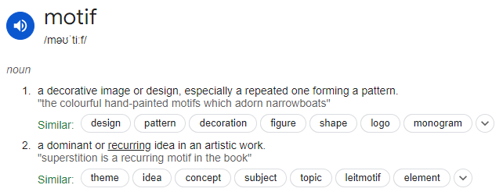
Key Vocab - revision
What is a motif?
Why might this be relevant to creative writing?

Slide 51

Write a description of a childhood experience, as suggested by this picture.
Complete the planning sheet. What would you say?
Consider cohesion
How will you make it interesting to read?
Notes:
Practice task – if time. Or homework?

Slide 52
Mini-Narratives
GCSE Language Paper 1
Pre-requisite knowledge:
Where is this going?
Revising descriptive structures and developing planning
Skills that are being examined
DZSL
Building independent creative writing skills
Learning Journey

Slide 53
Mini-narratives
You should not be aiming to write a full-length epic in these tasks.
You should be focussing on a brief moment in time (think more Pixar shorts vs ‘Game of Thrones’)
Keeping them small and focussed allows you to develop depth and insight – that’s the stuff we really care about.
'Emotionally complex and structurally simple'

Slide 54
Top Tips
Only use 1-3 lines of dialogue. But think carefully about exactly when they come and why they are being used – make them make an impact!
Steer away from big action. Make little moments exciting by developing the detail.
Use your DZSL effectively – what exactly are you zooming in on? Why?
You need to plan your reader’s journey – what are they experiencing at different points?
Example: Mr Fisher extract
D – bored teacher, wintry day
Z – focus on his never-ending marking
S – Tibbet’s story appears
L – complete contrast to the Mr T at the start.

Slide 55
Incorporating Motif & Effect in planning
Section | Ideas | Motif | Effect on reader
Drop
Link
An easy trick to improve your cohesion is to incorporate a motif.
This might be:
Sounds
Colours
A theme
A recurring image
etc

Slide 56


Task: Write a description of a visit to the park, as suggested by this picture
 | Ideas | Motif | Effect on reader
Drop | ‘There she sits…’ Spring day. Birds tweeting. Green of the leaves. Sunlight. World warming up. Smell of warmth, life | ‘There she sits’ Colour – green of the trees | Hope, peacefulness
Zoom | The feel of the sun on her skin, reawakening old memories. The pushing up of shoots – a single flower fighting against the weight of the soil etc. A bird gradually building it’s nest? | Colour – red flower. ‘There she sits’ – quiet and still, oblivious of the raging life all around? | Sense of action, a hidden world revealed. Positive.
Shift | A lifetime in this park. Sat with her boyfriend, later husband, eating ice-creams. Taught her daughter to ride her bike. Walked her grandchildren in their pushchairs. | There she sat… Colour – kaleidoscope of colours and memories | Nostalgia. Warmth.
Link | She sits there watching new young couples, new parents, living their lives here as she did. Misses them. Will continue to visit, watching the colours change and the seasons pass… | So, now she still sits… Colour – fading to orange of sunset, green fading to browns as the seasons pass | Pathos.

Slide 57

Task: Write a description of a morning, as suggested by this picture
Section | Ideas | Motif | Effect on reader
Drop
Link

Slide 58

Task: Write a description of a woodland, as suggested by this picture.
Include:
A metaphor
A simile
A short sentence
A different sentence opening each time
Can you create the feeling of being there?

Slide 59
Tension Tactics
GCSE Language Paper 1
Pre-requisite knowledge:
Where is this going?
Exploring strategies for building tension
Different methods of crafting writing
The importance of structure
Building independent creative writing skills
Learning Journey

Slide 60

What is tension & why is it important?
Tension in writing is a feeling of suspense, anticipation, and uncertainty that keeps readers engaged and guessing about what will happen next. It's created by conflict, which is when something is preventing a character from getting what they want.
Tension is both a strategy and an effect.
You can create, build and develop tension in your writing.

Slide 61
Types of tension
What different types of tension can you think of?
E.g. Internal conflict
Tension isn’t always something bad or scary!

Slide 62
Conflict Tension
Internal Conflict: The character struggles with their own desires, fears, or moral dilemmas.
External Conflict: The tension arises from conflicts between characters, or between a character and an external force
Suspense Tension: Readers are aware of something potentially dangerous or dramatic that the characters do not know, creating a sense of anticipation. Uncertainty about what will happen next builds a tense atmosphere.
Relational Tension: Occurs in relationships between characters. It can be romantic tension, unresolved issues, or rivalry, causing emotional intensity in their interactions.
Moral or Ethical Tension: Characters face decisions that test their morals or ethics, creating tension around what choice they'll make and the consequences of their actions.
Atmospheric Tension: The mood or setting creates a tense feeling. This often happens in horror, thrillers, or dark, eerie scenes where something feels off.
Dramatic Irony Tension: The reader knows something important that the characters do not, leading to tension as the audience anticipates the moment the character finds out. May also involve misdirection.
Emotional Tension: Focuses on the internal emotional states of characters, often involving love, anger, fear, or guilt. Emotional tension often overlaps with other types, especially in complex character development.
Philosophical Tension: The narrative explores different worldviews, ideologies, or beliefs in conflict. This type of tension arises from intellectual debates or existential questions.
Temporal Tension (Time Pressure): Characters are under a time limit, increasing the urgency and tension of their actions and decisions. This is common in action and thriller stories.
Physical Tension: Often used in action scenes where characters are in immediate danger (fights, chases, battles). The tension is generated by the physical stakes involved.

Slide 63
Tension Tactics
Tension Tactics
Building tension in creative writing tasks for GCSE students can be achieved through several techniques. Here are some effective strategies:
Pacing: Vary sentence length to create a sense of urgency. Short, sharp sentences can quicken the pace, while longer, more descriptive sentences can slow it down to build suspense.
Foreshadowing: Drop subtle hints about future events to create anticipation. This keeps readers on edge as they wait to see if their predictions come true.
Dialogue: Use realistic and dynamic dialogue to convey tension. Characters can express conflicting emotions or misunderstandings that heighten the stakes.
Setting: Choose a setting that evokes unease or foreboding. Dark, isolated, or chaotic environments can enhance the tension in your narrative.
Character Emotions: Dive into the characters’ internal conflicts and fears. Show their vulnerability, which can create empathy and tension as readers worry about their fate.
Conflict: Introduce obstacles or conflicts that characters must overcome. This can be internal (within the character) or external (between characters or against forces).
Uncertainty: Keep readers guessing by introducing twists or unreliable narrators. This creates doubt and makes them question what will happen next.
Imagery: Use vivid and sensory imagery to immerse readers in the moment. This can make tense situations more impactful.
Cliffhangers: End sections or scenes with unresolved issues or sudden twists. This compels readers to keep going to find out what happens next.
Symbolism: Incorporate symbols that represent larger themes or fears, adding depth to the tension.

Slide 64
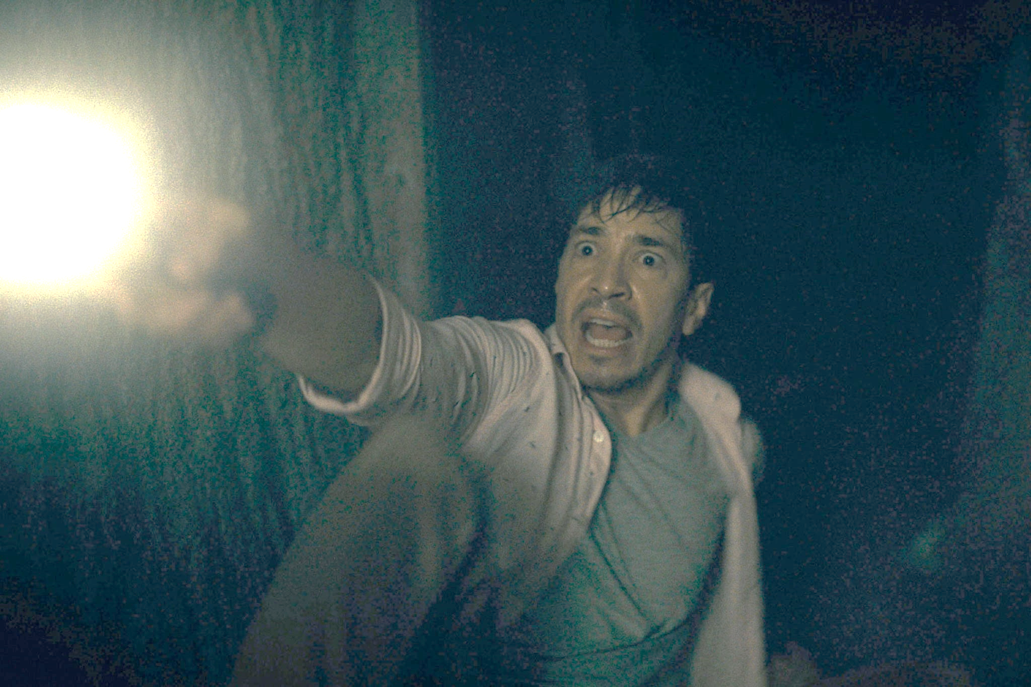
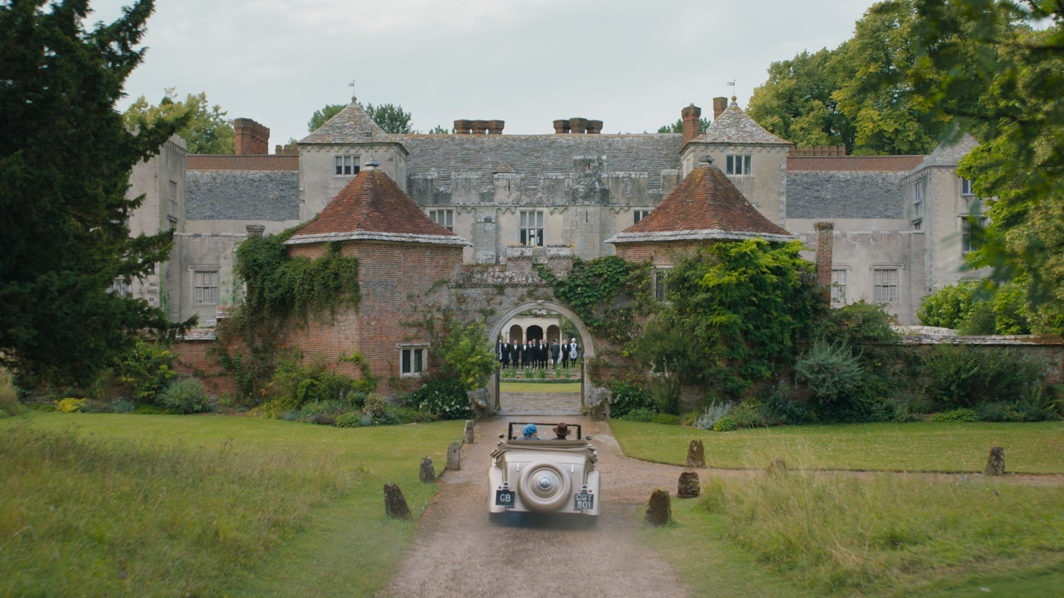
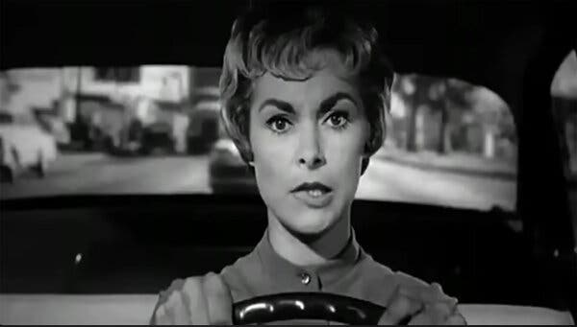
Deliberate Practice: Building Tension
Task choice: Pick an image and then plan a response to one of the following, using the image as inspiration
Write a description of an unexpected meeting
Write a story titled ‘decisions’

