Slide 1

Language Paper 1
Cheat Sheets

Slide 2



Language Questions: Cheat Sheet
Select interesting words and phrases
Identify the method
Justify the choice of these words: what is the effect?
‘Specifically, the use of ____________ is interesting because…’
‘It’s almost as if…’
‘By using ________, __________ and _________ the writer is building an impression of…’
Level | Skills Descriptors
Level 4 Detailed, perceptive analysis 7-8 marks | Shows detailed and perceptive understanding of language: • Analyses the effects of the writer’s choices of language • Selects a judicious range of textual detail • Makes sophisticated and accurate use of subject terminology
Level 3 Clear, relevant explanation 5-6 marks | Shows clear understanding of language: • Explains clearly the effects of the writer’s choices of language • Selects a range of relevant textual detail • Makes clear and accurate use of subject terminology
Level 2 Some, understanding and comment 3-4 marks | Shows some understanding of language: • Attempts to comment on the effect of language • Selects some appropriate textual detail • Makes some use of subject terminology, mainly appropriately
Level 1 Simple, limited comment 1-2 marks | Shows simple awareness of language: • Offers simple comment on the effect of language • Selects simple references or textual details • Makes simple use of subject terminology, not always appropriately

Slide 3


Structure: Cheat Sheet
What is established early on?
What changes? Why there?
How are we prepared for the ending & how are we left?
Establishes
Develops
Builds
Shifts
Changes
Contrasts
Transforms
Prepares
Reveals
Foreshadows
Concludes
Leaves us
Prepares us
Connects
Surprises
Repeats
Level | Skills Descriptors
Level 4 Detailed, perceptive analysis 7-8 marks | Shows detailed and perceptive understanding of structural features: • Analyses the effects of the writer’s choice of structural features • Selects a judicious range of examples • Makes sophisticated and accurate use of subject terminology
Level 3 Clear, relevant explanation 5-6 marks | Shows clear understanding of structural features: • Explains clearly the effects of the writer’s choice of structural features • Selects a range of relevant examples • Makes clear and accurate use of subject terminology
Level 2 Some, understanding and comment 3-4 marks | Shows some understanding of structural features: • Attempts to comment on the effect of structural features • Selects some appropriate examples • Makes some use of subject terminology, mainly appropriately
Level 1 Simple, limited comment 1-2 marks | Shows simple awareness of structural features: • Offers simple comment on the effect of structure • Selects simple references or examples • Makes simple use of subject terminology, not always appropriately
Level 0 No marks | No comments offered on the use of structure. Nothing to reward

Slide 4
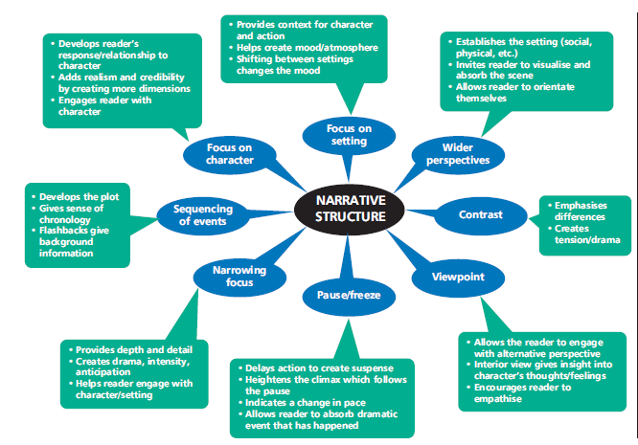
Effects of structural features

Slide 5


Evaluation: Cheat Sheet
Marker’s Checklist:
Have you given your opinion on both parts of the statement?
Have you included evidence to back up your opinion?
Have you identified how the writer has helped you to form your opinion – the methods they have used? (Necessary to get to the top of the band)
Have you explained why this evidence has helped you to form this opinion? Can I follow your line of reasoning?
I [dis]agree that [part of the statement] because the writer has used [method] such as [evidence] which leads me to think…
Furthermore, the reference to [more evidence] clearly demonstrates [link to statement] because…
- Write things you believe – you don’t have to show ‘the other side’ unless you think it exists.
- Use WHAT HOW WHY:
WHAT you think
HOW that thought has been formed
WHY you think this is the right way to respond to the text
Level | Skills Descriptors
Level 4 Detailed, perceptive analysis 16-20 marks | Shows perceptive and detailed evaluation: • Develops a convincing and critical understanding of ideas • Shows perceptive understanding of writer’s methods • Evaluates critically and in detail the impact of the writer’s ideas and methods on the reader • Selects a range of judicious textual detail
Level 3 Clear, relevant explanation 11-15 marks | Shows clear and relevant evaluation: • Makes a clear and relevant understanding of ideas • Shows clear understanding of writer’s methods • Evaluates clearly the impact of the writer’s ideas and methods on the reader • Selects a range of relevant textual references
Level 2 Some, understanding and comment 6-10 marks | Shows some attempts at evaluation: • Shows some understanding of ideas • Shows some understanding of writer’s methods • Makes some evaluative comment(s) on the impact of the writer’s methods and ideas on the reader • Selects some appropriate textual reference(s)
Level 1 Simple, limited comment 1-5 marks | Shows simple, limited evaluation: • Shows simple, limited understanding of ideas • Shows limited understanding of writer’s methods • Makes simple, limited evaluative comment(s) on the impact of the writer’s methods and ideas on the reader • Selects simple, limited textual reference(s)

Slide 6
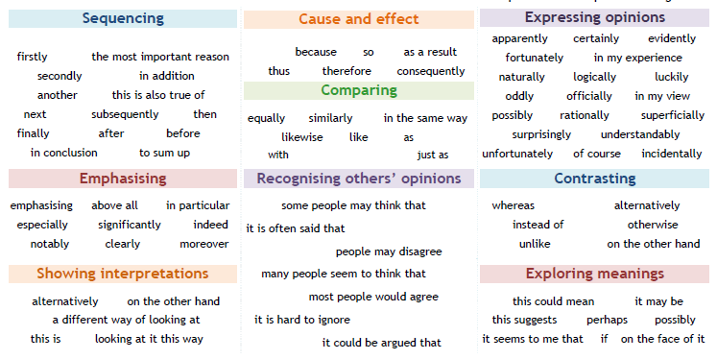
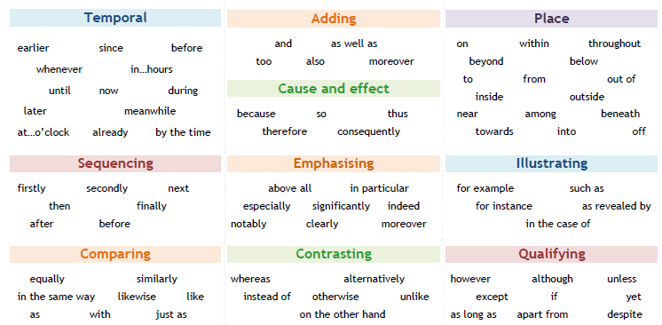
Discourse Markers

