Slide 1

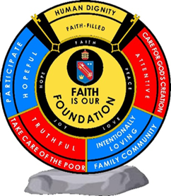
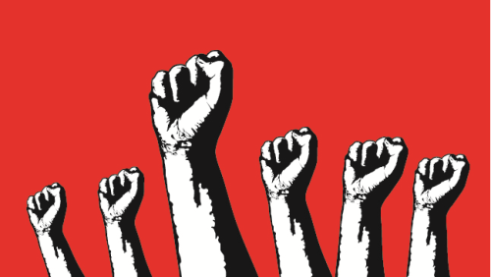
St. Peter’s Catholic School
Power and the People
REVISION DF 1
Y10 History
Homework
The Magna Carta (1215)
Simon de Montfort, The Origins of Parliament (1265) Provisions of Oxford (1258)
The Peasants' Revolt (1381)
4. Pilgrimage of Grace (1536)
5. The English Civil War and Oliver Cromwell (1625-1649)
6. American Independence (1770s)

Slide 2
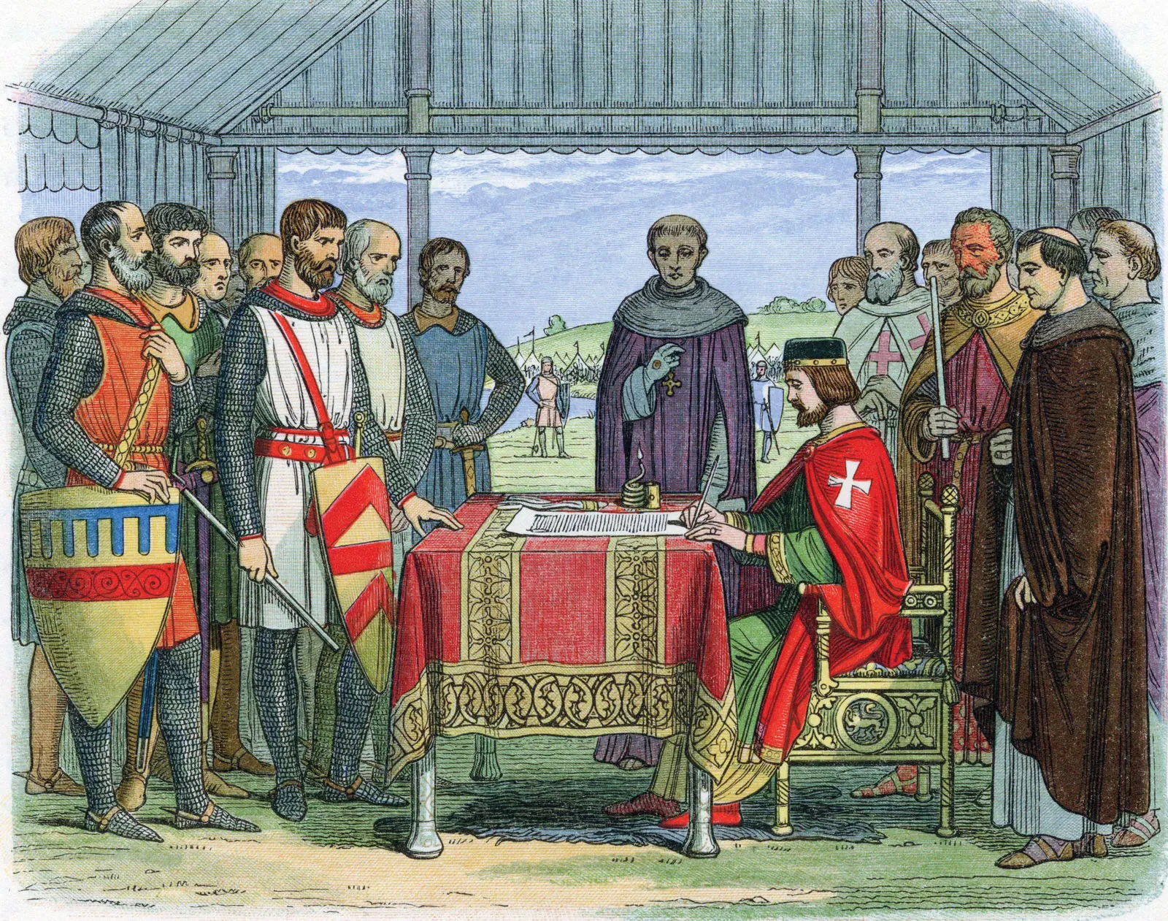
Topic 1. Magna Carta 1215
Key Vocab
Baron – man who had been given high rank by the king, the title came with land.
Feudal System – System of land holding in which use of the land is paid for by performing services for the owner.
Knight – a man who served his feudal lord as a soldier on horseback.
Excommunicated – being removed from the Catholic Church
Scutage – tax collected during wartime, it was paid by a knight or baron to the king to avoid military service.
Summary
According to some historians, in Anglo-Saxon times kings worked together with the Witan, or Council, to run the country.
The Normans used the feudal system in which the king had all the power and the barons depended on the king for land and wealth.
Strong monarchs could do much as they liked, but weaker ones, and those who lost land or mad unrealistic demands on the barons, could expect trouble. This is what happened to King John.
John was forced by the barons to concede a charter – which became known as the Magna Carta.
This was the first time a king had been forced to agree legal limits on his power. There had been a previous charter issued by Henry I but that was voluntary – he had issued a charter on his coronation to gain support.
The idea gradually grew that kings were subject to the law, too.
Despite having very little legal power, Magna Carta has remained a powerful icon for freedom to this day.
Background
Before the Magna Carta there were two previous charters made by the King. However, unlike the Magna Carta they were not forced upon the King.
1014 – King Aethelred’s Charter promised: Govern more justly than he did before
1100 - Henry I’s Coronation Charter promised: Abolish the customs which are oppressing England. Restore laws and relationships between rule and ruled to the time of Edward the Confessor.
Significance of Magna Carta
At the time:
It did not solve the problem: King John only agreed to sign the Magna Carta to buy himself time. He went back on his word and a civil war broke out
After the event
The Magna Carta was only about the relationship between the barons and the King. The barons were not interested in the rights of the peasants.
As more people became free it applied to more people therefore increasing its significance.
It showed that the King could be held account by barons if he did not rule correctly.
The Magna Carta become a symbol of people power. When protest groups challenged strong authority they used Magna Carta as their defence.
It was seen as the first step in a long process towards democracy.
It inspired….. The US Constitution & Bill of Rights: American colonists relied on the Magna Carta's principles. It heavily inspired the 1776 Declaration of Independence and the U.S. Constitution, which is the supreme law of the land in the United States.
In the 1800s the Chartists viewed their charter as a successor
In the 1900s the Suffragettes referred to it in their magazine.
The Universal Declaration of Human Rights passed in 1948 after WW2 by the United Nations.

Slide 3






1. Magna Carta 1215
King John was a weak leader
King John argued with the Church
Failures of King John
Nicknamed ‘Softsword’
Lost land in Normandy
People thought they were going to hell
The Pope banned church services in England
John increased the Scutage Tax
King John paid mercenaries to fight for him in France
The barons thought their money was being wasted
Need to pay for his failures in war
Raised this money through Scutage Tax
Left King John in debt
It contained 63 rules the King promised to follow
The king must seek advice before asking for money
The King must not interfere with the Church
What did Magna Carta say?
Barons can only be fined if other barons find them guilty
Every man is allowed a free and fair trial
The council of 25 Barons – a committee of Barons to monitor King John
The Common Council: A council of Archbishops, bishops and Greater Barons to advise the King
Judges are not allowed to take bribes
Factors
Factor | How it affected the Magna Carta story
War and violence | John’s failure in war and the taxes he raised to pay for the war made the barons want to bring John under control.
Religion | The Pope banned church services in England which made the people fear they were going to hell. However, the Pope sided with King John and stated that the charter was invalid.
Government | King John decided to ask the barons for scutage tax. He also refused to accept the terms of the carta which led to a civil war.
Communication | When the king refused to accept the Magna Carta the barons made alliances with the King of Scotland and asked Prince Louis of France to become King of England.
Role of the individual | Stephen Langton worked with the barons to devise the Magna Carta and resent it to the King.
Ideas | The Idea that the King was not above the law and should listen to his barons via the Council of 25 Barons

Slide 4
Magna Carta – King John - 15 June 1215. Why did John fall out with the barons? a) King John fell out with the Pope when he refused to support the Pope’s appointment of Stephen Langton as Archbishop of Canterbury. John did not approve of this appointment as he did not want someone who would obey the Pope and go against the king’s wishes. In response the Pope banned church services in England, including marriages and funerals. This frightened people as they thought this would mean they would go to hell. The barons thought that this could trigger an invasion from a foreign king. b) John made the barons pay taxes called scutage to help him fight wars in France. Scutage angered the barons because John was not living up to their expectations, they were not getting good value for money. His poor record in battles meant he lost many battles and the barons lost their lands in France. This meant they lost money. To make things even worse John charged them even higher levels of scutage. c)When he lost the crown jewels in the marshland called the Wash people further questioned his competence. Why does John have such a negative reputation? There are mainly negative accounts of John and what kind of king he was because he came into conflict with the people who wrote about events, mainly educated monks. Many historians have argued that it would have been hard for John to live up to the great reputations of his father and brother. Richard had left John in debt so it was hard for him to raise enough money to govern and defend the country. John did win some wars against the Scots and the Welsh and improved the English navy. John ensured English people could have a fair trial with a judge and a jury. He sometimes delayed proceedings so he could be there himself to ensure a trial was fair. This helped everyone in England, not just the rich barons. However, the barons were fed up with John and put an army together led by Robert Fitzwater. They sent the army to occupy London. The barons were ready to fight the king. If John wanted to form an army of his own he would need the support of the barons. He therefore had to negotiate with them. On June 15th 1215 John met the barons at Runnymede, near Windsor, to sign the Magna Carta which forced the king to agree to conditions about how the country should be run. The barons drew up a list of complaints about the way John ruled several times, but he refused to change. Now he had no choice because the barons were prepared to fight him. They had the upper hand and John needed their support to keep power. Magna Carta contained 63 promises that the barons wanted John to keep. These would change the power of the king and give the barons more control. (Learn 6 main clauses on the right.) John had no intention of sticking to the promises he made at Runnymede, he only agreed so the civil war would end. Many people consider it a failure in the short term as John quickly backed out of the agreement saying he had been forced to sign it. Magna Carta only referred to freemen, such as barons. Peasants and villeins were not free. The barons were looking out for their own interests when they drew up Magna Carta. They only included merchants and the Church so that they could get more support against John. Magna Carta changed nothing for the ordinary people of England, only the politically powerful benefitted. Six main clauses of the Magna Carta a baron’s heir shall inherit his lands on payment of £100 to the king no scutage shall be imposed on barons except with the common consent of the realm no freeman shall be arrested or imprisoned without a proper trial and according to the laws of the land the English Church will be free to make its own appointments all merchants shall have safety in staying and travelling to England for buying and selling goods, free from evil tolls a group of 28 barons will be created to monitor the king and he commits to Magna Carta

Slide 5




Independent learning clips
What is Magna Carta
800 years of
Magna Carta
Significance of
Magna Carta

Slide 6
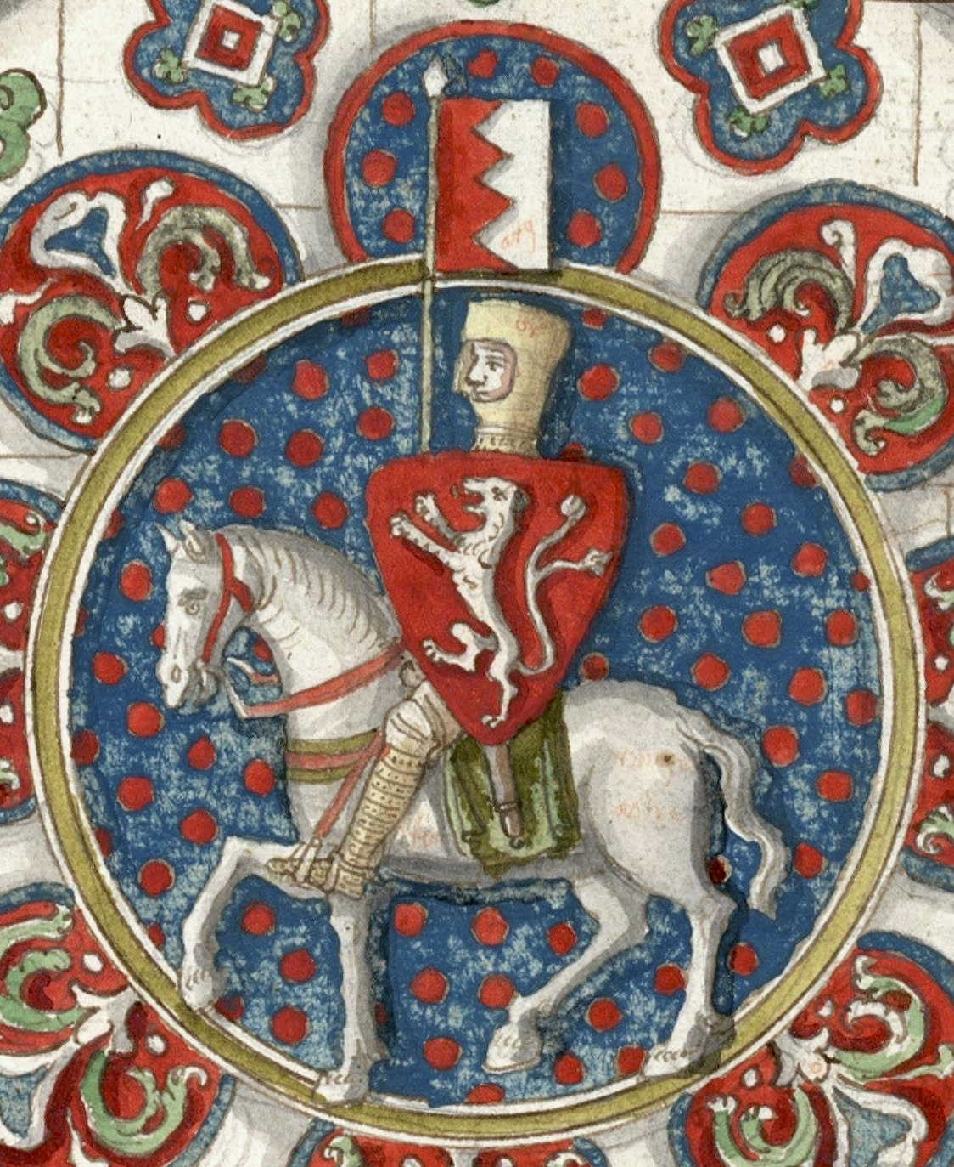
Topic 2. Simon de Montfort and the Provisions of Oxford
Summary
The barons tried to stop King Henry III from ruling unjustly.
King Henry re-issued Magna Carta, reaffirming the rights of the barons, on several occasions during his rule.
Simon de Montfort was heavily involved in attempts to force the King to rule justly.
Simon de Montfort rebelled against the King and ruled the country for several months.
Simon invited the Commons to join Parliament for the first time.
After his death any changes made by Simon were removed by Henry III.
Background
Provisions of Oxford
Stated that: foreign members of the royal household should be banished and that all castles should be held by Englishmen.
Gave the barons power over decision making than the King as it made the King accountable for his actions.
The barons were divided, as a result the King refused to sign the Provisions.
The barons asked Simon de Montfort to lead an army against the King which he won. King Henry III and his son were captured after the Battle of Lewes
Parliament
January 1265: Simon invited representatives of the Commons to Parliament.
The representatives were allowed to air their problems in return of being taxed by the government.
This was the first time that commoners were consulted on national matters.
Due to Simon de Montfort’s actions he is regarded as the ‘Father of Parliament’.
Simon did this without consulting the other barons who were furious with him.
Henry III | Simon de Montfort
Henry made the same mistakes made by King John | Simon had a difficult relationship with Henry III
He lost two major wars in France and only listened to a few advisers | Simon married the King’s sister and was owed a large dowry from Henry III
He was always short of money | Henry put Simon on trial for some of his actions, but he was always found innocent
The barons took action before history could repeat itself again | Simon was religious and was known to keep his promises
Henry allowed a lot of foreigners to help him govern the country | Earl of Leicester and his wife had lost land in France because of the King.
Future Kings had to call Parliament
To increase taxes
Increased the power of parliament over the King
Parliament to approve
future taxes
Significance of Simon de Montfort
The beginning of democratic principles
First to include representatives of the County
Symbol of
democracy
Burgesses - Not just the nobility invited into the commons. Model Parliament 1295
Father of Democracy
Knights, Gentry and Merchants
England nearly became a Republic

Slide 7
Factors
Factor | How it affected the Magna Carta story
War and violence | Simon de Montfort went to war with the Barons against King John and at the Battle of Lewes he overthrew the King and England nearly became a Republic
Religion | Simon was very pious, he lived a frugal life and wore a hair shirt under his clothes as a sign of Christianity.
Government | Simon de Montfort invited two representatives called Burgesses (Knights and Gentry) into the Commons and created a council of 15 to monitor the King. 1295 Model Parliament
Role of the individual | Simon was asked to lead an army against the King. It was his actions whilst as regent that developed Parliament – father of
Ideas | Simon had the idea that representatives (Burgesses) from shires and towns should be called to Parliament to represent the commons. A council of 15. The idea of a Republic, ruling without a King.
SHORT-TERM SIGNIFICANCE
Firstly, it did emphasise a king’s accountability to his subjects.
1.The Provisions of Oxford insisted the king’s decisions be approved by a ‘Council of Fifteen’.
2.The battle of Lewes overthrew the king for ruling unjustly.
3.In power, de Montfort forced Henry III to re-confirm the royal limitations in Magna Carta.
All of these measures highlighted the principle of consent.
They made clear that kings couldn’t simply rule as they wished.
However, these developments were short-lived as de Montfort was then killed at the battle of Evesham and Henry III returned to power.
Secondly, it did reshape Parliament for a short period.
For the first time ever in our history, commoners (eg burgesses from the boroughs) were given a prominent voice in parliament.
De Montfort’s 1265 parliament, therefore, was a significant step forward in the granting of political influence to the lower classes.
However, de Montfort may have done this not due to any burning democratic idealism but due to a need to increase his own support within the growing middle-classes. He had, after all, deposed the anointed king and placed himself in charge. There were questions, therefore, about the legitimacy of his regime.
Regardless, the Second Barons’ War, then, was of some significance in challenging royal authority and demonstrating the way forward for the increasing democratisation of our country.
LONG-TERM SIGNIFICANCE Much greater.
Firstly, it had a profound effect on the shape of later Parliaments.
When Edward I became king in 1272, he tried to rule more consensually than his father had done.
He called more frequent parliaments which also had commoners in them.
In 1295, in fact, he called what is now known as the ‘Model Parliament’. This based exactly on what Simon de Montfort had designed. The format was then followed by subsequent kings.
The Second Baron’s War, then, influenced the long-term development of Parliament hugely.
Secondly, it became an inspirational symbol to later movements.
De Montfort’s actions and martyrdom inspired many later protests.
Such was his long-term impact on the structure and development of Parliament that he even became known as the ‘Father of the House of Commons’.
And such is the reach of his example that, on the other side of the world, in the US House of Representatives, a stone relief of de Montfort adorns the wall to this very day.
The Second Barons’ War, then, was even more significant to later generations than to its own.

Slide 8


Key terms for Simon de Montfort
Aristocratic – being part of the ruling class or the nobility
Steward – person who managed the king’s finances and estates, in some cases he managed the kings interests in other countries
Democracy – system of government which gives everyone a say by allowing them to vote for people to represent them in Parliament
Pious – deeply religious, observing religion completely
Chancellor- in Medieval times this was the person who wrote all the paperwork for new laws and produced the official paperwork
Burgess – person who owned land or a house in a burgh; like peasants they were bound to their lord
Tenant – person who lived on a lord’s land and paid rent and taxes, usually a peasant
Republic – country with a system of government where an elected President has supreme power, rather than a monarch
Autocrat – ruler who holds all the power
Model Parliament – the first Parliament that resembles ours today, it had representatives from the Church and the aristocracy, as well as those from the counties and boroughs (commoners)
Independent learning: Reinforce your knowledge with these clips
Origins of Parliament
SDM and the
2nd Barons War

Slide 9
Homework 4: Simon de Montfort
TASK INSTRUCTIONS: Read, highlight key points and summarise them
Who was Simon de Montfort? In 1216 King John died, his nine year old son Henry took over as king with a regent to help him rule. He personally took over as king in 1234. Simon de Montfort was Earl of Leicester from 1239-1265. His family were Norman; since 1066 they had lost more and more land to the king. In 1229 de Montfort approached Henry III to try and reclaim some of this land. Henry agreed and also made de Montfort his steward, he soon became one of Henry’s favourites. Why did Henry III fall out with the barons? Henry fell out with the barons due to his pious nature and close relationship with the church. This led to the church having influence over English affairs and financial problems for the King and the barons. Why did Henry need the barons? In 1254 Henry needed the help of the barons to give him the money he needed to pay the Pope the money he owed him to avoid being excommunicated. The barons did not support the king’s plan to raise taxes because their relationship with Henry had deteriorated due to the lands he had lost in France and his relationship with the Pope. De Montfort was quickly becoming the barons’ spokesperson. What were the Provisions of Oxford? When Henry asked the barons’ for their help they refused. Four years later in 1258 the barons set out to change the shape of royal control in England, under the leadership of Simon de Montfort they called a meeting of the Great Council against Henry. At the meeting Henry agreed to the Provisions of Oxford. By agreeing to The Provisions of Oxford gave the barons the majority of power, they stated that the barons could make decisions without the king’s presence or approval. The king could not make decisions without the approval of the council. These changes had a real impact on royal authority. Some barons did not agree with the Provisions of Oxford, particularly Richard de Clare, Earl of Gloucester. Along with other older barons he felt that the changes were interfering with their local interests. Some younger barons disliked the provisions because they were not elected to the council and felt they had lost their influence. They were also unhappy that people lower on the social scale now had a greater say. The barons wanted a return to the feudal system when knights and burgesses had much less influence. What were the Provisions of Westminster? In October 1259 the Provisions of Oxford were extended by the introduction of the Provisions of Westminster. These provisions reformed local government and were popular with the less powerful and less wealthy members of society. Many barons were unhappy with the Provisions of Westminster because they forced them to accept reforms demanded by their tenants. How did Henry return to power? Due to the arguments between the barons Henry was able to return to power and reject the Provisions of Oxford and the Provisions of Westminster. Henry wrote to the Pope and asked for his permission to cancel the provisions. In 1261 the Pope confirmed that Henry was free from the provisions. He then appointed his own men to the council. With Henry back in power, de Montfort left for France in disgust. What changes did Simon de Montfort make to the way England was governed? After three years of Henry’s new rule the barons were so frustrated with Henry that they sent for de Montfort. He returned and started the Second Barons’ War. The barons were fed up with negotiating and were now using military strength. De Montfort and his men won the Battle of Lewes in 1264, they captured the king and imprisoned his son, Prince Edward. Without a king de Montfort was in charge and England was on its way to becoming a republic.

Slide 10
Homework 4: Simon de Montfort
TASK INSTRUCTIONS: Read, highlight key points and summarise them
De Montfort in power Once he was in power de Montfort appointed a Great Council of nine which was made up of his friends and allies. Some barons worried that he was too powerful. He also reconfirmed Magna Carta and the Provisions of Oxford. The barons who had supported Henry wanted their old lives of power, influence and money back. In 1265 de Montfort, worried that he was losing his control, called a meeting of the Great Council. This time he invited knights and burgesses from every county. This increased the support he was lacking from the powerful barons. The burgesses represented the growing merchant classes who were making money in the growing towns. Ordinary people – sometimes known as commoners – had been invited to the Great Council for the first time. This became known as the Commons and was a historic event. What were the results of the Battle of Evesham? The barons were concerned with their own interests and were starting to think that de Montfort was ruling as an autocrat. They began to put all their support behind Henry. His son, Prince Edward, had been released and had raised an army. They were out to get de Montfort. On August 4th 1265 at the Battle of Evesham de Montfort was killed How did Henry return to power? Due to the arguments between the barons Henry was able to return to power and reject the Provisions of Oxford and the Provisions of Westminster. Henry wrote to the Pope and asked for his permission to cancel the provisions. In 1261 the Pope confirmed that Henry was free from the provisions. He then appointed his own men to the council. With Henry back in power, de Montfort left for France in disgust. What changes did Simon de Montfort make to the way England was governed? After three years of Henry’s new rule the barons were so frustrated with Henry that they sent for de Montfort. He returned and started the Second Barons’ War. The barons were fed up with negotiating and were now using military strength. De Montfort and his men won the Battle of Lewes in 1264, they captured the king and imprisoned his son, Prince Edward. Without a king de Montfort was in charge and England was on its way to becoming a republic. De Montfort in power Once he was in power de Montfort appointed a Great Council of nine which was made up of his friends and allies. Some barons worried that he was too powerful. He also reconfirmed Magna Carta and the Provisions of Oxford. The barons who had supported Henry wanted their old lives of power, influence and money back. In 1265 de Montfort, worried that he was losing his control, called a meeting of the Great Council. This time he invited knights and burgesses from every county. This increased the support he was lacking from the powerful barons. The burgesses represented the growing merchant classes who were making money in the growing towns. Ordinary people – sometimes known as commoners – had been invited to the Great Council for the first time. This became known as the Commons and was a historic event. What were the results of the Battle of Evesham? The barons were concerned with their own interests and were starting to think that de Montfort was ruling as an autocrat. They began to put all their support behind Henry. His son, Prince Edward, had been released and had raised an army. They were out to get de Montfort. On August 4th 1265 at the Battle of Evesham de Montfort was killed.

Slide 11
Provisions of Oxford
Provisions of Oxford the king agreed that,
Castles would be held by Englishmen
Foreign members of the royal household would be banished
Each county would have a sheriff and taxes would be decided locally
Council of fifteen barons would be in charge of the Great Council. (elected by twenty four men, twelve appointed by the king and twelve by the barons.)

Slide 12
Topic 3. The Peasants Revolt
The fourteenth century was a difficult time – poor harvests, inflation, the Black Death, attempts to limit freedom.
However, wages were rising for many. Those unrepresented in Parliament were making their voices heard.
The rich fought hard to maintain their privileged position.
The events of 1381 was not only a peasants revolt; other groups in society were involved too.
The fact that the ‘humble classes’ asserted their rights caused real consternation among the ruling classes.
The peasants remained powerless; but 70 years later all had been freed.
The Peasants Revolt was used as an inspiration in many succeeding rebellions, and is still regarded by many today as a significant step on the road to democracy.
The causes of the Peasants Revolt
Earlier disputes | The Black Death 1347-9 | Poll Taxes
1315-1317: harvests fell by 50%. 1319-1320: nearly half the sheet died and oxen were struck with rinderpest which made it harder to farm the land. Food prices increased. Rent prices increased. The gap between rich and poor increased. There were floods, drought and famine throughout the first half of the 14th century | Killed 50% of the population wiping out villages all together. Some areas did not have enough men to work the land. Rich were forced to lower rents or raise wages if they wanted to get workers. Landlords attempted to retaliate against this by keeping more sheep. Statue of Labourers in 1351: every person under the age of 60 had to work. Wages were to be no higher than in 1347 Sumptuary Laws: Regulate clothes people wore and food they ate. | First Poll Tax 1377: 4d per person – a couple days wages for a labourer. The richer wanted to place the tax burden on the poor labourers and workers. Second Poll Tax 1379: Created to pay for another invasion for France. Poor paid 4d per head whilst earls paid £4. At least 1/3 of tax payers ‘disappeared’ from tax lists. Third Poll Tax 1381: 1s 4d – two weeks’ wages for a labourer, Aimed to raise £160,000
Story of the Peasants Revolt
Wat Tyler led the Kentish rebels in an attempt to free the peasants from the land.
The Kentish rebels attacked Maidstone prison and freed prisoners including John Ball.
The rebels marched to Canterbury, killed royal officials and then marched for London.
They reached Blackheath by 12th June 1381. Many people in London supported the rebels and opened the gates to them.
The rebels targeted royal officials, wealthy churchmen and records of land ownership and debts.]
14th June the rebels entered the Tower of London and executed the treasures and the Archbishop of Canterbury. Their heads were put on top of long poles and paraded around London.
Richard II went to mile end to talk to the rebels and was presented with a list of demands.
Amnesty for rebels, handing over of corrupt officials and to make all peasants free.
On 15th June Wat Tyler met Richard II again. During the meeting the Lord Mayor or London stabbed Wat Tyler.
The King defused the situation by telling all of the rebels that he would agree to their demands and ordered them to disband.
Significance at the time (short term) | Significance since (Long term)
It was the first time in our history commoners had openly challenged the authority of their king and not just wealthy Barons They were angry with the feudal system, unfair taxes and other restrictions that were oppressing them. This terrified the king and the nobility, especially whilst the rebels rampaged through the capital city unhindered and managed to kill some leading nobles. It spread to quickly and it spread to London where the King had to meet them and make promises to listen. | Its aims were achieved within 100 years. No future king ever dared try to impose a poll tax again. Wages began to rise once more. More peasants bought their freedom and became freemen with increasing rights. This freed them from having to work for the lords for free whenever required. By 1450, feudalism had ended. It became an inspirational symbol to later movements. The rebels’ aims became widely admired. - John Ball’s sermons were picked up again by later protest movements. -1600s English Civil War, the Levellers and Diggers used his slogan “When Adam delved and Eve span, who then was the gentleman?” to criticise extreme social inequality. - 1989, protesters against the Community Charge chose the same route through London that the Peasants’ Revolt had taken 600 years earlier.

Slide 13


Factor | How it affected the Peasants Revolt story
War | The Second Poll Tax was introduced to pay for an invasion of France which frustrated the poor.
Chance | It was luck that the rebellion in Kent happened at the same time as that in Brentwood. This meant more people were marching on London.
Government | The government introduced three Poll Taxes which made the people rebel. They also made law attempting to control how the peasants lived their lives after the Black Death
Ideas | It began to be believed that serfdom and unfree tenure should be abolished. This meant that peasants should be free from their masters or lord.
Role of the individual | Wat Tyler led the revolt to London and gave the king a list of demands. John Ball was released from Maidstone prison and was the main influence on the leaders of the revolt
Key terms
Justice of the Peace – local official appointed by the king, responsible for law and order.
Hundred Years War – series of wars between England and France.
poll tax – tax of a certain amount that all individuals over a certain age had to pay, regardless of income.
groat – silver coin worth four English pennies.
pardon – act of forgiving a crime.
socialist – person believing in the rights of the working class (socialism).
The Peasants' Revolt - BBC Teach
What was the Significance of the Peasants' Revolt? | 3 Minute History

Slide 14
Homework 7: Peasants Revolt
TASK INSTRUCTIONS: Read, highlight key points and summarise them
Why was the Statute of Labourers introduced? The Black Death had the greatest impact on peasants, who made up the majority of the workforce. This led to fields of crops being left to rot because there weren’t enough people to bring in the harvests. Many villages were abandoned altogether. For the peasants who were lucky enough to survive there were big advantages. As there were fewer workers peasants started to demand higher wages. Strong, hard-working peasants were now in high demand, so to gain better pay or to work for a fairer lord, many peasants moved to other villages. This started to worry the lords and the king himself. They were concerned that the peasants were gaining too much power and that the feudal system was starting to break down. This is why, in 1351, the king introduced the Statute of Labourers. ‘Every man and woman in the realm must work for those that want them, and shall only receive the same wages as before the plague’ Adapted from the Statute of Labourers, 1351 This angered the peasants. Some who had left their villages were captured and forced to work for their former lord again. Many peasants did not accept this situation. Between 1377 and 1379, 70% of the cases brought before the Justice of the Peace were people accused of breaking the Statute of Labourers. It was clear that the peasants who survived the Black Death were not afraid to stand up for themselves. What were the causes of the Peasants’ Revolt? Although the Statute of Labourers tried to control the peasants and their rising wages – some peasants were in quite a powerful position. The Black Death had killed so many workers that lords were desperate for peasants to bring in the harvests, many lords had to ignore the Statute of Labourers. The peasants started to question the way the government was running the country. Richard II, who came to the throne in 1377, was a new and inexperienced king whose reputation was not helped by his association with John of Gaunt, who was his main adviser and one of England’s most hated landowners. After years of fighting unsuccessful campaigns in the Hundred Years Wars. To help fund these campaigns a Poll Tax was introduced. In fact three were introduced in as many years. By 1380 every person over the age of 15 had to pay four groats per year to the king. This was a massive increase from the one groat they had previously paid. Additionally many priests started to preach about how the Church had been exploiting the peasants. The key people doing this were John Wycliff and John Ball. They argued that the Church should not be charging pardons for sins and that the Church should not have so much property when others were starving. In 1381 the peasants had had enough. They started a revolt against the system that they felt suppressed them. The Peasants’ Revolt had begun. How did the Peasants’ Revolt start? The peasants were inspired by the preaching of John Ball, who told them that in the Bible there was no rich and poor, thus everyone was equal. Ball said ‘When Adam delved and Eve span, who was then a gentleman?’ Richard II had Ball arrested so his preaching couldn’t influence any more people against the feudal system and the unfair distribution of wealth. Richard was clearly worried. Uprisings started in Essex and Kent the men involved in these uprisings eventually joined forces. They were not necessarily angry with the king but more with the oppressive system that they lived under. They were more interested in removing bad priests and evil landowners, as these were the very people who directly exploited them. What happened once the revolt was over? When the revolt was over Richard did not keep his promises. He stated, as kings had done before him, that he was forced to make these promises. The rebel leaders were rounded up and hanged. John Ball was hanged and his body was cut into pieces. His head was stuck on a spike on London Bridge. Next to it was the head of Wat Tyler.

Slide 15
How did the Peasants’ Revolt start? The peasants were inspired by the preaching of John Ball, who told them that in the Bible there was no rich and poor, thus everyone was equal. Ball said ‘When Adam delved and Eve span, who was then a gentleman?’ Richard II had Ball arrested so his preaching couldn’t influence any more people against the feudal system and the unfair distribution of wealth. Richard was clearly worried. Uprisings started in Essex and Kent the men involved in these uprisings eventually joined forces. They were not necessarily angry with the king but more with the oppressive system that they lived under. They were more interested in removing bad priests and evil landowners, as these were the very people who directly exploited them. What happened once the revolt was over? When the revolt was over Richard did not keep his promises. He stated, as kings had done before him, that he was forced to make these promises. The rebel leaders were rounded up and hanged. John Ball was hanged and his body was cut into pieces. His head was stuck on a spike on London Bridge. Next to it was the head of Wat Tyler. TIMELINE OF EVENTS
30th May 1381 – Fobbing: Soldiers turn up to support the tax collector John Bampton who has come to collect the poll tax. The peasants refuse to pay and threaten to kill Bampton. Scared, he rides straight back to London. The villagers hide in the woods as they are worried they will be punished for their actions.
3rd of June 1381 – Brentwood: Rebels from other villages join forces. When the Chief Justice is sent to the village to get the taxes Bampton had failed to collect the men from the village return and threaten to kill him. When the Chief Justice leaves the men find Bampton’s clerks and behead them. They start setting fire to the houses of Bampton’s supporters.
7th June 1381 – Maidstone: Peasants in Kent march to Maidstone. When they get there they listen to Wat Tyler speak, the rebels make him their leader. They also free John Ball from Maidstone prison and storm Rochester Castle. These man also kill the Archbishop of Canterbury. They destroy tax records by burning down government buildings.
12th June 1381 – Bishopsgate : The men make it to the outskirts of London’s city walls and set up camp. Leaving the Tower of London, Richard II sailed to meet the peasants. When they see his boat there is so much shouting and booing that his men will not let him off the boat. Convinced they will not break through the city walls Richard says he will meet the rebels on June 17th.
13th June 1381 – City of London: The rebels enter London through the city gates which have been opened by supporters. They storm the Savoy Palace, which belongs to John of Gaunt, and burn it to the ground. They kill foreign merchants and supporters of the king. However not all the peasants are violent and Wat Tyler gives clear orders to be peaceful. The king offers to meet the rebels and their leader at Mile End the next day.
14 June – Mile End: Wat Tyler meets the king and outlines the peasants’ demands. The king is to give a royal pardon to all involved and all villeins are to be made freemen. The king agrees and asks the peasants to go home in peace. Some of the peasants go on another killing spree
15th June 1381 – Smithfield: Richard II meets the rebels again. Tyler is bold and refuses to leave until the king has agreed to his demands. He wants a full change to the legal system. He also wants Church lands to be given to the people and all bishops removed except one. The king agrees. However, one of his men steps forward and kills Wat Tyler. The peasants are confused and are ready to fight. The king rides forward shouting ‘Will you shoot your king? I am your leader, follow me!’ The peasants follow the king out of London. The revolt is over.

Slide 16
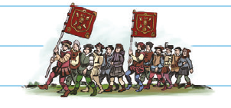
Topic Pilgrimage of Grace 1536
The Pilgrimage of Grace was the most serious rebellion against the Crown since the Peasants’ Revolt. It started in Lincolnshire, in October 1536, and spread throughout the north of England. There was no single cause. The focus was religious but it featured a mix of social, economic and political factors.
What were the causes?
The dissolution of the monasteries following the first Dissolution Act of March 1536. Lots of people were upset by the religious change, but also because monasteries had played an important social role by providing education, hospitality for travellers, help for the poor and medical care for the sick.
Anne Boleyn, Henry’s wife, had a reputation for witchcraft and many people thought she had bewitched the king into divorcing Catherine of Aragon.
Many people were upset that Henry VIII had divorced Catherine of Aragon, and that Princess Mary had been declared illegitimate (not the child of married parents, and
therefore not in line to the throne) by the 1534 Act of Succession.
Advisers like Thomas Cromwell and Richard Rich were seen to be leading the king astray, and many people wanted them removed. They were not nobles, which meant the nobility didn’t like their influence over the king.
Lots of people wanted a return to the ‘old ways’ of religion, such as the old Catholic masses.
Poor harvests in 1535 and 1536 had caused high food prices and widespread hunger.
The people of the north felt isolated and cut off from London, and were angry at being neglected.
There were rumours of taxes on baptisms, marriages and burials.
Taxes had increased.
The 1535 prayer book was unpopular, especially with Catholics in the north.
How the rebellion spread | Robert Aske and the Pilgrimage
Many people in Louth, Lincolnshire were already unhappy about the dissolution of the local abbey. Rumours began to spread – that the local church would have its silver confiscated, that churches would be closed, that junior clergy would be sacked. The rebellion soon spread throughout Lincolnshire, and the gentry began to join. A list of demands, called the Lincoln Articles, was sent to the king. Over 10 000 protestors went to Lincoln to wait for Henry’s reply. When they heard that the king was sending an army to Lincoln, the rebellion melted away. However, some rebels had gone to Yorkshire, and revolt spread quickly throughout the north. This was because many people in the north of England were Catholics who hated Henry’s religious changes. The royal castle at Pontefract was captured and there were revolts in Cumbria, Lancashire, Northumberland and Durham. Soon around 40 000 men had joined the revolt, including nobles (such as the Percys), knights and gentry. | Robert Aske was a lawyer, and a member of the gentry. He was caught up in the Lincolnshire rebellion and became leader of the Yorkshire rebels. Aske gave the Pilgrimage its religious identity. (A pilgrimage is a special religious visit to a holy place.) He insisted that the rebellion was peaceful. Aske wanted to maintain high standards so that no one could accuse them of being a mob or rabble. He did not want to frighten more nobles from joining. The rebels marched under religious banners and their processions were often led by priests and monks. Aske wrote a ‘Pilgrim’s Oath’ and everyone who joined had to swear to protect the Church from the king’s interference. It was a significant challenge to royal authority over the Church.
Key terms
Pilgrimage: Religious journey
Grievances: When someone is angry or upset
Protestant: A follower of Martin Luther
Robert Aske: Leader of the Pilgrimage of Grace

Slide 17
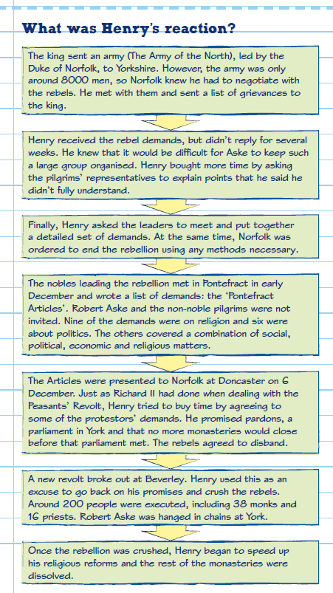
Henry VIII tried to pretend that the Pilgrimage of Grace was a minor rebellion. However, many historians now think that it was the biggest internal threat that Henry faced during his reign. Around40 000 men in rebellion had implications for Henry’s authority: it was a major threat.
There was a risk that the pope could
instruct all Catholics to assist the
Pilgrimage, which would have made
Henry’s position even weaker
There was a risk that another country could use the disruption caused by the rebellion to attack England in the south. With Henry’s army engaged against the rebels in the north, there would have been little to stop a landing on the Kent/Sussex coast.
The rebels were not just ‘common’ people. Nobles were also involved: a group the king usually relied on for support
Why was the pilgrimage of grade a threat to royal authority?
The king could not use local militia
to stop the uprising in case they
joined the rebels. This meant that
troops had to be brought in from
other areas of the kingdom, and it
would have been very difficult for
Henry to have gathered together
an army that was big enough.
The anger about Henry’s religious reforms was not confined to the north. If the rebels had marched south, it is almost certain that others would have joined them.
Why did it fail?
The rebels were too ready to accept the promises of the King.
Could have beaten the King with force, not with diplomacy.
The leaders did not trust the commons.
by disbanding their force of 50,000 people they handed over the initiative to Henry.
The rebels were easily duped by the Duke of Norfolk and his promises in Doncaster.

Slide 18
The Pilgrimage of Grace reading
Henry and the Reformation Henry was a devout Catholic but he was unhappy about the power and wealth of the Pope and the Church. To Henry the Church was a competing power. Henry wanted English people to only listen to him, he disliked the influence the Pope had over them. Henry did not support the ideas of Luther and the Protestants. However he did use their ideas to go against the Pope. What problems did Henry face? Henry’s divorce was not the only problem he had. Despite making himself head of the Church of England and stopping sending taxes to the Pope, Henry was still spending too much money. His conflict with the Pope had angered Catholics in other European countries and he began to worry about invasion. Henry ensured each change was made through Parliament so he could blame his government for the changes. Cromwell promised he would make Henry the richest king in Europe. One way to do this was to take money from the monasteries. This became known as the dissolution of the monasteries. The monasteries controlled a quarter of all the land in England and had an annual income of £200,000. This was double that of the king himself. In 1536, Parliament passed an act closing all small monasteries that had an annual income of less than £200. Cromwell then set up Valor Ecclesiasticus to evaluate monastery finances. He sent inspectors to see what they were spending their money on. If they were seen to not be run properly they would be closed down and the Crown would take the finances. Reports were sent to Cromwell, and if they were positive they were sent back to be re-written in a way that showed them in a less positive light. What problems did Henry face? How did he solve them? By 1536 Henry had married Anne Boleyn (who was now pregnant) and had established a firm grip on the Church. However he was not expecting an uprising against him in Yorkshire. Peasants who were marching to London wanted Henry to listen to their demands and return the Pope as head of the Church. They also wanted the monasteries to be restored. The demands of the pilgrims In 1536 a rebellion broke out in Yorkshire. It was an uprising by devout Christians who were worried and angry about the changes that Henry had made to the Church. They had to be careful as new laws meant that criticism of religion meant criticising the king, this meant they could be charged with treason. Their leader was Robert Aske, he assured people that they were not against the king and believed in the existing social hierarchy and royal authority. They said they had no intention of challenging Henry. Their demands were to, Restore the monasteries (in the north of England monasteries did important social work and were not as corrupt as those in the south) Recognise the Pope as the head of the Church Dismiss Thomas Cromwell and other ministers who they thought were giving Henry poor advice. The king and others would be in no doubt of the purpose of the pilgrimage, known as the Pilgrimage of Grace, as the marchers carried a banner showing the five wounds of Christ. This uprising was about religion and was against those who were seen to be corrupting it. Norfolk marches north Throughout October 1536 the pilgrims captured key locations. The rebellion began in Lincoln, here it was led by Lord Hussey who had been a staunch supporter of Catherine. He, and others, did not want to have to pay taxes during times of peace. The rebels then took control of York. Soon they controlled Pontefract Castle, which had been controlled by Lord Darcy, a supporter of Henry. Darcy surrendered to the pilgrims and joined their campaign. By the end of October they had control of most of England, north of Lincolnshire and Cheshire. Henry was worried, however he chose the right man to represent him and negotiate with the rebels, the Duke of Norfolk. Norfolk was a Catholic and a critic of Cromwell. On October 27th he met with the pilgrims at Doncaster Bridge. He had an army of 8000 men and Aske had an army of 30,000. Norfolk reassured Aske that he would present a list of demands straight to Henry. The rebels took a month to draw up their demands. They were the same as before except this time they added the demand that a parliament must meet in York to give the north better representation. Norfolk reassured Aske and the rebels that royal pardons would be given. Aske took off his pilgrims badge and the rebels went home.

Slide 19
Aske and Henry In December 1536, after the list of demands had been given to the king, Aske spent the Christmas holiday with Henry at his palace in Greenwich. Henry did not disagree with Aske regarding Cromwell. He reassured him that he, and the other rebels, had his support. Meanwhile news was reaching the rebels that Henry was strengthening his garrison in the north: he had no intention of sticking to his word. The rebels decided to strike first. The revolt breaks out again In January 1537 castles in Hull, Beverley and Scarborough were attacked by the rebels. This gave Henry the excuse he needed to cancel the pardons. Norfolk travelled north again and he went to Carlisle to deal with another rebellion. The rebels surrendered and 74 of them were hanged in their own gardens. Norfolk did not hang more men because he felt they had been humiliated enough. The second wave of rebellion had been squashed.

Slide 20
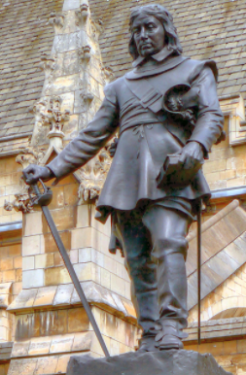
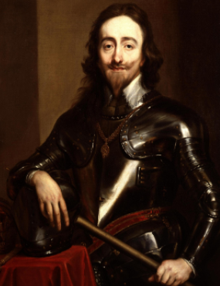
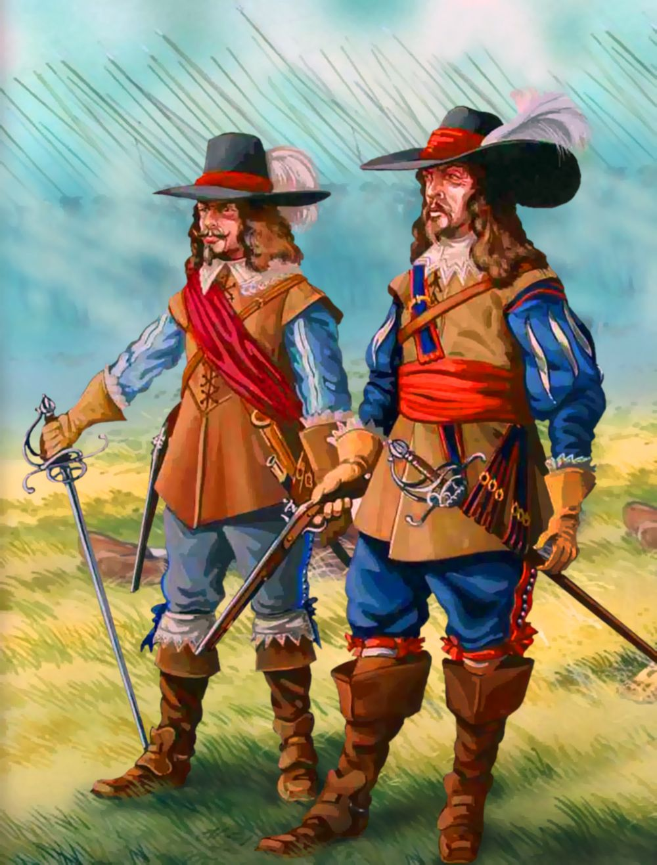
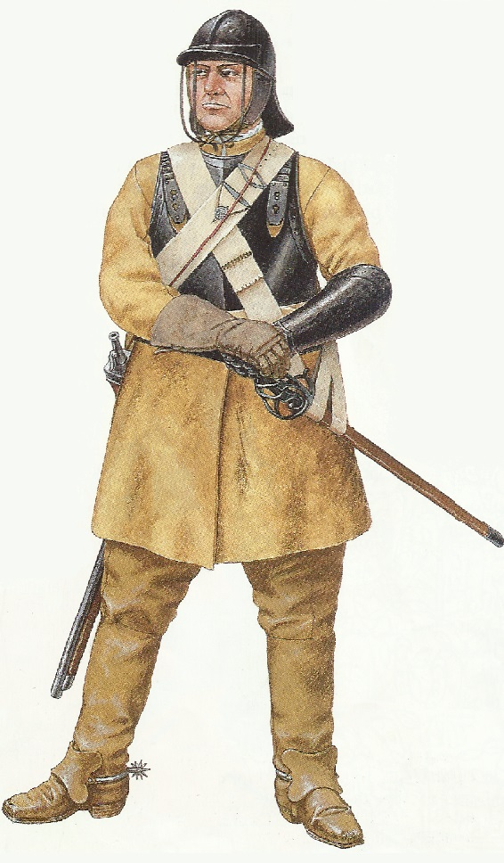
Topic The English Civil War
Knowledge organiser
Summary
During this time the nation fought a civil war, executed a king, became a republic, restored the monarchy and replaced the king yet again.
People in the 1640s talked about a ‘world turned upside down’.
It was a period of strong feelings and dissent in politics, in economics and in religion.
Families were often divided. Loyalties were tested and big questions asked such as, is it right to rebel against your King?
The demands of Parliament were met, but those of the poor, and women, were not.
The reputations of key characters involved – Charles I and Cromwell – are still disputed today.
Causes of the English Civil War
Religion | Money | Power
Charles was married to a Catholic and people feared his children were being brought up as Catholics. Puritans dominated Parliament. They did not like the Catholic changes to Churches by Archbishop Laud. The Scots opposed the introduction of a new prayer book and went to war against Charles. | Charles ruled without Parliament for eleven years and raised taxes without Parliament’s permission. Charles introduced ship tax to pay for his failed war against Scotland. Charles was forced to pay compensation to the Scots but had limited funds. | Charles believed in the Divine Right of Kings – he was appointed by God. Charles preferred the advice of his favourite ministers to consulting with Parliament. Charles attempted to arrest the leading members of Parliament. After this failed he fled to Nottingham to wage war against them.
The New Model Army
Swung the balance of power in Parliament’s favour.
The first fully professional army created by Oliver Cromwell.
Soldiers were veterans from other battles and held strong religious views.
The soldiers believed that God was on their side
Officers were promoted by merit and not class.
Soldiers were well paid – 8d per day.
Many members believed that all men should have the vote.
Charles’ Execution
MPs were divide about how to treat the King. The army ejected 300 MPs leaving only a Rump who put the King on trial.
Charles was found guilty of treason. He refused to plea as he did not recognise the power of the court.
Charles was executed on 30th January 1649.
After his execution Parliament abolished the monarchy and the House of Lords.
England was declared a Commonwealth.

Slide 21
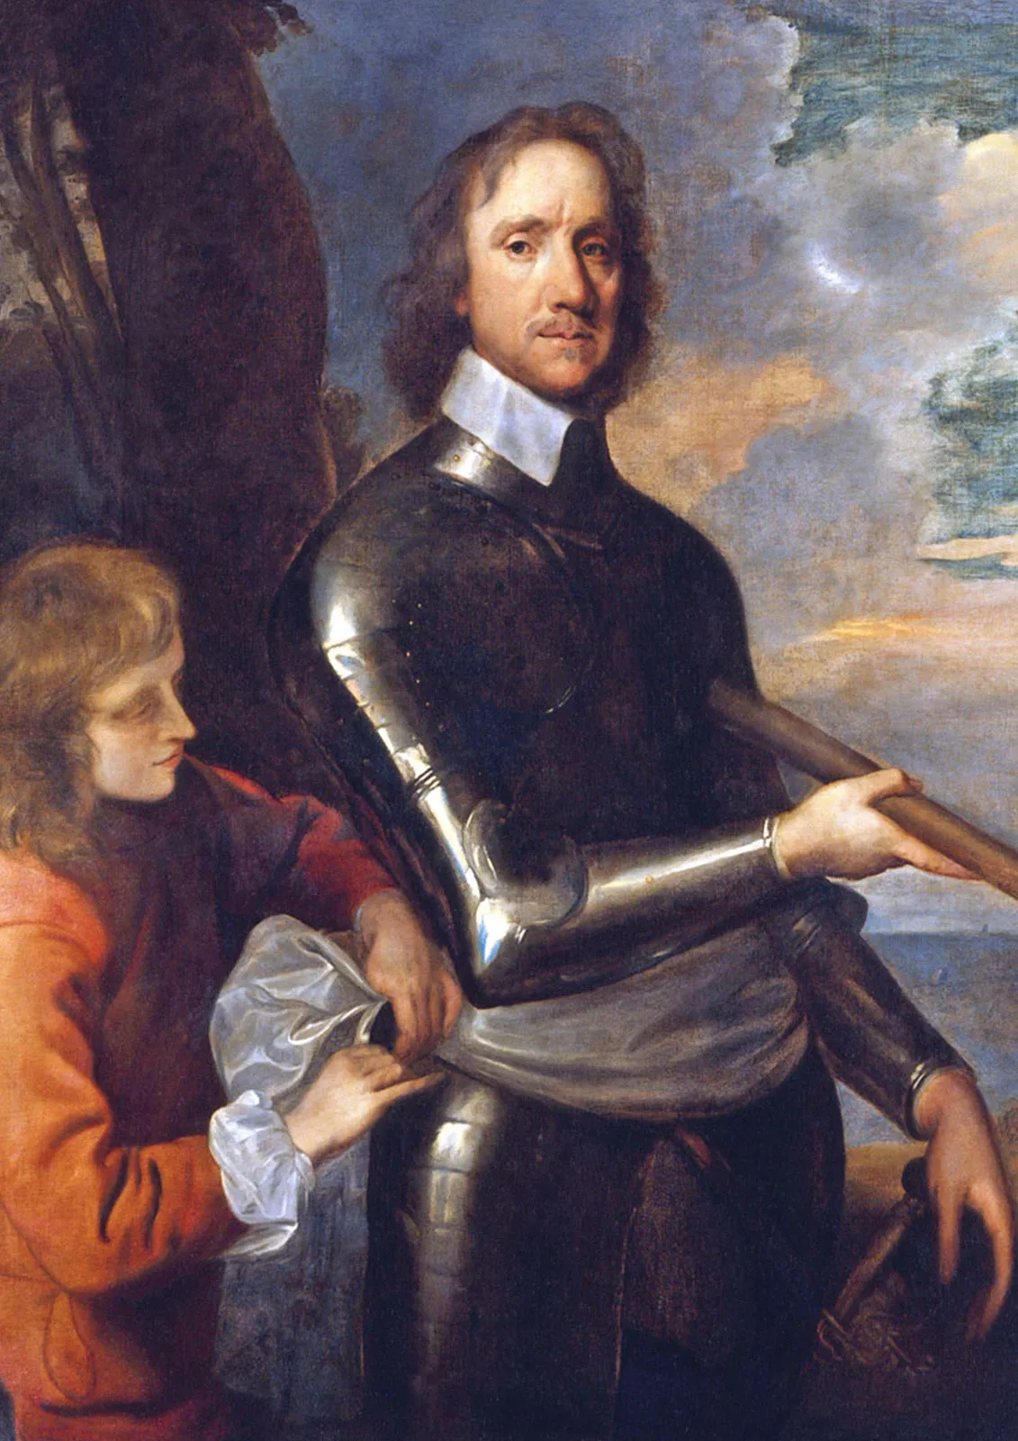
Oliver Cromwell
The mastermind behind the New Model army which was used to defeat the Royalist army and capture Charles I
1649 Cromwell crushed a rebellion in Ireland.
Groups going against the government were marginalised and their leaders were imprisoned.
1653 Cromwell, backed with the army, marched into Parliament and took power as Lord Protector.
Attempted to create a religious settlement that would appeal to all but his puritan views made him unpopular.
He closed theatres, banned Christmas and stopped women wearing make up.
After Cromwell’s death Parliament restored the monarchy but it had gained more powers than before the Civil War.
Rule by the army
Rule by Parliament
It was the first time a King was not replaced by another King
Rule by Cromwell
Between 1649-60 England tried three ways to rule without a King – but failed
Significance of the English Civil War
When the monarchy was restored it did not hold the same power
Parliament asked Charles II to become King
Not as influenced by the abilities of each king
Parliament met more regularly
Factor | How it affected the English Civil War story
War | Charles went to war with the Scots to enforce a new prayer book on them. He was defeated and was ordered to pay them compensation.
Government | Charles’ actions alienated Parliament and led to the start of the Civil War. The ‘Rump’ Parliament decided that the King should be executed,
Religion | The first argument started when Charles attempted to force a new prayer book to Scotland. The Puritan members of Parliament were defending their faith against their ‘Catholic’ King.
Ideas | Parliament believed that the power of the army and the right to end Parliament should be transferred from the King to them.
Role of the individual | Cromwell created the New Model Army which defeated the Royalists. After he was pivotal in the execution of Charles I and became the ruler of England.

Slide 22
Causes of the English Civil War
Charles was not a Catholic, but did marry a Catholic princess from France, Henrietta Maria. When Buckingham was killed in 1628, she became Charles’ closest adviser. English people were scared of her influence and what this could mean for their Church. The person who went on to have the most influence over religion in England was William Laud. He was made Archbishop of Canterbury in 1633 and felt the same as Charles about making changes to the Church. Laud was not a Catholic, but he Arminian, which meant he thought people should worship in a similar way to Catholics. For example, he wanted the church clergy to be more separate from the congregation and to be dressed in robes that showed their importance, he also wanted churches to be more decorated, with candles, crosses, statues and paintings. Laud’s changes met so much opposition because many Puritans – who were Protestants who wanted the king to reverse the reforms Laud had introduced – had become prominent in parliament. They were vocal in their opposition. One famous case of opposition was from three men; Prynne, Bastwick and Burton. They wrote a pamphlet criticising the Church. The men were tried in the Star Chamber, which had become a substitute for parliament during Charles’ personal rule. It was used against anyone who spoke out against the king and Laud, and was known for being corrupt because it always came down on the side of the king. Prynne, Bastwick and Burton were punished as thieves would be pilloried, their faces were branded, and their ears cut off. What Laud and Charles had not expected was the widespread support for the men. When they were released from prison they were met by a large cheering crowd, when their ears were cut off people crammed in to dip their handkerchiefs in the blood. These men were seen as heroes. The Causes of the English Revolution The Scottish rebellion and the Covenanters Charles’ changes in religion also caused unrest in Scotland. The Scots had always had their own Church which by this time was Presbyterian, which is a type of Protestantism. However in 1637, the king insisted that everyone in Scotland should use the new Laudian prayer book. This relied on the catechism - religious instruction from the priest – and moved away from the Protestant method of personal worship. There were riots in St Giles Cathedral in Edinburgh: the Scots would not be told how to worship. In 1638 they signed an agreement, called a covenant, saying they would not accept the changes. The people who signed it were known as the Covenanters. When Charles sent an army to Scotland in 1639, the Covenanters defeated it. They then invaded England. The Short Parliament and continued opposition Charles needed more money if he was going to defeat the Scots. Eleven years after he had closed parliament, he needed to ask it to meet again. In April 1640, Parliament agreed to provide Charles with the funds he needed to fight the Scots, but only with conditions. He had to promise not to pass laws without parliament’s agreement, not to raise unpopular taxes and to stop Laud’s religious changes. This parliament was called the Short Parliament as it only lasted a month. Charles would not give into parliament’s demands. The Long Parliament Another parliament was called by Charles in November 1640. Charles was running out of options and was keen to defeat the Scots and restore order. He knew he needed Parliament. Many people were convinced that the agreements would mark an end to the unrest. The demands of parliament, November 1640, and what the king had agreed to by the summer of 1641 Rebellion in Ireland When Strafford returned to England in 1640, riots broke out in Ireland. Thousands of Protestants were killed by Catholics. Many people in England thought that Charles supported the rebellion, they saw it as a Catholic plot. Parliament was willing to give money to suppress the Irish rebellion but they did not want Charles in charge of the army. Parliament took control of the army, Charles’ response was ‘By God! Not for an hour!’ He was furious.

Slide 23


Causes of the English Civil War
1642 and the Five Members By 1642, relations had deteriorated again between the king and parliament. John Pym, a leading opponent of the king, presented the Grand Remonstrance. This was a list of grievances towards Charles, and was the straw that broke the camel’s back. Charles would not be made a fool of by parliament. He raised an army and marched to parliament to arrest the five men – the Five Members – who led the opposition. They had already escaped but now everyone knew how far Charles would go to protect himself. This was even more proof that he was a tyrant who would not listen to the people.
Independent learning clips
History in a nutshell
The causes of the English Civil War
What caused the English Civil
War – History Hub

Slide 24
Who fought whom? The war was fought between the Royalists (Cavaliers) against the Parliamentarians (Roundheads). It is generally agreed that peoples’ class affected which side they supported. The wealthy landowners supported the king, as a way to show personal loyalty and to keep in place the social structure they benefitted from. The middle classes and peasant workers supported parliament, as there was a less rigid social structure in parliament. There were also clear geographical allegiances. The king’s support came mostly from the north, while Parliament had support in the south and in London. This was partly due to a merchant class (traders and businessmen) who were not happy about the taxes Charles was imposing. Religious and political reforms introduced by Charles gave many people good reason to go against him and support parliament. Also, many people simply felt that Charles’ personality did not make him a good king. There were reports that some families divided their loyalties so that no matter who won, they would be on the winning side. Many poorer people were forced to support whichever side their lord supported. Propaganda as a tactic The war started with a draw at the Battle of Edgehill in 1642. The king tried to take London but failed, and withdrew to Oxford. Both sides fought using infantry and cavalry, and used tactics that had been seen in many battles before. The king’s nephew, Prince Rupert, was one of the most prominent royalist commanders. He led successful campaigns against parliamentary forces and this earned him a bad reputation among the Roundheads. To combat his successes, parliamentary forces created propaganda against Rupert and his trusty dog, Boy, who would accompany him into battle. Propaganda is still used today; it is designed to wear the opponent down and make people turn against them. This worked in the case of Rupert because it made people think he was weak; it created the idea that the king was weak. The New Model Army and Naseby It is important to remember that not all parliamentarians wanted the full removal of the monarchy. The just wanted the removal of royal reforms. This attitude angered Oliver Cromwell. He was the Member of Parliament for Cornwall and had been leading the Roundheads against the Cavaliers, with Thomas Fairfax. Fairfax was a lord who had once worked with Charles to fight the Scots; he joined the parliamentary forces in 1642. Cromwell was committed to removing the king. He knew that the Battle of Marston Moor could have been a defeat for his side and he did not want that to be the case again. He trained a new army which would be known as the New Model Army. He recruited men based on their ability, rather than their privilege. The army was disciplined and lived by a strict religious and moral code. The men were not allowed to drink or swear. The army was used for the first time at the Battle of Naseby in 1645. The New Model Army with 14,000 men outnumbered the king who had 9000 men. They defeated the royalist cavalry by slowly approaching, rather than charging. They overcame the royalist infantry by manoeuvring behind them and attacking from the rear. Naseby was the end of the king’s last great army. The New Model Army, under Cromwell, went on to capture Bristol and then Oxford in 1646. There was now little doubt about who would win the war. Second Civil War When Charles was imprisoned he was keen to negotiate with parliament to secure a peaceful end to their disagreements. However, at the same time, he was writing to the Scottish parliament to convince them to raise an army to fight against the English parliament and the New Model Army. He promised them a Presbyterian Church in England. The Scots did organise an army to fight Cromwell and the Second Civil War began. The two sides met at the Battle of Preston in 1648. The Scots were defeated and Charles had proved that he could not be trusted. The Rump Parliament In December 1648, the regiment of Colonel Thomas Pride surrounded the Houses of Parliament and refused entry to Members of Parliament who were known to support negotiations with the king. Thomas Pride was a soldier in the civil war and had fought with Cromwell against the Scots. His actions became known as ‘Pride’s Purge’ and meant that the king would stand trial with no supporters. The remaining members formed a parliament that was known as the Rump Parliament.

Slide 25

Causes of the English Civil War
Independent learning clips
Significance of the English
Civil War– History Hub

Slide 26

Knowledge organiser
TOPIC The American war of Independence
In 1776 the thirteen colonies of North America declared their independence from Britain. Most people believed that colonies were unable to exist as a separate country.
Over the previous 150 years these colonies had been largely self-governing but it was war with France that brought to a head the tensions that led to the American Revolution.
There are echoes of Magna Carta and other revolts in the words of the Declaration of Independence, words that are still powerful today and which would have a most profound impact on events during the following 200 years.
The American Revolution and the War of Independence that followed it had important consequences for the way Britain was governed.
The slogan of the Revolution, ‘no taxation without representation’, remains a strong political rallying cry today
Causes of the American War of Independence
Taxes and War | Powerful ideas & Strong Individuals
The Seven Years war with France made Britain introduce new taxes in America. Britain sent troops to defend their 13 American colonies but wanted them to pay for their up keep. As a result they introduced new taxes on the 13 colonies including the Stamp Act of 1763. There was wide spread opposition to the new taxes as the Americans felt they as they were not represented in the British Parliament then they should not be taxed. This promoted the slogan of the War of Independence, ‘No taxation without representation’. 1773 Boston Tea Party: tipped all the tea on a boat going to Britain into the sea as a protest against British rule. The British responded by closing Boston Harbour to all shipping until compensation was paid. This angered the Americans more. | There were three groups which had different ideas: Moderates: wanted a compromise with the British. Loyalists: wanted to remain part of the British Empire. Radicals: Americans should be represented in any law that taxed them. Thomas Paine was a strong individual: Wrote a pamphlet called ‘Common Sense’ in 1776. The pamphlet urged for American Independence. Sold over 500,000 copies
The British surrender at Yorktown
The American’s supported by the French surrounded the British army at Yorktown.
The British commander had no choice but to surrender as he could not bring in reinforcements.
They were forced to surrender all of their weapons including 214 artillery pieces and thousands of muskets.
On hearing the surrender the British Government passed a Bill stating that no more attempts to defeat the Americans should be taken.
Britain did not have the political will to continue the fight.
The defeat at Yorktown was a humiliating end and defeat for the ’superior’ British forces.
Consequences of the American War of Independence
USA | Great Britain | France | Rest of the World
Declared independence – the declaration reflected the Magna Carta. First time a colony rejected the rule of a European country. | Trading increased with Canada and India. Led to people wanting change in the voting system and the way power was distributed in England | Supported the Americans with troops, ships & money. Erupted into their own revolution six years after. | People began questioning about the rights of having an empire. Adam Smith believed that trade was more important in generating wealth than having colonies.

Slide 27


Changes to the voting system
Fairer distribution of power in Britain
Freedom of the individual
Support for radical opinions grew in Britain
Re-affirmed democratic beliefs
Significance of the American War of Independence
Caused other revolutions against powerful leaders
The defeat made the British more determined never to experience it again
French Revolution 17789
Defeated the French in 1815
Factor | How it affected the American Civil War story
War | The Seven Years war with France resulted in Britain increasing the taxes on the colonies. This forced the American colonies to declare their independence and fight against British rule.
Government | The British government decided to introduce new taxes to force the Americans to pay for British troops to defend their country, This caused the Americans to declare their independence.
Communication | All of the colonies worked together to battle against British rule. After news spread they were supported by France in their battle for independence.
Ideas | There was a widespread belief within America that they colonies should reject British rule.
Role of the individual | Thomas Paine and John Adams were key in promoting independence. Adams helped draft the American Constitution.
Independent learning clips
Significance of the
American Revolution
Stamp Act & origins of
American Revolution

Slide 28
Homework 8 : The American Revolution
TASK INSTRUCTIONS: Read, highlight key points and summarise them
Key words
Empire – collection of tribes, regions, territories, states or countries that are ruled over and controlled by one leader or ‘mother country’.
Colony – country or area under the full or partial control of another country and occupied by settlers from that country.
Colonist – settler in or inhabitant of a colony.
Native American – person that is a member of any of the first groups of people living in North or South America or the Caribbean.
Congress – national legislative body in the USA that makes laws.
Peninsula – long stretch of land that is connected to the mainland but bordered by water on three sides.
Penal colony – place of imprisonment and punishment at a remote location.
Plantation – large farm that specialises in growing usually just one crop.
Autocratic – relating to a ruler who holds all the power.
Long-term causes of the American Revolution The control of large areas of land in North America had been fought over by Britain and France for many years. Britain eventually defeated the French and used the colonies to make money, growing crops like cotton, tobacco and sugar which they sold all over the world. By the early 1700s, there were 13 separate English colonies in North America, with 2.5 million settlers living in them. Many people made huge amounts of money buying and selling slaves that were used in the colonies to farm the land. Countries like Britain wanted empires so they could tax people who lived in the colonies, and ensure that they bought British goods. However, many of the colonists in America, despite being of British descent, now considered themselves American. The American colonists started to resent the economic support they had to give to Britain. One tax they resented was to pay for the British army. The British felt it was acceptable to tax the Americans as the army had been ‘protecting’ the colonists from other foreign powers. Throughout the 1760s, the American colonists were also forced to obey Navigation Acts, which meant only British goods were imported into America. There could be no trading with other countries. If Britain produced something, the colonists could not buy it from another country. In addition, the colonists felt bossed about by the British because they were given boundaries on the land that they could not cross. The British had made these agreements with the Native Americans without consulting the colonists. These boundaries stopped them accessing good farmland: the colonists wanted to have more of a say.

Slide 29
Homework 8: American Revolution
TASK INSTRUCTIONS: Read, highlight key points and summarise them
No taxation without representation: short term causes of the revolution The citizens of America were ruled directly from Britain yet they had no representatives in parliament in London. So they felt there was no-one to speak up for them. Throughout this topic the desire for representation has been a common theme. People wanted a voice in what was done to them and for them, especially if they were expected to pay for it through taxes. So the colonists, who had started to identify as American rather than British, stated: No taxation without representation! One key event which was the kickstarted the fight against the British was the Boston Massacre of 1770. When some anti-British colonists jeered, and threw snowballs and sticks at the British army on 5 March, the army opened fire and killed some of them. Unrest in Boston continued to grow when some of the colonists, unhappy with the heavily taxed British tea they were forced to buy, boarded a ship and poured the tea out into the harbour. This act of defiance scared the British and in retaliation they closed the port of Boston. This event is known as the Boston Tea Party. By 1775, anti-British feeling was so strong that when the British army tried to seize a supply of gunpowder in Concord they were fired on by 20,000 ‘minutemen’. These men were local farmers, office workers and ploughboys who had enough of British rule. This became known as the Lexington incident and marked the start of the revolution against the British. Declaration of Independence The Americans organised themselves quickly. They met in Congress and by 1775 had made George Washington the leader of their army. In 1776 Congress met in Philadelphia and issued a Declaration of Independence. This stated that the 13 colonies were free and that all control from Britain had ended. This was the easy step; the hard part would come in making the declaration a reality. There would be seven years of fighting before the colonists were victorious and an independent America was a reality. Yorktown and the defeat of the British One of the world’s biggest and best-trained armies had been defeated by a group of American farmers and office workers. How could this have happened and what did this mean for Britain’s control of their empire. The British had won most of the battles during the American War of Independence. They had a world class army that was well-trained and well supplied. However, many of the battles took place in areas with forests and mountains and in places that the British did not know well.

Slide 30







Homework 10 Factors revision: bullet point examples for each factor
FACTORS | Government | War | Religion | Communication
1. Magna Carta
2. Simon de Montfort
3. Peasants Revolt
FACTORS | The Economy | Ideas e.g. representation | The Role of the Individual | Chance
1. Magna Carta
2. Simon de Montfort
3. Peasants Revolt

