Slide 1
Do it now! Whiteboards
What does secularisation mean?
What legal changes have come about that have changed family types?
How have gender roles changed in society?
How has this impacted the family?

Slide 2



Learning Journey
Reasons why we have family diversity.
Is the nuclear family still important?
Functionalist view of the nuclear family

Slide 3

Is the nuclear family still important in modern Britain?
Learning Objectives:
To explain the importance of the nuclear family.

Slide 4
Getting us thinking….
Where do we see the nuclear family image portrayed in different aspects of our society?
NUCLEAR FAMILY
THINK-PAIR-SHARE

Slide 5
Nuclear Family
The nuclear family is often seen as the ideal, typical family type in society.
The typical roles are:
Father- going out to work (breadwinner). Instrumental: They are decision makers and provide for the family.
Mother- staying at home to look after the home and children.Expressive role: they look after the emotional needs of the family.

Slide 6
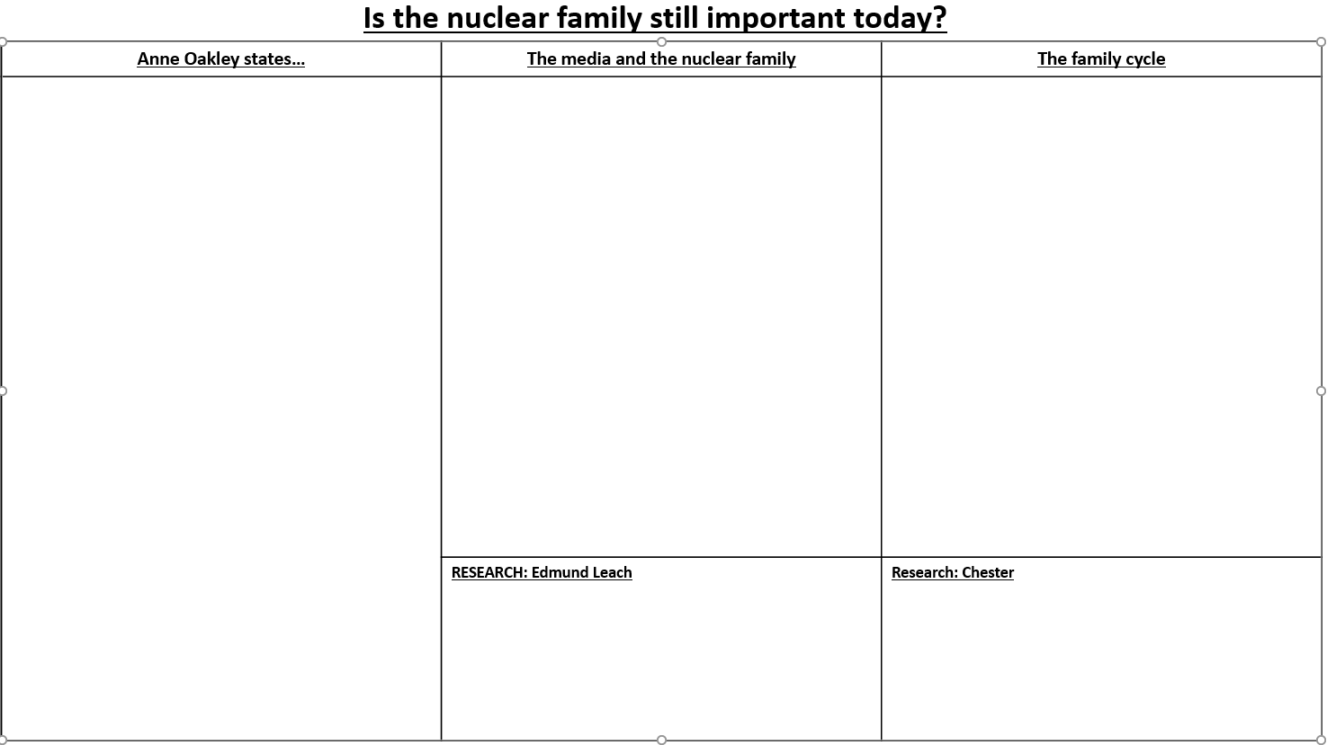
Task: Read and reduce
Using the information given, highlight and read through the studies and evidence of the nuclear family. (5 minutes)
Reduce this information onto your worksheet, try and do no more than five bullet points for each column. (10 minutes)
Extension:
Using the information you have now learnt over the last few weeks, draw out a table in your books stating whether the traditional family is still important in society today.
Yes it is still important No it is not still important
When you finish your task: Add 5 words to your word bank!

Slide 7
What have we learnt? Whiteboards!
Give three factors that Oakley said would make a family nuclear?
Which sociologists see the nuclear family as the perfect fit?
How does the media influence the view of the nuclear family?
What is meant by the term ‘cereal packet family’?
What did sociologist Chester say about the nuclear family?

Slide 8
Practice exam question
Explain what sociologists mean by the nuclear family. [4 marks]
HOW?
Define the Nuclear family as per Ann Oakley (1)
Describe the roles in the nuclear family (1)
What do functionalists believe about the nuclear family? (1)
What did Leach stay about the nuclear family? (1)

Slide 9
Model answer
Explain what sociologists mean by the nuclear family. [4 marks]
Sociologist Oakley states the nuclear family is a family that consists of a heterosexual couple who are married with their biological children. [1] Within the nuclear family the role of the father is to be the breadwinner and the mom stays at home and is the caregiver, looking after the house and children. [2] Functionalists see the nuclear family as the perfect fit for society as the mom and dad each have a role and teach their children the norms and values of society. [3] Sociologist Leach called this family the ‘cereal packet family’ because it is society’s model image of how a family should be. [4]

Slide 10
Getting us thinking….
What alternatives are there to living in a family unit?
Alternatives to the family
THINK-PAIR-SHARE

Slide 11
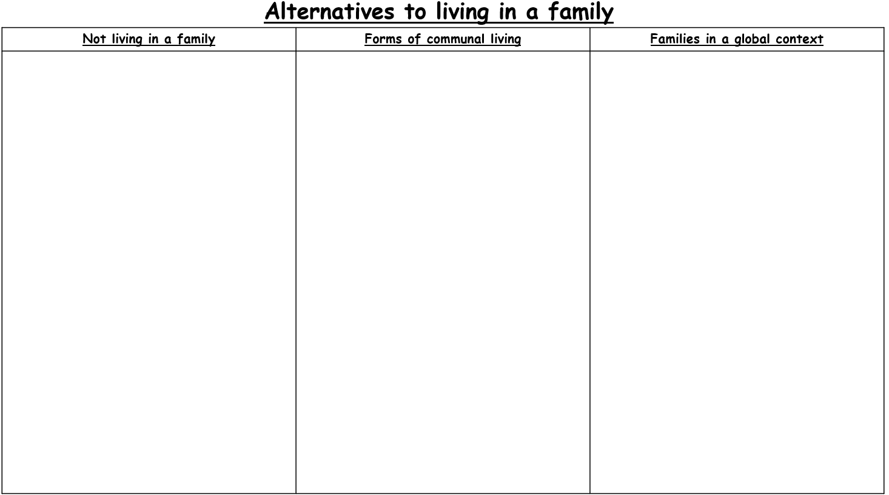
Alternatives to living in a family
Task:
Read through the alternatives to living in a family and reduce into four key bullet points for each column.
(10 minutes)
When you finish your task: Add 5 words to your word bank!
Extension:
Why sociologists favour the nuclear family? Why?
Which sociologists do not favour the nuclear family? Why?
Record into your classwork book!
Notes:
What Life Is Like On An Israeli Kibbutz | Zionism Revisited | Unpacked – YouTube
The Pros and Cons of Living in an Income-Sharing Commune - YouTube

Slide 12
What did we learn?
Why might someone not live in a family?
What is a Kibbutz?
What is a house share?
Give one example of how families are different across the world.

Slide 13
Homework: Revision for knowledge quiz
Revise for knowledge quiz number 2!
The focus is on: different types of family, Rapoport’s study and family diversity.

Slide 14
Plenary: What have we learnt?
What might someone prefer to do rather than live in a family?
Give a form of communal living. What is it?
What is a typical family like in China?
How are south Asian families different?
What is a typical Afro-Carribean family like?

