Slide 1
Knowledge Quiz!
8 minutes

Slide 2
Knowledge Quiz! Answers
A man, woman who are married and their dependent children.
The main income earner in a family/household.
A children who lives at home and is in full time education so relies on their parents.
Beanpole, nuclear, extended, same sex, lone parent, reconstituted.
Beanpole.
Cultural, organisational, life cycle, social class and life course.
Depending on when you were born in history can impact the set-up of your family. E.g. during war time it was common for dads to be absent.
Divorce Reform Act 1969, Same Sex Couples Act 2014, Equal Pay Act 1970
Benefits provided for single mothers helps them become financially independent and therefore they can live in a lone parent family rather than relying on a man.
The decline of religion.

Slide 3
Do it now! Whiteboards
What might someone prefer to do rather than live in a family?
Give a form of communal living. What is it?
What is a typical family like in China?
How are south Asian families different?
What is a typical Afro-Carribean family like?
Live alone, live with friends, house share, live in a communal area - commune.
Commune, kibbutz, house share, residential homes.
Male dominated, daughters obey fathers, women obey husband, widow obeys her son.
Based around extended family networks, male dominated, the older you are the more important you are.
Mother tends to be head of the family. Children looked after by other relatives and friends.

Slide 4



Learning Journey
Is the nuclear family still important?
Functionalist view of the nuclear family
Marxist view of the nuclear family

Slide 5

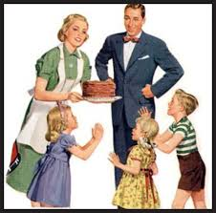
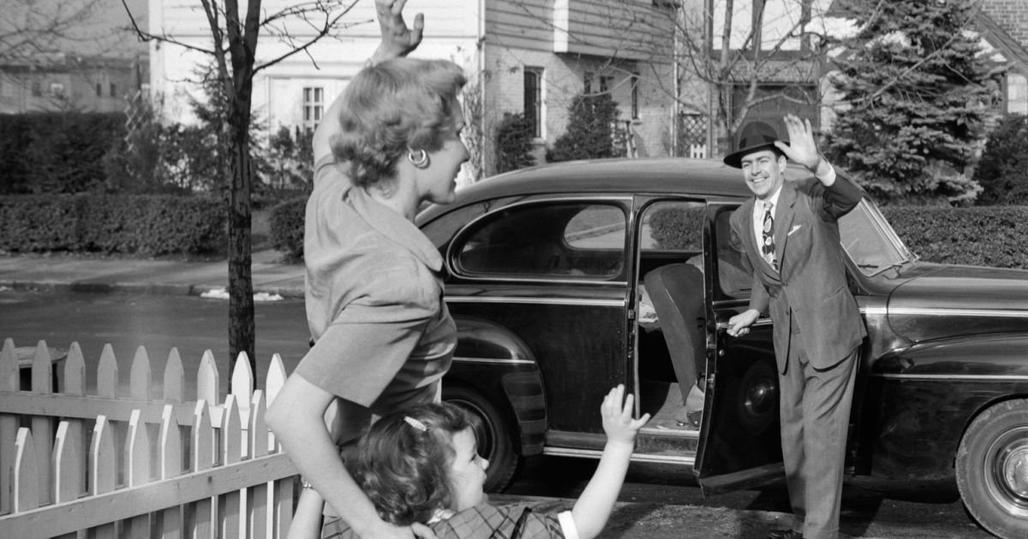
Functions of the family: Functionalist view
Learning Objectives:
To describe the functions of families and explain the work of sociologist Parsons.

Slide 6
Getting us thinking… whiteboards
Write a list of all the domestic jobs that need to be done within a household.
THINK-PAIR-SHARE
Functions of the family
Now write next to each job whether you think it is a man or woman’s role. Who tends to take on the role in your household?

Slide 7
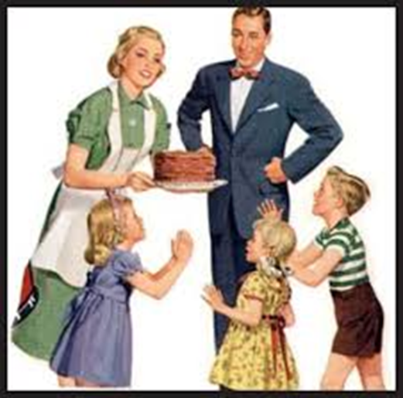
Functionalism and the family
Functionalists are interested in the positive functions of the family.
They see the nuclear family as extremely functional.
It is necessary for the smooth running of society.

Slide 8
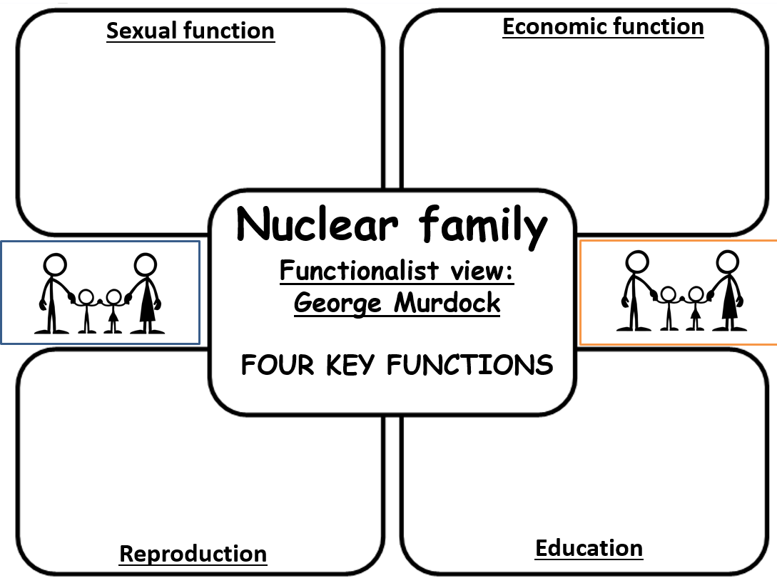
Functionalism and the nuclear family
Using the information given, highlight and read through the information on Murdock and the nuclear family. (2 minutes)
Reduce this information into the correct box on your worksheet your worksheet, try and do no more than two bullet points for each box.
(6 minutes)
Extension:
What other sociologists might criticise the functionalist view of the family? Write your answers in your book!
What negatives might functionalists ignore of the nuclear family? Write your answers in your book!
When you finish your task: Add 5 words to your word bank!

Slide 9
What have we learnt? Whiteboards!
Who did Murdock study when researching the nuclear family?
What did he find in those societies?
What did functionalist Murdock state are the four functions of the family?

Slide 10
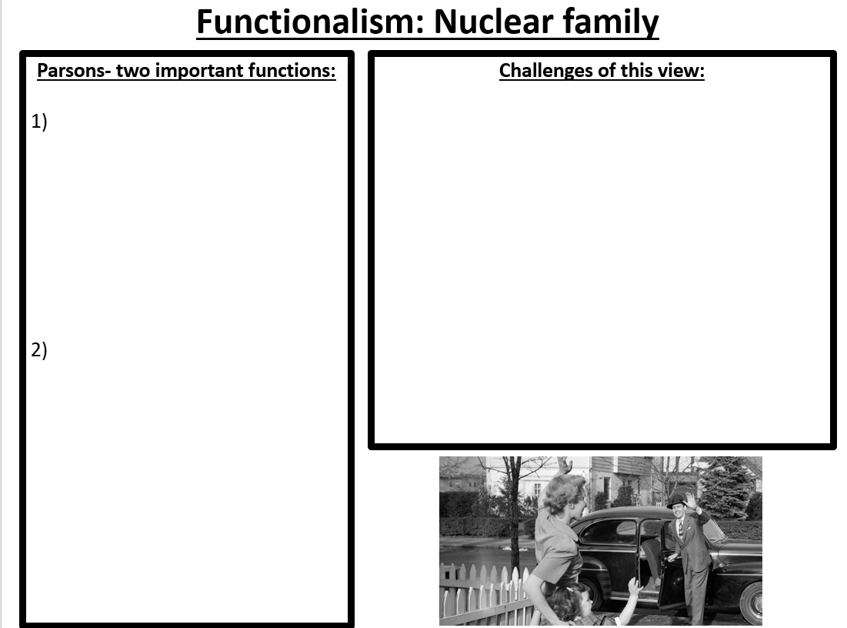
Functionalism and the nuclear family
Using the information given, highlight and read through the information on Parsons and the nuclear family. (2 minutes)
Reduce this information into the correct box on your worksheet your worksheet, try and do no more than four bullet points.
(5 minutes)
Extension:
What other sociologists might criticise the functionalist view of the family? Write your answers in your book!
What negatives might functionalists ignore of the nuclear family? Write your answers in your book!
When you finish your task: Add 5 words to your word bank!

Slide 11
What have we learnt? Whiteboards!
Name the two functions of the family according to functionalist Parsons.
What is primary socialisation?
What did Parsons mean by stabilisation of adult personality?

Slide 12
Functionalism and the nuclear family
Now let’s read through the criticisms of the functionalist view of the family. (1 minutes)
Reduce this information into the correct box on your worksheet your worksheet, try and do no more than four bullet points.
(5 minutes)
Extension:
What other sociologists might criticise the functionalist view of the family? Write your answers in your book!
What negatives might functionalists ignore of the nuclear family? Write your answers in your book!
When you finish your task: Add 5 words to your word bank!

Slide 13
What have we learnt? Whiteboards!
Give two criticisms of the functionalist view of the nuclear family.

Slide 14
What have we learnt? Whiteboards!
What did functionalist Murdock state are the four functions of the family?
Name the two functions of the family according to functionalist Parsons.
Give two criticisms of the functionalist view of the nuclear family.

Slide 15
READ THE KEY STUDY SHEET ON DELPHY AND LEONARD

Slide 16
Practice exam question
Explain the functions of the family according to Murdock.
[4 marks]
Functionalist Murdock studied… He believes…
The four functions of the family are…
This is beneficial for society because… (explain two of the functions and why they are good for society according to Murdock).

Slide 17
Model answer
Explain the functions of the family according to Murdock.
[4 marks]
Functionalist Murdock studies over 250 societies and found some form of a nuclear family existed in all of them. He believes the nuclear family is the best fit to keep society running smoothly. [1] He states there are four clear functions of the nuclear family, they are the sexual, reproductive, educational and economic functions. [2] Murdock believed these were beneficial for society, for example the reproductive function ensured new people are being born to continue society, which generally occurs in a family setting. [3] Furthermore, the educational function meant children learnt the norms and values of society through their parents (primary socialisation) which helps society run smoothly when everyone knows and follows these values. [4]

Slide 18

Key study! Parsons
As we mentioned with the Rapoport’s study on family diversity, there are key studies you must know for your exam.
One of these key studies will be on your exam paper and you must be able to answer an exam question on this.
We will complete an Item question on Parsons.

Slide 19
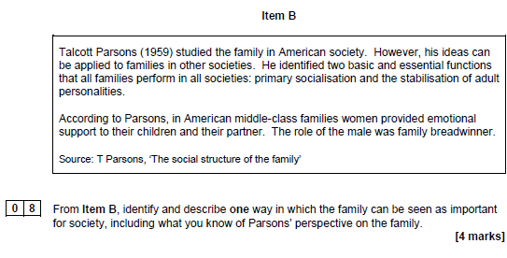
Key study! Parsons
Studying from a ________ perspective, Parson’s believed….. (quote the item).
One way the family is seen as important is…
This is when…
The roles in the family are…
This is beneficial for society because…

Slide 20
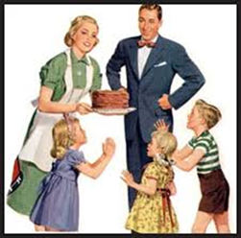
What have we learnt…. 3, 2, 1.
Three things I have learnt today is…
Two things I did well was…
One question I still have is…

