Slide 1
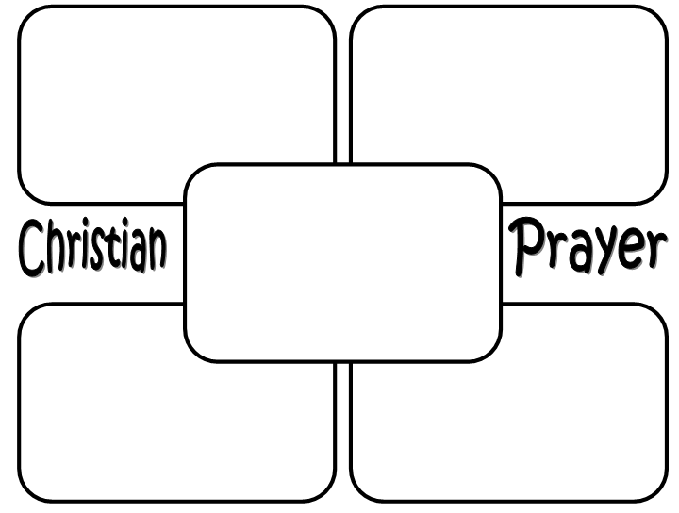

Sexual function
Economic function
Task
Nuclear family
Functionalist view: George Murdock
FOUR KEY FUNCTIONS
Reproduction function
Education function

Slide 2
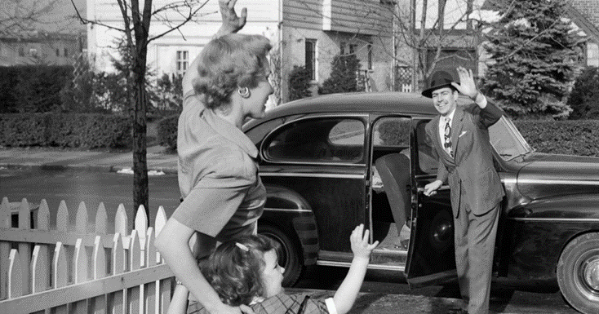
Functionalism: Nuclear family
Parsons- two important functions:
1)
2)
Challenges of this view:

