Slide 1
Knowledge Quiz 2
10 mins

Slide 2

Knowledge Quiz 2
A group of two or more persons associated by birth, cohabitation, marriage or adoption.
The person in the household who is the main income earner.
A person living in the household who is under 16 years of age or aged between 16-18 but in full time education.
Nuclear, lone parent, same sex, beanpole, extended, reconstituted.
Beanpole.
Cultural, life course, organisational, generational (life cycle), social class.
Different generations have different beliefs on how the family should be ran depending on when they were born.
Same Sex Couples Act 2013.
Women have been able to leave unhappy marriages and claim benefits to support them and therefore be a lone parent family.
Decline in religion.

Slide 3
From last lesson – 1 point | From two lessons ago – 2 points | From three lessons ago – 3 points | From four lessons ago - 4 points
What are the four functions of the family according to Murdock? | Give an example of communal living | What is meant by the term ‘cereal packet family’? | Why is there now cultural diversity amongst families?
What did Parsons call the belief that families pass on the norms and values of society? | What might someone prefer to do rather than live in a family? | Which sociologists see the nuclear family as the perfect fit? | Why has the organisation of families changed over time?
In Stabilisation of adult personality: Parsons argued that the family stabilises adults and he called this the…. | What are the three rules of obedience in a Chinese family? | Give at least one factor that Oakley said would make a family nuclear? | How do families differ amongst different social classes?
Identify one criticism of the Functionalist view of family | What is a typical Afro-Caribbean family like? | How does the media influence the view of the nuclear family? | Why might life cycle impact families?

Slide 4
From last lesson – 1 point | From two lessons ago – 2 points | From three lessons ago – 3 points | From four lessons ago - 4 points
What are the four functions of the family according to Murdock? Sexual, reproductive, educational and economic | Give an example of communal living Student at Uni House share Commune e.,g. Kibbutz Care home | What is meant by the term ‘cereal packet family’? society’s model image of a family | Why is there now cultural diversity amongst families? Legal changes, changes in social attitudes, longer life expectancy, benefits, decline in religion, immigration
What did Parsons call the belief that families pass on the norms and values of society? Primary socialisation | What might someone prefer to do rather than live in a family? Live with friends, house share or live alone | Which sociologists see the nuclear family as the perfect fit? Functionalists | Why has the organisation of families changed over time?have different beliefs and lifestyles which means they tend to have different types of family.
In Stabilisation of adult personality: Parsons argued that the family stabilises adults and he called this the…. Warm bath | What are the three rules of obedience in a Chinese family? obeys father, a married woman obeys her husband, a widow obeys her son | Give at least one factor that Oakley said would make a family nuclear? one or two of their natural children The couple - married heterosexual Dad is the breadwinner | How do families differ amongst different social classes? Difference in attitudes, conjugal roles, more instability in lower class families, affects life chances,
Identify one criticism of the Functionalist view of family Perfect picture Functional families can turn into dysfunctional families Does not consider other families may be different due to ethnicity, religion and class. outdated. | What is a typical Afro-Caribbean family like? matrifocal’ culture. This family type also tends to have a lot of support from extended family members. As a result, multiple women are involved in the childhood socialisation | How does the media influence the view of the nuclear family? present a stereotypical image of the family that is based around the roles of mothers, fathers and children in the traditional nuclear family | Why might life cycle impact families? People get divorced, remarried, die, children leave home

Slide 5



Learning Journey
Functionalist view of the nuclear family
Marxist view of the nuclear family
Feminist view of the nuclear family

Slide 6
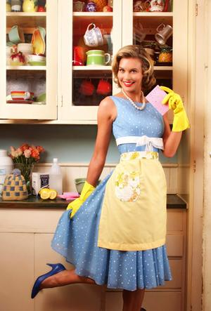
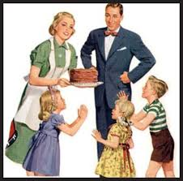
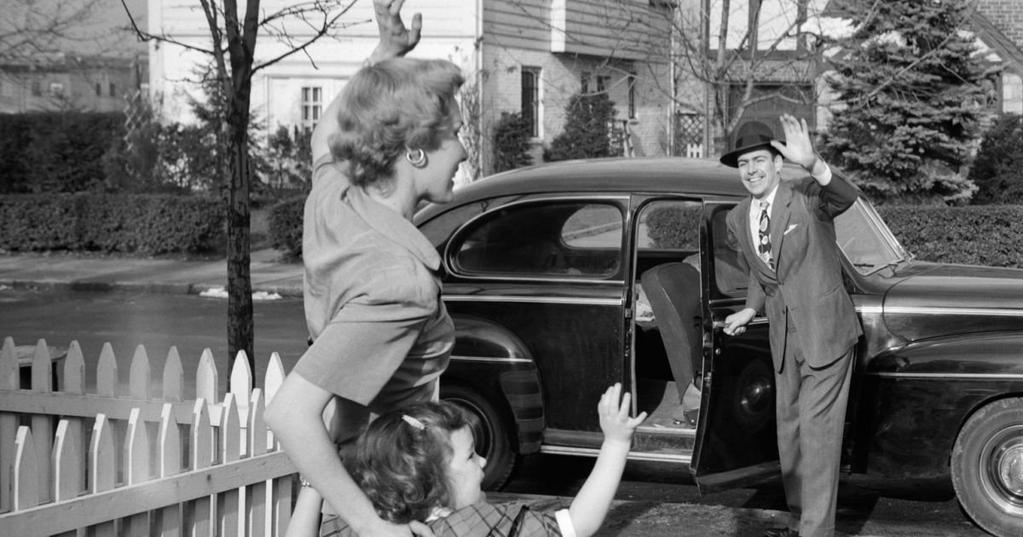
Functions of the family: Marxist view
Learning Objectives:
To describe the functions of families according to Marxism.

Slide 7
Marxism and the family
Marxists DO NOT see the nuclear family as a necessary function.
They say the nuclear family as a way of driving a capitalist society.
This is a society driven by profit, money and conflict between social classes.

Slide 8
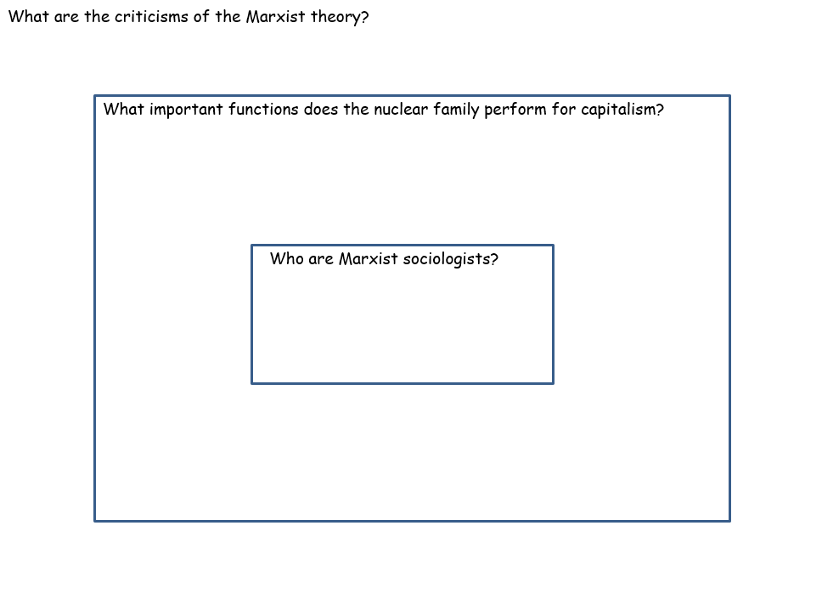
Marxism and the family
Read carefully through the information on the Marxist view of the family.
Answer the questions on your ripple diagram. Make sure you include:
1) What important functions does the nuclear family perform for capitalism according to Marxists?
GIVE FOUR EXAMPLES
2) What are the criticisms of the Marxist family?
GIVE FOUR EXAMPLES
When you finish your task: Add 5 words to your word bank!
Extension:
How are functionalists and Marxists alike in their studies? How are they different?
Draw a table in your book with the similarities and differences of the two theories.

Slide 9
What have we learnt? Whiteboards!
What do Marxists mean by a capitalist society?
Give a function that Marxists believe the nuclear family performs to serve a capitalist society?
How has the Marxist view been criticised? Give two criticisms!

Slide 10

Key study! Zaretsky
As we mentioned with the Rapoport’s study on family diversity and Parson’s study on the nuclear family, there are key studies you must know for your exam.
Glue into your book and read through the study on Marxist Zarestky. What does he state about the nuclear family and capitalism?
Summarise in FIVE key bullet points. (5 mins)
Let’s feedback together.

Slide 11
Practice exam question
Identify and explain the functions of a nuclear family according to Marxists.
[4 marks]
Marxist sociologists believe…
(what do they believe about society?)
They say the nuclear family encourages capitalism through key functions. These are… (give examples of functions and explain how they ensure capitalism continues in society).

Slide 12
Model answer…
Marxist sociologists believe the nuclear family is another way of driving a capitalist society and creates inequality between the rich and poor. [1] They say that the nuclear family encourages capitalism because families buy products for their members such as cars, houses and food, which supports capitalism and makes sure the rich make profit. [2] Also women in the family provide unpaid labour by staying at home and socialising children to be the next generation of workers, supporting capitalism. [3] They also provide emotional support for the fathers who go out to work in a capitalist society to help them deal with the exploitation they face at work such as long hours and low pay. [4]

Slide 13
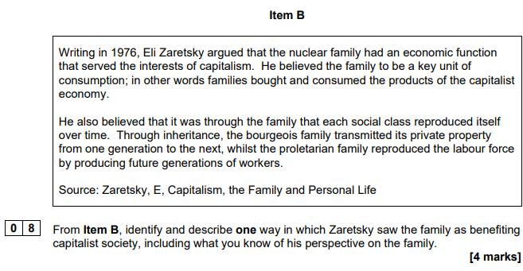
Key study! Zarestsky
Studying from a ________ perspective, Zaretsky believed…..
The nuclear family supports a capitalist society through…
This benefits the rich because…
As it states in Iten B…

Slide 14
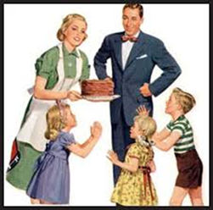
What have we learnt…. 3, 2, 1.
Three things I have learnt today is…
Two things I did well was…
One question I still have is…

