Slide 1
Do now! Whiteboards.
What do Marxist sociologists believe?
What do they say about the family?
3) What criticisms were made to the Marxist view of the family?

Slide 2
Do now! Whiteboards.
What do Marxist sociologists believe?
What do they say about the family?
3) What criticisms were made to the Marxist view of the family?
Society runs on profit and owning property. We live in a capitalist society.
Families buy things so supports capitalism, men have children to pass down their property, families socialise children to know their place in society, family provides unpaid labour.
Can be seen as old fashioned- men do not buy property just to pass it down to children anymore.
People do not marry just to keep their social class anymore, they marry for love and affection.
Ignores the benefits of the nuclear family such as support given by parents to children.

Slide 3



Learning Journey
Marxist view of the nuclear family
Feminist view of the nuclear family
Changes to family structure over time

Slide 4
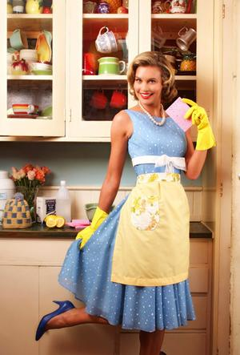
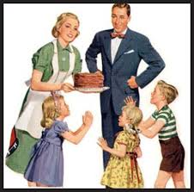
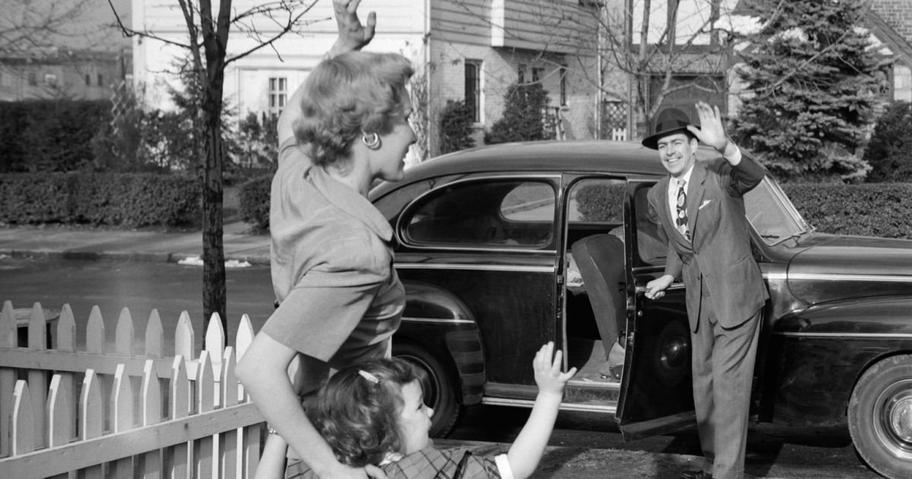
Functions of the family: Feminist view
Learning Objectives:
To describe the functions of families according to feminism.

Slide 5

Feminism and the family
All feminists believe we live in a patriarchal society where women are oppressed.
However, different kinds of feminists have different views on the family.
We will look at these different feminists now…

Slide 6
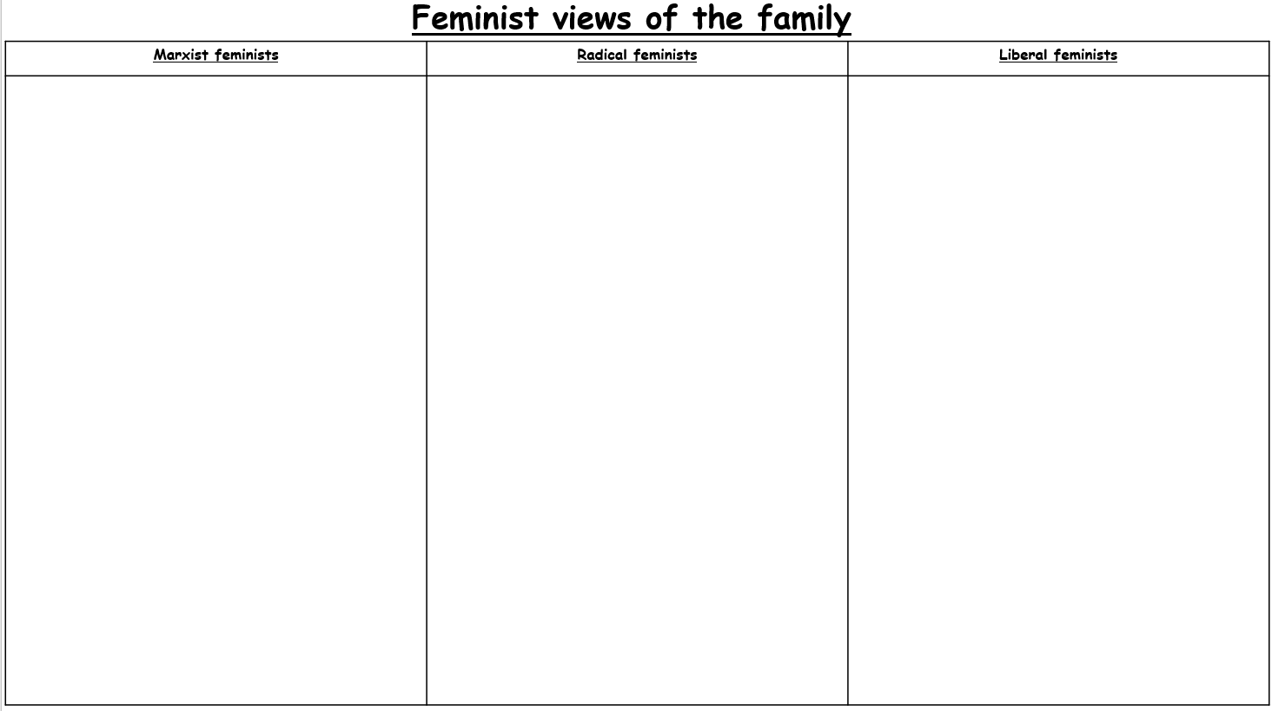
Feminism and the family
Read carefully through the information on the different feminist views of the family. We will start with Marxist feminists.
Record into no more than FIVE bullet points for each type of feminism.
Highlight the most important sentence from each box.
Why have you chosen this as your most important? Record in your book.
When you finish your task: Add 5 words to your word bank!
Extension:
How are feminists different in their studies of the family compared to functionalism? Record into your book.
How are feminists different in their studies of the family compared to functionalism? Record into your book.

Slide 7
What have we learnt? Whiteboards!
What do Marxist feminists believe about the nuclear family?
How is the family set up to benefit men?
How are women exploited in the family due to capitalism?

Slide 8
Feminism and the family
Read carefully through the information on the different feminist views of the family. We now look at liberal feminists.
Record into no more than FIVE bullet points for each type of feminism.
Highlight the most important sentence from each box.
Why have you chosen this as your most important? Record in your book.
When you finish your task: Add 5 words to your word bank!
Extension:
How are feminists different in their studies of the family compared to functionalism? Record into your book.
How are feminists different in their studies of the family compared to functionalism? Record into your book.

Slide 9
What have we learnt? Whiteboards!
What do liberal feminists believe about the nuclear family?
What does feminist Oakley state about gender socialisation?
What does Oakley mean by the ‘dual burden’?

Slide 10
Feminism and the family
Read carefully through the information on the different feminist views of the family. We now look at radical feminists.
Record into no more than FIVE bullet points for each type of feminism.
Highlight the most important sentence from each box.
Why have you chosen this as your most important? Record in your book.
When you finish your task: Add 5 words to your word bank!
Extension:
How are feminists different in their studies of the family compared to functionalism? Record into your book.
How are feminists different in their studies of the family compared to functionalism? Record into your book.

Slide 11
What have we learnt? Whiteboards!
What do radical feminists believe about the nuclear family?
What do radical feminists Delphy and Leonard state about women’s unpaid labour?
What do radical feminists Duncombe and Marsden mean by the ‘triple shift’?

Slide 12
Practice exam question
Identify and explain liberal feminists view of the nuclear family.
[4 marks]
Liberal feminists believe…
(what do they believe about the nuclear family?)
They say the nuclear family…
Feminist Oakley states…
This is when…

Slide 13
Model answer…
Liberal feminists believe that whilst we have some equality between men and women, the family is still a place where men oppress women and benefit. [1] They say that the nuclear family encourages inequalities between men and women through gender socialisation that is learnt in the family. [2] Feminist Oakley states that boys and girls are socialised differently through the toys they are given, boys having guns and swords whilst girls play with dolls and tea sets (canalisation) and the language that is used towards them, with boys being called words like ‘brave’ and girls being told to be ‘ladylike’ (manipulation). [3] This is when children are socialised into their stereotypical gender roles and this continues beyond the family into later life. [4]

Slide 14

Key study! Delphy and Leonard
As we mentioned with previous topics there are key studies you must know for your exam.
Glue into your book and read through the study on radical feminists Delphy and Leonard. What do they state about the nuclear family and the oppression of women?
Summarise in FIVE key bullet points. (5 mins)
Let’s feedback together.

Slide 15
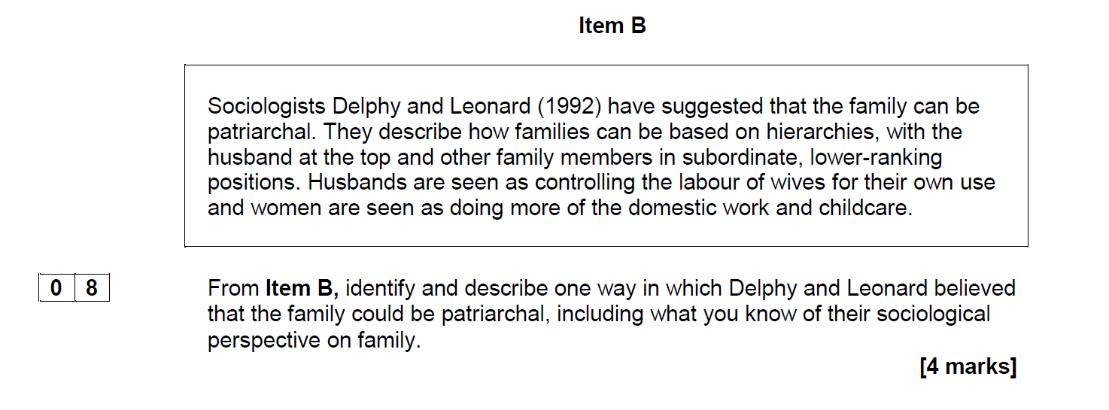
Key study! Delphy and Leonard
Studying from a ________ perspective, Delph and Leonard believe…
The nuclear family is a place where women are oppressed because…
This benefits men as…
They also believe the nuclear family oppresses women because…
This benefits men as…

Slide 16
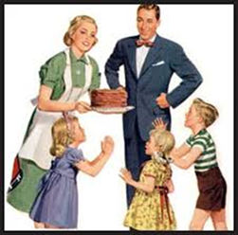
What have we learnt…. 3, 2, 1.
Three things I have learnt today is…
Two things I did well was…
One question I still have is…

