Slide 1
Practice exam question
Identify and explain liberal feminists view of the nuclear family.
[4 marks]
Liberal feminists believe…
(what do they believe about the nuclear family?)
They say the nuclear family…
Feminist Oakley states…
This is when…

Slide 2
Model answer…
Liberal feminists believe that whilst we have some equality between men and women, the family is still a place where men oppress women and benefit. [1] They say that the nuclear family encourages inequalities between men and women through gender socialisation that is learnt in the family. [2] Feminist Oakley states that boys and girls are socialised differently through the toys they are given, boys having guns and swords whilst girls play with dolls and tea sets (canalisation) and the language that is used towards them, with boys being called words like ‘brave’ and girls being told to be ‘ladylike’ (manipulation). [3] This is when children are socialised into their stereotypical gender roles and this continues beyond the family into later life. [4]

Slide 3
What can you remember? Whiteboards!
What do Marxist feminists believe about the nuclear family?
How is the family set up to benefit men?
How are women exploited in the family due to capitalism?
What do liberal feminists believe about the nuclear family?
What does feminist Oakley state about gender socialisation?
What does Oakley mean by the ‘dual burden’?
What do radical feminists believe about the nuclear family?
What do radical feminists Delphy and Leonard state about women’s unpaid labour?
What do radical feminists Duncombe and Marsden mean by the ‘triple shift’?

Slide 4

Key study! Delphy and Leonard
As we mentioned with previous topics there are key studies you must know for your exam.
Glue into your book and read through the study on radical feminists Delphy and Leonard. What do they state about the nuclear family and the oppression of women?
Summarise in FIVE key bullet points. (5 mins)
Let’s feedback together.

Slide 5
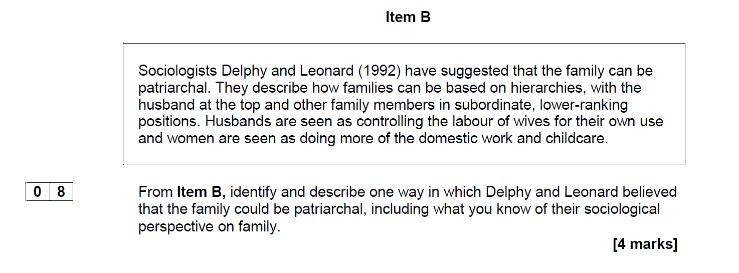
Key study! Delphy and Leonard
Studying from a ________ perspective, Delph and Leonard believe…
The nuclear family is a place where women are oppressed because. (explain/ quote the item)
This benefits men as…
Therefore, the nuclear family is patriarchal because…
Notes:
From item B, identify and describe one way in which Delphy and Leonard believed that the family could be patriarchal, including what you know of their sociological perspective on family [4 marks]

Slide 6
Model answer
Studying from a feminist perspective, Delphy and Leonard believe that the family is patriarchal, where men dominate and control women (1). The nuclear family is a place where women are oppressed as Item B states, ‘husbands are seen as controlling the labour of wives for their own use’ (2). This benefits men as the nuclear family is a place where women are oppressed because they are expected to perform more domestic work and take care of children, while men hold the authority within the household (3). Therefore, the nuclear family is patriarchal because men maintain their power because men are seen to be at the top of the hierarchy in the household and within wider society for example in the workplace this creates gender inequality and a patriarchal society (4).

Slide 7



Learning Journey
Functionalist view of the nuclear family
Marxist view of the nuclear family
Feminist view of the nuclear family
Changes in family structure over time
Is marriage still important today?

Slide 8
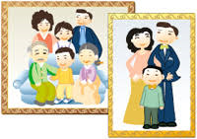
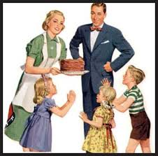
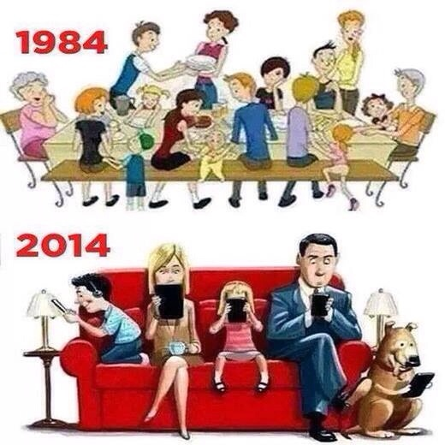
Changes in family relationships over time
Learning Objectives:
To describe how relationships in the family have changed over time.

Slide 9
Changes in family relationships over time
Think-Pair-Share: How has family life changed compared to 50 years ago?
The family has changed considerable over time in terms of:
Size: how big or small family sizes have become over time
Function: how they function within society
Roles within the family: who does what in the family i.e. chores like laundry

Slide 10
What can you remember? Whiteboards!
What do functionalists state about the nuclear family?
What do Marxists state about the nuclear family?
What do feminists state about the nuclear family?

Slide 11
Word banks
In preindustrial families they were a unit of production
Unit of production:
In contemporary families they were a unit of consumption
Unit of consumption:
The family are a group responsible for making something e.g. their own food and clothing
The family are now a group who buy goods and services. E.g. games, clothes, food

Slide 12
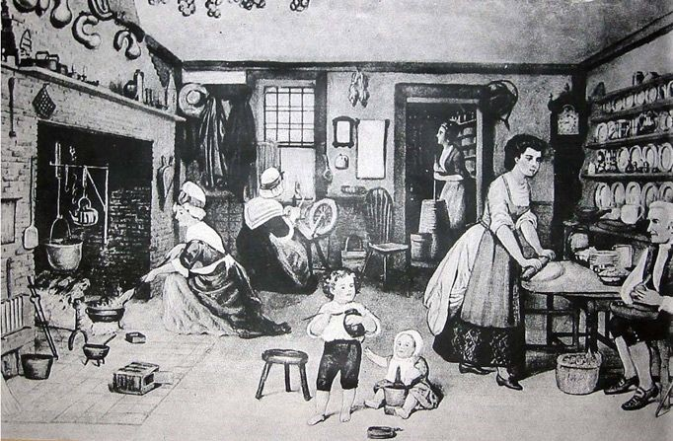
Changes in family relationships over time
Task: summarise the information on pre-industrial families 1600-1800s
Do not move past this!
Move on to your work bank and challenge questions
Extension: what is different from pre-industrial families and now? Give some examples
Word bank:
Peter Laslett
Parsons
Social mobility: the ability to move up or down the social class ladder e.g. receiving more money
When you finish your task: Add 5 words to your word bank!

Slide 13
What have we learnt?
1) What functions did the family perform?
2) What did Parsons argue about pre-industrial societies?
3) What is an extended family?
4) What did Peter Laslett say that challenged Parsons work?
Many functions such as health care, education and welfare.
Parsons (1995) argued that pre-industrial societies were largely based on extended family networks. Land and other resources were commonly owned by a range of relatives extending beyond the nuclear family.
This is a family unit where parents, their children and other relatives e.g. grandparents, aunts and uncles live together.
Arguing the typical pre-industrial family in Britain was nuclear. Either way, home and workplace were the same thing – very few people left home to go to work. At this time there was almost no social mobility, so roles passed from generation to generation and were determined by birth.

Slide 14
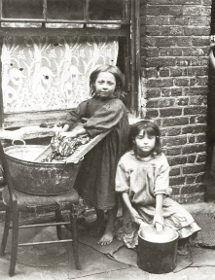
Changes in family relationships over time
Task: summarise the information on industrialised families
Do not move past this!
Move on to your work bank and challenge questions
Extension: what is different from industrialised family and now? Give some examples
Word bank:
Breadwinner
Geographically mobile
Child-centred
When you finish your task: Add 5 words to your word bank!

Slide 15
What have we learnt?
What happened after the 19th century to women and children?
How were children viewed?
What did the state take over?
What were women responsible for when they stayed at home?
Women and children became increasingly excluded from employment by legislation
Children were seen as vulnerable and in need of protection and became dependent on adults
The state took over education, health and welfare.
Responsible for the socialisation of children and the emotional care and support of family members.

Slide 16
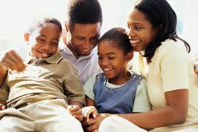
Changes in family relationships over time
Task: Summarise the information on contemporary families
Do not move past this!
Move on to your work bank and challenge questions
Extension: how do you think families will change in the future? Give some examples
Word bank:
Self-sufficient
Isolated
Child centred
When you finish your task: Add 5 words to your word bank!

Slide 17
What have we learnt?
What happened during the 20th century and early 21st century to families?
How has the family become a unit of consumption?
Families have become more child centred
With leisure activities centred on collective enjoyment such as having take always or days out.

Slide 18
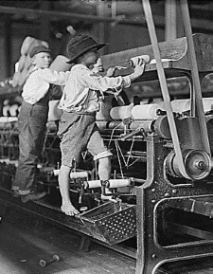
Changes in family relationships over time
Task: summarise the information on parent- child relationships in the past
Do not move past this!
Move on to your work bank and challenge questions
Extension: what is different from pre-industrial families and now? Give some examples
Word bank:
Education Act 1918
Young and Willmott
1841 census
1851 census
Poverty
When you finish your task: Add 5 words to your word bank!

Slide 19
What have we learnt?
Who looked after the middle-class children in the 19th century?
What was found in the 1841 census?
What was found in the 1851 census?
What happened after the Education Act?
What do Young and Willmott argue?
Nanny
More boys than girls worked around Lancashire, particular in the textile industry, where many were employed as cotton mill workers
37% of boys and 20% of girls aged 10-14 worked. Many girls worked unpaid at home, for example housework and childminding, but this was not officially recorded.
All children had to attend school until the age of 14 years.
Young and Willmott argue that only then did ‘childhood’ come to be officially recognised as a separate stage in human life.

Slide 20

Changes in family relationships over time
Task: summarise the information on parent- child relationships today
Do not move past this!
Move on to your work bank and challenge questions
Extension: what is different from pre-industrial families and now? Give some examples
Word bank:
Peter Laslett
Parsons
When you finish your task: Add 5 words to your word bank!

Slide 21
What have we learnt?
What does less authoritarian mean?
What does child centred mean?
State one way the family has changed now?
Less strict
Families are focused on the needs of the child
Family sizes have decreased
Parents work and leave children at nurseries
Young people are now dependent on their families financially

Slide 22
Changes in family relationships over time
Task: summarise the information on theories and the family
Do not move past this!
Move on to your work bank and challenge questions
Extension: what is different from pre-industrial families and now? Give some examples
When you finish your task: Add 5 words to your word bank!

Slide 23
What have we learnt?
How do functionalists view childhood?
How do feminists view childhood?
How do Marxists view childhood?
Childhood improved as a result of more child-centred families. They say changes in attitudes resulted in happier, safer and more valued children.
A time where girls were socialised to accept their secondary position to men in society. Girls watched the exploitation of their mothers in a patriarchal society and therefore learned their future roles.
Working-class children submit to a capitalist society rather than question it. Children become the next generation of workers who work long hours for low wages.

Slide 24
How do families now revolve around children more?
Families today have become more ‘child-centred’.
Why might this be the case? What decisions are you involved with at home? Think-Pair-Share
Using the resource, mind-map into your books ideas as to why families are now more child-centred.
Challenge:
Give reasons as to why some might say family life is NOT more child centred and children may not be as protected as we think?

Slide 25
What have we learnt? Whiteboards!
How has the role of the children in the family changed?
How have laws caused a change for children?
How has education shifted the role of children?
What do we mean by ‘pester power’?
Any other factors that influence the roles in the family?
However, what is a toxic childhood?

Slide 26
Practice exam question
Identify and explain one reason why families have become more child-centred.
[4 marks]

Slide 27
Model answer
Children used to be seen as ‘economic assets’ to their parents, bringing in money for the family as they used to go out and work alongside their parents. [1] However, children are far more protected now so families are now more child-centred. E.g. education has become compulsory until the age of 18 rather than children going out to work. [2] This means children have become more much dependant on their parents as they do not have a full time job where they earn their own money. [3] Children have gone from being ‘economic assets’ to their parents, to being ‘economic burdens’. [4]

Slide 28
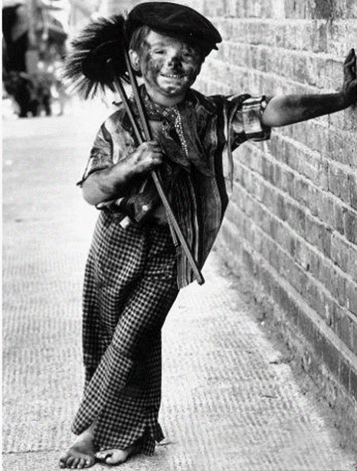
Loss of childhood
Why might some say there is an actual loss of childhood today?
LOSS OF CHILDHOOD

