Slide 1
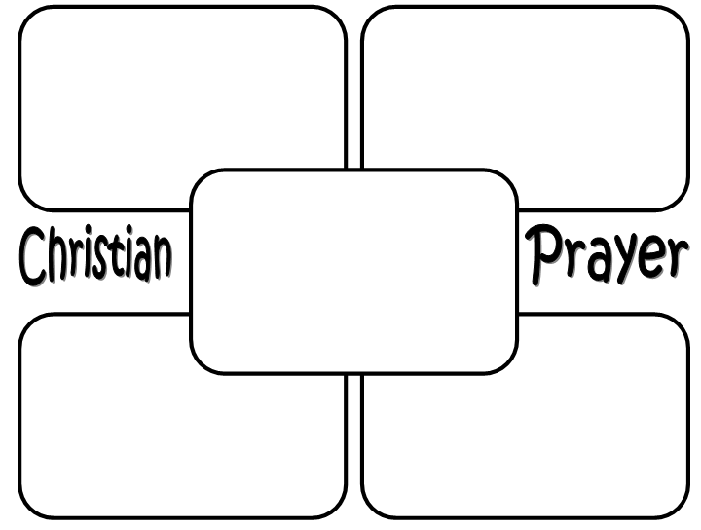
Nuclear family
Reconstituted family
Task
Beanpole family
Same sex family
Different types of family
Different types of family
Extended family
Lone parent family

