Slide 1
DO IT NOW TASK:
Knowledge Quiz! 8 minutes to complete.

Slide 2
Knowledge quiz- answers
Male dominated society that benefits men.
Family, workplace, politics, sport.
The Equality Act 2010.
A shared agreement of how society should work through shared values.
Police, government, schools, parents, teachers.
The socialisation you receive from your parents in the first five years of your life.

Slide 3
Knowledge quiz- answers
Capitalism means only a small amount of people (the rich) own the big businesses and make the profit, while the rest of society (the working class) work for low wages.
Ruling class and working class.
When you are given a label of who you are by others in society, usually those in power.
When you live up to the label you have been repeatedly given and act in that specific way that matches the label.
Charles Murray
Group at the very bottom of society who do not work and live off benefits to survive.

Slide 4



Learning Journey
Introduction to New Right
Knowledge quiz!
Begin Paper 1: Families
What is family diversity?

Slide 5
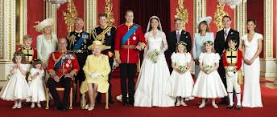
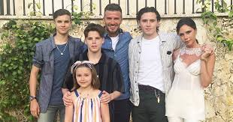
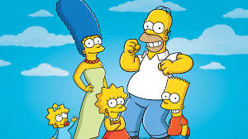
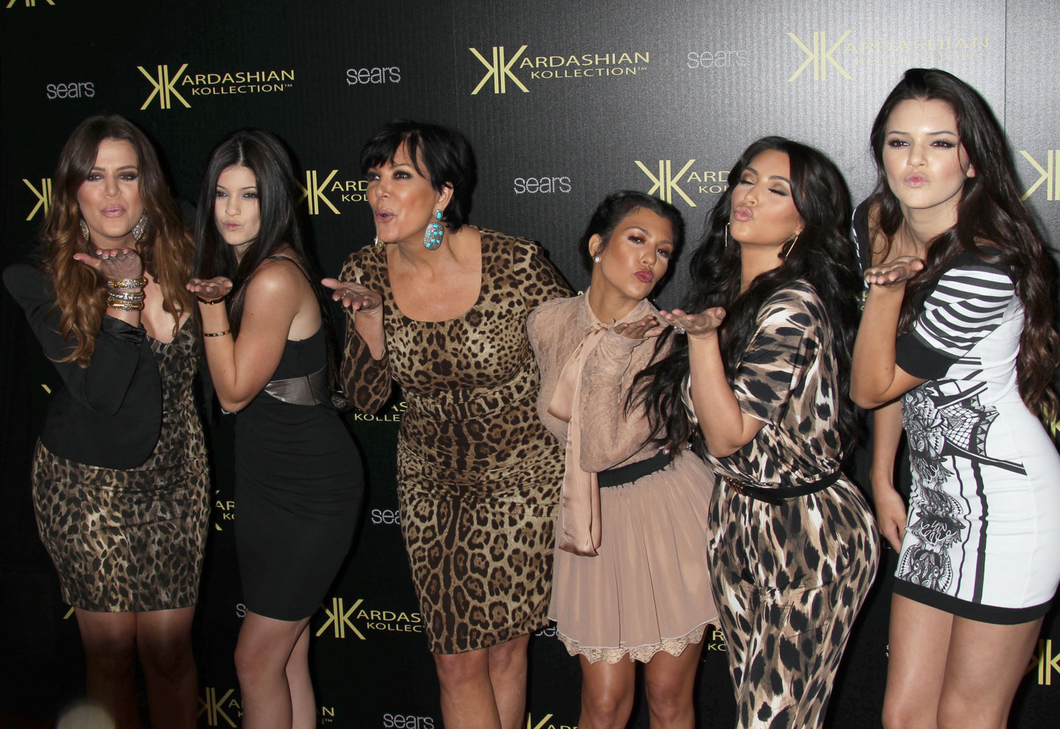
Starter… What is a family?
On your whiteboard you have one minute to write down as many different types of families you can think of….

Slide 6

KEY TERMS: list the following terms in your word bank!
Read through the definitions and match them to the correct definition. (8 minutes)
Family
Household
Family Diversity
Nuclear Family
Dependent Child
Breadwinner
Extended Family
Generation
A group of two or more persons associated by birth, cohabitation, marriage or adoption.
All the people living together in a domestic dwelling.
The idea that there are many different types of family structure.
A family consisting of the father, mother and their dependant children.
A person living in the household who is under 16 years of age or aged between 16-18 but in full time education.
The person in the household who is the main income earner.
A family exposed of the nuclear family and other relatives.
A group of people who live during the same time period.

Slide 7
What have we learnt..? Whiteboards!
What is a family?
What does family diversity mean?
What is a breadwinner?
What is a dependent child?

Slide 8
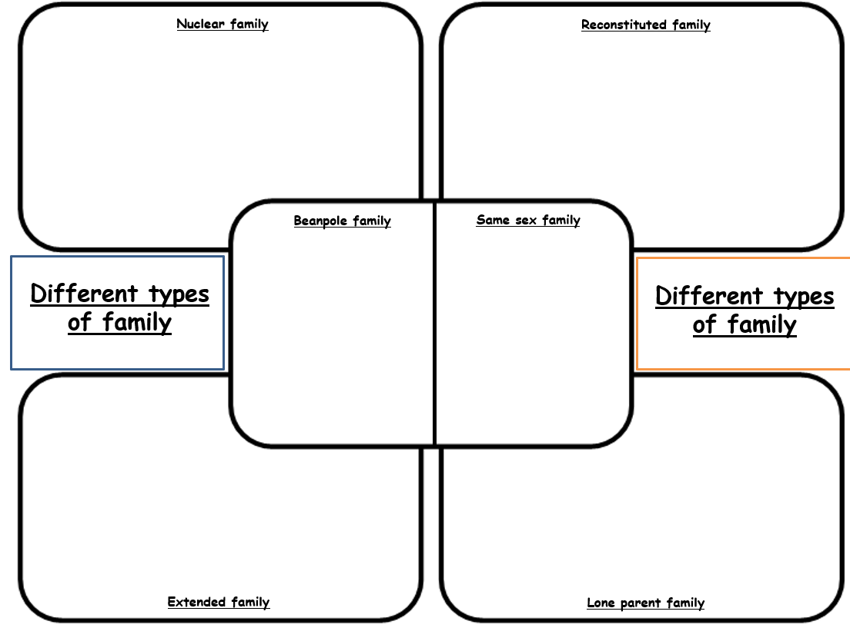
Different types of family
Read through the different types of families we have in society. (2 minutes)
Record into the correct box on your worksheet. (7minutes)
Challenge:
What are the positives of having family diversity in modern society?
What might the negatives be?
Can you give an alternative to living in a family? What might other people live in? Give examples!
When you finish your task: Add 5 words to your word bank!

Slide 9
What have we learnt..? Whiteboards!
What is a nuclear family?
Who favours this family?
What is a same sex family?
What is a lone parent family?
What is an extended family?
What is a reconstituted family?
What is a beanpole family?

Slide 10
Practice exam question
Describe what sociologists mean by a nuclear family.
[3 marks]
How do we answer a question like this? Let’s brainstorm ideas together!

Slide 11
Model answer
Describe what sociologists mean by a nuclear family.
[3 marks]
A nuclear family is a family that consists of two parents and their children living together as a unit. [1] It is the most common type of family in Britain, with over 70% of people living in this type of family. [2] Functionalist and New Right favour this type of family as they see it as the best fit for society to run smoothly. [3]

Slide 12
What is a household?
‘Household’ is used to describe a group of people who live together in the same dwelling.
Your family and household might be the same thing, but they may be different.
Can you give an example of a ‘household’ that may be different to your family?

Slide 13
Family diversity
Think-Pair-Share
Why do we have family diversity today?

