Slide 1
What can we remember? Whiteboards!
What is a nuclear family?
Who favours this family?
What is a same sex family?
What is a lone parent family?
What is an extended family?
What is a reconstituted family?
What is a beanpole family?

Slide 2



Learning Journey
Knowledge quiz!
Begin Paper 1: Families
Reasons why we have family diversity.
What is family diversity?

Slide 3
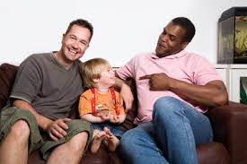
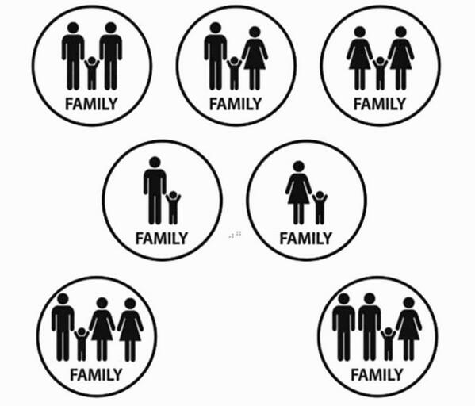
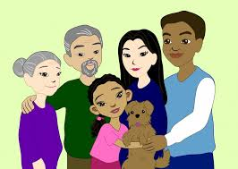
Family Diversity
Learning Objective:
To understand the work of Rapoport and Rapoport on family diversity.

Slide 4
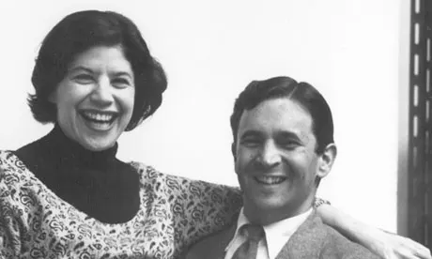
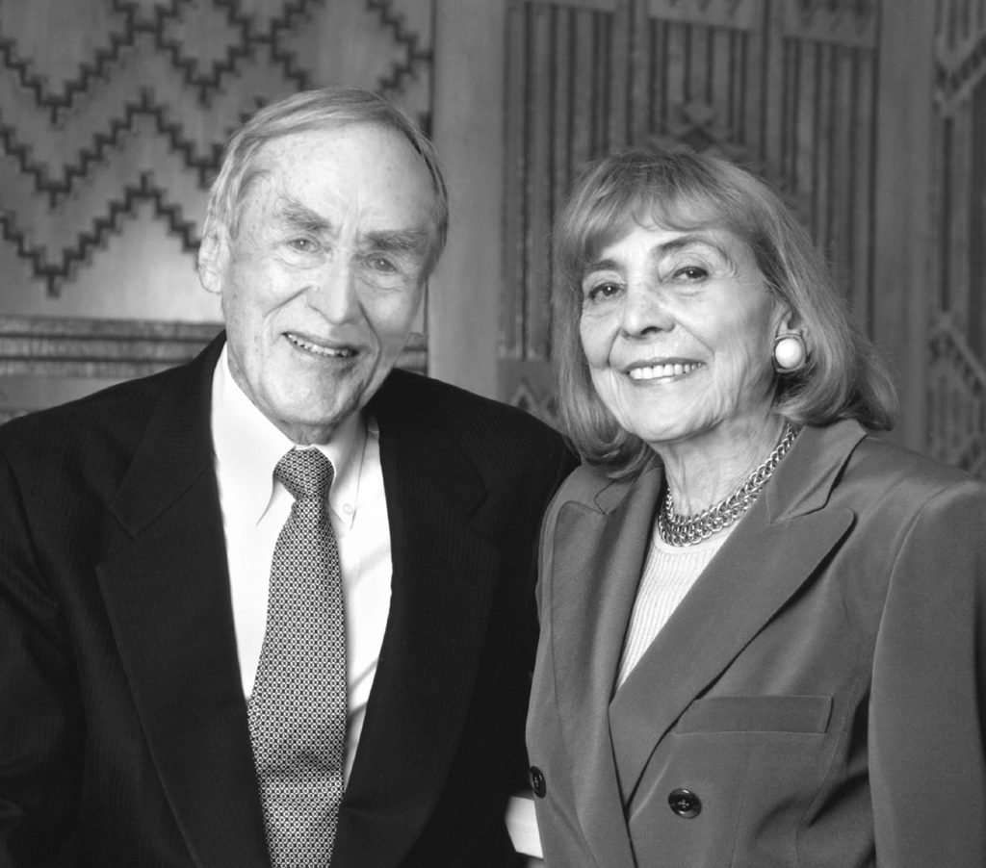
Robert and Rhona Rapoport
They said the nuclear family is was no longer the main family type, but they were optimistic about these changes.
They believe people have more freedom and choice about the type of family they lived in.
They said there is not a ‘right’ type of family and all should be accepted.
They identified five types of family diversity.

Slide 5
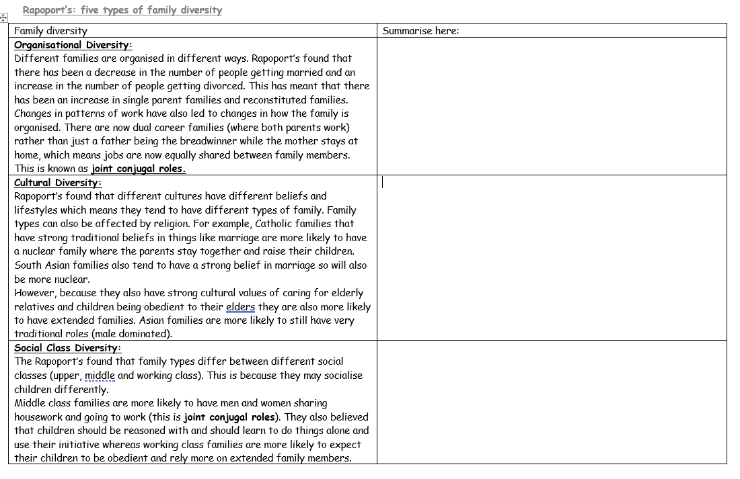
5 types of family diversity
Read through the different types of family diversity.
(4 minutes)
Reduce into the correct box on your worksheet.
(15 minutes)
Key words:
Joint conjugal roles: both partners do the chores in the house
Male dominated
Life course diversity
Life cycle diversity
Organisational diversity
Cultural diversity
Social class diversity
Cohabitation: live together in a relationship and not married
Challenge:
What are the positives of having family diversity in modern society?
What might the negatives be?
Can you give an alternative to living in a family? What might other people live in? Give examples!
When you finish your task: Add 5 words to your word bank!

Slide 6
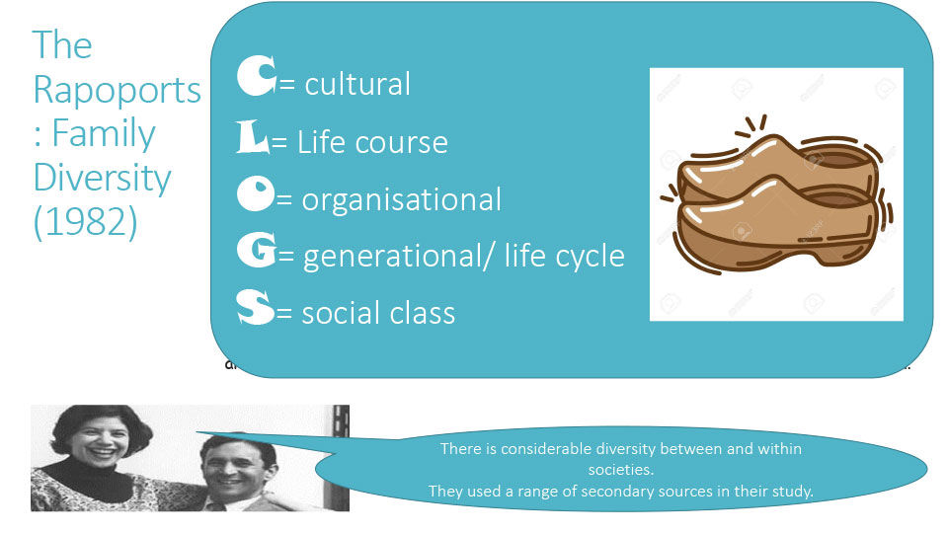

Slide 7
What have we learnt…? Whiteboards
Why has the organisation of families changed over time?
Why is there now cultural diversity amongst families?
How do families differ amongst different social classes?
Why might life cycle impact families?
How might a family move through different stages of life?

Slide 8
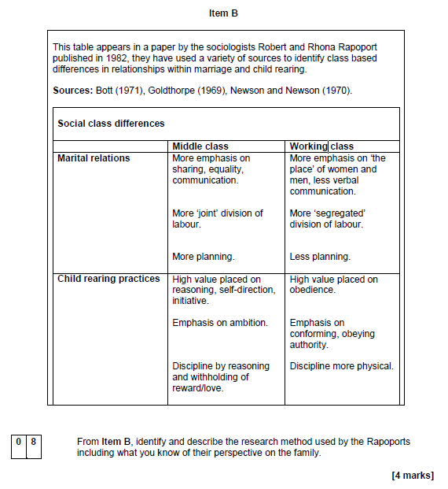
Practice exam question
From Item B, identify and describe what the Rapoports mean by family diversity, including what you know of their perspective on the family. [4 marks]
How do we answer a question like this? Let’s brainstorm ideas together!

Slide 9
Sentence starters
From Item B, identify and describe what the Rapoports mean by family diversity, including what you know of their perspective on the family. [4 marks]
The Rappaports believe.... (summary sentence)- [1 mark]
In Item B... (explain the item)- [2 marks]
The Rappaports found... (what family diversity did they find?)- [3 marks] (what did they say about the nuclear family?)- [4 marks]

Slide 10
Plenary: Applying to theory
What would a feminist say about family diversity?
What would a functionalist say about family diversity?
What would a New Right thinker say about family diversity?

Slide 11
Model answer
From Item B, identify and describe what the Rapoports mean by family diversity, including what you know of their perspective on the family. [4]
The Rapoports believe we have family diversity in society as people now have more freedom and choice about what type of family they want to live in. [1] Item B shows social class diversity, where middle class families socialise their children differently to working class families and the roles of the men and women in the middle-class families are more equal, with jobs being shared. [2] Rapoports believe there are five types of family diversity: organisational, cultural, social class, life cycle and life course diversity. [3] The Rapoports said the nuclear family are no longer the main family type, but they believed there is no ‘right family’ type, and all should be accepted. [4]

