Slide 1
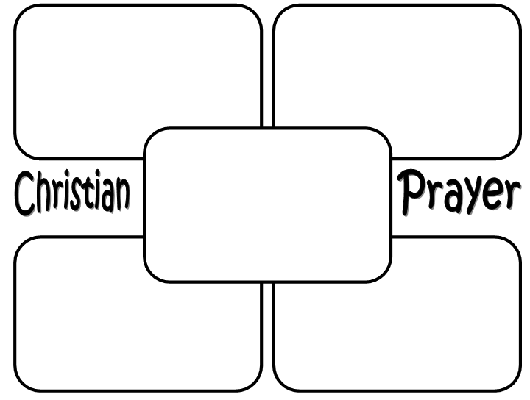
4) EMPLOYMENT OPPORTUNITIES
5) LONGER LIFE EXPECTANCY
Task
REASONS FOR FAMILY DIVERSITY
Key words:
Life expectancy
Secularisation
Immigration
Key words:
Social stigma
Cohabitation
Contraception
6) DECLINE IN RELIGION
7) IMMIGRATION

Slide 2
1) LEGAL CHANGES
2) CHANGE IN SOCIAL ATTITUDES
Task
REASONS FOR FAMILY DIVERSITY
Key words:
Life expectancy
Secularisation
Immigration
Key words:
Social stigma
Cohabitation
Contraception
3) CHANGE IN GENDER ROLES
4) BENEFITS FOR LONE PARENTS

