Slide 1
What can you remember? Whiteboards!
Who were the two people who took out a study on family diversity?
What five types of family diversity did they identify?
How do families differ amongst different social classes?
How might a family move through different stages of life?

Slide 2
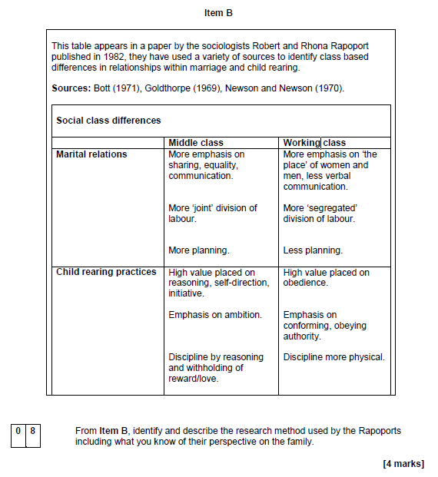
Sentence starters
From Item B, identify and describe what the Rapoports mean by family diversity, including what you know of their perspective on the family. [4 marks]
The Rappaports believe…
The five types of diversity they found are…
In Item B the focus is on social class diversity. This is…
The Rappaports found in different social classes…

Slide 3



Learning Journey
What is family diversity?
Reasons why we have family diversity.
Is the nuclear family still important?

Slide 4
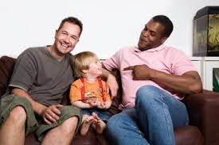
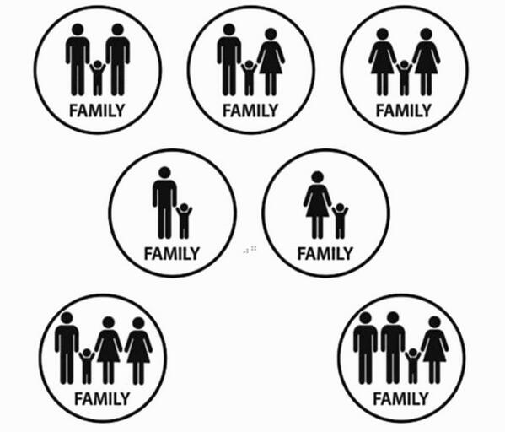
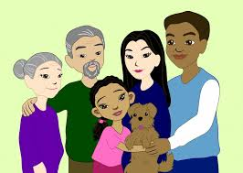
Reasons for Family Diversity
Learning Objectives:
To explain the reasons why there is family diversity in modern Britain.

Slide 5
Reasons for Diversity
There are many reasons why there is family diversity in the UK today.
Reasons for family diversity
THINK-PAIR-SHARE

Slide 6
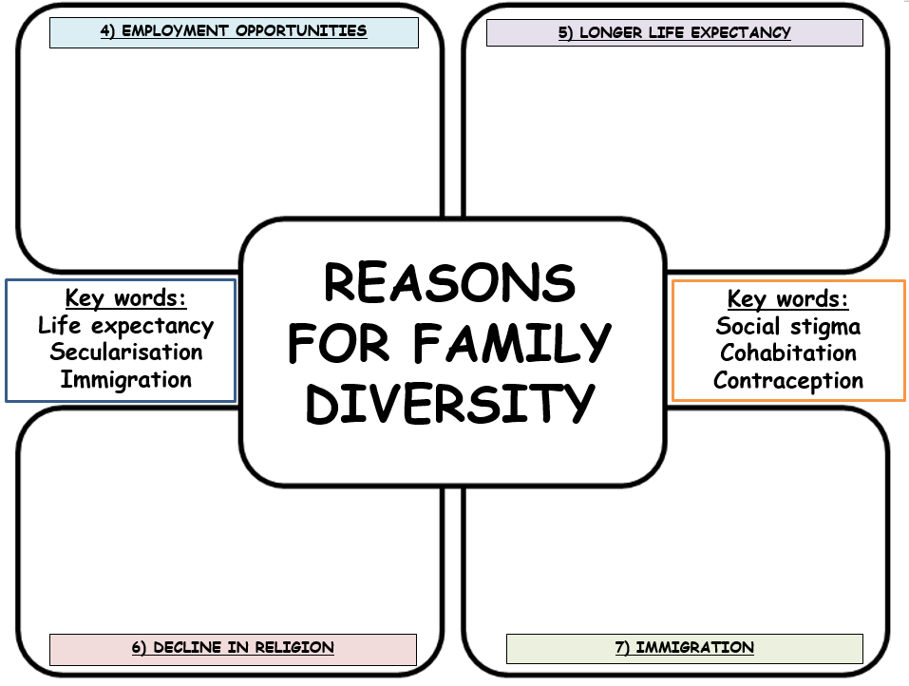
Reasons for family diversity
We will look at the four reasons first!
Read through the information. (3 minutes)
Reduce into no more than three bullet points in each box. (10 minutes)
Highlight the most important sentence. Record in your book WHY you see this as the most important part.
When you finish your task: Add 5 words to your word bank!
Extension:
Why might the reason you have just looked at be seen as both positive and negative? Record your points onto your worksheet.

Slide 7
What have we learnt? Whiteboards!
Name one law that has been passed which has led to family diversity.
How have social attitudes changed?
Why has women’s employment opportunities led to family diversity?
Why are people living longer?
How has this led to family diversity?

Slide 8
Reasons for family diversity
Now let’s look at the next four factors.
Read through the information. (3 mins)
Reduce into no more than four bullet points in each box. (10 mins)
Highlight the most important sentence. Record in your book WHY you see this as the most important part.
When you finish your task: Add 5 words to your word bank!
Extension:
Why might the reason you have just looked at be seen as both positive and negative? Record your points onto your worksheet.

Slide 9
What have we learnt? Whiteboards!
How have gender roles changed in society?
Why have benefits from the government created family diversity?
How might immigration impact families?
What is secularisation?
How has this impacted families?

Slide 10
Practice exam question
Identify and explain one factor that may have led to an increase in the number of children raised in lone-parent families. [3 marks]
1 mark- identify a factor:
“One factor is…”
2 marks- explain why this has meant there is an increase:
“This is…”
“This has led to an increase in lone parent families because..”

Slide 11

Model answer
Identify and explain one factor that may have led to an increase in the number of children raised in lone-parent families. [3 marks]
One factor that may have led to an increase is the changes in gender roles that have taken place between men and women. [1] Women today are much more focused on building careers than getting married, becoming economically independent. [2] This means they are earning their own money and can have children without the support of a man through methods such as IVF or adoption, bringing children up in a lone-parent family. [3]

Slide 12
What have you learnt…?
In your exercise books, answer the following in green pen:
Name two things that you have learnt in today’s lesson.
Name one thing that you feel you did well during the lesson?
Name one thing you could try to do better next lesson.
How would you rate your understanding of today’s lesson (excellent, good, okay, poor) and why?
How would you rate your understanding of the family topic so far (excellent, good, okay, poor) and why?

