Slide 1
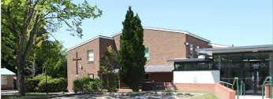

Unit 1 test for Y9
French

Slide 2
Main content to revise:
School subjects and opinions
Favourite subject
Opinions on teachers
Description of your school
Describe your primary school and our ideal school
Activities in school present past and future.

Slide 3
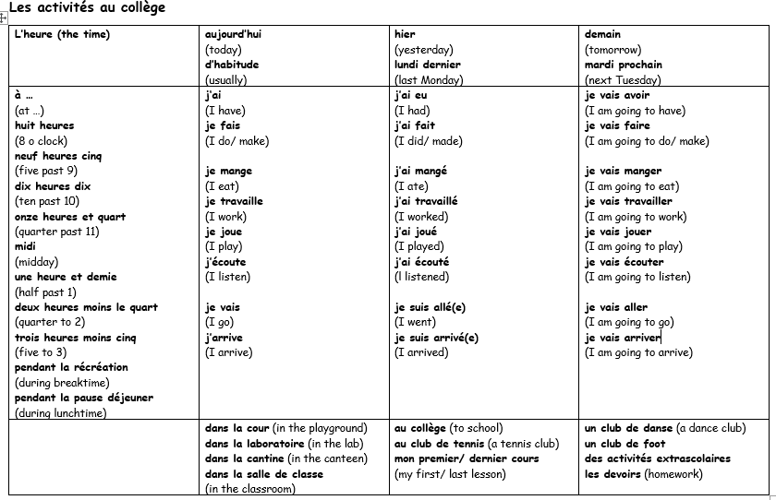
Notes:
Mini whiteboard work focusing on the present tense column of verbs if time.

Slide 4
Mon collège maintenant (my school now) | Mon collège est (My school is) Dans mon collège il y a (In my school there is/are) | une salle de classe (a classroom) un gymnase (a gym) des toilettes (some toilets) une piscine (a swimming pool) une cantine (a canteen) une bibliothèque (a library) une salle d’informatique (a computer room) un laboratoire (a science lab) un terrain de jeu (a playground) | mais ce n’est pas (but it isn’t) mais il n’y a pas de (but there isn’t a/aren’t any) | salle de classe (classroom) gymnase (gym) toilettes (toilets) piscine (swimming pool) cantine (canteen) bibliothèque (library) salle d’informatique (computer room) laboratoire (science lab) terrain de jeu (playground)
 | Mon école primaire était (My primary school was) Dans mon école primaire il y avait (In my primary school there was/ were) |  | mais ce n’était pas (but it wasn’t) mais il n’y avait pas de (but there wasn’t a/weren’t any)
Mon école primaire dans le passé (my primary school in the past) | Mon école primaire était (My primary school was) Dans mon école primaire il y avait (In my primary school there was/ were)
Mon collège idéal dans le futur (my ideal school in the future) | Mon collège idéal serait (My ideal school would be) Dans mon collège idéal il y aurait (In my ideal school there would be) | petit(e) small grand (e) big moderne modern vieux/ vieille old | mais ce ne serait pas (but it wouldn’t be) mais il n’y aurait pas de (but there wouldn’t be a/any) | petit(e) small grand(e) big moderne modern vieux/ vieille old

Slide 5
La correction avec un stylo vert
devoirs / fait / mes / J’ / ai
J’ / ai / joué / foot / au
allé / collège / au / suis / Je
prof / J’ / écouté / le / ai
cantine / J’ / dans / mangé / la / ai
 | Subject | Auxiliary verb | Past participle | Preposition or article | Noun
1. | J’ | ai | fait | mes | devoirs.
2. | J’ | ai | joué | au | foot.
3. | Je | suis | allé | au | collège.
4. | J’ | ai | écouté | le | prof.
5. | J’ | ai | mangé | dans la | cantine.

Slide 6
The near future tense
The near future tense is used to say what is going to happen. It is formed with the present tense of ’aller’ (to go) followed by the infinitive.
present tense of ‘aller’
Infinitive
Je vais (I go/ am going)
Tu vas (you go/ are going)
Il/elle va (he/she goes/ is going)
Nous allons (we go/ are going)
Vous allez (you go/ are going)
Ils/elles vont (they go/ are going
étudier (to study)
travailler (to work)
jouer (to play)
faire (to do)
manger (to eat)
aller (to go)
avoir (to have)
Notes:
Print this for students.

Slide 7
90 words writing
How to succeed…
You must:
Minimum 90 words
Try not to exceed 100 words
Cover all 3 bullet points (in order where possible)
Cover each BP in a different paragraph using your sequencers
Give 3 justified opinions
Use present, past and future tenses
Notes:
NN

Slide 8
How to revise:
Memorise your vocab pack and sentence builders
Revise past tense and future tense
Revise irregular verbs
To practise you can use many tools, like: Languagenut, memrise or…

Slide 9

These quizziz:

Slide 10

Vocab pack Unit 1 https://quizizz.com/admin/quiz/6740958a9e4091577ee7038f?aiQuizGen=true&aiQuizPublished=true

