Slide 1
Paper 1 Revision: Covalent Bonding
Do Now:
Will NaCl (l) conduct electricity? Explain your answer.
What is the name given to the structure of diamond, graphite and silicon dioxide?
Describe the melting points of ionic substances.
Copy and complete: In ionic bonds, electrons are ________________.
Explain why alloys can be harder than pure metals.

Slide 2
Paper 1 Revision: Bonding
Do Now:
Will NaCl (l) conduct electricity? Explain your answer. Yes NaCl(l) will conduct electricity because the ions are free to move and carry a charge.
What is the name given to the structure of diamond, graphite and silicon dioxide? Giant covalent
Describe the melting points of ionic substances. Very high melting points.
Copy and complete: In ionic bonds, electrons are transferred.
Explain why alloys can be harder than pure metals. Different size atoms distort the layers in the metal to stop them sliding over each other.

Slide 3
Explain why iodine has a low melting point
Explain why simple covalent structures are generally gases at room temperature
Explain in terms of particles, why liquid iodine does not conduct electricity.
Describe the structure and bonding in silicon dioxide and explain why it is a suitable material for making welding blankets.
Explain why diamond has a high melting point.
Give two physical properties of diamond.
Explain why graphite can conduct electricity.
Explain why graphite can rub off the pencil onto the paper (/is soft).
Like graphite, each carbon atom in the carbon nanotube is joined to three other carbon atoms. Explain why the carbon nanotube can conduct electricity.
Graphite is softer than diamond. Explain why.
Graphite conducts electricity, but diamond does not. Explain why.
Suggest why carbon nanotubes are used as lubricants.

Slide 4
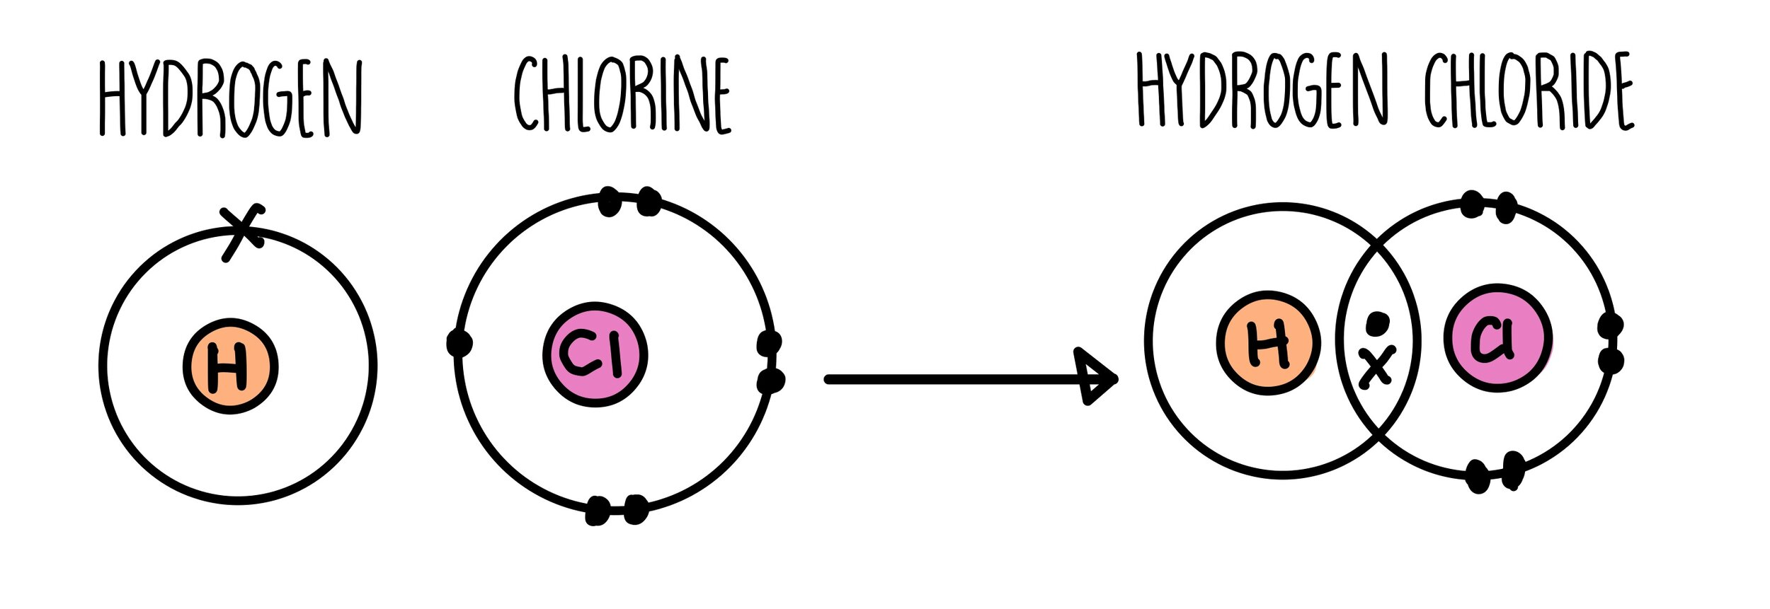
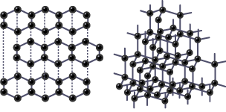
Part 1: Covalent bonding
Atoms SHARE outer shell electrons to form full outer shells.
Between non-metals.
Bonds can be single, double or triple.

Slide 5
Copy and Complete
Covalent bonds are formed when non-metal atoms _______ __ ________ of electrons between them, to achieve _____ ______ ____.
One shared pair is called a ______ bond, 2 shared pairs is called a _______ bond, and 3 shared pairs is called a _______ bond.

Slide 6
Covalent bonding: Properties
Small Molecules
Giant Covalent Structures
Liquids and gases at room temperature
Low melting and boiling points
  Low number of strong covalent bonds
  Weak intermolecular forces
Solids at room temperature
High melting and boiling points
  Many strong covalent bonds
  No intermolecular forces

Slide 7
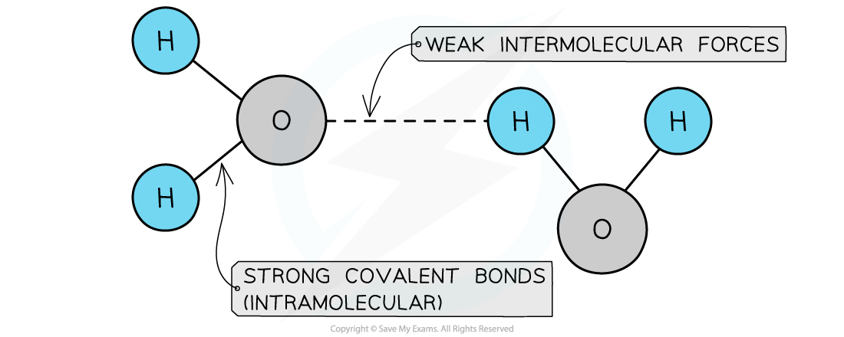
Intermolecular forces
The intermolecular forces increase with the size of the molecules, so larger molecules have higher melting and boiling points.

Slide 8
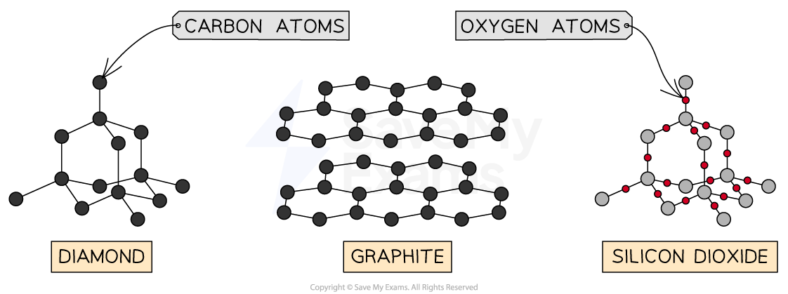
Giant Covalent Structures

Slide 9
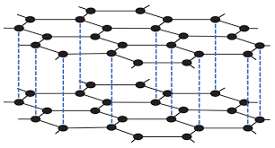
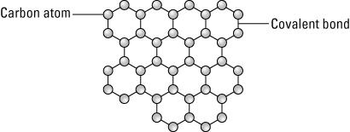
Conductivity
The majority of covalent structures DO NOT conduct electricity.
Exceptions:

Slide 10
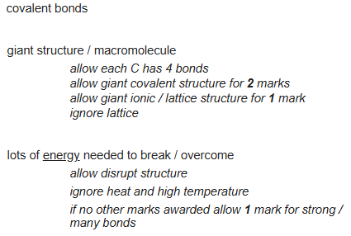
Exam Practice
Explain why diamond has a high melting point. [3]

Slide 11
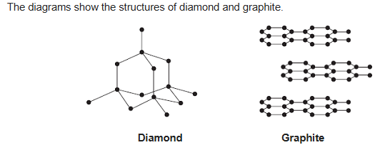
Exam Practice 2
Use the diagrams above and your knowledge of structure and bonding to explain why:
(i) graphite is very soft [2]
(ii) diamond is very hard [2]
(iii) graphite conducts electricity [2]

Slide 12
(i) (atoms are in) layers (that) can slide over each other [1]
because there are no (covalent) bonds between the layers [1]
  accept between the layers there are only weak forces
  accept Van der Waals forces between the layers
do not allow intermolecular bonds between the layers
if no other marks are awarded allow weak intermolecular forces for 1 mark
(ii) because each atom forms four (covalent) bonds or (diamond is a) giant (covalent) structure or lattice or macromolecular [1]
any reference to ionic / metallic bonding or intermolecular forces scores a maximum of 1 mark
accept carbon forms a tetrahedral shape
(and) covalent bonds are strong [1]
accept covalent bonds need a lot of energy / difficult to break

Slide 13
(iii) because graphite has delocalised electrons [1]
allow sea of electrons
allow each carbon atom has one free electron
which can move through the whole structure (and carry the current / charge / electricity) [1]

Slide 14
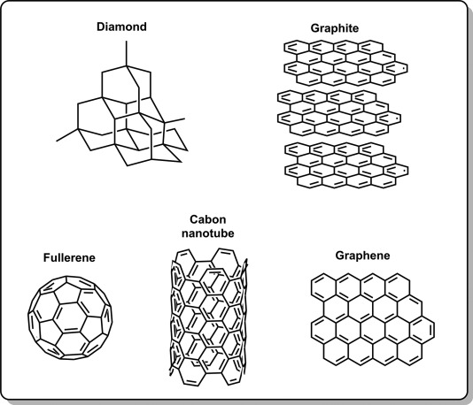
Allotropes of Carbon
Different structural forms containing the same element – carbon
Different structure = different properties

Slide 15
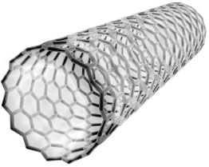
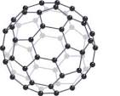
Fullerenes
Fullerenes are molecules of carbon atoms with hollow shapes.
Spheres
Tubes
Their structures are based on hexagonal rings of carbon atoms joined by covalent bonds.
Notes:
Nanotechnology, drug delivery, materials – body armor

Slide 16
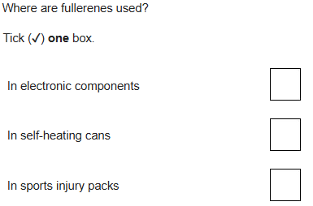
Exam Practice
A)
B) Describe the structure of the fullerene shown in the Figure above.

Slide 17
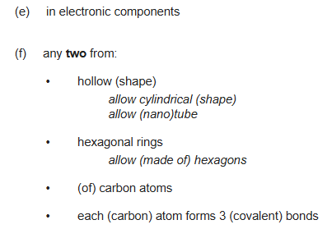
Exam Practice

Slide 18
Answer in full sentences.
Explain why iodine has a low melting point [2]
Explain why simple covalent structures are generally gases at room temperature [2]
Explain in terms of particles, why liquid iodine does not conduct electricity. [1]
Describe the structure and bonding in silicon dioxide and explain why it is a suitable material for making welding blankets. [3]
Explain why diamond has a high melting point. [3]
Give two physical properties of diamond. [2]
Explain why graphite can conduct electricity. [2]
Explain why graphite can rub off the pencil onto the paper (/is soft). [2]
Like graphite, each carbon atom in the carbon nanotube is joined to three other carbon atoms. Explain why the carbon nanotube can conduct electricity. [3]
Graphite is softer than diamond. Explain why. [4]
Graphite conducts electricity, but diamond does not. Explain why. [3]
Suggest why carbon nanotubes are used as lubricants. [1]

Slide 19
Green pen – self mark
Iodine is a simple molecule (one strong covalent bond between two atoms) [1] which have weak intermolecular forces that require little energy to overcome [1] (cannot get second mark without first)
There are weak intermolecular forces between molecules [1] which require little energy to overcome/break [1]
Iodine has no delocalised electrons (or free moving ions) so cannot carry charge. [1]
Silicon dioxide has a giant covalent structure[1], all atoms are joined together with strong covalent bonds [1] (each silicon atoms forms 4 bonds and each oxygen atom forms 2 bonds). These bonds require a lot of energy to break therefore it has a high melting point [1]and is suitable for making welding blankets.
Diamond has many strong covalent bonds [1] each carbon atom forms 4 covalent bonds forming a giant structure [1]. A lot of energy is needed to break these bonds. [1]
Any two from: Very hard [1], very high melting point [1], does not conduct electricity.

Slide 20
Answer in full sentences.
7. Explain why graphite can conduct electricity. [2]
8. Explain why graphite can rub off the pencil onto the paper (/is soft). [2]
9. Like graphite, each carbon atom in the carbon nanotube is joined to three other carbon atoms. Explain why the carbon nanotube can conduct electricity. [3]
10. Graphite is softer than diamond. Explain why. [4]
11. Graphite conducts electricity, but diamond does not. Explain why. [3]
12. Suggest why carbon nanotubes are used as lubricants. [1]

Slide 21
Green pen – self mark
7. Graphite can conduct electricity because it has delocalised electrons[1] that are free to move through the graphite and carry a charge [1].
8. Carbon atoms in graphite are arranged in layers [1] which have weak forces between them so they can slide over each other and/or separate [1].
9. Carbon nanotubes can conduct electricity because there are delocalised electrons [1] that are free to move and carry a charge through the structure [1]. One electron from each carbon atom [1].
10. Graphite is softer than diamond because graphite has layers of carbon atoms that can move/slide [1]. This is because there are only weak forces between the layers [1]. However, in diamond, each carbon atom has 4 strong covalent bonds [1] with 4 other carbon atoms so they are unable to move/slide [1].
11. Graphite conducts electricity because graphite has delocalised electrons [1] which are free to move can carry a charge through the stucture [1] but, diamond has no delocalised electrons [1].
12. Nanotubes can slide over each other because there are no covalent bonds between the nanotubes [1].

