Slide 1
Paper 1 Revision: Polymers
Do Now: Complete the last task from last lesson
Explain why iodine has a low melting point
Explain why simple covalent structures are generally gases at room temperature
Explain in terms of particles, why liquid iodine does not conduct electricity.
Describe the structure and bonding in silicon dioxide and explain why it is a suitable material for making welding blankets.
Explain why diamond has a high melting point.
Give two physical properties of diamond.
Explain why graphite can conduct electricity.
Explain why graphite can rub off the pencil onto the paper (/is soft).
Like graphite, each carbon atom in the carbon nanotube is joined to three other carbon atoms. Explain why the carbon nanotube can conduct electricity.
Graphite is softer than diamond. Explain why.
Graphite conducts electricity, but diamond does not. Explain why.
Suggest why carbon nanotubes are used as lubricants.

Slide 2
Green pen – self mark
Iodine is a simple molecule [1] which have weak intermolecular forces that require little energy to overcome [1] (cannot get second mark without first)
There are weak intermolecular forces between molecules [1] which require little energy to overcome/break [1]
Iodine has no delocalised electrons (or free moving ions) so cannot carry charge. [1]
Silicon dioxide has a giant covalent structure[1], all atoms are joined together with strong covalent bonds [1] (each silicon atoms forms 4 bonds and each oxygen atom forms 2 bonds). These bonds require a lot of energy to break therefore it has a high melting point [1]and is suitable for making welding blankets.
Diamond has many strong covalent bonds [1] each carbon atom forms 4 covalent bonds forming a giant structure [1]. A lot of energy is needed to break these bonds.
Any two from: Very hard [1], very high melting point [1], does not conduct electricity.

Slide 3
Paper 1 Revision: Polymers
Do Now: Complete the last task from last lesson
7. Explain why graphite can conduct electricity.
8. Explain why graphite can rub off the pencil onto the paper (/is soft).
9. Like graphite, each carbon atom in the carbon nanotube is joined to three other carbon atoms. Explain why the carbon nanotube can conduct electricity.
10. Graphite is softer than diamond. Explain why.
11. Graphite conducts electricity, but diamond does not. Explain why.
12. Suggest why carbon nanotubes are used as lubricants.

Slide 4
Green pen – self mark
7. Graphite can conduct electricity because it has delocalised electrons[1] that are free to move through the graphite and carry a charge [1].
8. Carbon atoms in graphite are arranged in layers [1] which have weak forces between them so they can slide over each other and/or separate [1].
9. Carbon nanotubes can conduct electricity because there are delocalised electrons [1] that are free to move and carry a charge through the structure [1]. One electron from each carbon atom [1].
10. Graphite is softer than diamond because graphite has layers of carbon atoms that can move/slide [1]. This is because there are only weak forces between the layers [1]. However, in diamond, each carbon atom has 4 strong covalent bonds [1] with 4 other carbon atoms so they are unable to move/slide [1].
11. Graphite conducts electricity because graphite has delocalised electrons [1] which are free to move can carry a charge through the stucture [1] but, diamond has no delocalised electrons [1].
12. Nanotubes can slide over each other because there are no covalent bonds between the nanotubes [1].

Slide 5
Polymers
Long chain molecules made up of repeating units (monomers)
  Covalent bonds throughout the structure
  Intermolecular forces between chains
    Longer the chain = increased forces
Most commonly hydrocarbons (P2)
  Can be natural e.g. DNA, cellulose
  Can be synthetic (man-made) e.g. polyethene
Very versatile
  e.g. Plastics

Slide 6
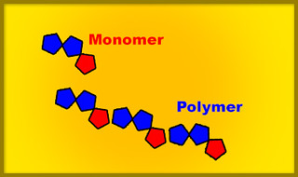
Polymers
In polymers, lots of small units link together to form one large molecule.

Slide 7
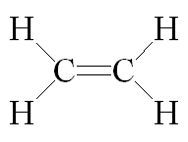
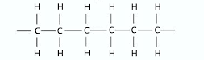
Monomer = Ethene
Polymer = Polyethene
Notes:
Alkenes form polymers (alkanes don’t) because are saturated

Slide 8
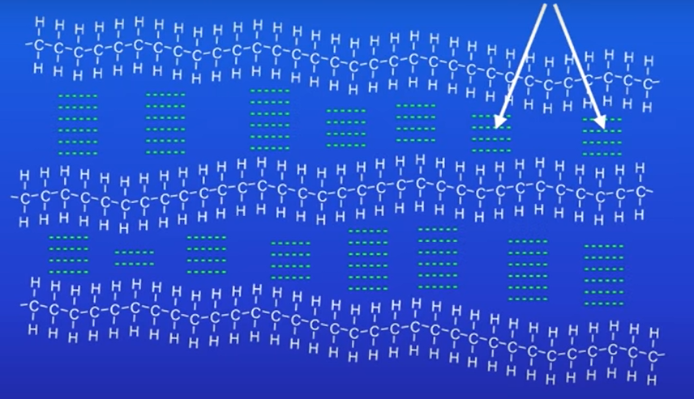
Intermolecular forces
Notes:
Intermolecular forces exist between the polymer chains → relates to function e.g. nylon has a similar structure allows for fibres to form
The intermolecular forces between polymer molecules are strong compared to the intermolecular forces between small molecules. This means that polymers melt at higher temperatures than substances with small molecules

Slide 9
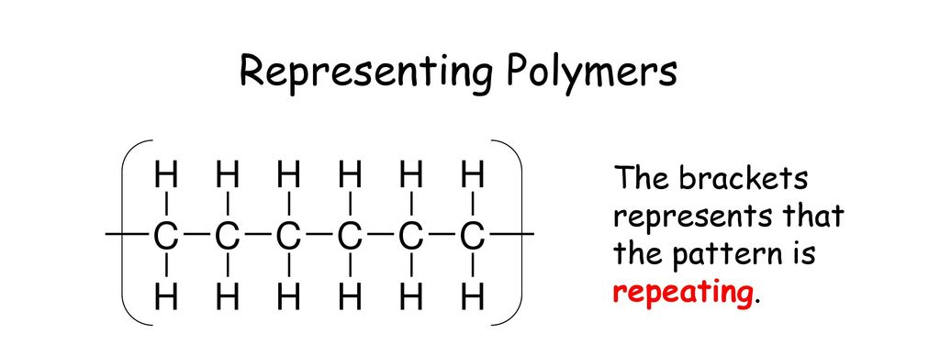

Notes:
Short hand = repeating unit shows single carbon-carbon covalent bond, have to show that the bonds on either side extend outside brackets as it shows that the polymer molecule extends out in both directions

Slide 10
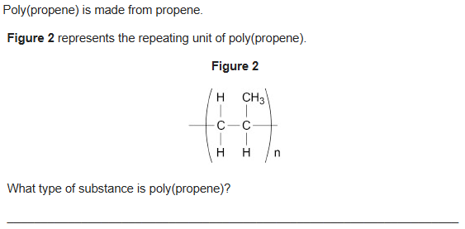
MWBs: Exam Question example
Polymer (plastic)

Slide 11
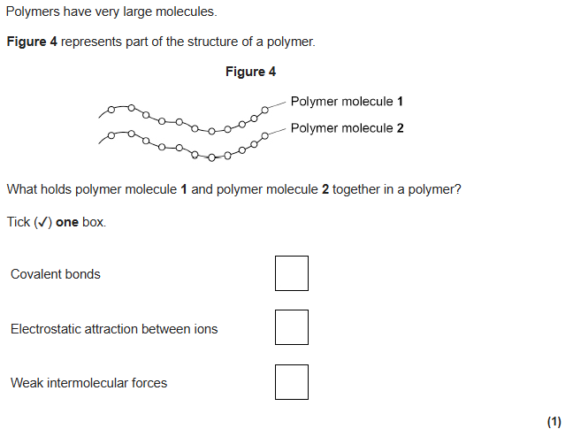

MWBs: Exam Question example

Slide 12
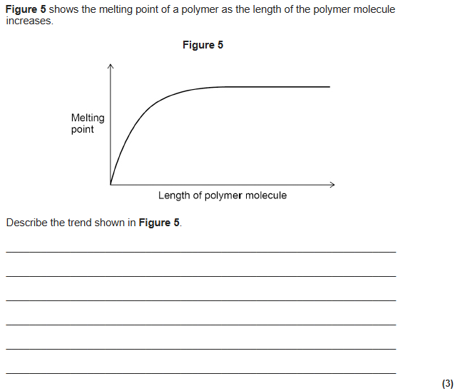
the melting point increases as the length of the polymer molecule increases [2]
allow 1 mark for melting point increases
(then the) melting point levels off (as the polymer molecule length increases) [1]
allow (then the) melting point becomes constant (as the polymer molecule length increases)

Slide 13
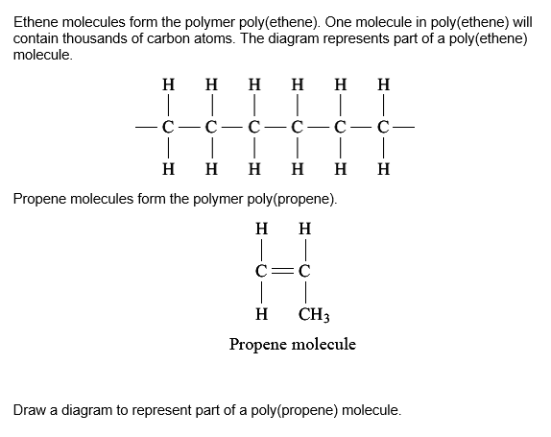
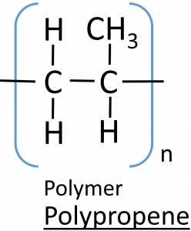
Notes:
Print out – go through answers on board

Slide 14
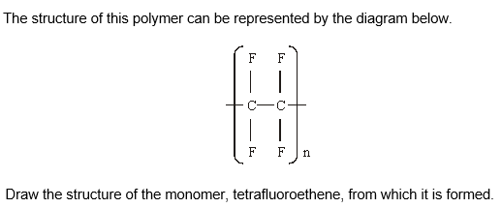
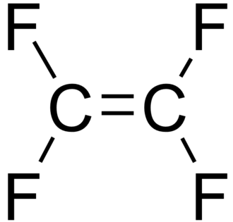

Slide 15
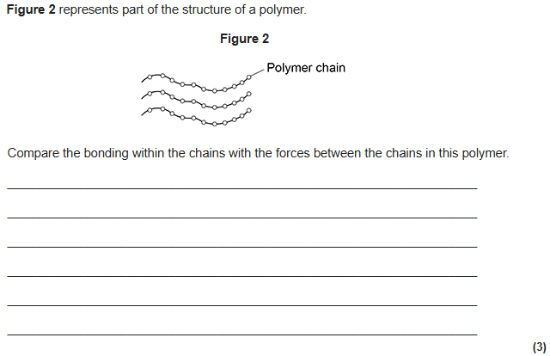
covalent bonds (between atoms) in the chain [1]
intermolecular forces between the chains [1]
covalent bonds are strong
and
intermolecular forces are weak [1]

Slide 16
Paper 1 Revision: Metallic Bonding
Gold is a metal. Describe the structure of a metal. [2]
Copper metal is used in electrical appliances. Describe the bonding in a metal, and explain why metals conduct electricity.[3]
Magnesium is a metal. Explain why metals can be bent and shaped. [1]
Explain why the magnesium alloy (with copper) is harder than magnesium metal. [3]
Describe how sodium conducts thermal energy. [2]
Explain why copper, like many other metals, has a high melting point.[3]

Slide 17
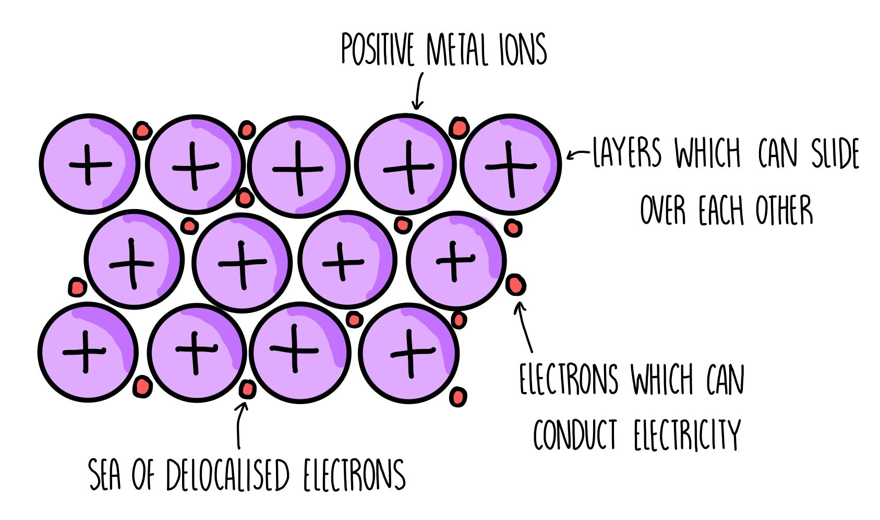
Structure Properties and Function

Slide 18
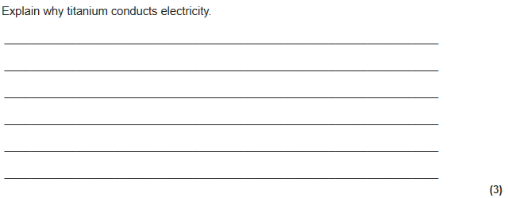
Exam Practice
(titanium conducts electricity) because electrons in the outer shell of the metal atoms are delocalised
[1]
and so electrons are free to move
allow the delocalised electrons in the metal carry electrical charge through the metal
[1]
through the whole structure
[1]

Slide 19
Exam Practice
By reference to their structure, explain how the particles in a piece of metal are held together and how the shape of the metal can be changed without it breaking. (You may use a diagram in your answer.) [5]
the electrons are delocalised [1]
metal atoms form positive ions [1]
[credit if done on appropriate diagram]
the attraction which exists between particles with opposite charges, holds the metal together [1]
no specific bonds exist between adjacent atoms/ions
atoms/ions can slide over each other so allowing metals to bend [1] and form layers [1]

Slide 20
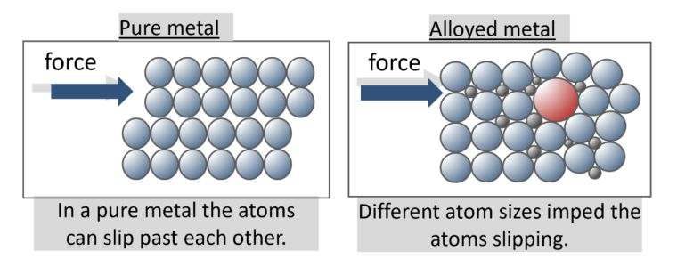
Alloys

Slide 21
Paper 1 Revision: Metallic Bonding
Gold is a metal. Describe the structure of a metal. [2]
Copper metal is used in electrical appliances. Describe the bonding in a metal, and explain why metals conduct electricity.[3]
Magnesium is a metal. Explain why metals can be bent and shaped. [1]
Explain why the magnesium alloy (with copper) is harder than magnesium metal. [3]
Describe how sodium conducts thermal energy. [2]
Explain why copper, like many other metals, has a high melting point.[3]

Slide 22
Gold has a regular arrangement of atoms/positive ions in layers [1] with delocalised electrons [1].
Metals conduct electricity because there is a lattice of positive ions [1] with delocalised electrons [1] that have electrostatic attraction between them. The delocalised electrons are free to move through the metal and carry a charge.
Magnesium can be bent and shaped because the layers [1] of atoms/positive ions can slide over each other[1].
Alloys are harder because the atoms are different sizes (copper atoms are bigger) [1] so the layers of magnesium atoms are distorted [1]. Therefore, the layers cannot easily slide [1].
In sodium delocalised electrons are free to move [1] and energy is transferred through the structure [1].
Metals like copper have a giant structure [1]made up of positive ions surrounded by delocalised electrons [1] with strong electrostatic attractions [1]. Therefore, a lot of energy is needed to break these bonds.

