Slide 1
SLR1.1 Systems architecture
Von Neumann architecture

Slide 2
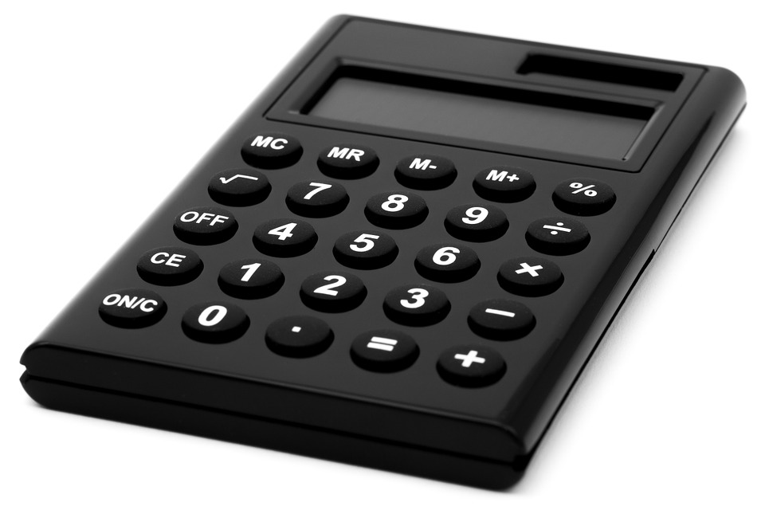
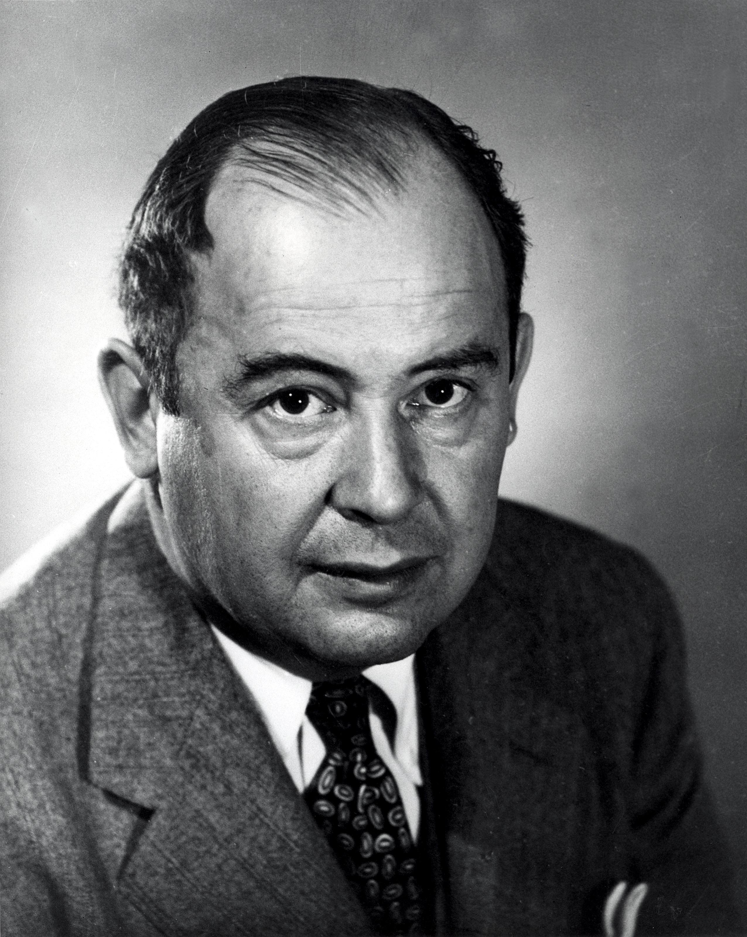
Fixed and stored program computers
Calculators are examples of computers
– they take inputs, process them and output a result.
John von Neumann designed computers with stored programs.

Slide 3
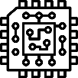

Von Neumann architecture
Central Processing Unit (CPU)
Main Memory (RAM)
Key characteristics
Central Processing Unit (CPU)
Control Unit (CU)
Arithmetic Logic Unit (ALU)
Cache
Clock
Control
Unit
(CU)
Arithmetic Logic Unit (ALU)
Address | Data
1 | Load address 5
2 | Add address 6
3 | Store in address 6
4 | End
5 | 23
6 | 12
Register
Cache
Clock

Slide 4
Von Neumann architecture
Central Processing Unit (CPU)
Main Memory (RAM)
Von Neumann architecture
Notice how both instruction data and program data are stored in the same memory in binary form.
Control
Unit
(CU)
Arithmetic Logic Unit (ALU)
Address | Data
1 | Load address 5
2 | Add address 6
3 | Store in address 6
4 | End
5 | 23
6 | 12
Register
Accumulator
Memory address Register (MAR)
Program Counter (PC)
Memory Data Register (Data)
Cache
Clock

Slide 5
Von Neumann architecture
Central Processing Unit (CPU)
Main Memory (RAM)
Von Neumann architecture
Notice how both instruction data and program data are stored in the same memory in binary form.
Control
Unit
(CU)
Arithmetic Logic Unit (ALU)
Address | Data
1 | Load address 5
2 | Add address 6
3 | Store in address 6
4 | End
5 | 23
6 | 12
Register
Accumulator
Memory address Register (MAR)
Program Counter (PC)
Memory Data Register (Data)
Cache
Clock

Slide 6
Von Neumann architecture
Central Processing Unit (CPU)
Main Memory (RAM)
Program Counter (PC)
Holds the address of the next instruction to be executed in memory.
Control
Unit
(CU)
Arithmetic Logic Unit (ALU)
Address | Data
1 | Load address 5
2 | Add address 6
3 | Store in address 6
4 | End
5 | 23
6 | 12
Register
Accumulator
Memory address Register (MAR)
Program Counter (PC)
Memory Data Register (Data)
Cache
Clock

Slide 7
Von Neumann architecture
Central Processing Unit (CPU)
Main Memory (RAM)
Memory Address Register (MAR)
Holds the memory address where data is to be fetched from or written to.
Control
Unit
(CU)
Arithmetic Logic Unit (ALU)
Address | Data
1 | Load address 5
2 | Add address 6
3 | Store in address 6
4 | End
5 | 23
6 | 12
Register
Accumulator
Memory address Register (MAR)
Program Counter (PC)
Memory Data Register (Data)
Cache
Clock

Slide 8
Von Neumann architecture
Central Processing Unit (CPU)
Main Memory (RAM)
Memory Data Register (MDR)
Holds data fetched from memory or to be written to memory.
Control
Unit
(CU)
Arithmetic Logic Unit (ALU)
Address | Data
1 | Load address 5
2 | Add address 6
3 | Store in address 6
4 | End
5 | 23
6 | 12
Register
Accumulator
Memory address Register (MAR)
Program Counter (PC)
Memory Data Register (Data)
Cache
Clock

Slide 9
Von Neumann architecture
Central Processing Unit (CPU)
Main Memory (RAM)
Accumulator
Holds the results of calculations.
Control
Unit
(CU)
Arithmetic Logic Unit (ALU)
Address | Data
1 | Load address 5
2 | Add address 6
3 | Store in address 6
4 | End
5 | 23
6 | 12
Register
Accumulator
Memory address Register (MAR)
Program Counter (PC)
Memory Data Register (Data)
Cache
Clock

Slide 10
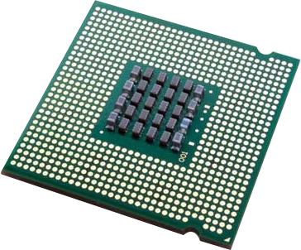
Von Neumann architecture
Fetch stage
The program counter is checked for the memory address of the next instruction to be executed.
Central Processing Unit (CPU)
Main Memory (RAM)
Control
Unit
(CU)
Arithmetic Logic Unit (ALU)
Address | Data
1 | Load address 5
2 | Add address 6
3 | Store in address 6
4 | End
5 | 23
6 | 12
Register
Accumulator
Memory address Register (MAR)
Program Counter (PC)
Memory Data Register (Data)
Fetch
Decode
Execute
Cache
Clock

Slide 11
Von Neumann architecture
Fetch stage
The program counter is checked for the memory address of the next instruction to be executed.
The Memory Address Register (MAR) fetches the instruction from main memory (RAM) and brings it into the Memory Data Register (MDR).
Central Processing Unit (CPU)
Main Memory (RAM)
Control
Unit
(CU)
Arithmetic Logic Unit (ALU)
Address | Data
1 | Load address 5
2 | Add address 6
3 | Store in address 6
4 | End
5 | 23
6 | 12
Register
Accumulator
Memory address Register (MAR)
Program Counter (PC)
Memory Data Register (Data)
Fetch
Decode
Execute
Cache
Clock

Slide 12
Von Neumann architecture
Fetch stage
The program counter is checked for the memory address of the next instruction to be executed.
The Memory Address Register (MAR) fetches the instruction from main memory (RAM) and brings it into the Memory Data Register (MDR).
The program counter is incremented so it points to the next instruction.
Central Processing Unit (CPU)
Main Memory (RAM)
Control
Unit
(CU)
Arithmetic Logic Unit (ALU)
Address | Data
1 | Load address 5
2 | Add address 6
3 | Store in address 6
4 | End
5 | 23
6 | 12
Register
Accumulator
Memory address Register (MAR)
Program Counter (PC)
Memory Data Register (Data)
Fetch
Decode
Execute
Cache
Clock

Slide 13
Von Neumann architecture
Decode stage
Now the instruction is in the CPU, the Control Unit (CU) decodes it to figure out what the CPU needs to do.
Central Processing Unit (CPU)
Main Memory (RAM)
Control
Unit
(CU)
Arithmetic Logic Unit (ALU)
Address | Data
1 | Load address 5
2 | Add address 6
3 | Store in address 6
4 | End
5 | 23
6 | 12
Register
Accumulator
Memory address Register (MAR)
Program Counter (PC)
Memory Data Register (Data)
Fetch
Decode
Execute
Cache
Clock

Slide 14
Von Neumann architecture
Execute stage
Now the CPU can execute the instruction. What it actually does depends on the instruction. It could be asked to:
  Go back to main memory (RAM), fetch data and add it to the accumulator.
  Jump to another instruction.
  Write data held in the accumulator back into main memory (RAM).
Central Processing Unit (CPU)
Main Memory (RAM)
Control
Unit
(CU)
Arithmetic Logic Unit (ALU)
Address | Data
1 | Load address 5
2 | Add address 6
3 | Store in address 6
4 | End
5 | 23
6 | 12
Register
Accumulator
Memory address Register (MAR)
Program Counter (PC)
Memory Data Register (Data)
Fetch
Decode
Execute
Cache
Clock

Slide 15

The von Neumann architecture consists of a:
  Control Unit (CU)
  Arithmetic Logic Unit (ALU)
  Main Memory (RAM)
  Inputs and outputs
The von Neumann architecture is based on the stored program concept.
Both instruction data and program data are stored in the same memory in binary form. There is no way to know if the pure binary held in memory represents instructions or data simply by looking at it.
A von Neumann CPU contains the following registers:
  Program Counter (PC): Holds the address of the next instruction to be executed in memory.
  Memory Address Register (MAR): Holds the memory address where data is to be fetched from or written to.
  Memory Data Register (MDR): Holds data fetched from memory or to be written to memory.
  Accumulator: Holds the results of calculations.

Slide 16

SLR1 Systems architecture
Going beyond the GCSE specification

Slide 17
Von Neumann architecture
Central Processing Unit (CPU)
Main Memory (RAM)
Control
Unit
(CU)
Arithmetic Logic Unit (ALU)
Address | Data
1 | Load address 5
2 | Add address 6
3 | Store in address 6
4 | End
5 | 23
6 | 12
Register
Accumulator
Memory address Register (MAR)
Program Counter (PC)
Memory Data Register (Data)
Cache
Clock

Slide 18
Von Neumann architecture
What is happening
The program counter is checked for the memory address of the next instruction to be executed.
Central Processing Unit (CPU)
Main Memory (RAM)
CU
ALU
Address | Data
1 | Load address 5
2 | Add address 6
3 | Store in address 6
4 | End
5 | 23
6 | 12
Register
Accumulator
MAR
PC
1
MDR
Fetch
Decode
Execute
Cache
Clock

Slide 19
Von Neumann architecture
What is happening
The address of the next instruction is copied into the Memory Address Register (MAR).
Central Processing Unit (CPU)
Main Memory (RAM)
CU
ALU
Address | Data
1 | Load address 5
2 | Add address 6
3 | Store in address 6
4 | End
5 | 23
6 | 12
Register
Accumulator
MAR
1
PC
1
MDR
Fetch
Decode
Execute
Cache
Clock

Slide 20
Von Neumann architecture
What is happening
The address then travels along the address bus.
Central Processing Unit (CPU)
Main Memory (RAM)
CU
ALU
Address | Data
1 | Load address 5
2 | Add address 6
3 | Store in address 6
4 | End
5 | 23
6 | 12
Register
Accumulator
MAR
1
PC
1
MDR
Fetch
Decode
Execute
Cache
Clock

Slide 21
Von Neumann architecture
What is happening
The contents of address 1 are sent along the data bus to the Memory Data Register (MDR).
Central Processing Unit (CPU)
Main Memory (RAM)
CU
ALU
Address | Data
1 | Load address 5
2 | Add address 6
3 | Store in address 6
4 | End
5 | 23
6 | 12
Register
Accumulator
MAR
1
PC
1
MDR
Load 5
Fetch
Decode
Execute
Cache
Clock

Slide 22
Von Neumann architecture
What is happening
The program counter is incremented so it points to the next instruction.
The fetch part of the cycle is done.
Central Processing Unit (CPU)
Main Memory (RAM)
CU
ALU
Address | Data
1 | Load address 5
2 | Add address 6
3 | Store in address 6
4 | End
5 | 23
6 | 12
Register
Accumulator
MAR
1
PC
2
MDR
Load 5
Fetch
Decode
Execute
Cache
Clock

Slide 23
Von Neumann architecture
What is happening
A copy of what has just been loaded into the CPU is placed in the cache.
This way, if the CPU needs the information again soon, it won’t need to go back to main memory.
Central Processing Unit (CPU)
Main Memory (RAM)
CU
ALU
Address | Data
1 | Load address 5
2 | Add address 6
3 | Store in address 6
4 | End
5 | 23
6 | 12
Register
Accumulator
MAR
1
PC
2
MDR
Load 5
Fetch
Decode
Execute
Cache
Load 5
Clock

Slide 24
Von Neumann architecture
What is happening
The Control Unit (CU) then decodes the instruction.
Central Processing Unit (CPU)
Main Memory (RAM)
CU
(Load 5)
ALU
Address | Data
1 | Load address 5
2 | Add address 6
3 | Store in address 6
4 | End
5 | 23
6 | 12
Register
Accumulator
MAR
1
PC
2
MDR
Load 5
Fetch
Decode
Execute
Cache
Load 5
Clock

Slide 25
Von Neumann architecture
What is happening
The Control Unit (CU) then decodes the instruction.
It discovers it needs to load the contents of memory address 5.
So, it updates the Memory Address Register (MAR) with the address 5.
The decode part of the cycle is done.
Central Processing Unit (CPU)
Main Memory (RAM)
CU
(Load 5)
ALU
Address | Data
1 | Load address 5
2 | Add address 6
3 | Store in address 6
4 | End
5 | 23
6 | 12
Register
Accumulator
MAR
5
PC
2
MDR
Load 5
Fetch
Decode
Execute
Cache
Load 5
Clock

Slide 26
Von Neumann architecture
What is happening
The CPU executes the instruction by passing the memory address 5 along the address bus.
Central Processing Unit (CPU)
Main Memory (RAM)
CU
(Load 5)
ALU
Address | Data
1 | Load address 5
2 | Add address 6
3 | Store in address 6
4 | End
5 | 23
6 | 12
Register
Accumulator
MAR
5
PC
2
MDR
Load 5
Fetch
Decode
Execute
Cache
Load 5
Clock

Slide 27
Von Neumann architecture
What is happening
The CPU executes the instruction by passing the memory address 5 along the address bus.
It then returns the contents of memory address 5 – the value 23 – back along the data bus into the Memory Data Register (MDR).
Central Processing Unit (CPU)
Main Memory (RAM)
CU
(Load 5)
ALU
Address | Data
1 | Load address 5
2 | Add address 6
3 | Store in address 6
4 | End
5 | 23
6 | 12
Register
Accumulator
MAR
5
PC
2
MDR
23
Fetch
Decode
Execute
Cache
Load 5
Clock

Slide 28
Von Neumann architecture
What is happening
The CPU executes the instruction by passing the memory address 5 along the address bus.
It then returns the contents of memory address 5 – the value 23 – back along the data bus into the Memory Data Register (MDR).
The CPU then copies the value from the MDR into the accumulator.
Central Processing Unit (CPU)
Main Memory (RAM)
CU
(Load 5)
ALU
Address | Data
1 | Load address 5
2 | Add address 6
3 | Store in address 6
4 | End
5 | 23
6 | 12
Register
Accumulator
23
MAR
5
PC
2
MDR
23
Fetch
Decode
Execute
Cache
Load 5
Clock

Slide 29
Von Neumann architecture
What is happening
A copy of the value 23 is placed in the cache in case it is needed again.
Although the contents of registers are being overridden, the cache is normally large enough to hold multiple items.
The first fetch-decode-execute cycle is finished.
Central Processing Unit (CPU)
Main Memory (RAM)
CU
(Load 5)
ALU
Address | Data
1 | Load address 5
2 | Add address 6
3 | Store in address 6
4 | End
5 | 23
6 | 12
Register
Accumulator
23
MAR
5
PC
2
MDR
23
Fetch
Decode
Execute
Cache
Load 5 | 23
Clock

Slide 30
Von Neumann architecture
What is happening
The program counter is checked for the memory address of the next instruction to be executed.
Central Processing Unit (CPU)
Main Memory (RAM)
CU
ALU
Address | Data
1 | Load address 5
2 | Add address 6
3 | Store in address 6
4 | End
5 | 23
6 | 12
Register
Accumulator
23
MAR
5
PC
2
MDR
23
Fetch
Decode
Execute
Cache
Load 5 | 23
Clock

Slide 31
Von Neumann architecture
What is happening
The address of the next instruction is copied into the Memory Address Register (MAR).
Central Processing Unit (CPU)
Main Memory (RAM)
CU
ALU
Address | Data
1 | Load address 5
2 | Add address 6
3 | Store in address 6
4 | End
5 | 23
6 | 12
Register
Accumulator
23
MAR
2
PC
2
MDR
23
Fetch
Decode
Execute
Cache
Load 5 | 23
Clock

Slide 32
Von Neumann architecture
What is happening
The address then travels along the address bus.
Central Processing Unit (CPU)
Main Memory (RAM)
CU
ALU
Address | Data
1 | Load address 5
2 | Add address 6
3 | Store in address 6
4 | End
5 | 23
6 | 12
Register
Accumulator
23
MAR
2
PC
2
MDR
23
Fetch
Decode
Execute
Cache
Load 5 | 23
Clock

Slide 33
Von Neumann architecture
What is happening
The contents of address 2 are sent along the data bus to the Memory Data Register (MDR).
Central Processing Unit (CPU)
Main Memory (RAM)
CU
ALU
Address | Data
1 | Load address 5
2 | Add address 6
3 | Store in address 6
4 | End
5 | 23
6 | 12
Register
Accumulator
23
MAR
2
PC
2
MDR
Add 6
Fetch
Decode
Execute
Cache
Load 5 | 23
Clock

Slide 34
Von Neumann architecture
What is happening
The contents of the Program Counter (PC) are incremented again so they point to the address of the next instruction to be executed.
The fetch part of the cycle is done.
Central Processing Unit (CPU)
Main Memory (RAM)
CU
ALU
Address | Data
1 | Load address 5
2 | Add address 6
3 | Store in address 6
4 | End
5 | 23
6 | 12
Register
Accumulator
23
MAR
2
PC
3
MDR
Add 6
Fetch
Decode
Execute
Cache
Load 5 | 23
Clock

Slide 35
Von Neumann architecture
What is happening
A copy of what has just been loaded into the CPU is placed in the cache.
Central Processing Unit (CPU)
Main Memory (RAM)
CU
ALU
Address | Data
1 | Load address 5
2 | Add address 6
3 | Store in address 6
4 | End
5 | 23
6 | 12
Register
Accumulator
23
MAR
2
PC
3
MDR
Add 6
Fetch
Decode
Execute
Cache
Load 5 | 23 | Add 6
Clock

Slide 36
Von Neumann architecture
What is happening
The Control Unit (CU) then decodes the instruction.
Central Processing Unit (CPU)
Main Memory (RAM)
CU
(Add 6)
ALU
Address | Data
1 | Load address 5
2 | Add address 6
3 | Store in address 6
4 | End
5 | 23
6 | 12
Register
Accumulator
23
MAR
2
PC
3
MDR
Add 6
Fetch
Decode
Execute
Cache
Load 5 | 23 | Add 6
Clock

Slide 37
Von Neumann architecture
What is happening
The Control Unit (CU) then decodes the instruction.
It discovers it needs to add the contents of memory address 6 to the value in the accumulator.
So, we update the Memory Address Register (MAR) with address 6.
The decode part of the cycle is done.
Central Processing Unit (CPU)
Main Memory (RAM)
CU
(Add 6)
ALU
Address | Data
1 | Load address 5
2 | Add address 6
3 | Store in address 6
4 | End
5 | 23
6 | 12
Register
Accumulator
23
MAR
6
PC
3
MDR
Add 6
Fetch
Decode
Execute
Cache
Load 5 | 23 | Add 6
Clock

Slide 38
Von Neumann architecture
What is happening
The CPU executes the instruction by passing the memory address 6 along the address bus.
Central Processing Unit (CPU)
Main Memory (RAM)
CU
(Add 6)
ALU
Address | Data
1 | Load address 5
2 | Add address 6
3 | Store in address 6
4 | End
5 | 23
6 | 12
Register
Accumulator
23
MAR
6
PC
3
MDR
Add 6
Fetch
Decode
Execute
Cache
Load 5 | 23 | Add 6
Clock

Slide 39
Von Neumann architecture
What is happening
The CPU executes the instruction by passing the memory address 6 along the address bus.
It then returns the contents of address 6 – the value 12 – back along the data bus and into the Memory Data Register (MDR).
Central Processing Unit (CPU)
Main Memory (RAM)
CU
(Add 6)
ALU
Address | Data
1 | Load address 5
2 | Add address 6
3 | Store in address 6
4 | End
5 | 23
6 | 12
Register
Accumulator
23
MAR
6
PC
3
MDR
12
Fetch
Decode
Execute
Cache
Load 5 | 23 | Add 6
Clock

Slide 40
Von Neumann architecture
What is happening
A copy of the value 12 is placed in the cache in case it is needed again.
Central Processing Unit (CPU)
Main Memory (RAM)
CU
(Add 6)
ALU
Address | Data
1 | Load address 5
2 | Add address 6
3 | Store in address 6
4 | End
5 | 23
6 | 12
Register
Accumulator
23
MAR
6
PC
3
MDR
12
Fetch
Decode
Execute
Cache
Load 5 | 23 | Add 6 | 12
Clock

Slide 41
Von Neumann architecture
What is happening
The Arithmetic Logic Unit (ALU) then adds the value in the MDR (12) to the value in the accumulator (23) and overrides the contents of the accumulator with the result (35).
The second fetch-decode-execute cycle is finished.
Central Processing Unit (CPU)
Main Memory (RAM)
CU
(Add 6)
ALU
12 + 23 = 25
Address | Data
1 | Load address 5
2 | Add address 6
3 | Store in address 6
4 | End
5 | 23
6 | 12
Register
Accumulator
35
MAR
6
PC
3
MDR
12
Fetch
Decode
Execute
Cache
Load 5 | 23 | Add 6 | 12
Clock

Slide 42
Von Neumann architecture
What is happening
The program counter is checked for the memory address of the next instruction to be executed.
Central Processing Unit (CPU)
Main Memory (RAM)
CU
ALU
12 + 23 = 25
Address | Data
1 | Load address 5
2 | Add address 6
3 | Store in address 6
4 | End
5 | 23
6 | 12
Register
Accumulator
35
MAR
6
PC
3
MDR
12
Fetch
Decode
Execute
Cache
Load 5 | 23 | Add 6 | 12
Clock

Slide 43
Von Neumann architecture
What is happening
The address of the next instruction is copied into the Memory Address Register (MAR).
Central Processing Unit (CPU)
Main Memory (RAM)
CU
ALU
12 + 23 = 25
Address | Data
1 | Load address 5
2 | Add address 6
3 | Store in address 6
4 | End
5 | 23
6 | 12
Register
Accumulator
35
MAR
3
PC
3
MDR
12
Fetch
Decode
Execute
Cache
Load 5 | 23 | Add 6 | 12
Clock

Slide 44
Von Neumann architecture
What is happening
The address then travels along the address bus.
Central Processing Unit (CPU)
Main Memory (RAM)
CU
ALU
12 + 23 = 25
Address | Data
1 | Load address 5
2 | Add address 6
3 | Store in address 6
4 | End
5 | 23
6 | 12
Register
Accumulator
35
MAR
3
PC
3
MDR
12
Fetch
Decode
Execute
Cache
Load 5 | 23 | Add 6 | 12

Slide 45
Von Neumann architecture
What is happening
The contents of address 3 are sent along the data bus to the Memory Data Register (MDR).
Central Processing Unit (CPU)
Main Memory (RAM)
CU
ALU
12 + 23 = 25
Address | Data
1 | Load address 5
2 | Add address 6
3 | Store in address 6
4 | End
5 | 23
6 | 12
Register
Accumulator
35
MAR
3
PC
3
MDR
Store 6
Fetch
Decode
Execute
Cache
Load 5 | 23 | Add 6 | 12
Clock

Slide 46
Von Neumann architecture
What is happening
The contents of the Program Counter (PC) are incremented again so they point to the address of the next instruction to be executed.
The fetch part of the cycle is done.
Central Processing Unit (CPU)
Main Memory (RAM)
CU
ALU
12 + 23 = 25
Address | Data
1 | Load address 5
2 | Add address 6
3 | Store in address 6
4 | End
5 | 23
6 | 12
Register
Accumulator
35
MAR
3
PC
4
MDR
Store 6
Fetch
Decode
Execute
Cache
Load 5 | 23 | Add 6 | 12
Clock

Slide 47
Von Neumann architecture
What is happening
A copy of what has just been loaded into the CPU is placed in the cache.
Central Processing Unit (CPU)
Main Memory (RAM)
CU
ALU
12 + 23 = 25
Address | Data
1 | Load address 5
2 | Add address 6
3 | Store in address 6
4 | End
5 | 23
6 | 12
Register
Accumulator
35
MAR
3
PC
4
MDR
Store 6
Fetch
Decode
Execute
Cache
Load 5 | 23 | Add 6 | 12 | Store 6
Clock

Slide 48
Von Neumann architecture
What is happening
The Control Unit (CU) then decodes the instruction.
Central Processing Unit (CPU)
Main Memory (RAM)
CU
(Store 6)
ALU
12 + 23 = 25
Address | Data
1 | Load address 5
2 | Add address 6
3 | Store in address 6
4 | End
5 | 23
6 | 12
Register
Accumulator
35
MAR
3
PC
4
MDR
Store 6
Fetch
Decode
Execute
Cache
Load 5 | 23 | Add 6 | 12 | Store 6
Clock

Slide 49
Von Neumann architecture
What is happening
The CU discovers it needs to store the contents of the accumulator in memory address 6.
It updates the Memory Address Register (MAR) with the address 6 and copies the value stored in the accumulator (35) into the MDR.
The decode part of the cycle is done.
Central Processing Unit (CPU)
Main Memory (RAM)
CU
(Store 6)
ALU
12 + 23 = 25
Address | Data
1 | Load address 5
2 | Add address 6
3 | Store in address 6
4 | End
5 | 23
6 | 12
Register
Accumulator
35
MAR
6
PC
4
MDR
35
Fetch
Decode
Execute
Cache
Load 5 | 23 | Add 6 | 12 | Store 6
Clock

Slide 50
Von Neumann architecture
What is happening
The CPU executes the instruction by passing the memory address 6 along the address bus and passing the value 35 along the data bus.
The value 35 is stored in address 6, overwriting its previous contents.
Central Processing Unit (CPU)
Main Memory (RAM)
CU
(Store 6)
ALU
12 + 23 = 25
Address | Data
1 | Load address 5
2 | Add address 6
3 | Store in address 6
4 | End
5 | 23
6 | 35
Register
Accumulator
35
MAR
6
PC
4
MDR
35
Fetch
Decode
Execute
Cache
Load 5 | 23 | Add 6 | 12 | Store 6
Clock

Slide 51
Von Neumann architecture
What is happening
As usual, a copy of the calculation result (35) is placed in the cache in case the CPU needs it again soon.
The third fetch-decode-execute cycle is now finished.
Central Processing Unit (CPU)
Main Memory (RAM)
CU
(Store 6)
ALU
12 + 23 = 25
Address | Data
1 | Load address 5
2 | Add address 6
3 | Store in address 6
4 | End
5 | 23
6 | 35
Register
Accumulator
35
MAR
6
PC
4
MDR
35
Fetch
Decode
Execute
Cache
Load 5 | 23 | Add 6 | 12 | Store 6 | 35
Clock

Slide 52
Von Neumann architecture
What is happening
The program counter is checked for the memory address of the next instruction to be executed.
Central Processing Unit (CPU)
Main Memory (RAM)
CU
ALU
12 + 23 = 25
Address | Data
1 | Load address 5
2 | Add address 6
3 | Store in address 6
4 | End
5 | 23
6 | 35
Register
Accumulator
35
MAR
6
PC
4
MDR
35
Fetch
Decode
Execute
Cache
Load 5 | 23 | Add 6 | 12 | Store 6 | 35
Clock

Slide 53
Von Neumann architecture
What is happening
The address of the next instruction is copied into the Memory Address Register (MAR).
Central Processing Unit (CPU)
Main Memory (RAM)
CU
ALU
12 + 23 = 25
Address | Data
1 | Load address 5
2 | Add address 6
3 | Store in address 6
4 | End
5 | 23
6 | 35
Register
Accumulator
35
MAR
4
PC
4
MDR
35
Fetch
Decode
Execute
Cache
Load 5 | 23 | Add 6 | 12 | Store 6 | 35
Clock

Slide 54
Von Neumann architecture
What is happening
The address then travels along the address bus.
Central Processing Unit (CPU)
Main Memory (RAM)
CU
ALU
12 + 23 = 25
Address | Data
1 | Load address 5
2 | Add address 6
3 | Store in address 6
4 | End
5 | 23
6 | 35
Register
Accumulator
35
MAR
4
PC
4
MDR
35
Fetch
Decode
Execute
Cache
Load 5 | 23 | Add 6 | 12 | Store 6 | 35
Clock

Slide 55
Von Neumann architecture
What is happening
The contents of address 4 are sent along the data bus to the Memory Data Register (MDR).
Central Processing Unit (CPU)
Main Memory (RAM)
CU
ALU
12 + 23 = 25
Address | Data
1 | Load address 5
2 | Add address 6
3 | Store in address 6
4 | End
5 | 23
6 | 35
Register
Accumulator
35
MAR
4
PC
4
MDR
End
Fetch
Decode
Execute
Cache
Load 5 | 23 | Add 6 | 12 | Store 6 | 35
Clock

Slide 56
Von Neumann architecture
What is happening
The contents of the Program Counter (PC) are incremented again so they point to the address of the next instruction to be executed.
The fetch part of the cycle is done.
Central Processing Unit (CPU)
Main Memory (RAM)
CU
ALU
12 + 23 = 25
Address | Data
1 | Load address 5
2 | Add address 6
3 | Store in address 6
4 | End
5 | 23
6 | 35
Register
Accumulator
35
MAR
4
PC
5
MDR
End
Fetch
Decode
Execute
Cache
Load 5 | 23 | Add 6 | 12 | Store 6 | 35
Clock

Slide 57
Von Neumann architecture
What is happening
A copy of what has just been loaded into the CPU is placed in the cache.
At some point, the internal cache will run out of space and the CPU will need to decide what to get rid of.
Central Processing Unit (CPU)
Main Memory (RAM)
CU
ALU
12 + 23 = 25
Address | Data
1 | Load address 5
2 | Add address 6
3 | Store in address 6
4 | End
5 | 23
6 | 35
Register
Accumulator
35
MAR
4
PC
5
MDR
End
Fetch
Decode
Execute
Load 5 | 23 | Add 6 | 12 | Store 6 | 35 | End
Clock

Slide 58
Von Neumann architecture
What is happening
The Control Unit (CU) then decodes the instruction.
Central Processing Unit (CPU)
Main Memory (RAM)
CU
(End)
ALU
12 + 23 = 25
Address | Data
1 | Load address 5
2 | Add address 6
3 | Store in address 6
4 | End
5 | 23
6 | 35
Register
Accumulator
35
MAR
4
PC
5
MDR
End
Fetch
Decode
Execute
Load 5 | 23 | Add 6 | 12 | Store 6 | 35 | End
Clock

Slide 59
Von Neumann architecture
What is happening
The Control Unit (CU) then decodes the instruction.
The fetched instruction is telling the CPU to end the program.
The decode part of the cycle is done.
Central Processing Unit (CPU)
Main Memory (RAM)
CU
(End)
ALU
12 + 23 = 25
Address | Data
1 | Load address 5
2 | Add address 6
3 | Store in address 6
4 | End
5 | 23
6 | 35
Register
Accumulator
35
MAR
4
PC
5
MDR
End
Fetch
Decode
Execute
Load 5 | 23 | Add 6 | 12 | Store 6 | 35 | End
Clock

Slide 60
Von Neumann architecture
What is happening
The CPU executes the instruction and ends the program.
This program calculated the sum 12 + 23 and stored the result (35) in main memory.
Central Processing Unit (CPU)
Main Memory (RAM)
CU
(End)
ALU
12 + 23 = 25
Address | Data
1 | Load address 5
2 | Add address 6
3 | Store in address 6
4 | End
5 | 23
6 | 35
Register
Accumulator
35
MAR
4
PC
5
MDR
End
Fetch
Decode
Execute
Load 5 | 23 | Add 6 | 12 | Store 6 | 35 | End
Clock

