Slide 1
SLR1.1 Systems architecture
Embedded systems

Slide 2
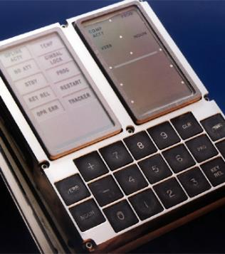
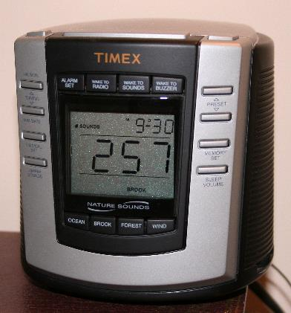
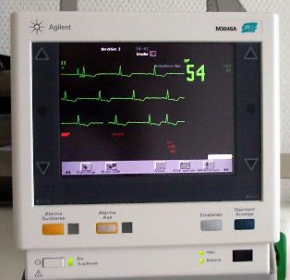
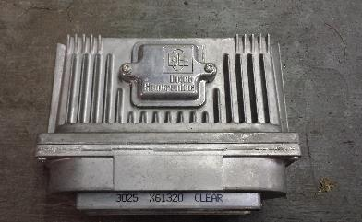
Embedded systems
98 percent of processors are manufactured as components of embedded systems.

Slide 3
Embedded systems
98 percent of processors are manufactured as components of embedded systems.
One of the earliest examples of an embedded system was the Apollo guidance computer for the moon missions.

Slide 4
Embedded systems
98 percent of processors are manufactured as components of embedded systems.
One of the earliest examples of an embedded system was the Apollo guidance computer for the moon missions.
Other examples include:
Hospital instruments

Slide 5
Embedded systems
98 percent of processors are manufactured as components of embedded systems.
One of the earliest examples of an embedded system was the Apollo guidance computer for the moon missions.
Other examples include:
Hospital instruments
Car engine management systems

Slide 6
Embedded systems
98 percent of processors are manufactured as components of embedded systems.
One of the earliest examples of an embedded system was the Apollo guidance computer for the moon missions.
Other examples include:
Hospital instruments
Car engine management systems
Digital clocks

Slide 7
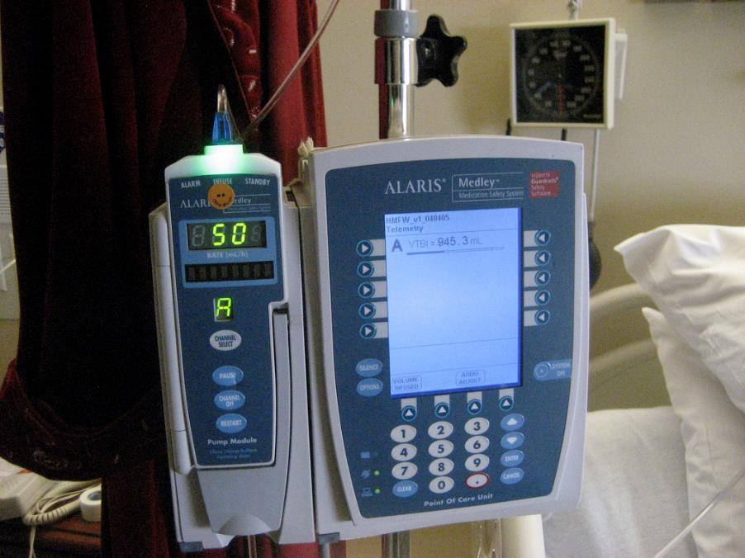
Embedded systems
Properties of embedded systems compared to general-purpose computers include:
Low power consumption
Small size
Rugged operating systems
Low cost per unit
These benefits come at the cost of limited processing resources, making them more difficult to program and interact with.

Slide 8
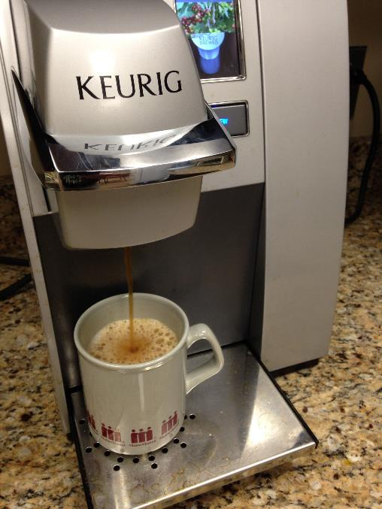
Embedded systems
Embedded systems are dedicated to a specific task – this means design engineers can optimise the system to:
Reduce the size and cost of the product
Increase its reliability for the given task
Many embedded systems are mass-produced, meaning further benefits can be gained from economies of scale.

Slide 9

Embedded system: A computer system with a dedicated function within a larger mechanical system.
Typical properties of embedded systems:
  Low power consumption
  Small size
  Rugged operating ranges
  Low cost per unit
Examples of embedded systems:
  Traffic lights
  Domestic appliances
  Factory equipment
  Engine management systems
  Hospital equipment

