Slide 1
SLR1.2 Memory and storage
The need for primary storage

Slide 2

Types of storage

Slide 3
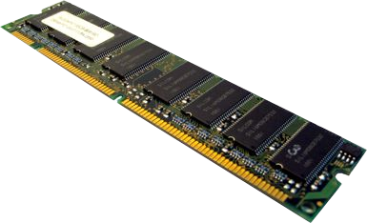
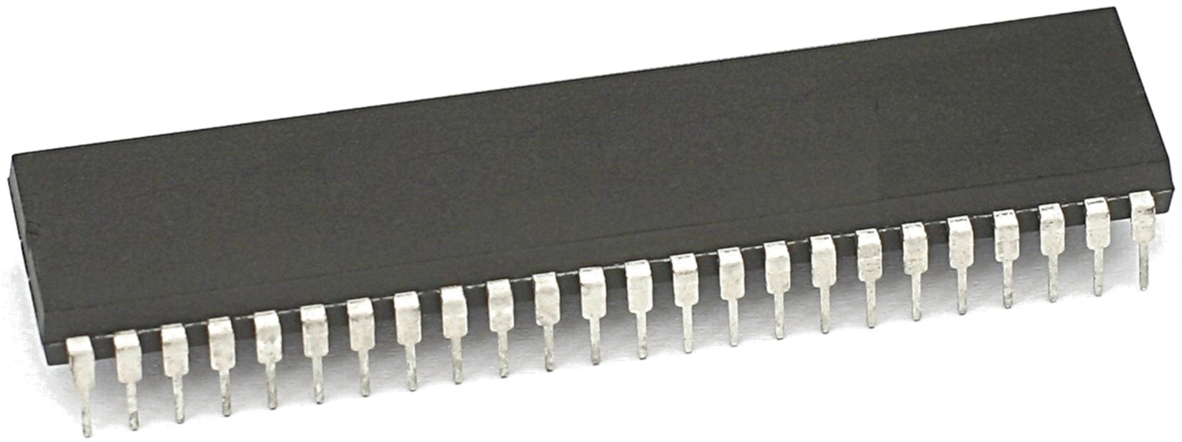
Types of storage
Primary storage
RAM, ROM, registers and cache

Slide 4
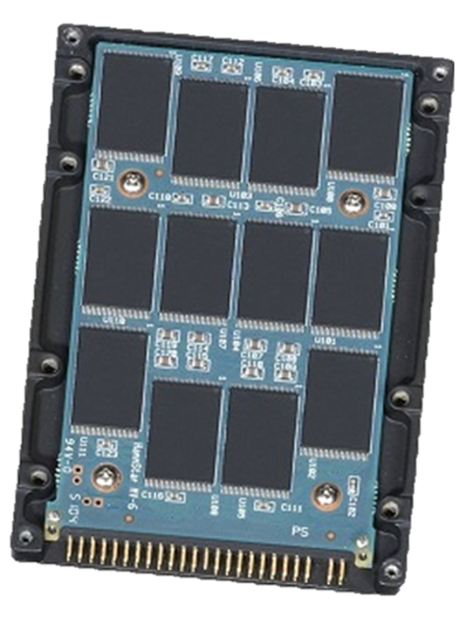
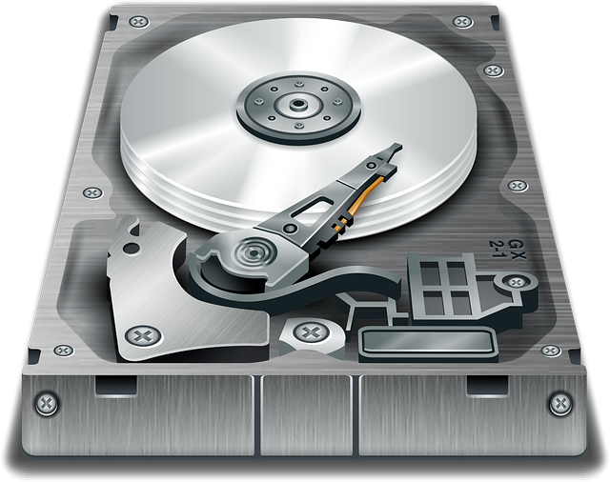
Types of storage
Primary storage
Secondary storage
RAM, ROM, registers and cache
Holds the operating system, programs and data when they are not in use

Slide 5
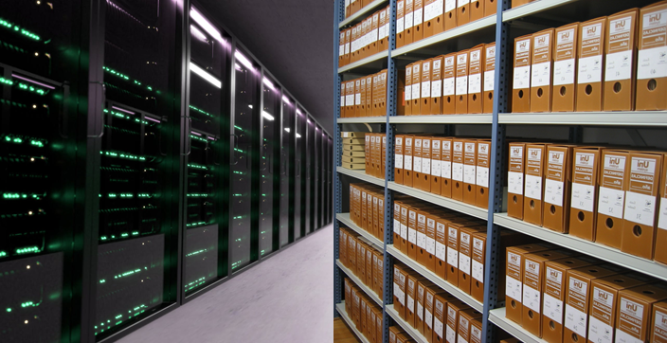
Types of storage
Primary storage
Secondary storage
Tertiary storage
RAM, ROM, registers and cache
Holds the operating system, programs and data when they are not in use
Used for backing up and archiving large amounts of data

Slide 6
Types of storage
Volatile – all except ROM.
Relatively small capacity compared to secondary storage.
Primary storage
Secondary storage
RAM, ROM, registers and cache

Slide 7
Types of storage
Volatile – all except ROM.
Relatively small capacity compared to secondary storage.
Non-volatile.
Much larger capacity compared to primary storage.
Primary storage
Secondary storage
RAM, ROM, registers and cache

Slide 8
Types of storage
Volatile – all except ROM.
Relatively small capacity compared to secondary storage.
Very fast access times compared to secondary storage.
Non-volatile.
Much larger capacity compared to primary storage.
Very slow access times compared to primary storage.
Primary storage
Secondary storage
RAM, ROM, registers and cache

Slide 9

Primary storage consists of:
  Random-Access Memory (RAM)
  Read-Only Memory (ROM)
  Registers
  Cache
It holds data and instructions that the CPU needs to access while the computer is running.
The CPU can access data far more quickly from primary memory than from secondary storage.

