Slide 1
SLR1.2 Memory and storage
RAM and ROM

Slide 2
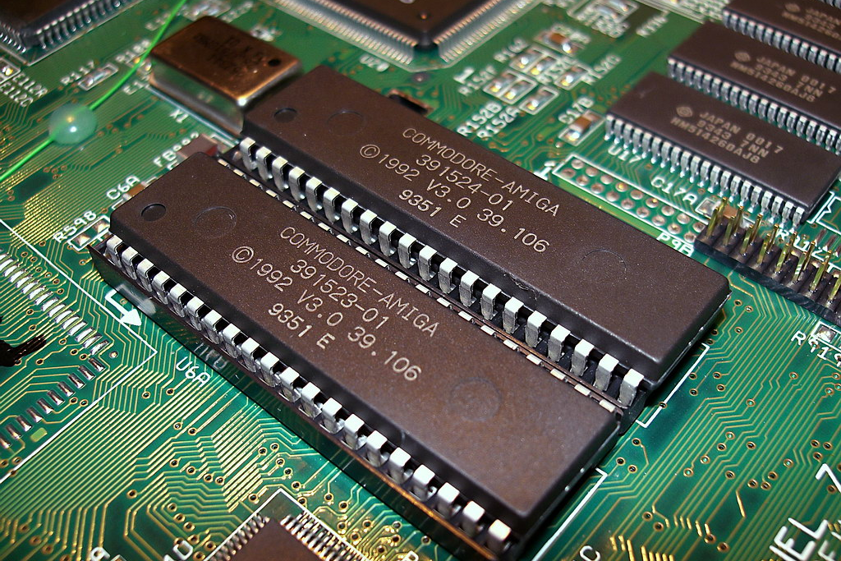
RAM and ROM
ROM
Small piece of read-only memory located on the motherboard.
Non-volatile.
Holds startup instructions for the computer (bootstrap).

Slide 3
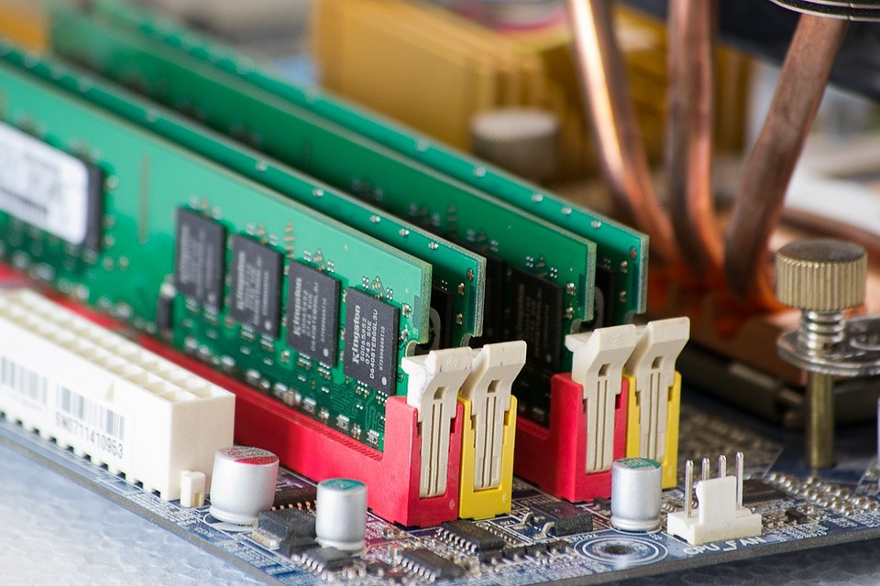
RAM and ROM
ROM
Small piece of read-only memory located on the motherboard.
Non-volatile.
Holds startup instructions for the computer (bootstrap).
RAM
Temporary storage of instructions and data.
Holds data currently being used by the processor.
Volatile.
Much faster to read from than the hard drive.

Slide 4
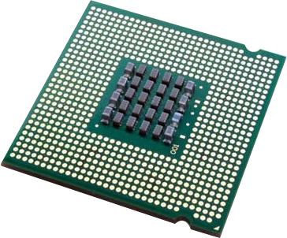
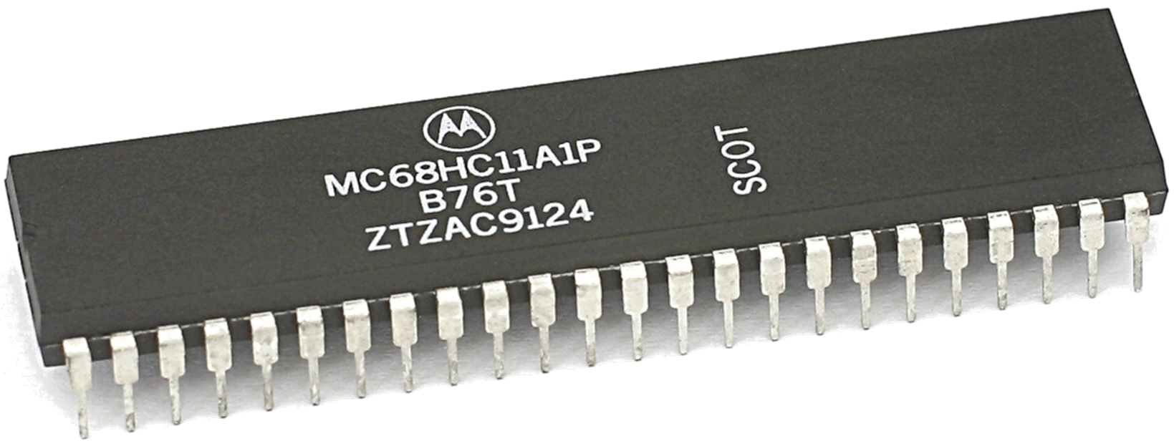
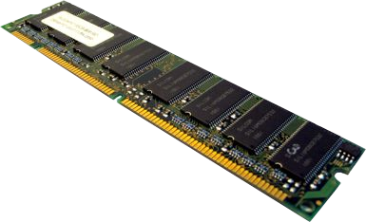
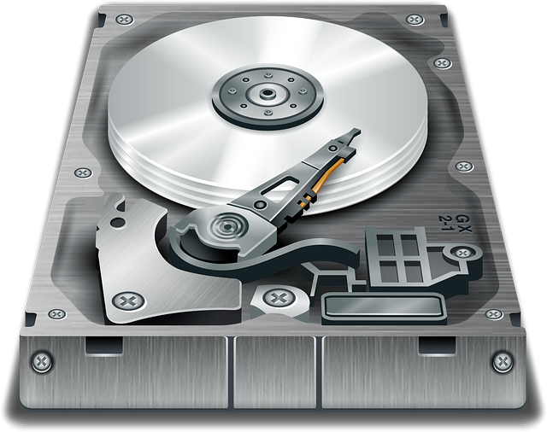
RAM and ROM
ROM
CPU
RAM
Hard drive

Slide 5
RAM and ROM
ROM
CPU
RAM
Hard drive

Slide 6
RAM and ROM
ROM
CPU
RAM
Hard drive

Slide 7
RAM and ROM
ROM
CPU
RAM
Hard drive

Slide 8

Random-Access Memory (RAM)
  Holds programs and data currently in use by the CPU.
  Volatile (contents are lost when the computer is powered off).
  Read-and-write.
  Large compared to ROM.
Read-Only Memory (ROM)
  Holds startup instructions for the computer, known as the bootstrap.
  In embedded systems, programs may by stored in ROM.
  Non-volatile (contents are retained when the computer is powered off).
  Read-only.
  Small compared to RAM.

