Slide 1
SLR1.2 Memory and storage
Suitable storage devices
and storage media

Slide 2

The question of which storage device to use comes down to:
  Capacity: How much data needs to be stored?
  Speed: How quickly does the data need to be read or transferred?
  Portability: Does the data needs to be transported?
  Durability: How robust is the media? Can it be damaged by shocks or extreme conditions?
  Reliability: Does the storage media need to be used over and over without failing?
  Cost: How expensive is the media per byte of storage?

Slide 3
Optical media (CD-R/RW, DVD-R/RW, Blu-ray) is suitable for:
  Large-scale, read-only data distribution.
  Low data capacity requirements.
Magnetic media (hard disk drive) is suitable for:
  High data capacity requirements.
  Fast data access requirements.
  Low-cost storage solutions.
  Cloud storage on server farms.
Solid-state media (SSD, memory stick, flash memory card) is suitable for:
  Low-power embedded systems.
  Rugged applications.
  Low-to-medium data capacity requirements.
  Silent-operation storage solutions.
  Very fast data access requirements.
  Small, lightweight devices.

Slide 4
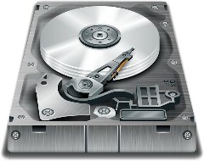
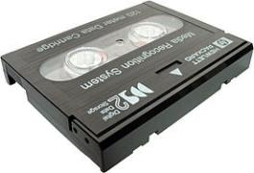
Suitable storage for a given application
Magnetic
Hard disk drive, tape

Slide 5
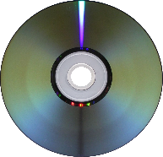
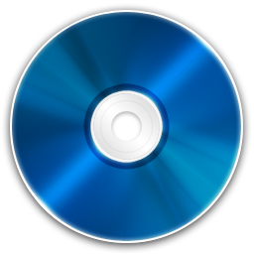
Suitable storage for a given application
Magnetic
Optical
Hard disk drive, tape
CD-R/RW, DVD-R/RW, Blu-ray

Slide 6
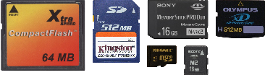
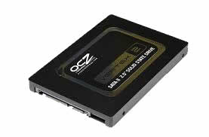
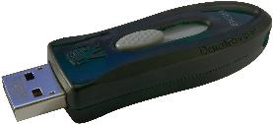
Suitable storage for a given application
Magnetic
Optical
Solid-state
Hard disk drive, tape
CD-R/RW, DVD-R/RW, Blu-ray
SSD, memory stick, flash memory card

Slide 7
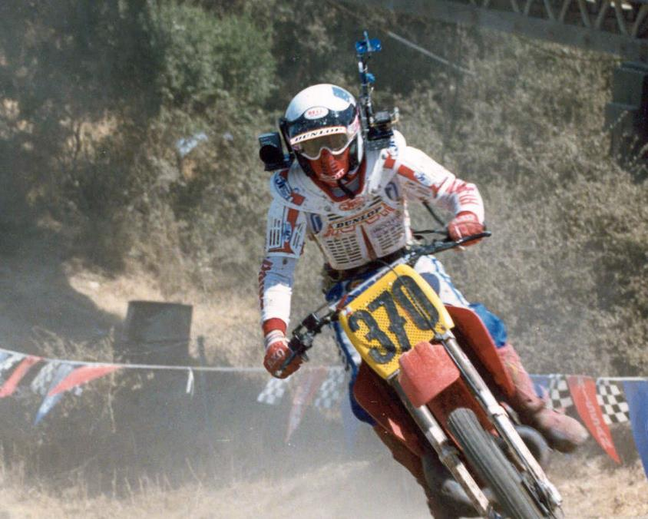
Suitable storage for a given application
Scenario: A helmet-mounted action camera.

Slide 8
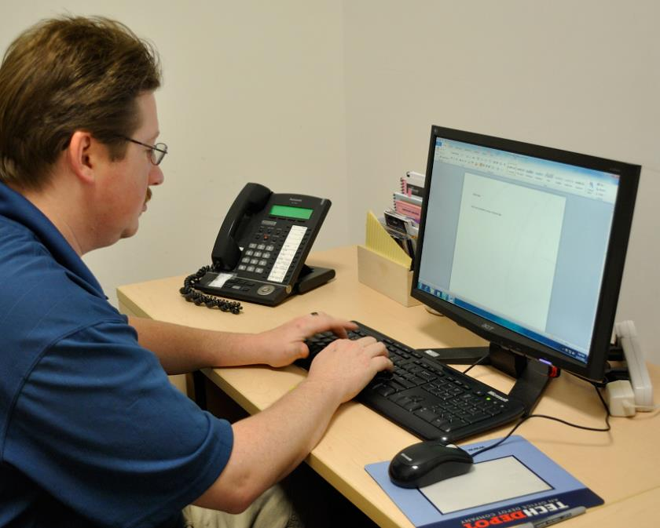
Suitable storage for a given application
Scenario: A home computer storing an operating system and applications.

Slide 9

Suitable storage for a given application
Scenario: A travel agent business backing up 800GB of data.

Slide 10

Suitable storage for a given application
Scenario: A student transferring files between home and school.

Slide 11
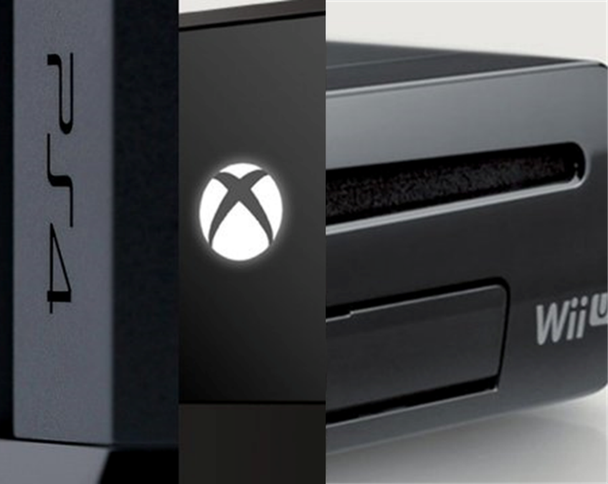
Suitable storage for a given application
Scenario: Distributing a video game for a console.

Slide 12
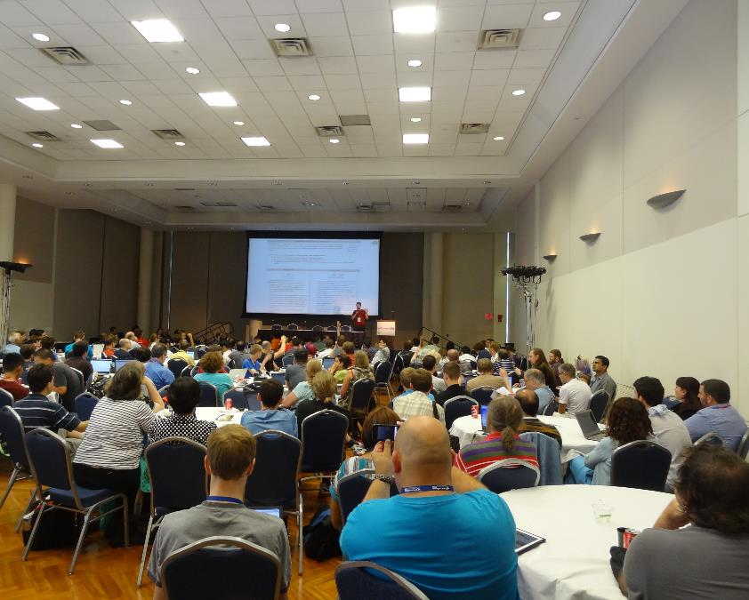
Suitable storage for a given application
Scenario: A company storing training videos long-term.

Slide 13

Suitable storage for a given application
Scenario: Storing audio tracks on a portable MP3 player.

