Slide 1
SLR1.2 Memory and storage
The units of data storage

Slide 2


Units of data storage
0
1
= Binary Digit

Slide 3
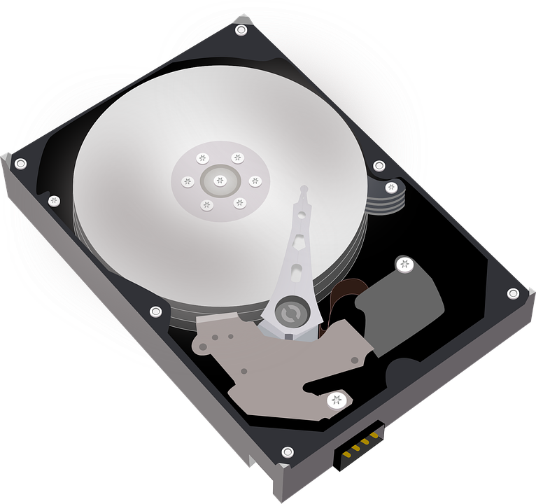
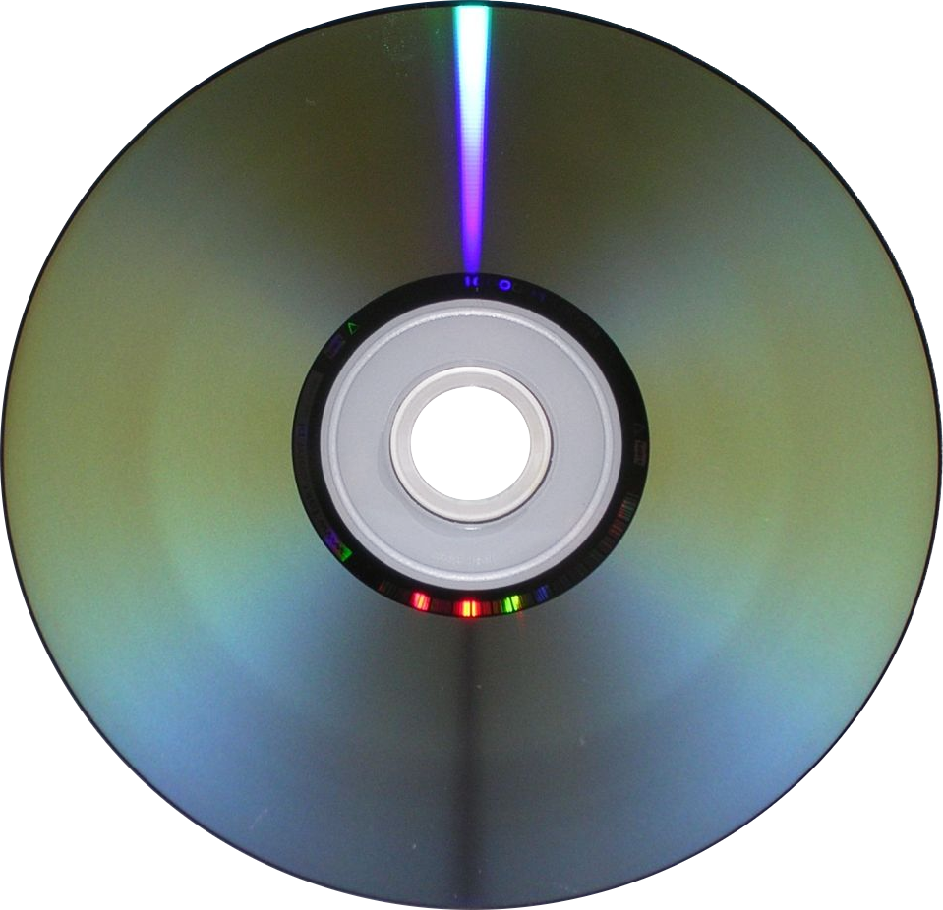
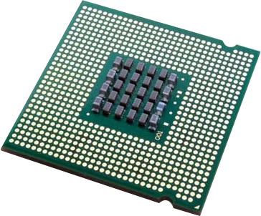
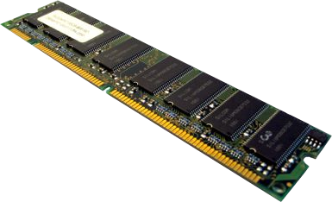
Units of data storage
0
1
= Binary Digit
N
S
S
N
land
pit

Slide 4
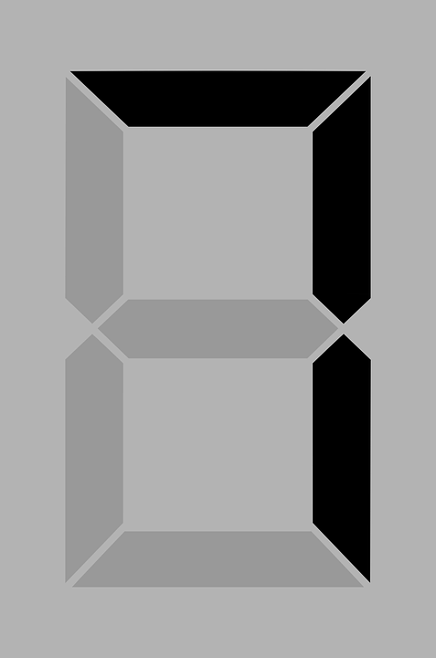
Units of data storage
= 0111

Slide 5
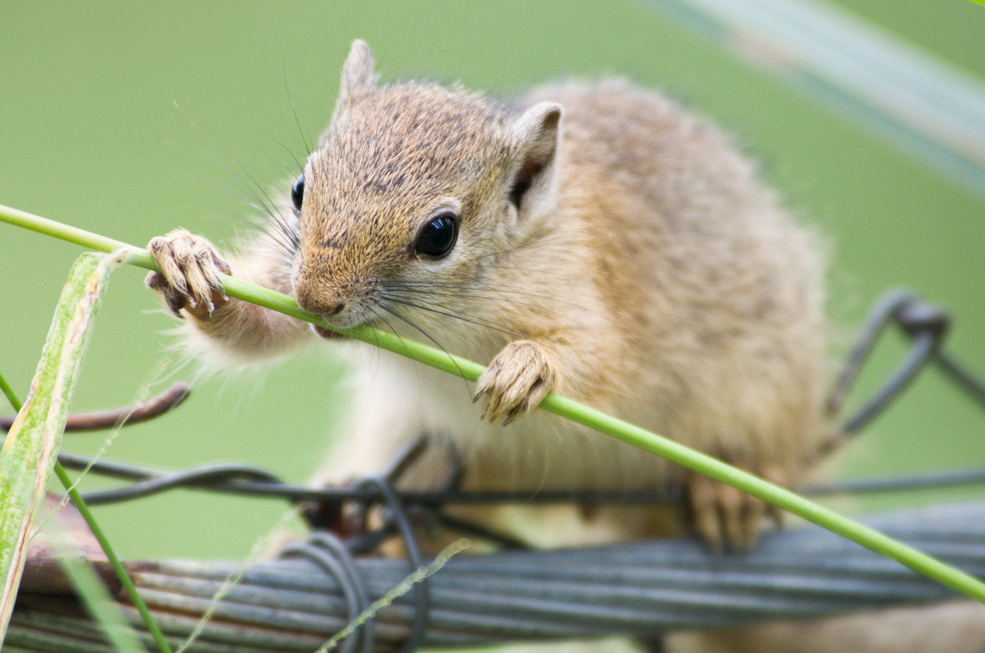
Units of data storage
= 0111

Slide 6
Units of data storage
1 byte = 8 bits (e.g., 00000111)
00010011 = 19
01000001 = A
= 0111

Slide 7
Units of data storage
1 byte = 8 bits (e.g., 00000111)
00010011 = 19
01000001 = A
1 kilobyte (KB)
  = 2¹⁰
  = 1024 bytes
  1000 ≈ bytes
= 0111

Slide 8

Units of data storage
Unit | Symbol | Binary value | Decimal value | Approximation | Written
Bit | b | 0 or 1
Nibble |  | 4 bits |  | ½ byte
Byte | B | 8 bits |  | 1 byte
Kilobyte | KB | 1024 bits | 10³ | 1,000 bytes | One thousand bytes
Megabyte | MB | 1024² bits | 10⁶ | 1,000,000 bytes | One million bytes
Gigabyte | GB | 1024³ bits | 10⁹ | 1,000,000,000 bytes | One billion bytes
Terabyte | TB | 1024⁴ bits | 10¹² | 1,000,000,000,000 bytes | One trillion bytes
Petabyte | PB | 1024⁵ bits | 10¹⁵ | 1,000,000,000,000,000 bytes | One quadrillion bytes

Slide 9
Units of data storage
Unit | Symbol | Binary value | Decimal value | Approximation | Written
Bit | b | 0 or 1
Nibble |  | 4 bits |  | ½ byte
Byte | B | 8 bits |  | 1 byte
Kilobyte | KB | 1024 bits | 10³ | 1,000 bytes | One thousand bytes
Megabyte | MB | 1024² bits | 10⁶ | 1,000,000 bytes | One million bytes
Gigabyte | GB | 1024³ bits | 10⁹ | 1,000,000,000 bytes | One billion bytes
Terabyte | TB | 1024⁴ bits | 10¹² | 1,000,000,000,000 bytes | One trillion bytes
Petabyte | PB | 1024⁵ bits | 10¹⁵ | 1,000,000,000,000,000 bytes | One quadrillion bytes

Slide 10
Converting between units
 | Unit
Multiply by 8 | Bit | Divide by 8
 | Byte
Multiply by 1000 | Kilobyte | Divide by 1000
 | Megabyte
 | Gigabyte
 | Terabyte
 | Petabyte

Slide 11
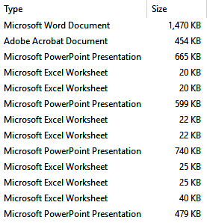
Units of data storage

Slide 12
Units of data storage
= 1.47 MB

Slide 13
Units of data storage
= 1.47 MB
= 0.74 MB

Slide 14
Units of data storage
= 1.47 MB
= 0.74 MB
= 25000B (x 1000)
= 200000b (x 8)

Slide 15

SLR13 Data representation
Going beyond the GCSE specification

Slide 16

Data capacity vs transfer speeds
When describing quantities of bytes, we can use both:
  Binary prefixes (powers of 2)
  Decimal prefixes (powers of 10)
Name | Symbol | Power | Value |  | Name | Symbol | Power | Value
Binary (base 2) |  |  |  |  | Decimal (base 10)
kibi | Ki | 2¹⁰ | 1,024 |  | Kilo | K | 10³ | 1000
mebi | Mi | 2²⁰ | 1,048,576 |  | Mega | M | 10⁶ | 1,000,000
gibi | Gi | 2³⁰ | 1,073,741,824 |  | Giga | G | 10⁹ | 1,000,000,000
tebi | Ti | 2⁴⁰ | 1,099,511,627,776 |  | Tera | T | 10¹² | 1,000,000,000,000
The terms kilobyte, megabyte, gigabyte and terabyte are often used to represent powers of 2.
However, the International System of Units (SI units) uses these terms to refer to values based only on powers of 10.
When referring to powers of 2, you should use the terms kibi, mebi, gibi and tebi instead, but you won’t be penalised in for using kilo, mega, etc. in exams.

Slide 17
Data capacity vs transfer speeds
Symbols for units use capital letters to indicate that they are representing bytes, not bits – e.g., KB, MB, GB, TB, PB.
Storage capacities and file sizes are measured in bytes, so they use a capital B.
Data and network transfer speeds are measured in bits, so they use a lowercase b.
1MB is not the same as 1Mb – it is eight times bigger!

