Slide 1
SLR1.2 Memory and storage
Converting data into binary to be processed by a computer

Slide 2


Living in an analogue world
Analogue signal

Slide 3
Living in an analogue world
Digital signal
On
Off
Off
Analogue signal

Slide 4
What is binary?
= 0
Off
= 1
On

Slide 5
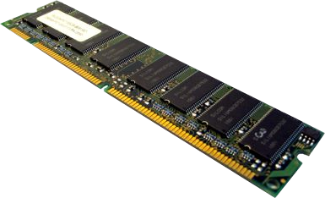
Random-access memory (RAM)

Slide 6
Random-access memory (RAM)

Slide 7
Random-access memory (RAM)

Slide 8
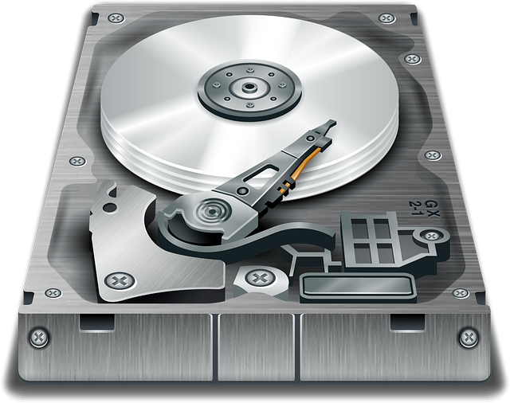
Hard disk
N
S
S
N

Slide 9
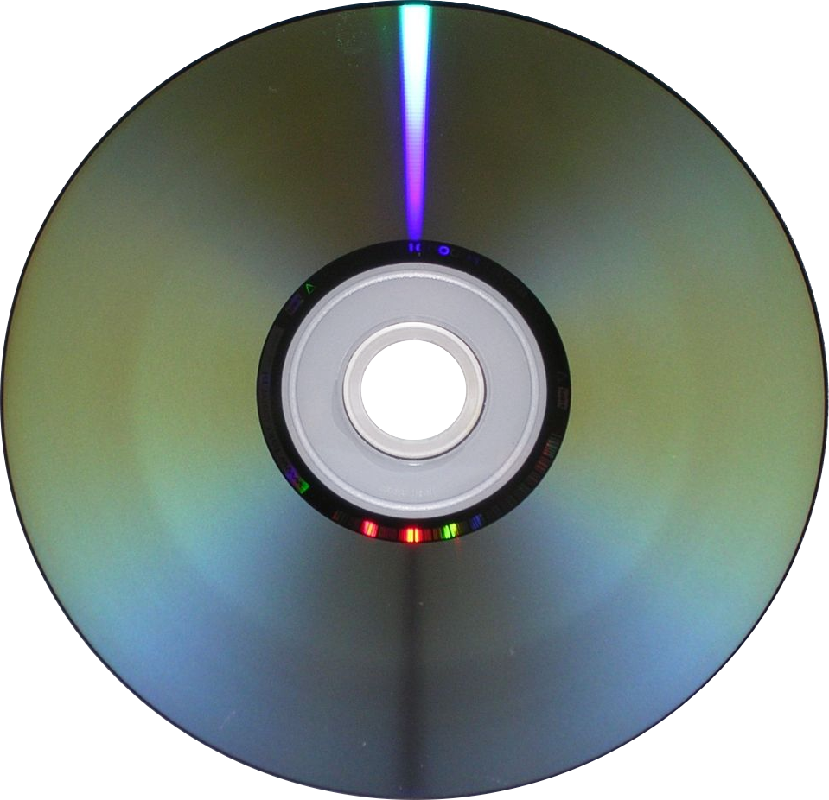
Optical disc
pit
land

Slide 10
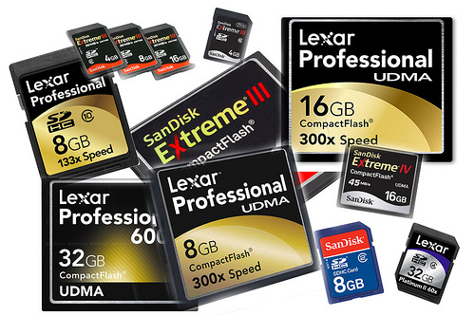
Solid-state memory

Slide 11

With just two states, electronic components are:
  Easier to manufacture
  Cheaper
  More reliable
Examples of using two states to store data:
RAM
Optical disc
N
S
Hard disk
Solid-state memory
S
N

