Slide 1
SLR1.2 Memory and storage
Data capacity and calculating data capacity requirements

Slide 2



Calculating file sizes
Text files
Sound files
Image files

Slide 3
Calculating file sizes
Text files
Sound files
Image files
Bits per character
×
Number of characters

Slide 4
Calculating file sizes
Text files
Sound files
Image files
Bits per character
×
Number of characters
Sample rate
×
Duration (s)
×
Bit depth

Slide 5
Calculating file sizes
Text files
Sound files
Image files
Bits per character
×
Number of characters
Sample rate
×
Duration (s)
×
Bit depth
Colour depth
×
Image height (px)
×
Image width (px)

Slide 6
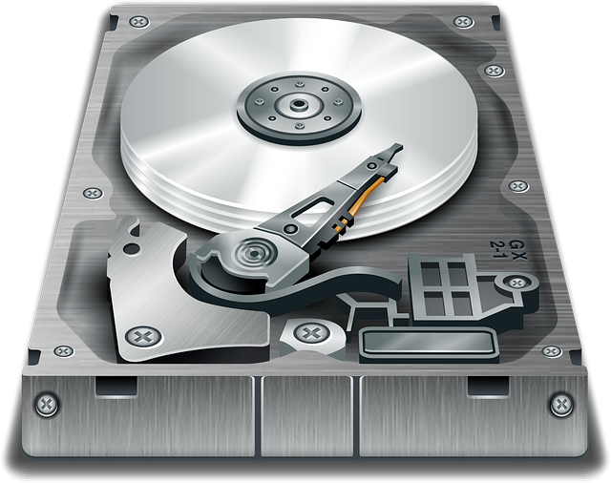
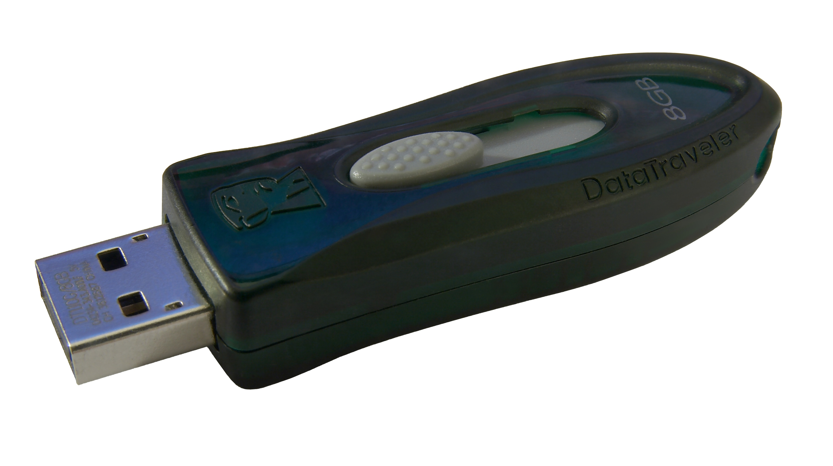
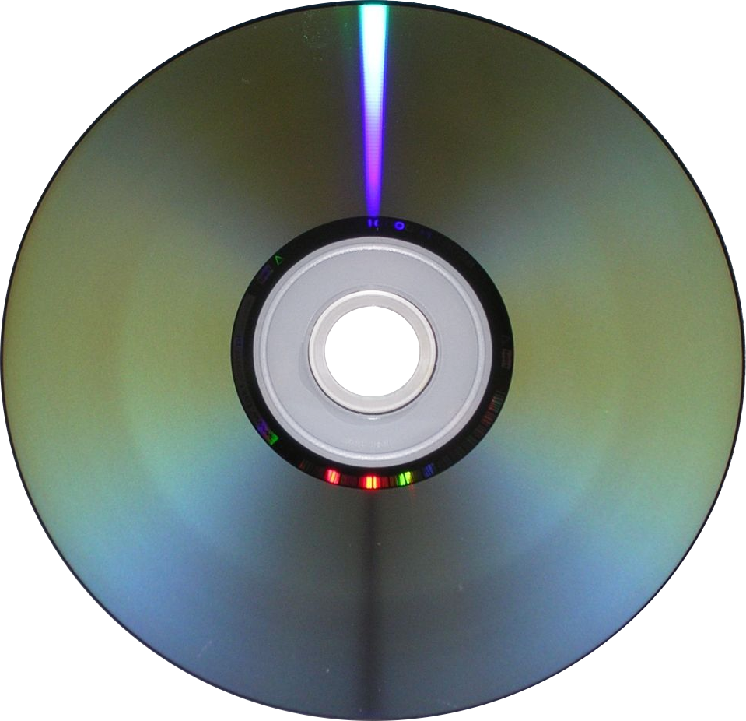
Calculating file sizes
Hard disk
8TB
Solid-state
256GB
CD-R
640MB
Note: These are illustrative capacities for relative comparison.
The actual capacity of storage media is increasing as technology advances.

Slide 7
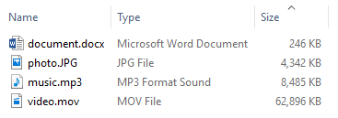
Calculating file sizes

Slide 8
Calculating file sizes
Hard disk
8TB
Solid-state
256GB
CD-R
640MB

Slide 9
Calculating file sizes
Hard disk
8TB
Solid-state
256GB
CD-R
640MB

Slide 10
Calculating file sizes
Hard disk
8TB
Solid-state
256GB
8,000,000 MB
CD-R
640MB
≈ 40,000,000 documents
0.2 MB

Slide 11
Calculating file sizes
Hard disk
8TB
Solid-state
256GB
CD-R
640MB

Slide 12
Calculating file sizes
Hard disk
8TB
Solid-state
256GB
256,000 MB
CD-R
640MB
≈ 1,280,000 documents
0.2 MB

Slide 13
Calculating file sizes
Hard disk
8TB
Solid-state
256GB
CD-R
640MB

Slide 14
Calculating file sizes
Hard disk
8TB
Solid-state
256GB
640 MB
CD-R
640MB
≈ 3,200 documents
0.2 MB

Slide 15
Calculating file sizes
Hard disk
8TB
Solid-state
256GB
CD-R
640MB

Slide 16
Calculating file sizes
Hard disk
8TB
Solid-state
256GB
8,000,000 MB
CD-R
640MB
≈ 127,186 videos
62.9 MB

Slide 17
Calculating file sizes
Hard disk
8TB
Solid-state
256GB
CD-R
640MB

Slide 18
Calculating file sizes
Hard disk
8TB
Solid-state
256GB
256,000 MB
CD-R
640MB
≈ 59,534 photos
4.3 MB

Slide 19
Calculating file sizes
Hard disk
8TB
Solid-state
256GB
CD-R
640MB

Slide 20
Calculating file sizes
Hard disk
8TB
Solid-state
256GB
640 MB
CD-R
640MB
≈ 76 music files
8.4 MB

Slide 21
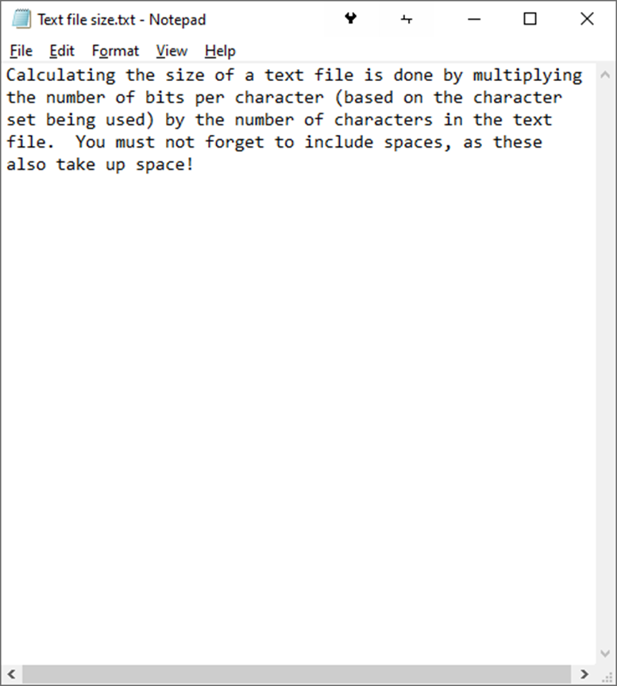
Calculating text file sizes
Bits per character
×
Number of characters
Text file size
Bits per character |  | Based on the standard ASCII character set being used
No. of characters |  | Including spaces

Slide 22
Calculating text file sizes
Bits per character
×
Number of characters
Text file size
Bits per character | 7 | Based on the standard ASCII character set being used
No. of characters |  | Including spaces

Slide 23
Calculating text file sizes
Bits per character
×
Number of characters
Text file size
Bits per character | 7 | Based on the standard ASCII character set being used
No. of characters | 244 | Including spaces

Slide 24

Calculating text file sizes
Bits per character
×
Number of characters
Text file size
Bits per character | 7 | Based on the standard ASCII character set being used
No. of characters | 244 | Including spaces
7 × 244 | = | 1,708 bits = 214 bytes
We cover the topic of character sets in more detail in our video titled
GCSE OCR 1.2 Representing characters and character sets

Slide 25
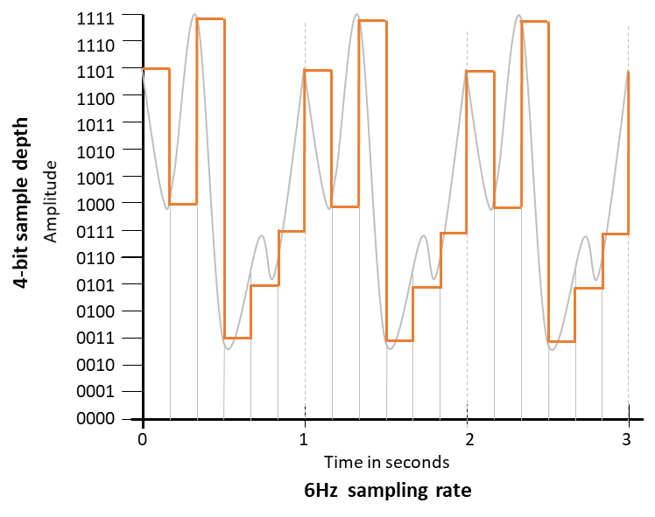
Calculating sound file sizes
Sample rate
×
Duration (s)
×
Bit depth
Sound file size
Sample rate |  | Number of samples per second
Duration |  | Length of sample in seconds
Bit depth |  | Number of bits required to store each sample

Slide 26
Calculating sound file sizes
Sample rate
×
Duration (s)
×
Bit depth
Sound file size
Sample rate | 6 | Number of samples per second
Duration |  | Length of sample in seconds
Bit depth |  | Number of bits required to store each sample

Slide 27
Calculating sound file sizes
Sample rate
×
Duration (s)
×
Bit depth
Sound file size
Sample rate | 6 | Number of samples per second
Duration | 3 | Length of sample in seconds
Bit depth |  | Number of bits required to store each sample

Slide 28
Calculating sound file sizes
Sample rate
×
Duration (s)
×
Bit depth
Sound file size
Sample rate | 6 | Number of samples per second
Duration | 3 | Length of sample in seconds
Bit depth | 4 | Number of bits required to store each sample

Slide 29
Calculating sound file sizes
Sample rate
×
Duration (s)
×
Bit depth
Sound file size
Sample rate | 6 | Number of samples per second
Duration | 3 | Length of sample in seconds
Bit depth | 4 | Number of bits required to store each sample
6 × 3 × 4 | = | 72 bits = 9 bytes
We cover the topic of sound in more detail in our video titled
GCSE OCR 1.2 Representing sound

Slide 30
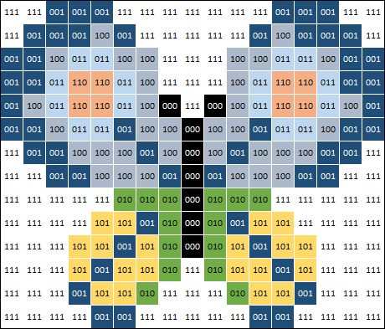
Calculating image file sizes
Colour depth
×
Image height (px)
×
Image width (px)
Image file size
Image height |  | Height measured in pixels
Image width |  | Width measured in pixels
Colour depth |  | Number of bits required to store each pixel

Slide 31
Calculating image file sizes
Colour depth
×
Image height (px)
×
Image width (px)
Image file size
Image height | 14 | Height measured in pixels
Image width |  | Width measured in pixels
Colour depth |  | Number of bits required to store each pixel

Slide 32
Calculating image file sizes
Colour depth
×
Image height (px)
×
Image width (px)
Image file size
Image height | 14 | Height measured in pixels
Image width | 17 | Width measured in pixels
Colour depth |  | Number of bits required to store each pixel

Slide 33
Calculating image file sizes
Colour depth
×
Image height (px)
×
Image width (px)
Image file size
Image height | 14 | Height measured in pixels
Image width | 17 | Width measured in pixels
Colour depth | 3 | Number of bits required to store each pixel

Slide 34
Calculating image file sizes
Colour depth
×
Image height (px)
×
Image width (px)
Image file size
Image height | 14 | Height measured in pixels
Image width | 17 | Width measured in pixels
Colour depth | 3 | Number of bits required to store each pixel
14 × 17 × 3 | = | 714 bits = 90 bytes
We cover the topic of images in more detail in our video titled
GCSE OCR 1.2 Representing images

Slide 35

Calculating text file sizes: (Bits per character) × (Number of characters)
Calculating image file sizes: (Colour depth) × (Image height px) × (Image width px)
Calculating sound file sizes: (Sample rate) × (Duration in seconds) × (Bit depth)

