Slide 1
SLR1.2 Memory and storage
Representing characters and character sets

Slide 2


Storing characters in binary
0
1

Slide 3
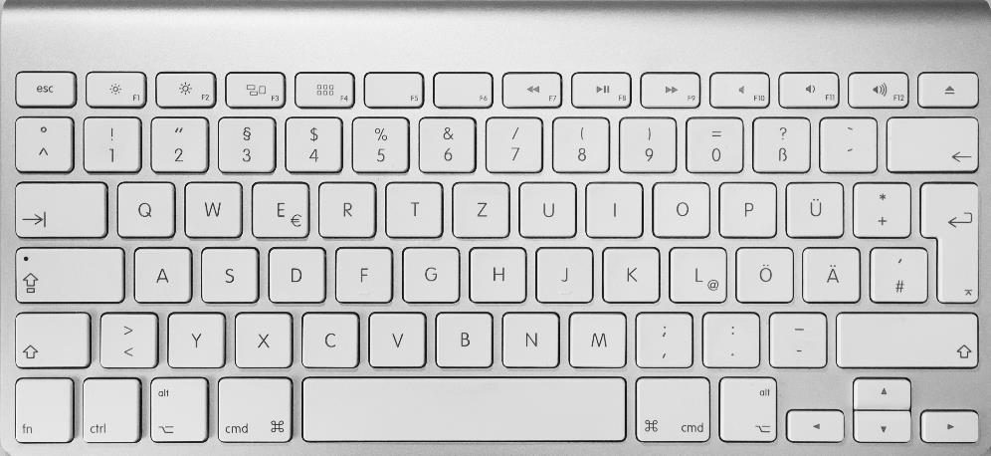
Storing characters in binary
0
1

Slide 4


Storing characters in binary
0
1

Slide 5
Storing characters in binary
0
= A
1
= B

Slide 6
Storing characters in binary
0
0
1
0
= A
= C
0
1
1
1
= B
= D

Slide 7
Storing characters in binary
2⁵ ⁼ 32

Slide 8
Storing characters in binary
2⁵ ⁼ 32
0
1

Slide 9
Storing characters in binary
5 bits
2⁵ ⁼ 32
0
1

Slide 10
Storing characters in binary
Code | Character | Code | Character
0 | A | 13 | N
1 | B | 14 | O
2 | C | 15 | P
3 | D | 16 | Q
4 | E | 17 | R
5 | F | 18 | S
6 | G | 19 | T
7 | H | 20 | U
8 | I | 21 | V
9 | J | 22 | W
10 | K | 23 | X
11 | L | 24 | Y
12 | M | 25 | Z
5 bits
2⁵ ⁼ 32
0
1
Character set: A defined list of characters recognised by computer hardware and software.
Each character is represented by a single number.

Slide 11
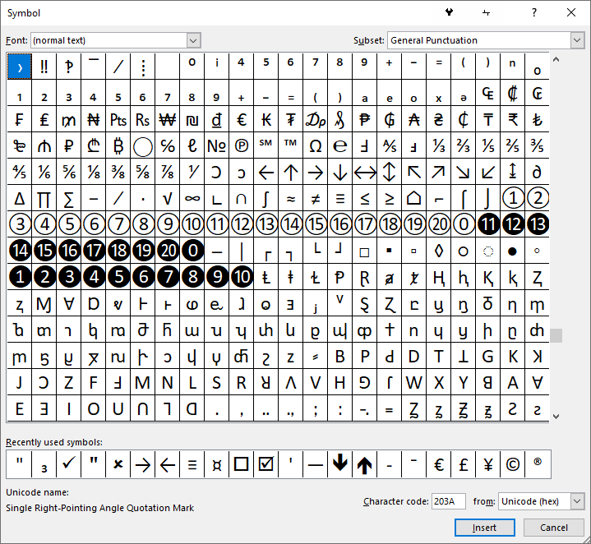
Storing characters in binary
5 bits
2⁵ ⁼ 32
0
1

Slide 12
Storing characters in binary
2⁷ ⁼ 128

Slide 13

Storing characters in binary
01000001
= 65 = A

Slide 14
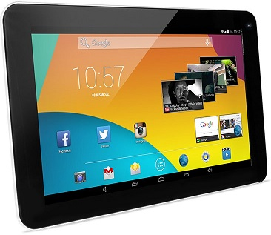
Storing characters in binary
If one device recognises the binary sequence 01000001 as “A”, other devices must also recognise this sequence as “A”.
01000001
= 65 = A

Slide 15
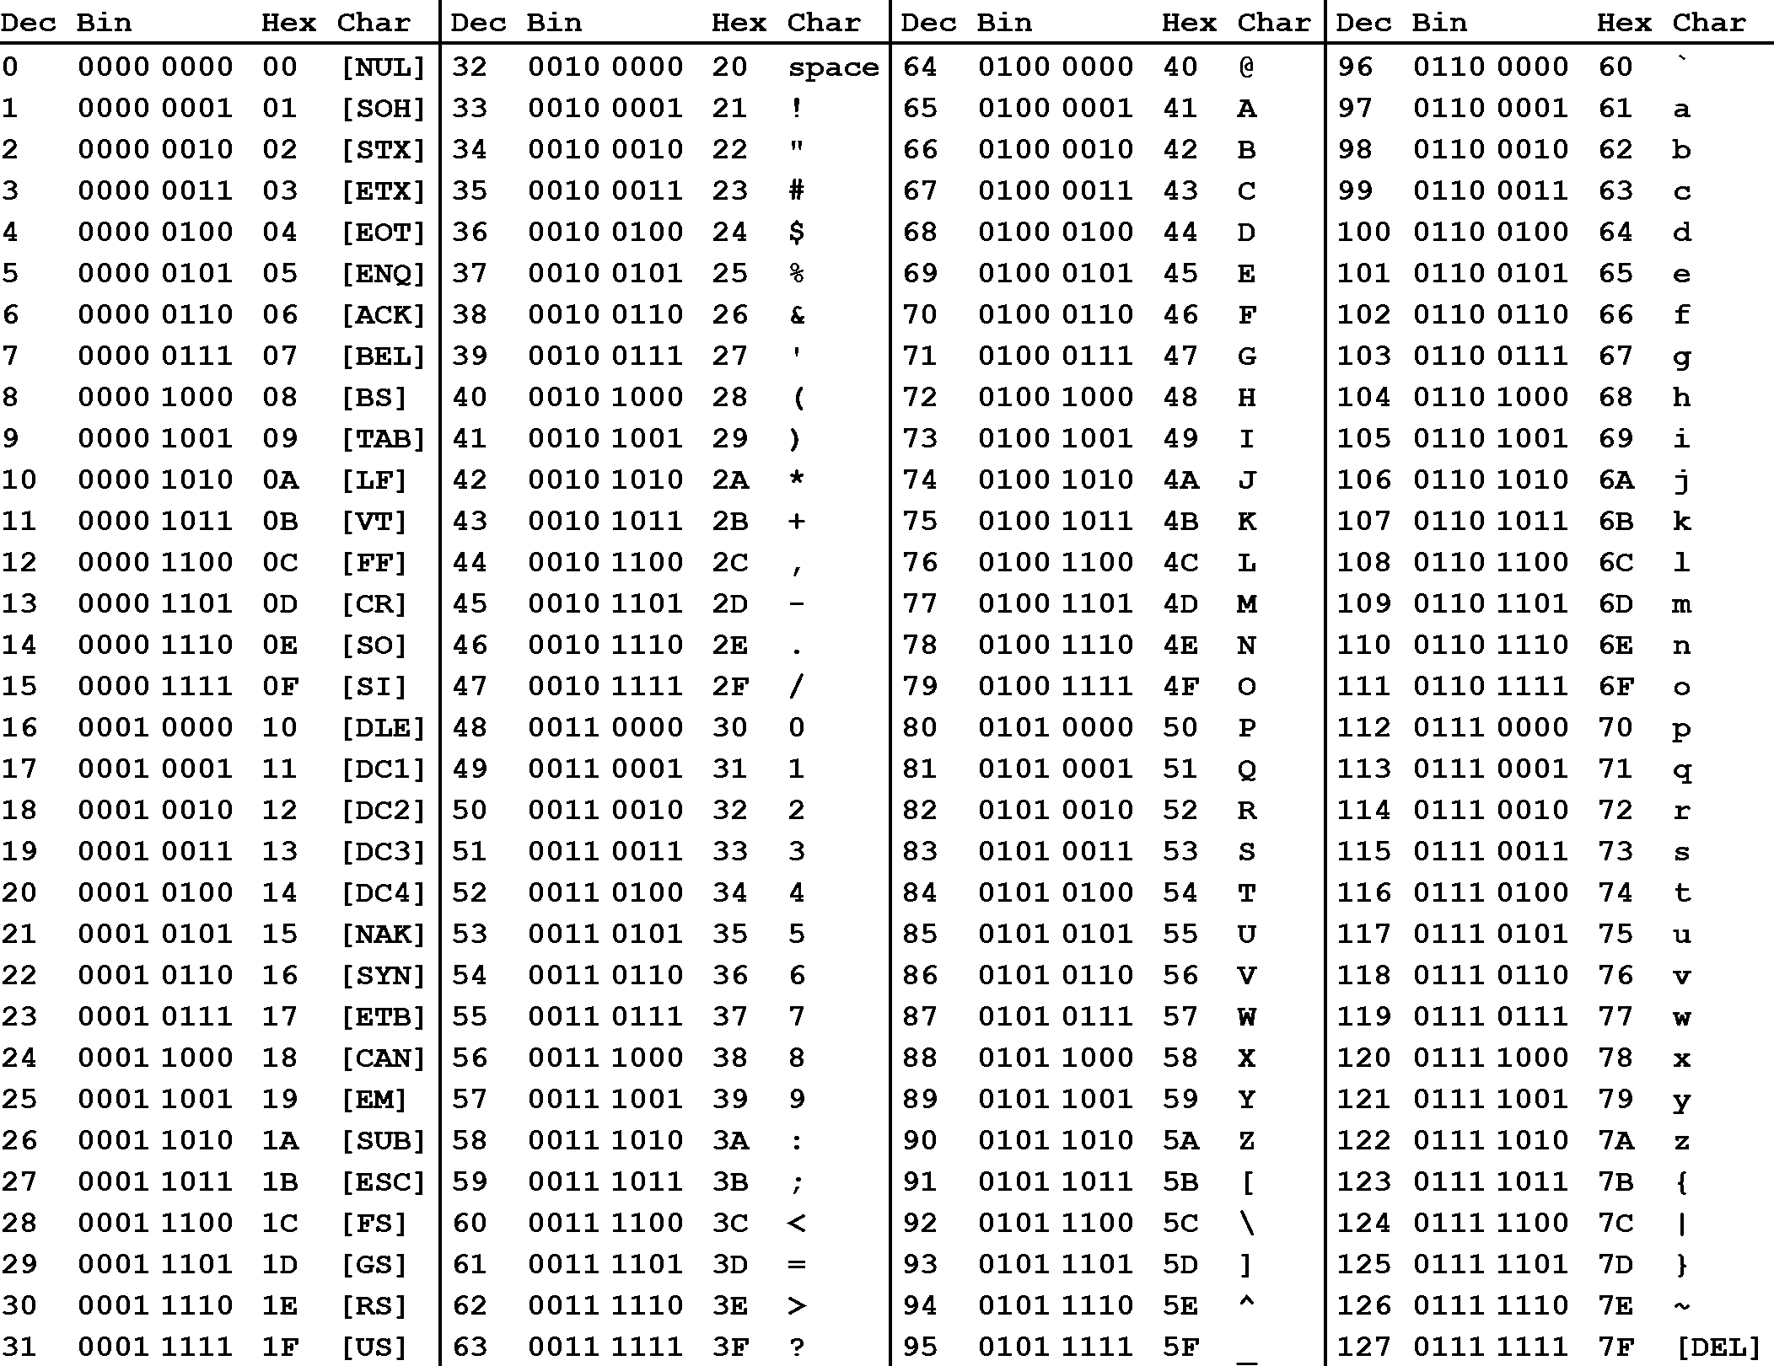
Storing characters in binary
ASCII (7-bit)
2⁷ combinations = 128

Slide 16
Storing characters in binary
ASCII (7-bit)
2⁷ combinations = 128
Extended ASCII (8-bit)
2⁸ combinations = 256

Slide 17
Storing characters in binary

Slide 18
Storing characters in binary

Slide 19
Storing characters in binary

Slide 20
Storing characters in binary

Slide 21
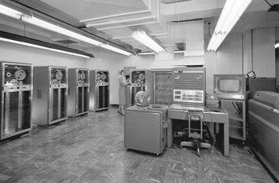
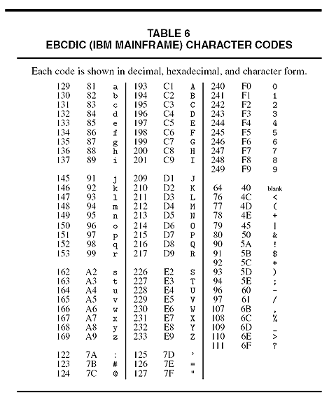
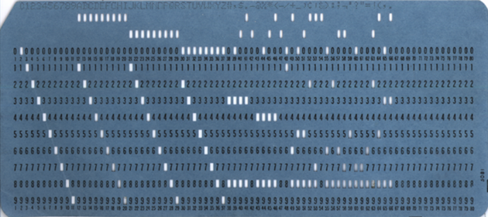
Storing characters in binary

Slide 22
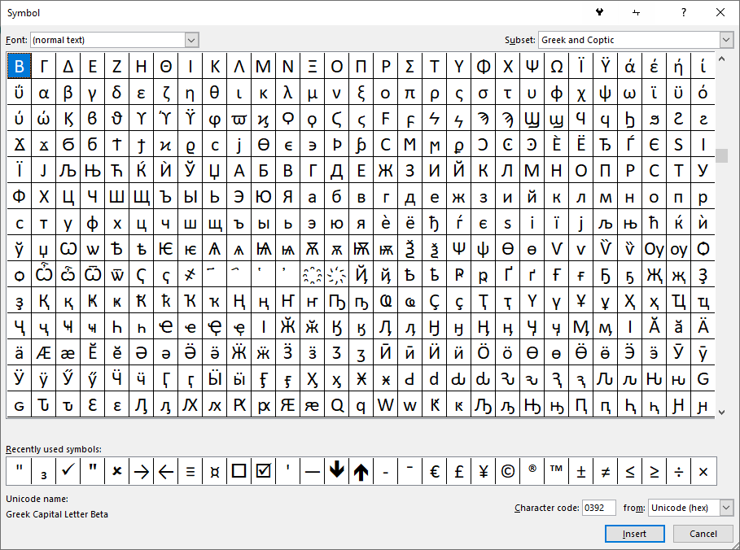

Storing characters in binary
There are thousands of international and multilingual characters and symbols.

Slide 23
Storing characters in binary
Unicode (16-bit)
Some obscure characters were not included in this set.

Slide 24
Storing characters in binary
Unicode (24-bit)
2²⁴ characters = over 16 million!
Writing in 24 bits is slower and prone to error, so hexadecimal is often used instead.
6 digits in hexadecimal = 24 bits in binary.
Remember, 1 nibble = 1 hex digit.

Slide 25

Character sets
A character set is a defined list of characters recognised by a computer. Each character is represented by a unique binary number. Well-known character sets include:
  ASCII: A 7-bit character set with 2⁷ characters (128).
  Extended ASCII: An 8-bit character set with 2⁸ characters (256).
  Unicode: A 24-bit character set with 2²⁴ characters (over 16 million).

