Slide 1
SLR1.3 Computer networks, connections and protocols
Types of networks

Slide 2

Advantages of networking
Thanks to networking technology, we can:
  Transfer files quickly and easily.
  Share peripherals and internet connections.
  Access files from any computer on a network.
  Control security, software updates and backups via a server.
  Communicate with each other via email and social media.

Slide 3
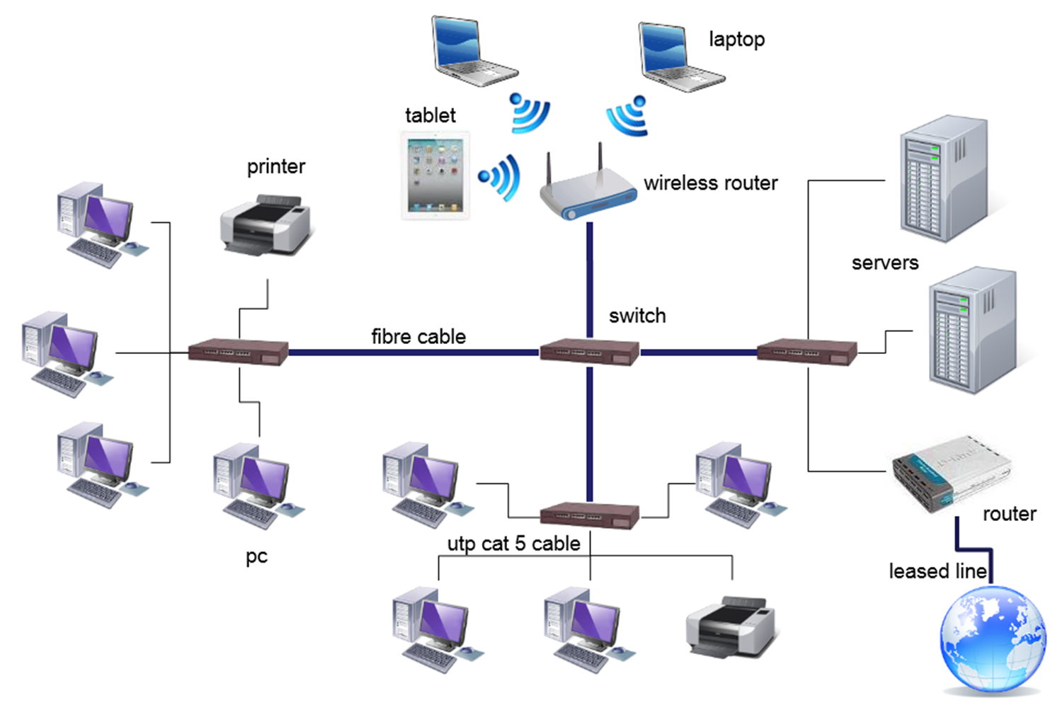
Local Area Network (LAN)
Covers a single site within a small geographical area.
All the hardware is owned by the organisation using it.
Wired with UTP or fibre optic cable or wireless using Wi-Fi.

Slide 4
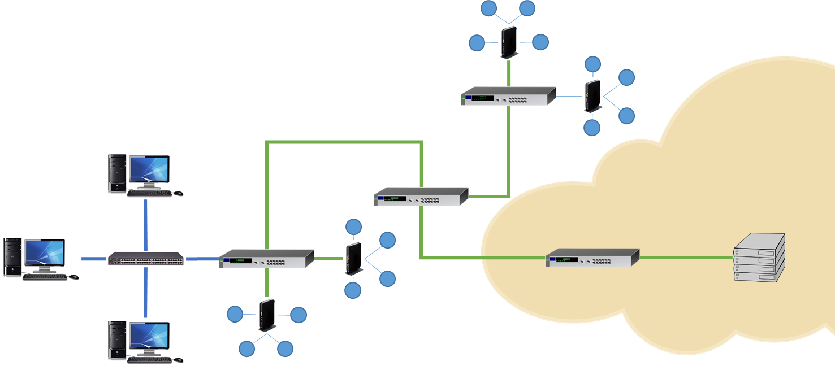
Wide Area Network (WAN)
Connects LANs together over a large geographical area.
Infrastructure is leased from telecommunication companies who own and manage it.
Connected with telephone lines, fibre optic cables or satellite links.

Slide 5
Wide Area Network (WAN)
Connects LANs together over a large geographical area.
Infrastructure is leased from telecommunication companies who own and manage it.
Connected with telephone lines, fibre optic cables or satellite links.

Slide 6
Wide Area Network (WAN)
Connects LANs together over a large geographical area.
Infrastructure is leased from telecommunication companies who own and manage it.
Connected with telephone lines, fibre optic cables or satellite links.

Slide 7
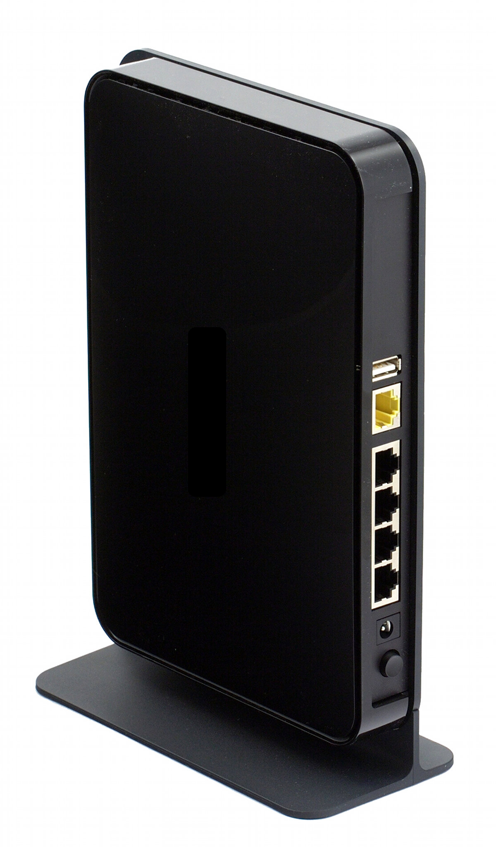
Wide Area Network (WAN)
Routers for personal, home use tend to be multi-function, all-in-one devices that act as the:
Switch
Router
Wireless access point
Connects LANs together over a large geographical area.
Infrastructure is leased from telecommunication companies who own and manage it.
Connected with telephone lines, fibre optic cables or satellite links.

Slide 8
Disadvantages of networking
However, networking does have its drawbacks:
  Increased security risk to data.
  Malware and viruses can spread very easily between computers.
  If a server fails, the computers connected to it may not work.
  Computers may run slower if there is a lot of data travelling on the network.

