Slide 1
SLR1.3 Computer networks, connections and protocols
Factors that affect
network performance

Slide 2
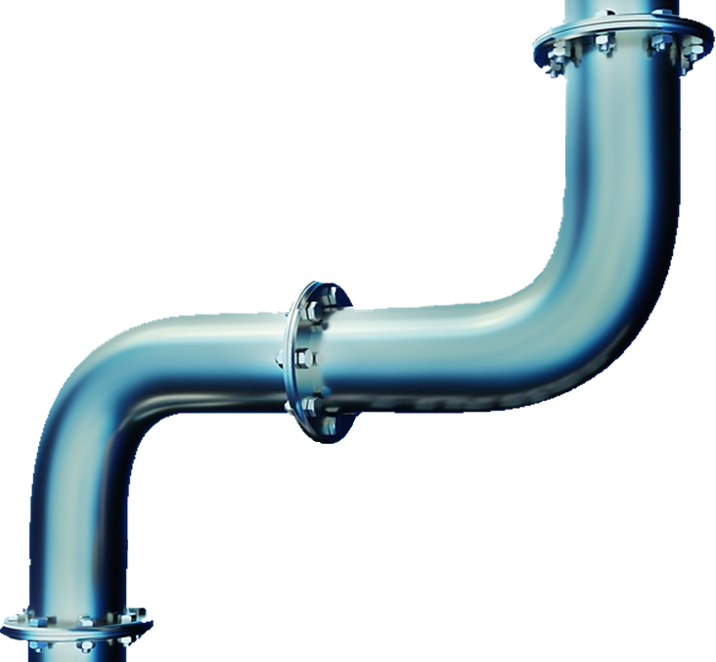

Factors that affect the performance of networks
Bandwidth
The amount of data that can be sent and received successfully in a specified period of time.
Not a measure of how fast data travels but how much data can be sent via transmission media.
Measured in bits per second, often called bit rate.

Slide 3

Factors that affect the performance of networks
Numbers of users
Too many users or devices on the same network can cause it to slow down if there is insufficient bandwidth available.

Slide 4
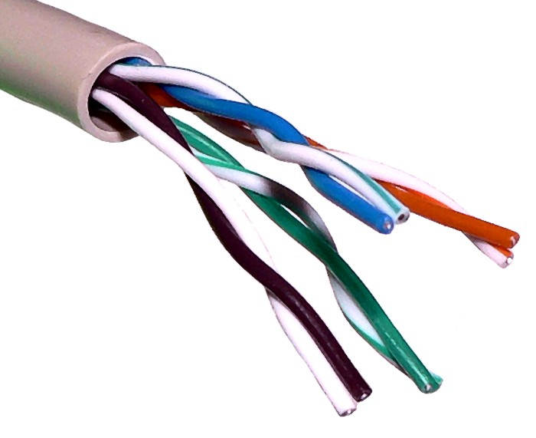
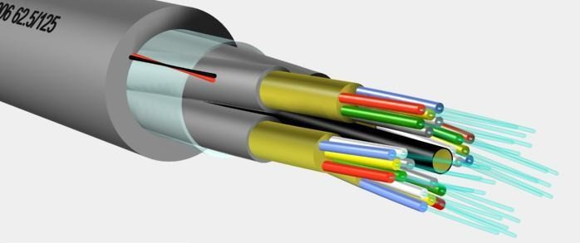
Factors that affect the performance of networks
Transmission media
Wired connections offer higher bandwidth than wireless connections.
Fibre optic cables offer higher bandwidth than copper cables.

Slide 5

Factors that affect the performance of networks
Error rate
Less reliable connections increase the occurrence of errors during data transfer.
Data must be resent until it arrives correctly.
The quality of a wireless connections depends on the device’s distance from the wireless access point and other environmental factors.
The quality of the signal provided by copper cables is determined by the grade of the material used – higher-quality cables help to reduce interference.
The length of the cable is also a factor.

Slide 6

Factors that affect the performance of networks
Latency
The delay between data being transmitted and a user’s device receiving it, latency is caused by bottlenecks in network infrastructure.
For example, not using switches to appropriately segment network traffic.
Various pieces of hardware like switches and cables may not operate at the same speed.

