Slide 1
SLR1.3 Computer networks, connections and protocols
Client-server and
peer-to-peer networks

Slide 2

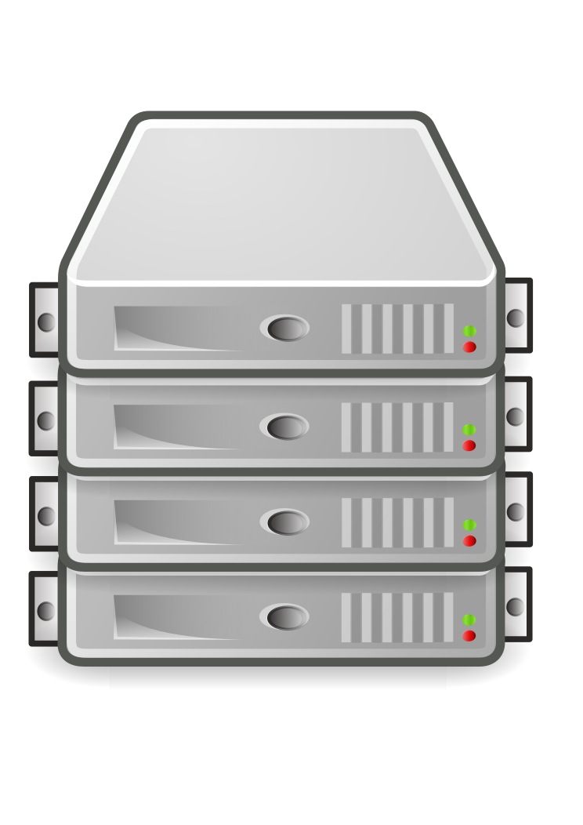
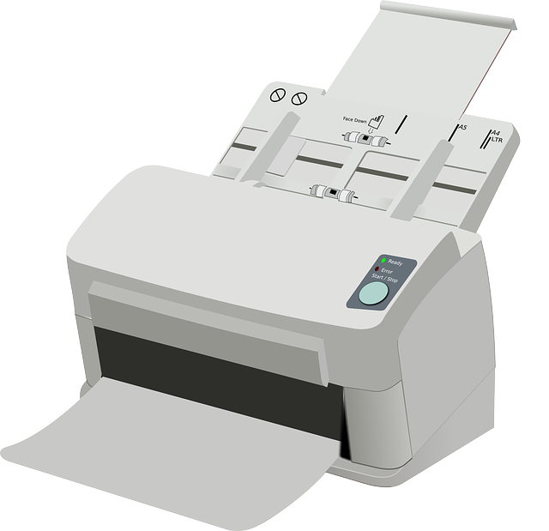
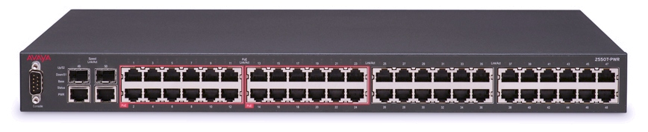

Server
Client-server model
Printer
Server
Controls access and security to one shared file store.
Manages access to the internet.
Manages printing jobs.
Provides email services.
Runs data backups.
Client
Makes requests to the server for data and connections.
Client
Client
Client

Slide 3
Server
Client-server model
Printer
Advantages
Easier to manage security.
Easier to back up shared data.
Easier to install software updates on all computers at once.
Disadvantages
Expensive to set up and maintain.
Requires IT specialists.
Single point of failure.
Users lose access if the server fails.
Client
Client
Client

Slide 4
Peer-to-peer model
Printer
Peer
A peer is a computer on a network and equal to all other peers.
Peers serve their files to each other.
Each peer is responsible for its own security and backups.
Peers usually have their own printers.
You can send print jobs to another peer to process, but that peer needs to be switched on to communicate with the printer.
Peer
Logical connection
Peer
Peer

Slide 5
Peer-to-peer model
Printer
Peer
Advantages
Very easy to maintain.
Specialist staff are not required.
No dependency on a single computer.
Cheaper to set up.
No expensive hardware.
Disadvantages
Less secure.
Users manage their own backups.
Can be difficult to maintain a well-ordered file store.
Peer
Logical connection
Peer
Peer

