Slide 1
SLR1.3 Computer networks, connections and protocols
Hardware used to connect a LAN

Slide 2
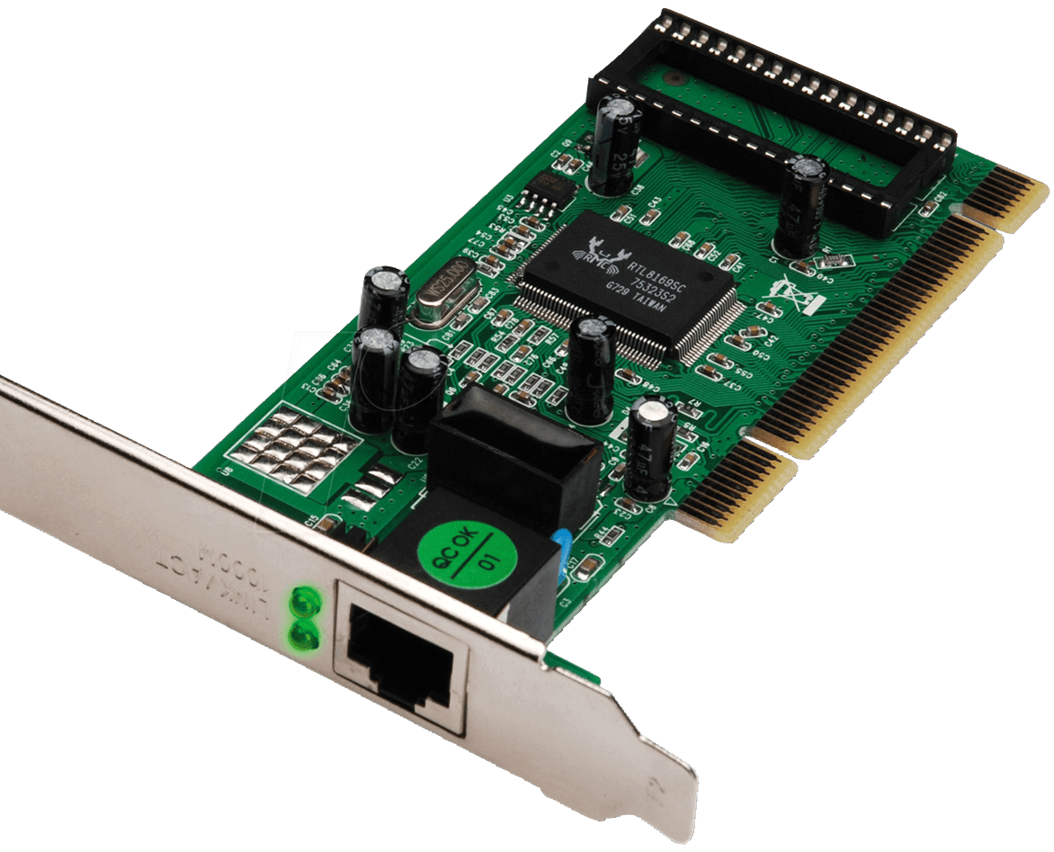
Network interface card/controller
Every computer connecting to a network needs a network interface card/controller (NIC).
These days, NICs are not physically separate but integrated.
An NIC use a set of rules to determine how the connection should work.
It allows a device to connect to either a wired or wireless network.

Slide 3
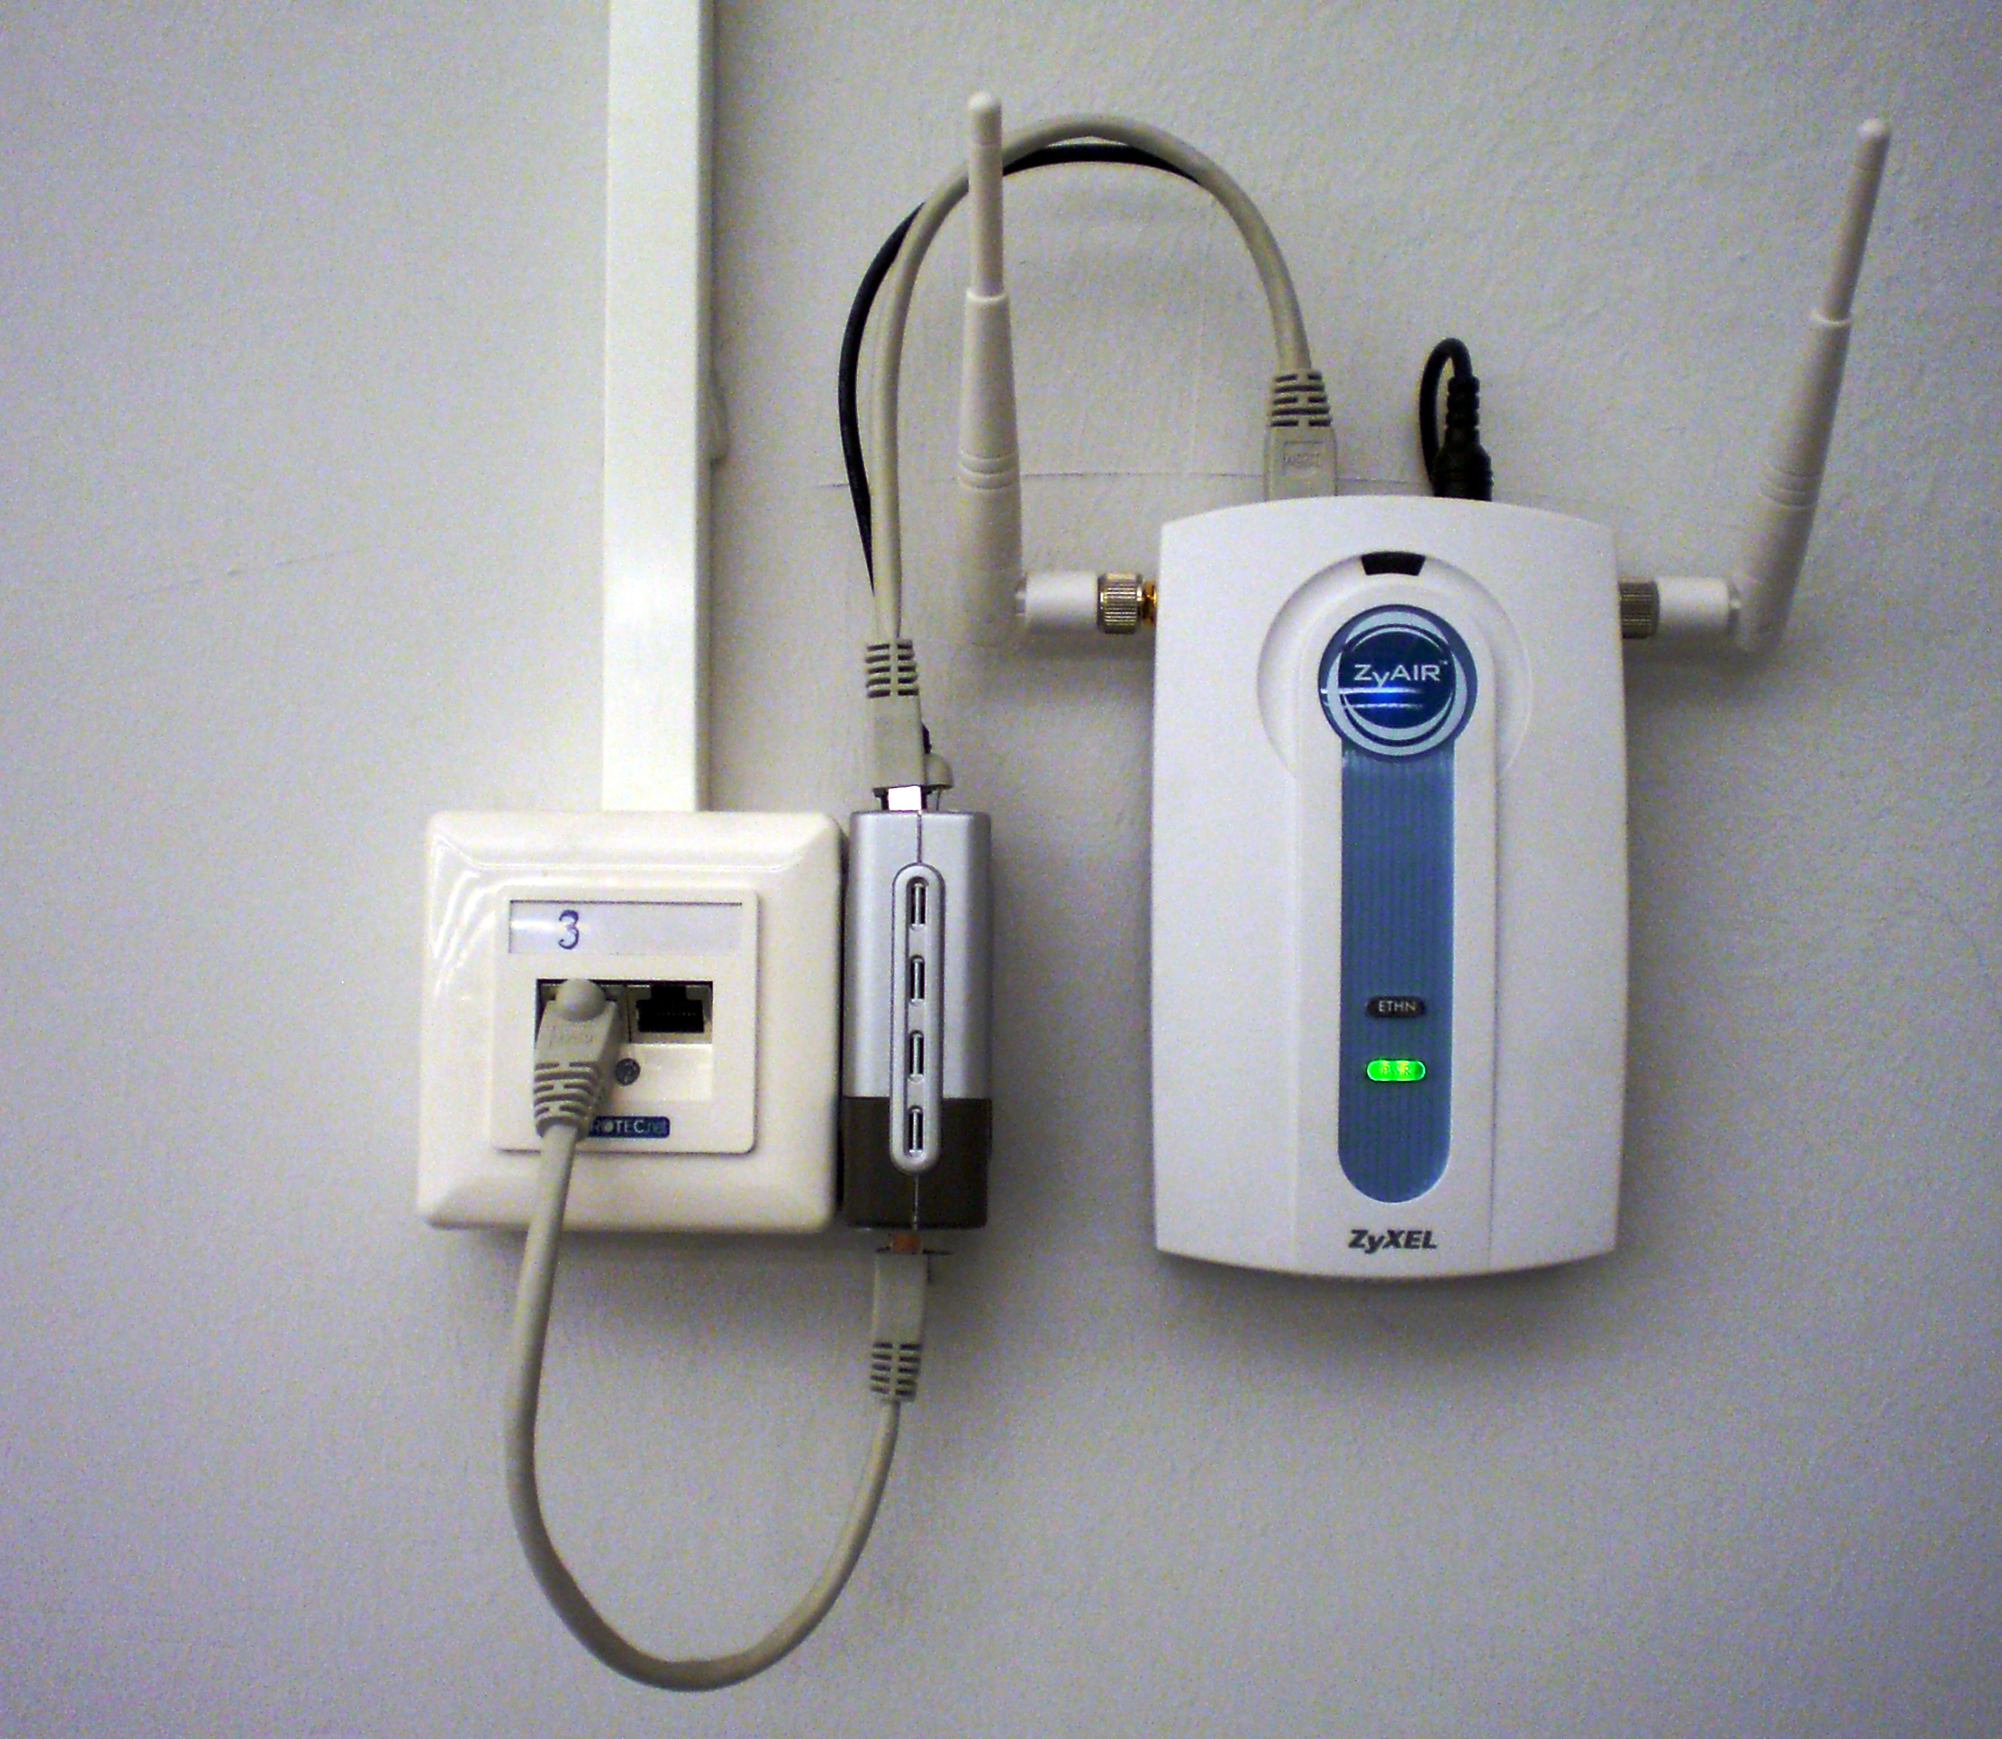
Wireless access point
Allows wireless-enabled devices to connect to a network without cables.
More convenient.
Less bandwidth than a wired connection.
Security is more of a concern.
Performance may not be as strong or reliable as a wired connection.

Slide 4
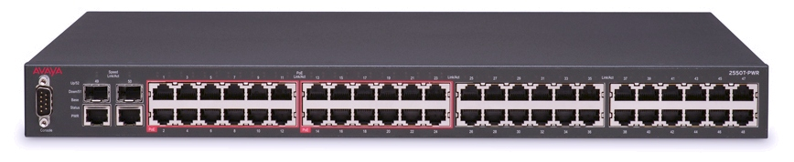
Switch
Sends data between computers on a LAN.
Segments the network by forwarding traffic to the correct location.
Learns which devices are connected and forwards traffic in an intelligent way.

Slide 5
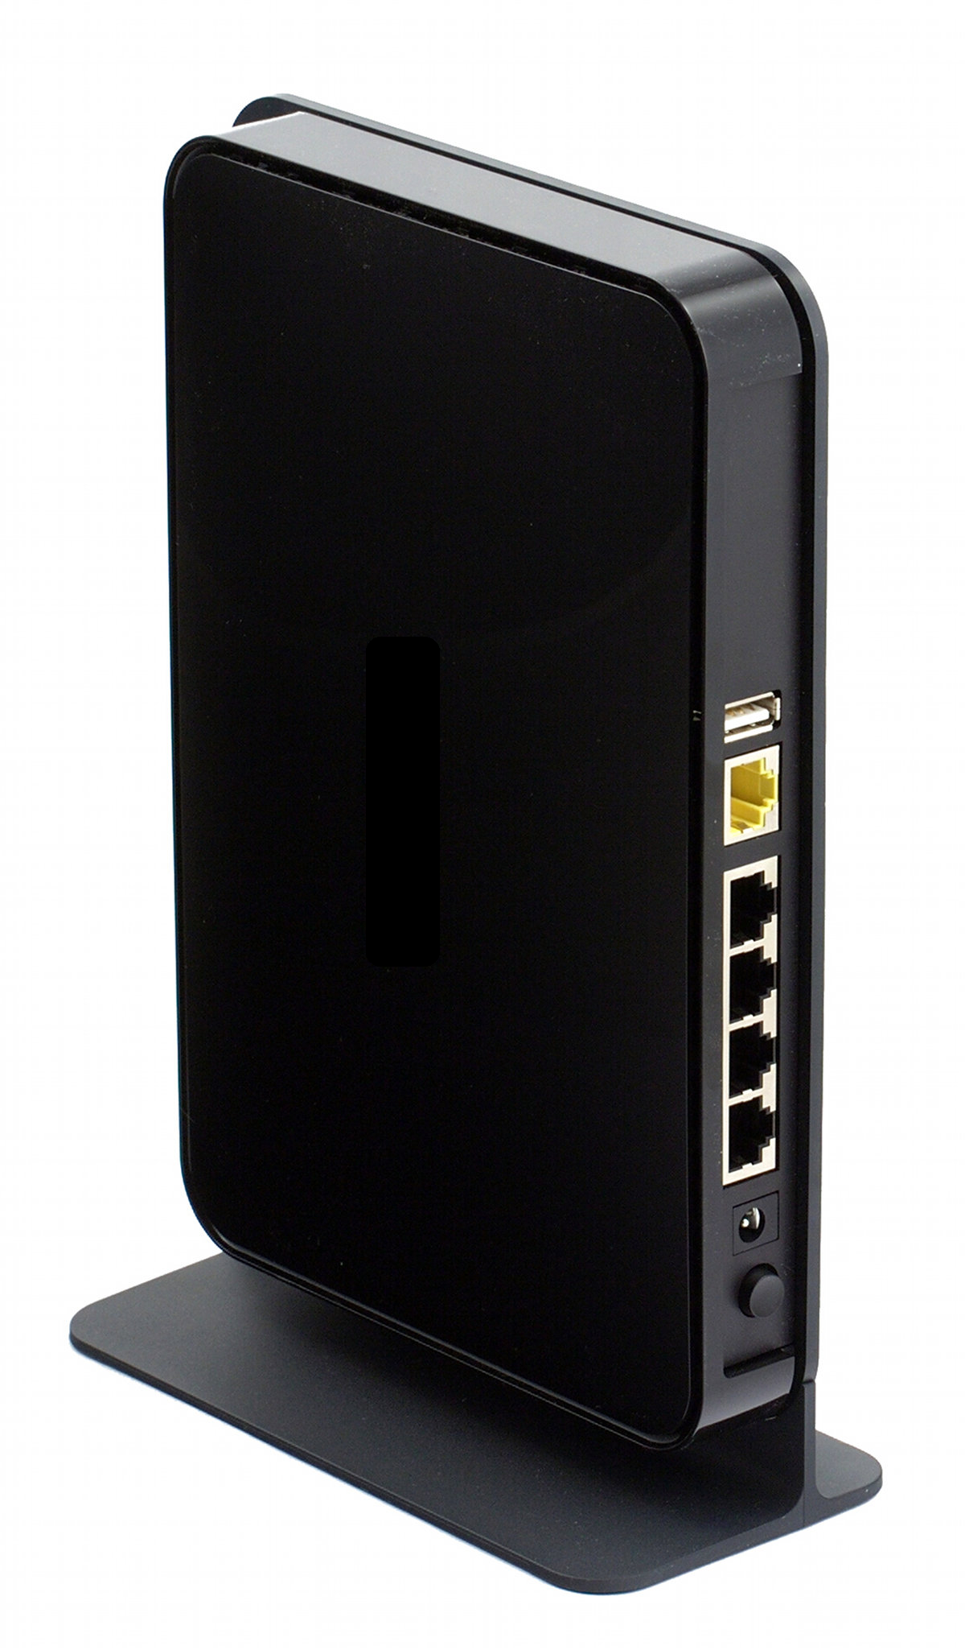
Router
Sends data between networks.
Creates a WAN from a number of LANs.
You cannot connect to a WAN without using a router.
A router uses an internet protocol (IP) address to route traffic.

Slide 6
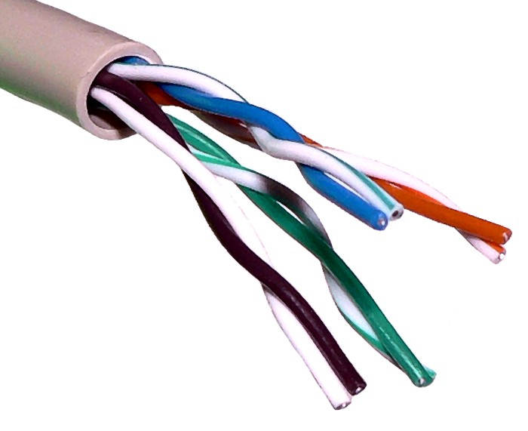
Transmission media: Copper cables (UTP)
Wired connections provide optimal bandwidth, security and reliability.
With twisted pair cables, the wires are twisted around each other to reduce interference.
Typically, there will be separate sets of wires for transmitting and receiving.
The grade of copper and insulating material affects the quality of the overall cable – and therefore, the bandwidth.

Slide 7
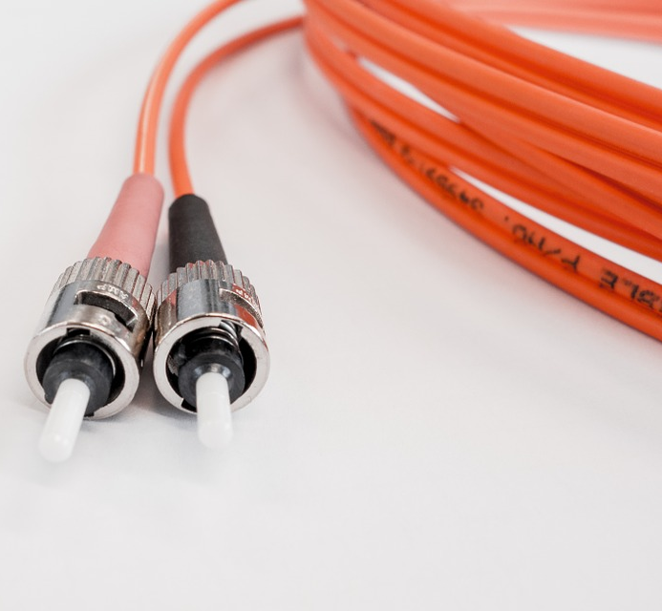
Transmission media: Fibre optic cables
Use light to transmit data.
Cover much longer distances and provide higher bandwidth than copper.
The backbone of the internet uses fibre optic cables.

Slide 8

Hardware required to connect a standalone computer to a LAN
A network interface controller (NIC) connects a device to a wired or wireless network. An NIC uses a protocol to ensure successful communication.
Wireless access points allow wireless-enabled devices to access a network. Wireless connections are popular because they avoid the need to install cables.
Bandwidth on a wireless connection is lower than a wired network.
Security is more of a concern with wireless networks.
A switch uses a device’s NIC address to route traffic.
A router sends data between networks and is required to connect a local area network to a wide area network. Routers use devices’ IP address to route traffic to other routers.
Connections between a desktop PC and switch usually use unshielded twisted pair (UTP) copper cable. Copper cable is cheap, flexible and easy to install.
Longer-distance and wide area networks are usually connected with fibre optic cable. Fibre optic has a higher bandwidth than copper and suffers from less interference.

