Slide 1
SLR1.3 Computer networks, connections and protocols
Star and mesh
network topologies

Slide 2

Topologies
Network topology: The arrangement of all the elements required to build a network.

Slide 3


Historical network topologies
Bus topology: Devices connected to a central backbone cable.
Terminator
Main bus cable
Terminator
Just for information – not in the specification

Slide 4
Historical network topologies
Bus topology: If the backbone breaks, all devices lose their connection.
Just for information – not in the specification

Slide 5
Historical network topologies
Ring topology: Devices connected by a ring cable.
Just for information – not in the specification

Slide 6
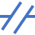
Historical network topologies
Ring topology: Has the same potential issues as a bus network regarding main cable failure.
Just for information – not in the specification

Slide 7
Historical network topologies
Ring topology: A second ring can be introduced to prevent the issue – but that requires extra cable.
Just for information – not in the specification

Slide 8
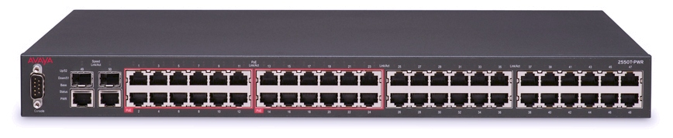
Star network topology
Most popular type of wired network.
Central switch.
All devices connect to the switch.
The switch is intelligent, ensuring traffic only goes where it is intended.
Switch

Slide 9
Star network topology
Most popular type of wired network.
Central switch.
All devices connect to the switch.
The switch is intelligent, ensuring traffic only goes where it is intended.
If a single cable breaks, only that computer is affected.
Switch

Slide 10

Star network topology
Most popular type of wired network.
Central switch.
All devices connect to the switch.
The switch is intelligent, ensuring traffic only goes where it is intended.
If a single cable breaks, only that computer is affected.
However, the switch is still a serious point of failure.
Switch

Slide 11
Full mesh network topology
Every device is connected to every other device.

Slide 12
Full mesh network topology
Every device is connected to every other device.

Slide 13
Full mesh network topology
Every device is connected to every other device.
If any of the connections break, traffic can be sent via another route.

Slide 14
Full mesh network topology
Every device is connected to every other device.
If any of the connections break, traffic can be sent via another route.
More cabling and switch hardware required, which adds to the cost.

Slide 15
Partial mesh network topology
Multiple routes exist between devices, but every device is not connected to every other device.
Reduces the amount of hardware compared to a full mesh network.

