Slide 1
SLR1.3 Computer networks, connections and protocols
Modes of connection
– wired and wireless

Slide 2
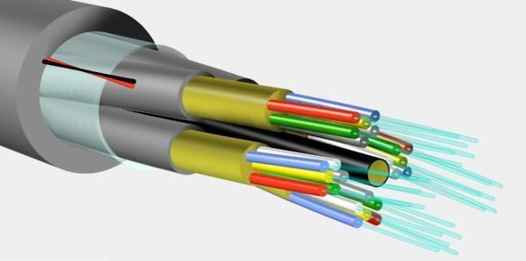
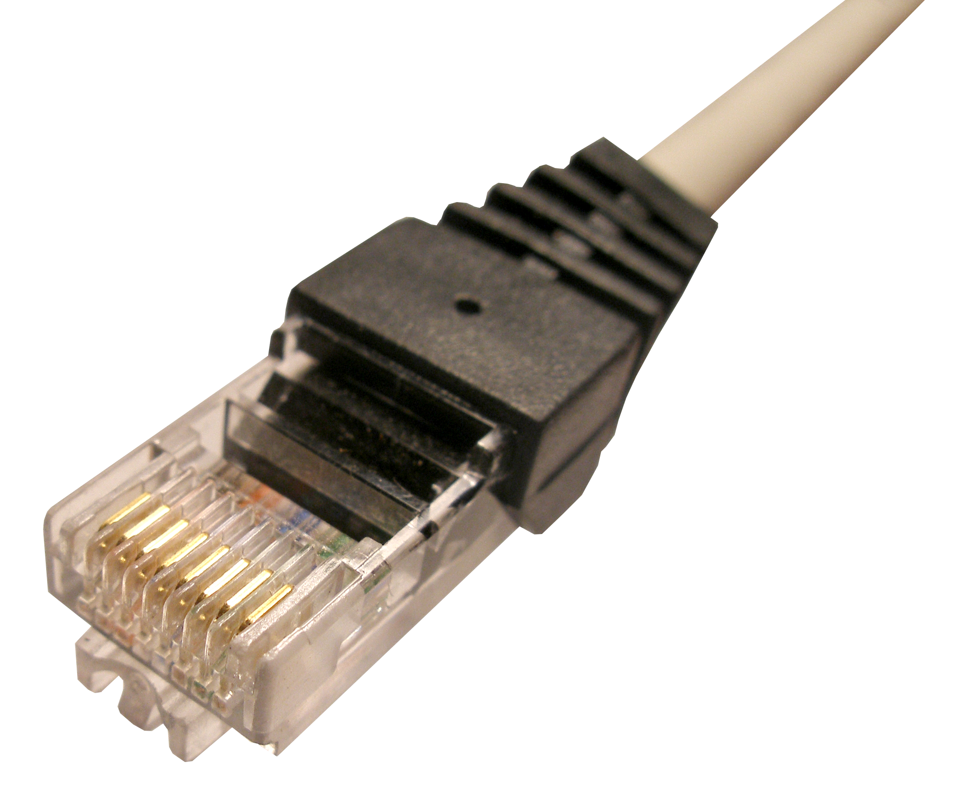


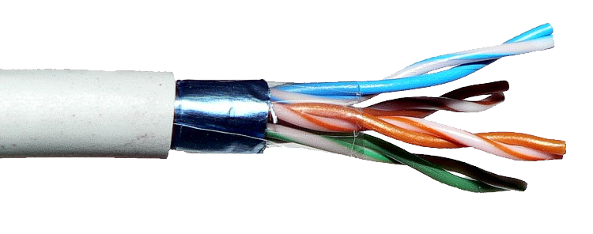
Modes of connection
Wired
Wireless
Wi-Fi
Bluetooth
Fibre optic
Ethernet
Twisted pair copper

Slide 3
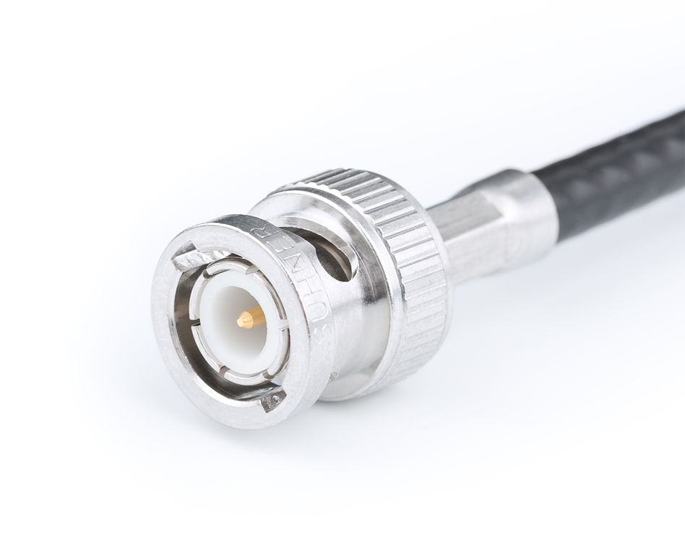

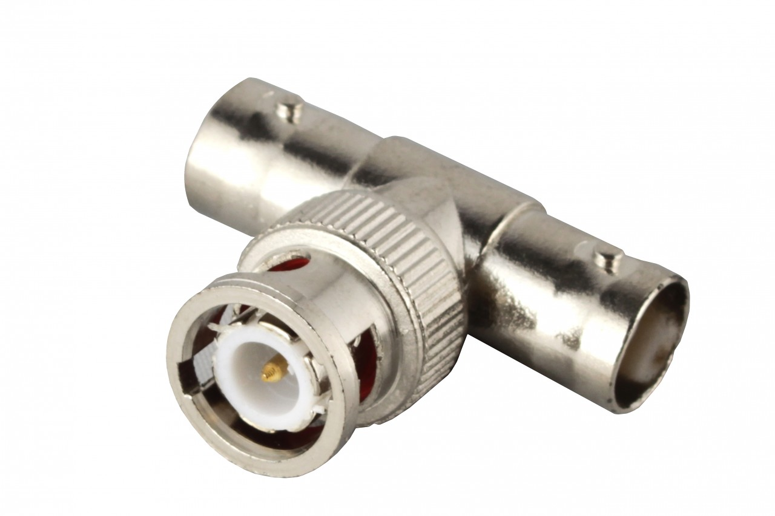
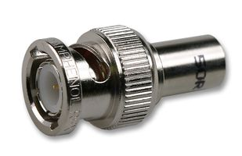

Ethernet
Ethernet is a standard that has been around for many years.
It has evolved as network topologies have evolved.
Here is an old-style bus network.
A shared backbone cable uses a protocol called CSMA/CD to listen for a communication before transmitting and to detect when two computers are transmitting at the same time.
This is just for your information, as it is not covered in the specification. The Ethernet protocol suite will be covered in a later video.

Slide 4
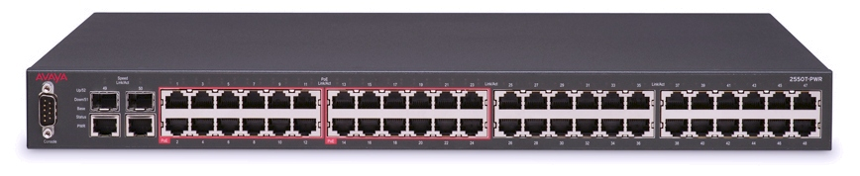
Ethernet and star network topologies
Here is a more modern star network.
With twisted pair cables, duplex communication is possible – sending and receiving data at the same time.
With this kind of network, the CSMA/CD protocol is not required because frames do not collide.

Slide 5

Ethernet
A standard for networking technologies.
Used for communicating on a wired local area network.
Includes a number of associated protocols (rules for governing communications).
Provides reliable, error-free, fast communication between two points.
Originally used in old-style bus networks.
Still used today in more modern star and mesh networks.
Data is transmitted in frames, which include:
  Preamble of bits used to synchronise transmission.
  Start frame deliminator to signify the start of the data part of the frame.
  Source and destination MAC address.
  The actual data.
  Error-checking information (cyclic redundancy check or CRC).
User location is limited by the need for a physical cable connection.
An Ethernet setup relies on lots of cables, connections, ports and physical hardware, raising costs.

Slide 6




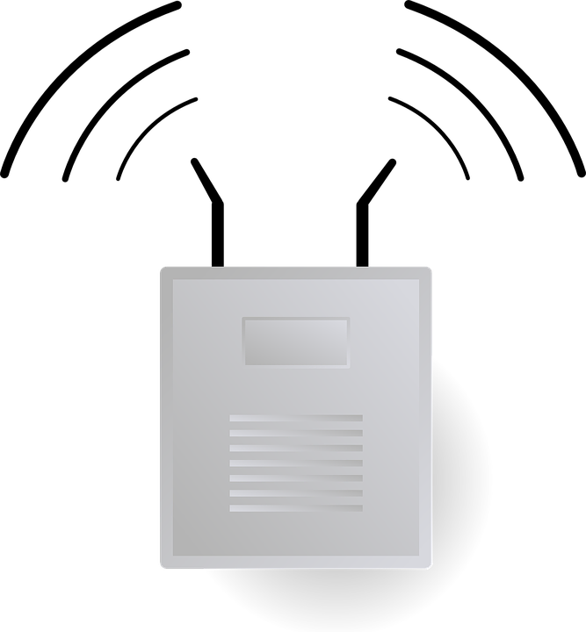


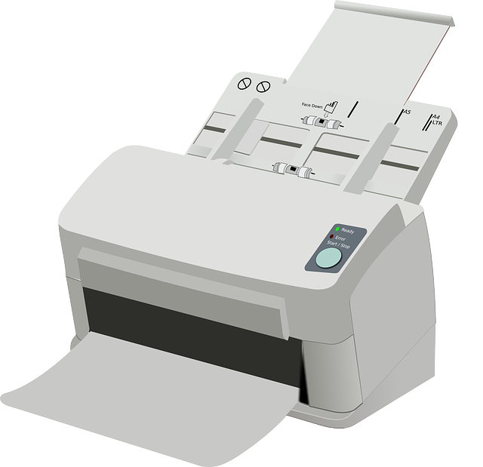

Wireless networks (Wi-Fi and Bluetooth)
Smart TV
Laptop
Wireless connections are popular because they are portable and avoid the need for cables.
However, their bandwidth is lower than that of a wired connection.
Security is also more of a problem than with wired connections.
An ever-increasing number of home devices are making use of Wi-Fi.
Wireless connections are ideal as running lots of cabling through a home is undesirable.
Phone
Games
console
Wireless access point
Printer
Tablet

Slide 7

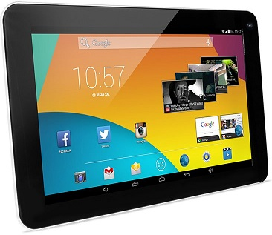



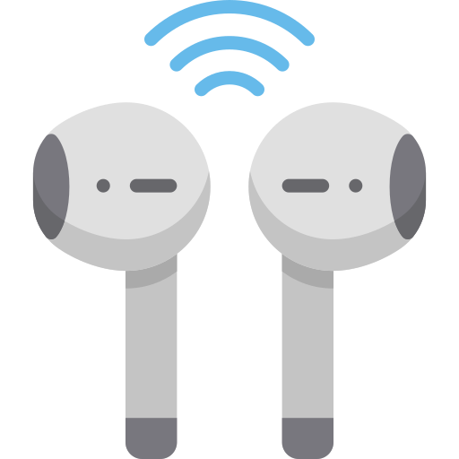
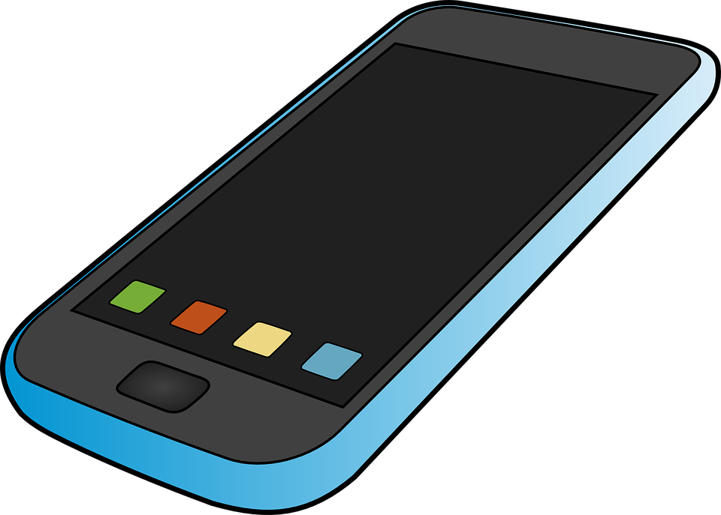
Wireless networks (Wi-Fi and Bluetooth)
Tablet
Bluetooth is ideal for connecting personal devices.
However, it has a very short range.
It can be used to connect things like a wireless keyboard to a computer or wireless headphones to a smartphone.
Bluetooth-enabled stylus
Smartphone
Wi-Fi
Range | 100 meters
Bandwidth | High
Power consumption | High
Bluetooth
Range | 10 meters
Bandwidth | Low
Power consumption | Low
Bluetooth-enabled headphones

Slide 8
Wireless networks (Wi-Fi and Bluetooth)
Wi-Fi is a common standard for wireless networks:
  Users can move around freely.
  Easier to set up and less expensive.
  More convenient to use.
  Can handle a large number of users.
  Data transfer is much easier.
  Network speeds are lower than with wired networks.
  Relies on signal strength to the wireless access point (WAP).
  Signal can be obstructed by objects or building elements.
  Less secure than wired networks.
Bluetooth is another, more modern standard for wireless networks:
  Ideal for connecting personal devices like Bluetooth-enabled headphones to a smartphone.
  Very short range – around 10 meters
  Low power consumption compared to Wi-Fi.

Slide 9

SLR 3 Computer networks, protocols and layers
Going beyond the GCSE specification

Slide 10
Ethernet
A
Let’s look at what happens to data being transmitted from Computer A to Computer B on a wired, partial mesh local area network (LAN).
DATA
B

Slide 11
Ethernet
HEADER
A
Computer A applies a header and CRC to the data. The header contains:
  Preamble
  Start frame deliminator
  Source and destination MAC addresses
DATA
CRC
B

Slide 12
Ethernet
HEADER
A
Before transmitting the data, Computer A checks if there is another transmission on the cable it is attached to.
DATA
CRC
B

Slide 13
Ethernet
HEADER
A
The frame is transmitted to the switch.
DATA
CRC
B

Slide 14
Ethernet
A
The switch examines the CRC to make sure the frame has arrived correctly.
If it hasn’t, the switch will ask for the frame to be resent.
HEADER
DATA
CRC
B

Slide 15
Ethernet
A
The switch then examines the header and decides which port the frame should be sent down.
HEADER
DATA
CRC
B

Slide 16
Ethernet
A
It also checks if there is another transmission on the cable it wants to use.
HEADER
DATA
CRC
B

Slide 17
Ethernet
A
The frame is transmitted to the next switch.
HEADER
DATA
CRC
B

Slide 18
Ethernet
A
Before sending the frame on to Computer B, the new switch will also check:
  the CRC;
  where the frame is heading; and
  if the required cable is available.
HEADER
B
DATA
CRC

Slide 19
Ethernet
A
Computer B performs a final CRC check to confirm the frame has arrived without any errors before stripping off the header and CRC to get back to the original data.
DATA
B

Slide 20

Wireless networks – Frequency and channels
Wireless networks use electromagnetic radiation to transmit data between two points.
We think of radio frequencies as being:
  on a frequency; and
  on a channel.
Wi-Fi operates in the same way.
BBC Radio 1 – 97MHz BBC Radio 3 – 90 MHz
BBC Radio 2 – 88MHz BBC Radio 4 – 92 MHz

Slide 21
Wireless networks – Frequency and channels
Here is a typical example showing how different frequencies are set to different Wi-Fi channels.
Devices on the same channel can communicate with each other.
2.417 GHz 2.427 GHz 2.437 GHz 2.477 GHz 2.457 GHz
Channel 2 Channel 4 Channel 6 Channel 8 Channel 10

Slide 22
Wireless networks – Frequency and channels
Here is a typical example showing how different frequencies are set to different Wi-Fi channels.
Devices on the same channel can communicate with each other.
Each channel has a range of 22 MHz – this means channel ranges overlap slightly.
For example, channel 6 overlaps with channels 5 and 7.
2.417 GHz 2.427 GHz 2.437 GHz 2.477 GHz 2.457 GHz
Channel 2 Channel 4 Channel 6 Channel 8 Channel 10
Single channel = 22 MHz

Slide 23
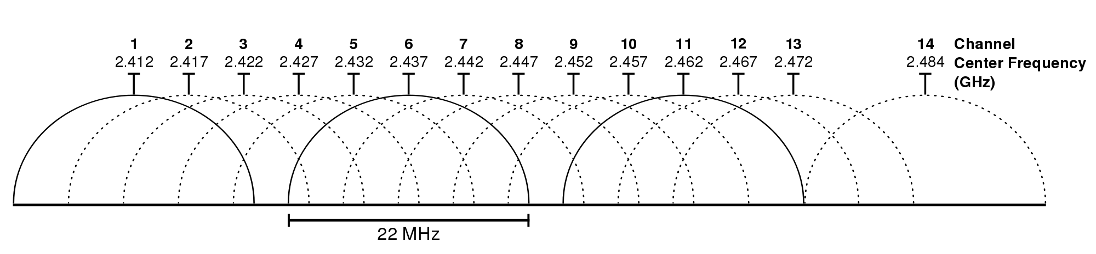
Wireless networks – Frequency and channels

