Slide 1
SLR1.3 Computer networks, connections and protocols
Wireless encryption

Slide 2
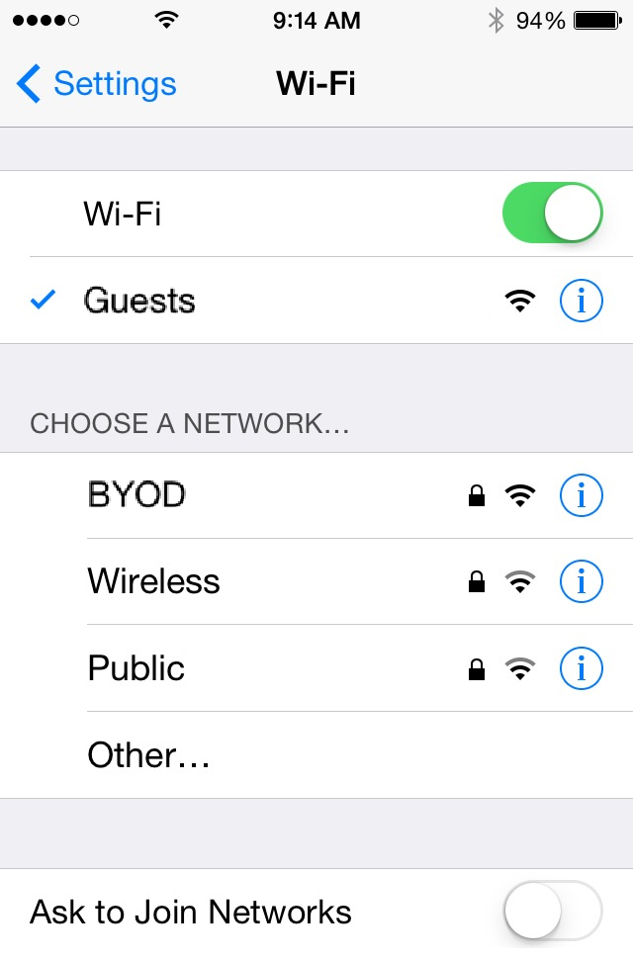

Encryption
Wireless networks are identified with a unique Service Set Identifier (SSID). The SSID must be used by all devices that want to connect to the network and can be set to automatically broadcast to any device in range of a WAP.
Protecting your wireless network:
The SSID is set automatically, but you can change it if you wish.
It can also be hidden to make it harder to detect.
Additionally, it can be secured with a password.
Just for information – not in the specification

Slide 3




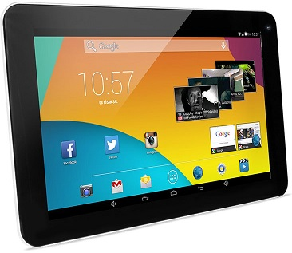
Encryption
Wireless networks broadcast data that must be encrypted in order to be secure – this is done by scrambling the data into ciphertext using a master key created from the network’s SSID and password.
Device listening in

Slide 4
Encryption
Data is decrypted by the receiver using the same master key – the key is not transmitted.
Device listening in

Slide 5
Encryption
Data is decrypted by the receiver using the same master key – the key is not transmitted.
Wireless encryption protocols include WEP, WPA and WPA2. A handshake protocol is used to ensure the receiver has a valid master key before transmission begins.
Device listening in

Slide 6




Encryption
Although wired networks are more secure, encryption can still be used and is often a sensible precaution.
Plain text message
Encryption key
Encrypted message
Encrypted message
Decryption key
Plain text message
“HELLO WORLD”
“CZGGJ RJMGY”
“CZGGJ RJMGY”
“HELLO WORLD”

