Slide 1
SLR1.3 Computer networks, connections and protocols
The use of IP and
MAC addressing

Slide 2
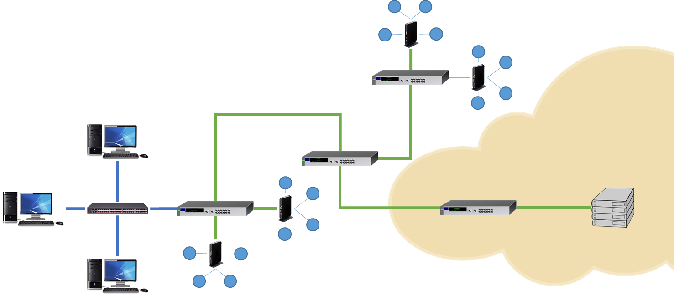
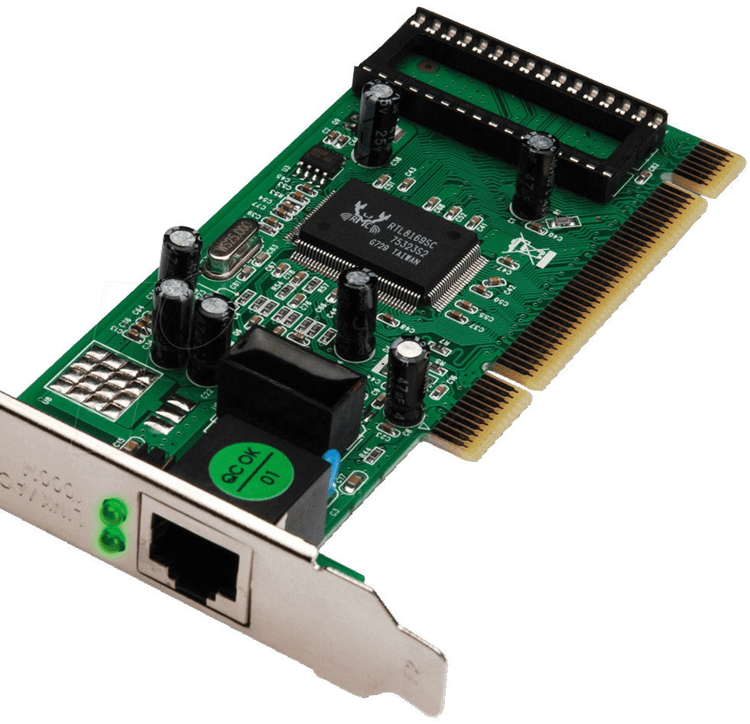
IP and MAC addressing
Every device on a network has a network interface card (NIC).

Slide 3
IP and MAC addressing
Every device on a network has a network interface card (NIC)
Every NIC has a Media Access Control (MAC) address, which is
used to route frames on a local area network (LAN).
00:0a:95:9d:68:16

Slide 4
IP and MAC addressing
If the LAN is connected to a WAN such as the internet, a different addressing method is required.
IP addressing is used to route frames on a wide area network (WAN) – with a WAN, we refer to frames as packets.

Slide 5
IPv4
An IP (Internet Protocol) address is a unique number used to identify a host computer or node that communicates over the internet. There are currently two versions of IP in use today – IPv4 and IPv6.
193 . 74 . 211 . 63
11000001 01001010 11010011 00111111
32 bits (4 bytes) in size
IPv4 format: Four numbers between 0 and 255 separated with periods.

Slide 6
IPv4
107.56.94.111
128
64
32
16
8
4
2
1
128
64
32
16
8
4
2
1
128
64
32
16
8
4
2
1
128
64
32
16
8
4
2
1
0
1
1
0
1
0
1
1
0
0
1
1
1
0
0
0
0
1
0
1
1
1
1
0
0
1
1
0
1
1
1
1
107
56
94
111
IPv4 provides us with approximately 4 billion possible addresses from 000.000.000.000 – 255.255.255.255.
The actual number is slightly lower, as some addresses are reserved for special uses.

Slide 7
IPv4
107.56.94.111
128
64
32
16
8
4
2
1
128
64
32
16
8
4
2
1
128
64
32
16
8
4
2
1
128
64
32
16
8
4
2
1
0
1
1
0
1
0
1
1
0
0
1
1
1
0
0
0
0
1
0
1
1
1
1
0
0
1
1
0
1
1
1
1
Network identifier (3 bytes): 107.56.94
Host identifier (1 byte): 111
An IPv4 address has two parts:
  Network identifier
  Host identifier

Slide 8
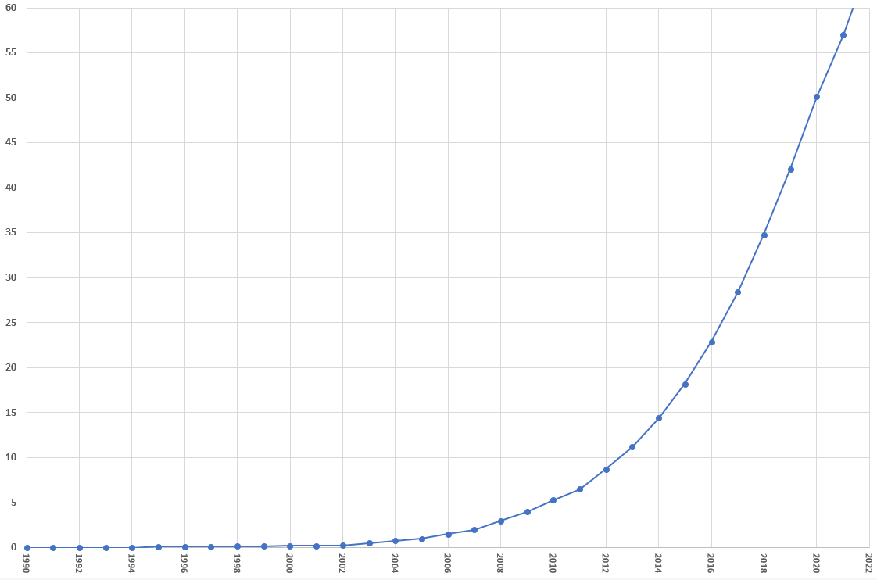

The Internet of Things (IoT)
Billions of devices
1992
1,000,000

Slide 9

The Internet of Things (IoT)
Billions of devices
2012
8.7 billion
1992
1,000,000

Slide 10


The Internet of Things (IoT)
2018
34.8 billion
Billions of devices
2012
8.7 billion
1992
1,000,000

Slide 11


The Internet of Things (IoT)
2020
50.1 billion
2018
34.8 billion
Billions of devices
2012
8.7 billion
1992
1,000,000

Slide 12
IPv6
49cd:c92d:dabb:469f:003c:4877:f44b:5441
0100100111001101 1100100100101101 1101101010111011 0100011010011111 0000000000111100 0100100001110111 1111010001001011 0101010001000001
128 bits (16 bytes) in size.
Approximately 340 trillion-trillion-trillion combinations
IPv6 format: Eight groups of four 16-bit hex values separated by colons.

Slide 13

MAC addressing is used to route frames on a local area network (LAN). Each MAC address is unique to every network interface card (e.g., 00:0a:95:9d:68:16).
IP addressing is used to route packets on a wide area network (WAN). There are two versions of IP addresses – IPv4 and IPv6.
IPv4:
  32 bits in size.
  Four numbers between 0 and 255 separated with periods (e.g., 69.89.31.212).
  A router has a unique WAN-facing IP address and a LAN-facing IP address – this enables a LAN device to have the same IP address as another device on a separate LAN.
  IPv4 is being replaced by IPv6 because unique static addresses are running out.
IPv6:
  128 bits in size.
  Eight groups of four 16-bit hex values separated by colons (e.g., 2001:0db8:85a3:0000:0000:8a2e:0370:7334).

