Slide 1
SLR1.3 Computer networks, connections and protocols
Common protocols

Slide 2



What is a protocol?
✗

Slide 3
What is a protocol?
A protocol is a set of rules that allows
two devices to communicate.
✓

Slide 4
Common protocols
Different types of protocols are used for different purposes.
You need to be aware of the basic principles and purposes of the following protocols.
Acronym | Full name | Area/purpose
TCP/IP | Transmission Control Protocol/Internet Protocol | Communication over a LAN/WAN
HTTP | Hypertext Transfer Protocol | Web page requests
HTTPS | Hypertext Transfer Protocol Secure | Web page requests
FTP | File Transfer Protocol | File transfers
POP | Post Office Protocol | Email
IMAP | Internet Message Access Protocol | Email
SMTP | Simple Mail Transfer Protocol | Email

Slide 5

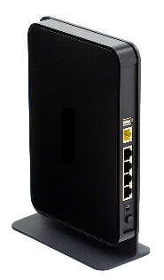
TCP/IP
The Transmission Control Protocol (TCP) provides error-free transmission between two routers.
The Internet Protocol (IP) routes packets across a wide area network (WAN).
Together, they make up the TCP/IP protocol stack the foundation of communication over the internet.

Slide 6


HTTP / HTTPS
The Hypertext Transfer Protocol (HTTP) is a way for a client and server to send and receive requests, and to deliver HTML web pages.
It is the fundamental protocol of the World Wide Web (WWW).
The Hypertext Transfer Protocol Secure (HTTPS) is effectively the same as HTTP except it adds in encryption and authentication.
So it should be used on the web when a website needs to deal with sensitive information such as passwords or bank account details.

Slide 7
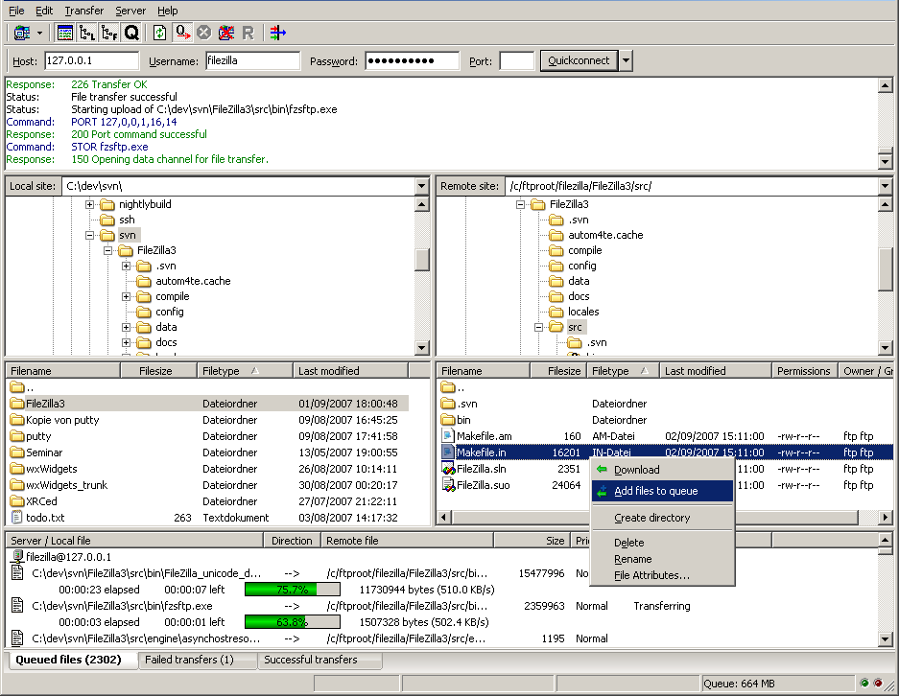
FTP
The File Transmission Protocol (FTP) is a protocol used for sending files between computers, normally on a wide area network (WAN).
Often people use FTP clients.
These are software applications which sit on top of the actual FTP protocol.
You interact with the program and it generates and sends the appropriate FTP commands.
Upload
Download

Slide 8

HTTP/HTTPS
The Hypertext Transfer Protocol (HTTP) is a way for a client and server to send and receive requests and to deliver HTML web pages. It is the fundamental protocol of the World Wide Web (WWW).
The Hypertext Transfer Protocol Secure (HTTPS) is effectively the same as HTTP, except it adds in encryption and authentication. HTTPS should be used whenever a website handles sensitive information like passwords or bank details.

Slide 9
FTP
The File Transmission Protocol (FTP) is a protocol used for sending files between computers, typically via a wide area network (WAN).
People often use FTP clients, software applications that sit on top of the actual FTP protocol.
Users interact with the program to generate and send the appropriate FTP commands.
Upload
Download

Slide 10
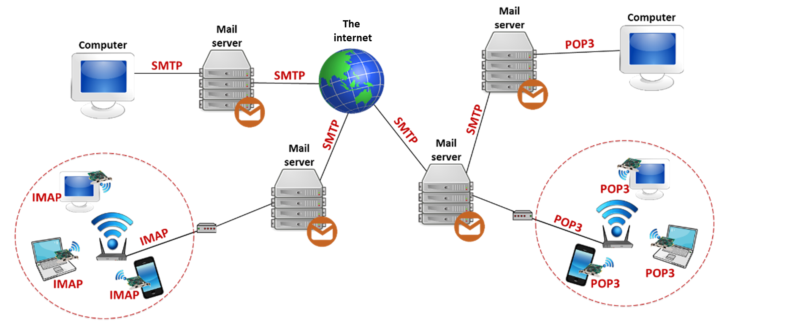
POP/IMAP/SMTP
Three popular protocols are used in conjunction with mail servers to deal with email.
Mail servers act like a virtual post office for all incoming and outgoing email.
Simple Mail Transfer Protocol (SMTP) transfers outgoing emails between servers or from an email client to a server.

Slide 11
POP/IMAP/SMTP
Three popular protocols are used in conjunction with mail servers to deal with email.
Mail servers act like a virtual post office for all incoming and outgoing email.
Post Office Protocol (POP) transfers emails from the mail server to your device, removing them from the server in the process.
✗
✗

Slide 12
POP/IMAP/SMTP
Three popular protocols are used in conjunction with mail servers to deal with email.
Mail servers act like a virtual post office for all incoming and outgoing email.
Internet Message Access Protocol (IMAP) keeps emails on the mail server, ensuring synchronicity between devices.
✗
✗
✓

Slide 13

A protocol is a set of rules that allows two devices to communicate:
  TCP (Transmission Control Protocol): Provides error-free transmission between two routers.
  IP (Internet Protocol): Routes packets across a wide area network. Along with TCP, it makes up the TCP/IP protocol stack.
  HTTP (Hypertext Transfer Protocol): A client-server method of requesting and delivering HTML web pages.
  HTTPS (Hypertext Transfer Protocol Secure): Encryption and authentication for requesting and delivering HTML web pages. Used to transfer sensitive information – e.g., passwords, bank details.
  FTP (File Transfer Protocol): Used to send files between computers, typically via a wide area network.
  POP (Post Office Protocol): Retrieves email from a mail server, removing it from the server and transferring it to your device.
  SMTP (Simple Mail Transfer Protocol): Sends email to an email server.
  IMAP (Internet Message Access Protocol): Used by mail clients to manage remote mailboxes and retrieve email from a mail server.

