Slide 1
SLR1.1 Systems architecture
The purpose of the CPU:
The fetch-decode-execute cycle

Slide 2
What is a computer?
INPUT
An electronic device that takes input…

Slide 3
What is a computer?
INPUT
PROCESS
An electronic device that takes input… processes data…

Slide 4
What is a computer?
INPUT
PROCESS
OUTPUT
An electronic device that takes input… processes data… and delivers output.

Slide 5
What is a computer?
INPUT
5
PROCESS
OUTPUT
An electronic device that takes input… processes data… and delivers output.

Slide 6
What is a computer?
INPUT
5
PROCESS
Multiply by 2
OUTPUT
An electronic device that takes input… processes data… and delivers output.

Slide 7
What is a computer?
INPUT
5
PROCESS
Multiply by 2
OUTPUT
10
An electronic device that takes input… processes data… and delivers output.

Slide 8

What is a computer?
INPUT
PROCESS
OUTPUT

Slide 9

What is a computer?
INPUT
PROCESS
OUTPUT

Slide 10

What is a computer?
INPUT
PROCESS
OUTPUT

Slide 11
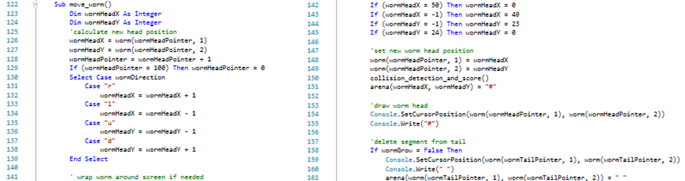
What is a computer?
INPUT
PROCESS
OUTPUT
To do this, computers follow a set of instructions known as a program.

Slide 12
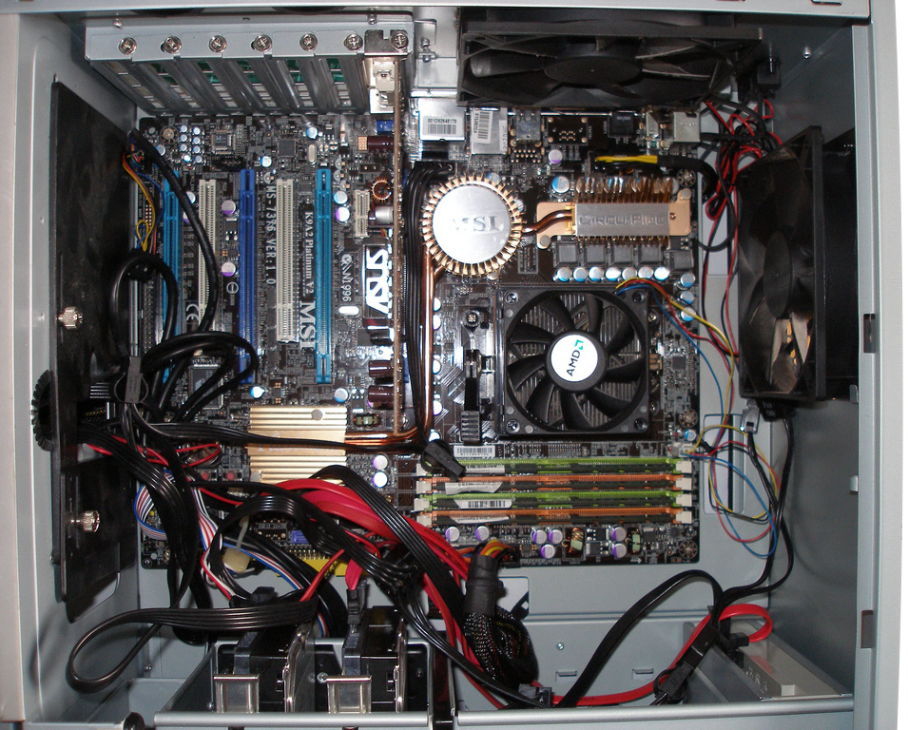

Slide 13
MEMORY

Slide 14
CPU
MEMORY

Slide 15
Fetch
Decode
Execute

Slide 16
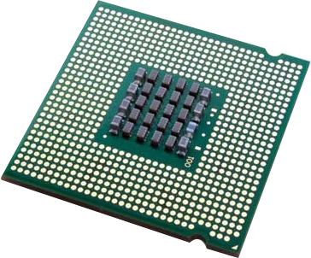
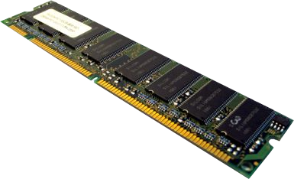
The fetch-decode-execute cycle
Fetch
Decode
Execute
Fetch stage
Fetch the next instruction from main memory (RAM).
Bring it back into the CPU.

Slide 17
The fetch-decode-execute cycle
Fetch
Decode
Execute
Decode stage
Inspect the instruction to find out what needs to be done.

Slide 18
The fetch-decode-execute cycle
Fetch
Decode
Execute
Execute stage
Carry out the instruction, which could be:
  Going back to main memory and fetching data.
  Performing a calculation.
  Storing information back in main memory.

Slide 19


The fetch-decode-execute cycle
Fetch
Decode
Execute
On a modern CPU, the fetch-decode-execute cycle occurs billions of times per second.
Clock speed
3Ghz processor = 3 billion cycles per second.

Slide 20

A computer is an electronic device that:
  takes input;
  processes data; and
  delivers output.
The purpose of the CPU is to fetch, decode and execute instructions.
Fetch
  Fetch the next instruction from main memory (RAM).
  Bring it back into the CPU.
Decode
  Inspect the instruction to find out what needs to be done.
Execute
  Carry out the instruction, which could be:
    Going back to main memory and fetching data.
    Performing a calculation.
    Storing information back in main memory.

