Slide 1


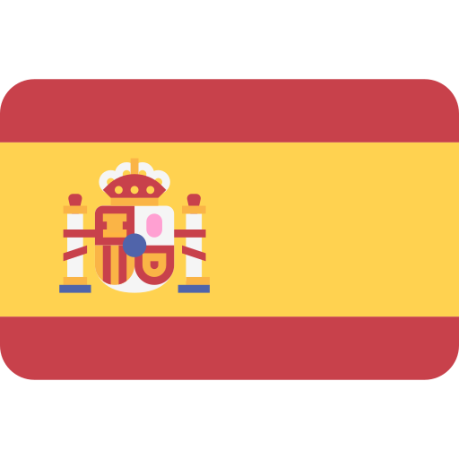
MFL
Department
Y10 Units 1 to 5 Vocabulary pack
SPANISH

Slide 2
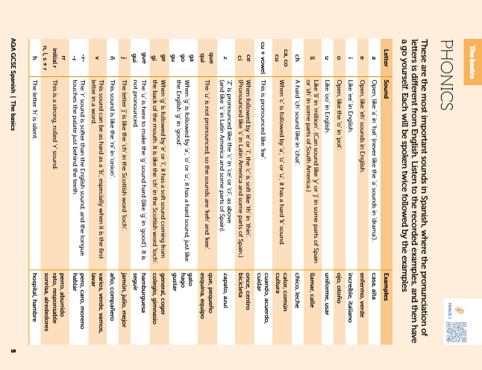

Slide 3
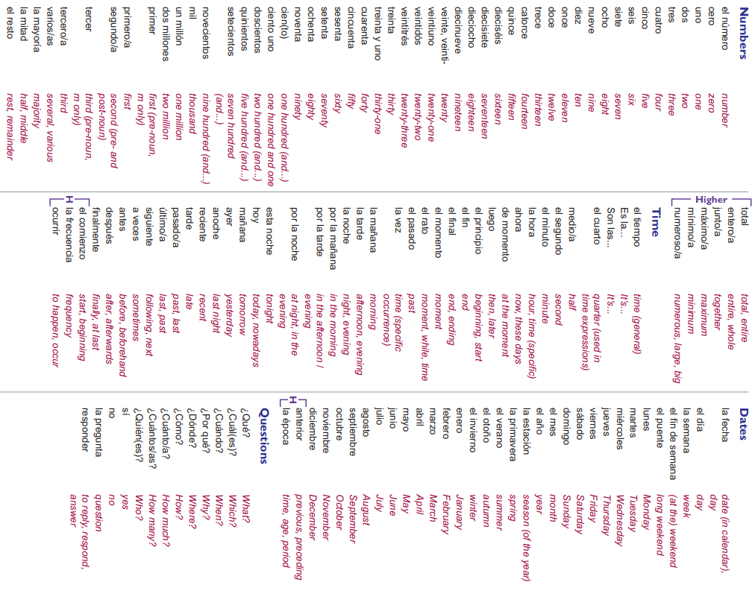

Slide 4
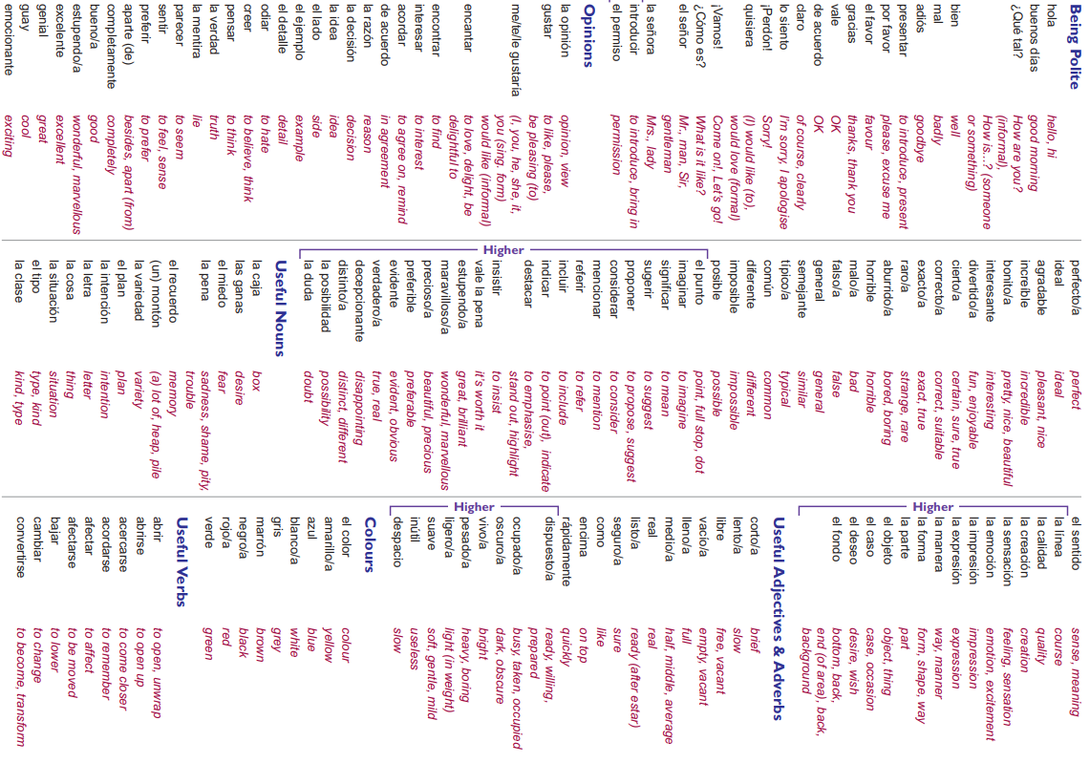

Slide 5
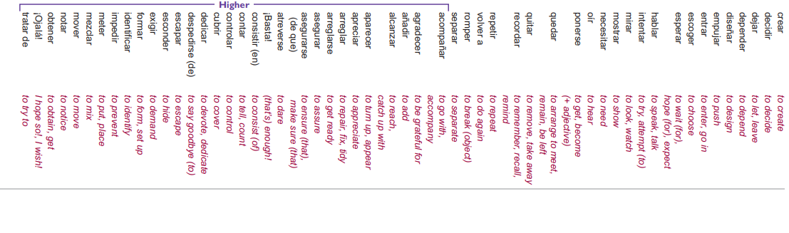

Slide 6

UNIT 1
Identity and Relationships
with Others

Slide 7
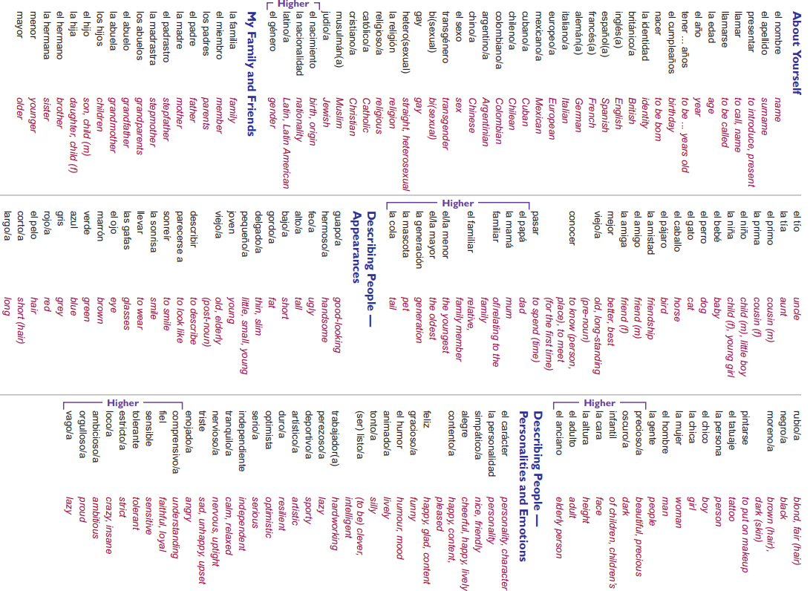

Slide 8
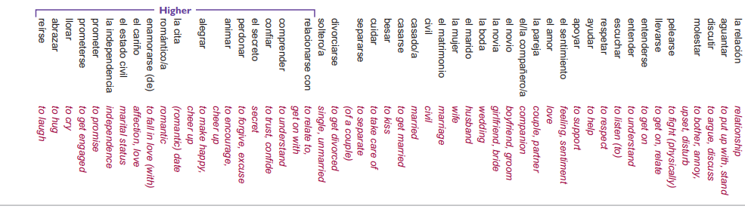

Slide 9
Extra vocab Unit 1

Slide 10
Unit 1 Identity and relationships with others
2.Descripción física Physical description
Tengo | I have
El pelo rubio | Blonde hair
El pelo castaño | Brown hair
El pelo corto | Short hair
El pelo liso | Straight hair
El pelo rizado | Curly hair
Los ojos marrones | Brown eyes
Las pecas | Freckles
Una barba | Beard
Pelirrojo/a | red-haired/ginger
Gafas | Glasses
Calvo/a | Bald
Alto/a | Tall
Pequeño/a | Small
Grande | Big
Delgado/a | Thin
Gordo | Fat
Bonito/a | Nice
Guapo/a | Handsome / pretty
Hermoso | Beautiful
Feo/a | Ugly
Un tatuaje | A tattoo
Cara | Face
Forma | Shape
1.Los países y las nacionalidades Countries and nationalities
Soy de | I am from | Soy | I am
Europa | Europe | Europeo/a | European
Portugal | Portugal | portugués | portugués
Francia | France | frencés | frencés
Inglaterra | England | Inglés/ Británico | Inglés /british
Alemania | Germany | alemán | alemán
España | Spain | español | español
Gales | Wales | galés | galés
Escocia | Scotland | escocés | escocés
Irlanda | Ireland | irlandés | irlandés
Italia | Italy | Italiano/a | italiano
Grecia | Greece | Giriego/a | giriego
Cuba | Cuba | Cubano/a | Cuban
Mexico | Mexico | Mexicano/a | Mexican
Colombia | Colombia | Colombiano/a | Colombian
Argentina | Argentina | Angetino/a | Argentinian
China | China | Chino/a | Chinese
Chile | Chile | Chileno/a | Chilian
Latino América/ Sudamericana | Latin America/ South america | Latino americano/ sedamericano | Latin American/ Southamerican
Nací en | I was born in

Slide 11
3.Adjetivos adjectives
Alegre | Happy
Responsable | Responsible
Duro | Hard/resilient
Amable | kind/friendly
Anciano/a / viejo/a | Old
Cariñoso | Affectionate
Gracioso | Funny
Joven | Young
Honrado | Honest
Cuidadoso | Careful
Maduro | Mature
Rico | Rich
Pobre | Poor
Religioso | Religious
Serio | Serious
Trabajador | Hardworking
Famoso | Famous
Optimista | Optimist
Independiente | Independent
Tradicional | Traditional
Artístico | Artistic
Nerviosos | Nervous
4.Adjetivos adjectives
Personalidad | Personality
Carácter | Character
Listo | Clever
Inteligente | Intelligent
Débil | Weak
Deportivo | Sporty
Tonto | Silly
Simpático | Friendly
Enojado | Angry
Enfadado | Mad at
Perezoso | Lazy
Vegano | Vegan
Vegetariano | Vegetarian
Extranjero | Foreigner
Ambicioso | Ambitious
Comprensivo | Understanding
Familiar | Familiar
Fiel | Loyal
Leal | Loyal
Infantil | Childish
Loco | Crazy
Orgulloso | Proud
Precioso | Beautifull
5.Adjetivos adjectives
Romántico | Romantic
Sensible | Sensitive
Solo | Alone
Solitario | Lonely
Tolerante | Tolerant
Vago | lazy
Impaciente | Impatient
6. Identidad sexual Sexual identity
Identidad | Identity
Gay | Gay
Bisexual (bi) | Bisexual (bi)
Heterosexual (hetero) | Straight, Heterosexual
Transgénero | Transgender
Sexo | Sex
7.Mascotas Pets
Perro | Dog
Gato | Cat
Conejo | Rabbit
Caballo | Horse
Pájaro | Bird
Hámster | Hamster
Serpiente | Snake
Tortuga | Turtle
Pez | Fish
Iguana | Iguana
8.Religiones Religions
Cristiano | Cristian
Católico | Catholic
Judío | Jewish
Musulmán | Muslim
Hindú | Hindu
Budista | Buddhist
Agnóstico | Agnostic
No religioso | Not religious

Slide 12
10.Verbos Verbs
Abandonar | To abandon
Abrazar | To hug
Amenazar | To threat
Atraer | To attract
Comprender | To understand
Confiar | To trust
Enamorarse | To get in love
Llorar | To cry
Pegar | To hit
Perdonar | To forgive
Regalar | To gift
Reírse | To lough
Relacionarse con | To relate to
Reunir | To gather
11.Verbos Verbs
Pasar | To spend time
Parecerse | To look alike
Llamar/se | To call
Morir | To die
Nacer | To be born
Permitir | To allow
Entender | To understand
Casarse | To get married
Romper | To break up
Empezar a salir | To start going out
Separar/se | To separate
Celebrar | To celebrate
Proteger | To protect
Respetar | To respect
Comunicar | To communicate
Discutir | To argue
Besar | To kiss
Criticar | To criticize
Pelearse | To argue
Divorciarse | To get divorce
9.Information personal Personal information
Nombre | Name
Primer apellido | First surname
Segundo apellido | Second surname
Peso | Weight
Altura | Hight
Étnica | Ethnicity
Pasaporte | Passport
DNI | Identity card
Carta/tarjeta de identidad | Card
identificación | Identification
Cumpleaños | Birthday
Fecha de nacimiento | Date of birth
Lugar de nacimiento | Place of birth
Estado civil | Status

Slide 13
12. Planes para el futuro
jubilarse | to retire
casarse | to get married
una boda | a wedding
tener suerte | to be lucky
soltero/a | single
solo/a | alone/only
un compañero | colleague/friend
buscar | to look for
encontrar | to find
libertad | freedom
próximo | next
Adulto | Adult
Anciano | Elderly person
13. Hablando de los amigos
Vecino | Neighbour
Compañero | Partner
Estudiante | Student
Amistad | Friendship
conocer | to know (a person)
cuidar | to look after
alegrarse de | to be happy about
un equipo | a team
fastidiar | to annoy/bother
mismo/a | same
reírse | to laugh
sentido del humor | sense of humour
el consejo | advice
una discusión | an argument
parecer | to seem
la gente | people
El papel de | The role of
Culpa | Fault
Vergüenza | Shame
14. Hablando de las parejas
Una pareja | A partner/couple
Un beso | A kiss
Echar de menos | To miss someone
Enamorado/a | In love
Los familiares / los parientes | Relatives
Un marido/esposo | Husband
El matrimonio | Marriage
La boda | The marriage
Una mujer/esposa | Wife
Un novio | Boyfriend
Una novia | Girlfriend
Pelear(se) | To fight
Discutir | To fight
Hablar | To speak to discuss
Sonreírse | To smile
Amor | Love
Cita | Date
15. Los colores Colours
Mi color favorito es |  | My favorite colour is
Negro/a | Black | Rojo/a | Red
Blanco/a | White | Rosa | Pink
Azul | Blue | Marrón | Brown
Amarillo/a | Yellow | Naranja | Orange
Morado/a | Purple | Verde | Green
Oscuro | Dark | Claro | Light

Slide 14
16. Los miembros de la familia Family members
Miembro | Member
Un abuelo | Grandfather
Una abuela | Grandmother
Abuelos | Grandparents
Un sobrino | Nephew
Una sobrina | Niece
Una madrastra | Stepmother
Un padrastro | Stepfather
Un medio hermano | Half-brother
Una medio hermana | Half-sister
Gemelos/as | Twins
Un hijo | Son
Una hija | Daughter
Niña/i | Child
Mayor | Older
Menor | Younger
Mediano | Middle
Mujer | Woman
Hombre | Man
Animal | Animal
Mascota | Pet
Bebé | Baby
Mamá | Mum
Papá | Dad
18. Las relaciones de hoy en día Relationships now a days
Ahora | Now
Casado | Married
Alguien | Someone
Cara a cara | Face to face
Distinto/a | Different
En contra | Against
Humor | Mood
La edad | Age
Estar de acuerdo | To agree
Jubilado/a | Retired person
Pagar | To pay
La piel | Skin
Sensible | Sensitive
Viudo/a | Widower/widow
Soltero/a | Single
Pareja | Couple
Presión | Pression
Confianza | Trust
Contacto | Contact
Consejo | advice
Apoyo | Support
Regalo | Present
Novio/a | Boyfriend/girlfriend
17. Relaciones con la familia
Abiero/a | Open
Aconsejar | To advise
Actualmente | Nowadays
Aguantar | To put up with
La barrera generacional | Generation gap
El cariño | Affection
Celoso/a | Jealous
La culpa | Blame/fault
Juntos | Together
Molestar | To annoy
Provocar | To cause
Orgulloso | Proud
Muerto | Dead
El/La menos | The youngest
El/La mayor | The oldest
Discriminación | Discrimination
Generación | Generation

Slide 15
Sentence builder Unit 1

Slide 16
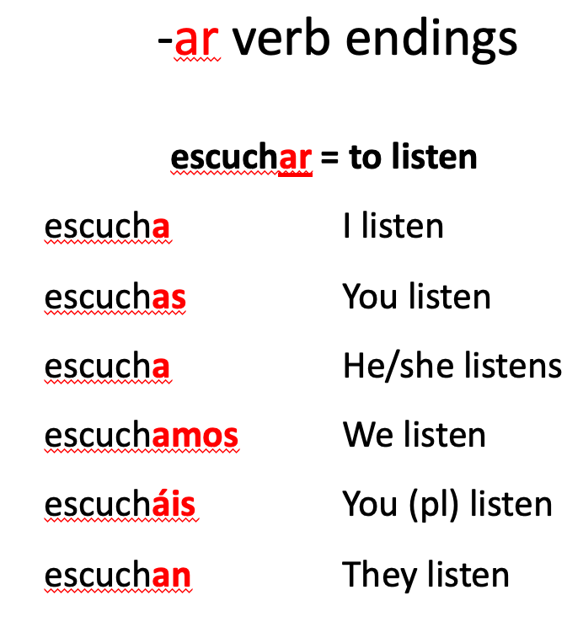
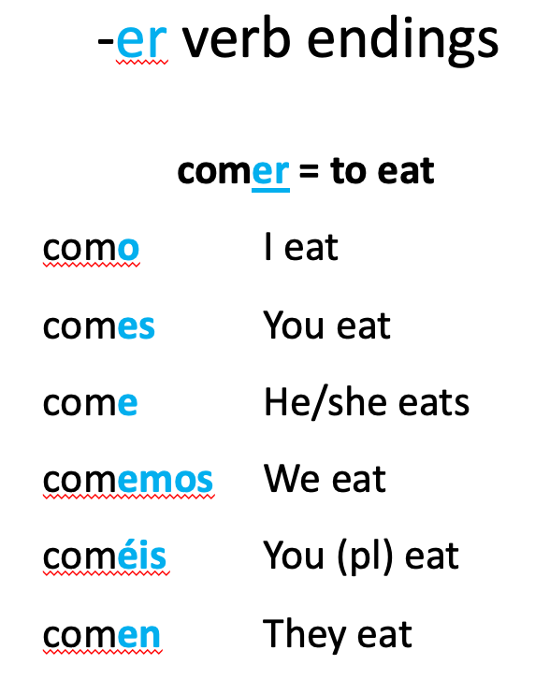
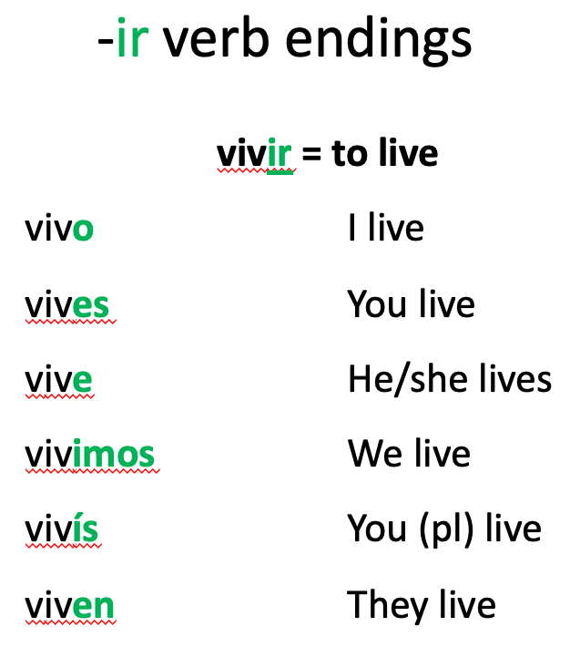

Slide 17
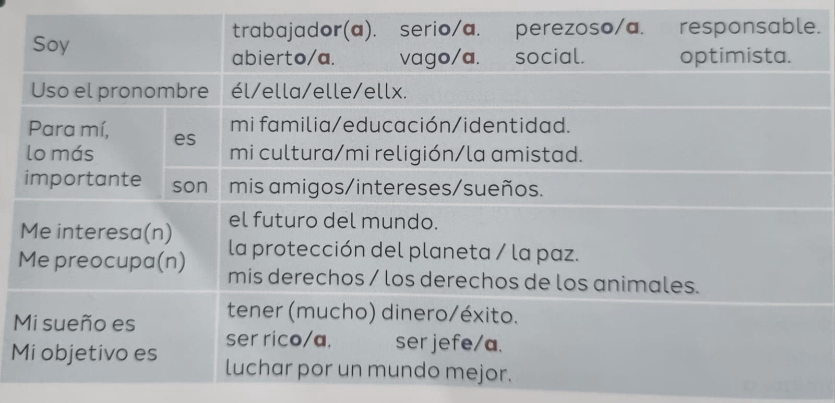

Slide 18
Yo (I) | me llamo (am called) | Alejandra Beatriz Isabel Julian | Soy (I am) | alemán / alemana (German) inglés / inglesa (English) canadiense (Canadian) chino / china (Chinese) escocés / escocesa (Scottish) español / española (Spanish) francés / francesa (French) galés / galesa (Welsh) indio / india (Indian) irlandés / irlandesa (Irish) italiano / italiana (Italian) japonés / japonesa (Japanese) polaco / polaca (Polish) | Tengo (I have) | un (1) dos (2) tres (3) cuatro (4) cinco (5) seis (6) siete (7) ocho (8) nueve (9) diez (10) once (11) doce (12) trece (13) catorce (14) quince (15) | año (year) años (years)
Mi hermano (My brother) Mi hermana (My sister) | se llama (is called) |  | Es (he is / she is) |  | Tiene (he has / she has)
In Spanish, we use the verb tener (to have) to talk about age. Although ‘tengo cuatro años’ literally means ‘I have four years’, in English, it’s translated as ‘I am four years old’

Slide 19
Vowels:
a: ah (like the "a" in "father")
e: eh (like the "a" in "late")
i: ee (like the "ee" in "see")
o: oh (like the "o" in "go")
u: ooh (like the "oo" in "moon")
Consonants:
b: beh (like the "b" in "bed")
c: seh (like the "s" in "see" or "th" in "think" in Spain)
d: deh (like the "d" in "day," but with your tongue further forward, almost like the "th" in "the")
f: eh-feh (like the "f" in "fan")
g: heh (like the "h" in "hello" before "e" or "i", and like the "g" in "get" before "a", "o", or "u")
h: ah-cheh (always silent, except in loanwords)
j: hoh-tah (like the "h" in "house")
k: kah (like the "k" in "kite")
l: eh-leh (like the "l" in "lion")
m: eh-meh (like the "m" in "mother")
n: eh-neh (like the "n" in "no")
ñ: eh-nyeh (like the "ny" in "canyon")
p: peh (like the "p" in "pen")
q: koo (like the "q" in "queen")
r: eh-rreh (a rolled "r" sound)
s: eh-seh (like the "s" in "sun")
t: teh (like the "t" in "top")
v: oo-beh (like the "b" in "bed" or a softer "v" sound, sometimes called "uve" or "ve")
w: doo-blay oo-beh (like the "w" in "water," often used in loanwords)
x: eh-kees (like the "x" in "extra," but sometimes like "s," "h," or "sh" depending on the word)
y: ee gre-gah (like the "y" in "yes")
z: seh-tah (like the "s" in "sun" or "th" in "think" in Spain)

Slide 20
Estoy – I am (temporary condition) | muy bien – very well bien – well bastante bien – quite well regular – not bad mal – bad muy mal – very bad | porque – because dado que – because | me siento – I feel | contento – happy relajado – relaxed tranquilo – calm enfermo – ill enfadado – angry nervioso – nervous preocupado – worried cansado – tired estresado – stressed triste – sad | contenta – happy relajada – relaxed tranquila – calm enferma – ill enfadada – angry nerviosa – nervous preocupada – worried cansada – tired estresada – stressed triste – sad

Slide 21
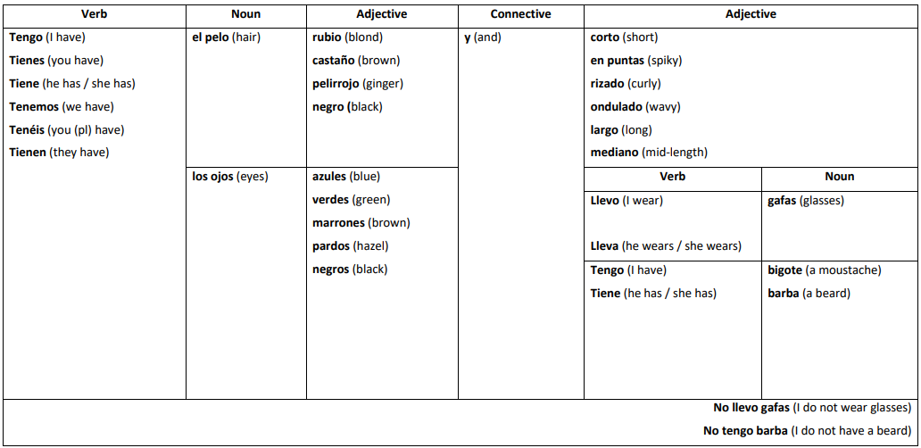
¿Cómo eres físicamente? How would you describe your physical appearance?

Slide 22
¿Cómo es tu personalidad? How would you describe your personality?
Verb | Adjective | Connective | Negative verb | Adjective
Soy (I am) Eres (you are) Es (he is) Es (she is) Somos (we are) Sois (you (pl) are) Son (they are) | hablador(a)(es) (chatty) gracioso(a)(os)(as) (funny) generoso(a)(os)(as) (generous) amable(s) (kind) honesto(a)(os)(as) (honest) inteligente(s) (intelligent) modesto(a)(os)(as) (modest) paciente(s) (patient) sociable(s) (sociable) simpático(a)(os)(as) (nice) tímido(a)(os)(as) (shy) | sin embargo (however) pero (but) | no soy (I am not) no eres (you are not) no es (he is not) no es (she is not) no somos (we are not) no sois (you (pl) are not) no son (they are not) | tonto(a)(os)(as) (silly) molestoso(a)(os)(as) (annoying) egoista(s) (selfish) impaciente(s) (impatient) antipático(a)(os)(as) (mean) perezoso(a)(os)(as) (lazy)

